Slide 1




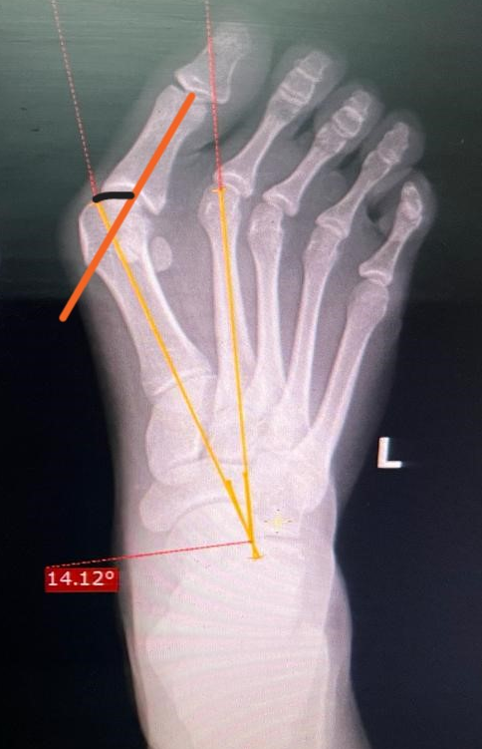
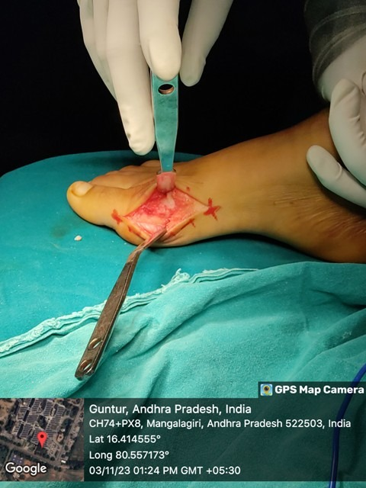
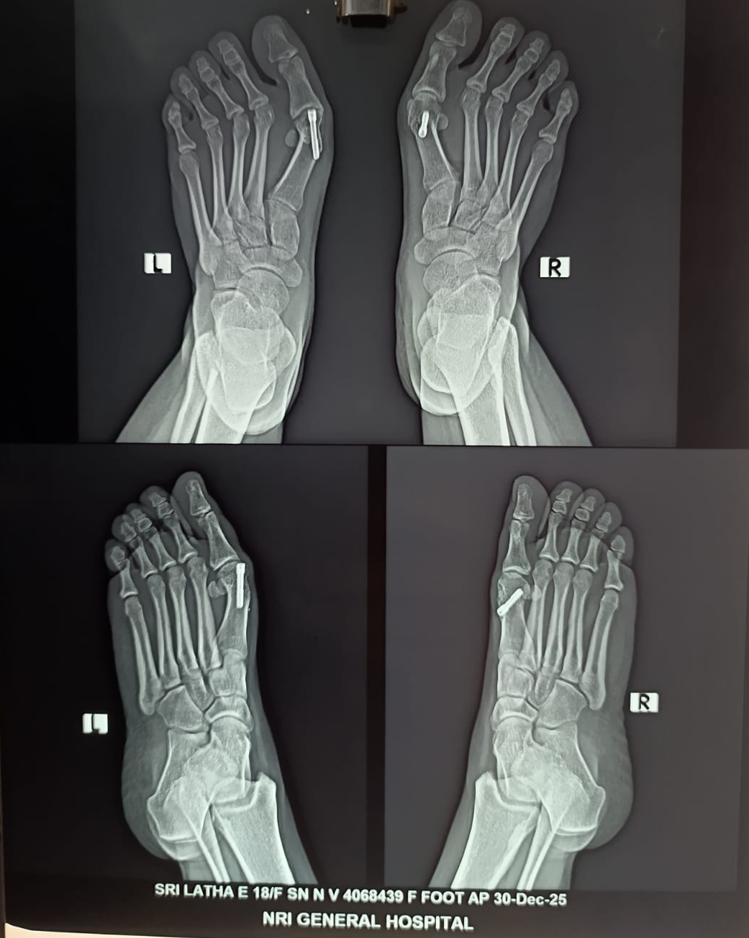
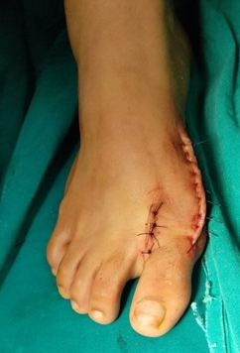
Role of corrective osteotomy in Bilateral hallux valgus
[Presenting Author] : Dr. Buddi Manoj Chandra
[Guide] : Dr. Usman Taufiq (Assistant Professor)
NRI Medical College and General Hospital, Chinakakani.
ID: OSSAP- 192
INTRODUCTION
OPERATIVE FINDINGS
DISCUSSION
Hallux Valgus is not a single disorder but a complex deformity of the first ray that is frequently accompanied by deformity and symptoms in lesser toes. Evidence suggests that hallux valgus maybe familial especially when it occurs in adolescent age group. Preoperative evaluation must include thorough clinical examintaion of foot, radiographs of foot in standard anteroposterior, lateral views and sesamoid views. Treatment focuses on deformity correction, adequate soft tissue release and post operative care to make sure that the deformity doesn’t reccur.
Intraoperatively, after skin and subcutaneous tissue were incised, longitudinal capsular incision is given in midline over medial eminence. Using saw, Chevron osteotomy was performed in metatarsal head. Capital fragment was shifted laterally and fixed internally with Herbert screw. Later, capsular release was performed on lateral side along with adductor hallucis tendon release to aid in deformity correction.
In our case, osteotomy and internal fixation with herbert screw was combined with lateral capsule and adductor hallucis release to help in preventing recurrence of deformity as the patient was a young adolescent female after the procedure. Post operatively, the patient was advised to use toe spacer and immobilisation for a period of 3weeks to aid in soft tissue healing. Immobilisation with below knee slab was continued for a period of 6weeks to allow bony union. 8weeks postop, the patient was allowed weight bearing walking on operated limb and advised to use splint for a further duration of 2months. At 1year follow up, the patient had no major complaints, with occasional pain while walking for prolonged duration and on using narrow footwear. Therefore, Corrective osteotomy and internal fixaxtion is an effective and safe treatment option for deformity correction in Hallux valgus. When combined with lateral soft tisssue release, the functional outcome had improved and our patient had satisfactory reduction of deformity and significant pain relief at 1 year followup.
CONCLUSION
CASE REPORT
Corrective osteotomy is an effective and safe surgical option for hallux valgus, providing reliable deformity correction and improved functional outcomes with minimal postoperative morbidity in a skeletally mature patient.
References:
1)Trnka HJ. The chevron osteotomy for correction of hallux valgus. J Bone Joint Surg Am. 2000;82(10):1373–1378.
2) Trnka HJ. Modified Austin procedure for correction of hallux valgus. Foot Ankle Clin. 2005;10(1):15–23.
A case report of deformity correction in a skeletally mature adolescent female with bilateral hallux valgus, treated with Chevron osteotomy and Herbert screw fixation.

