Slide 1




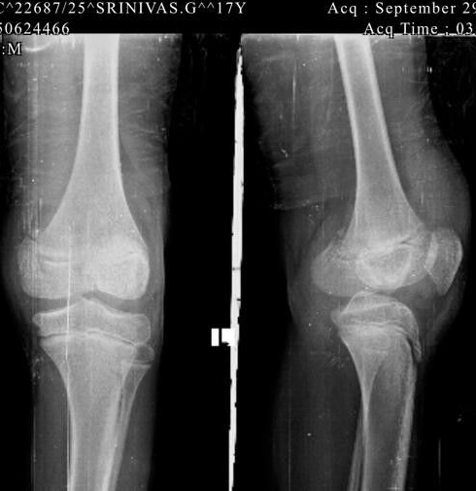
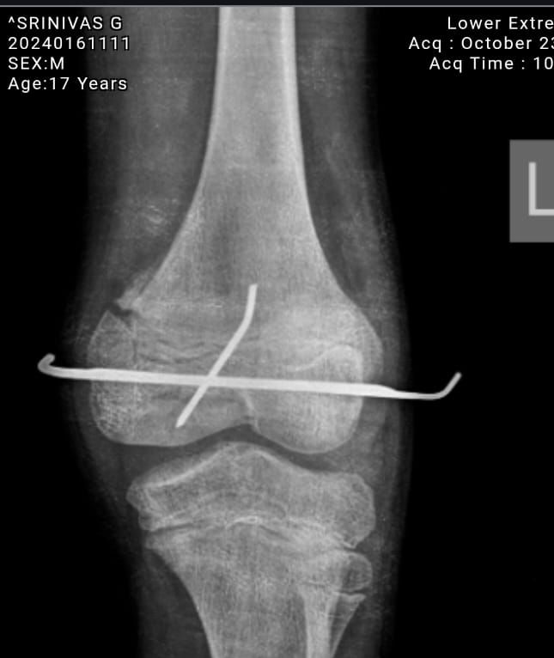
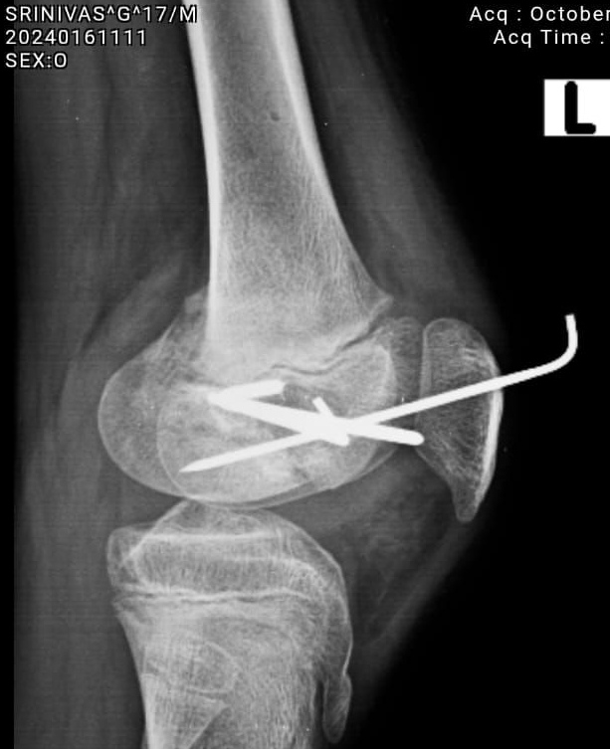

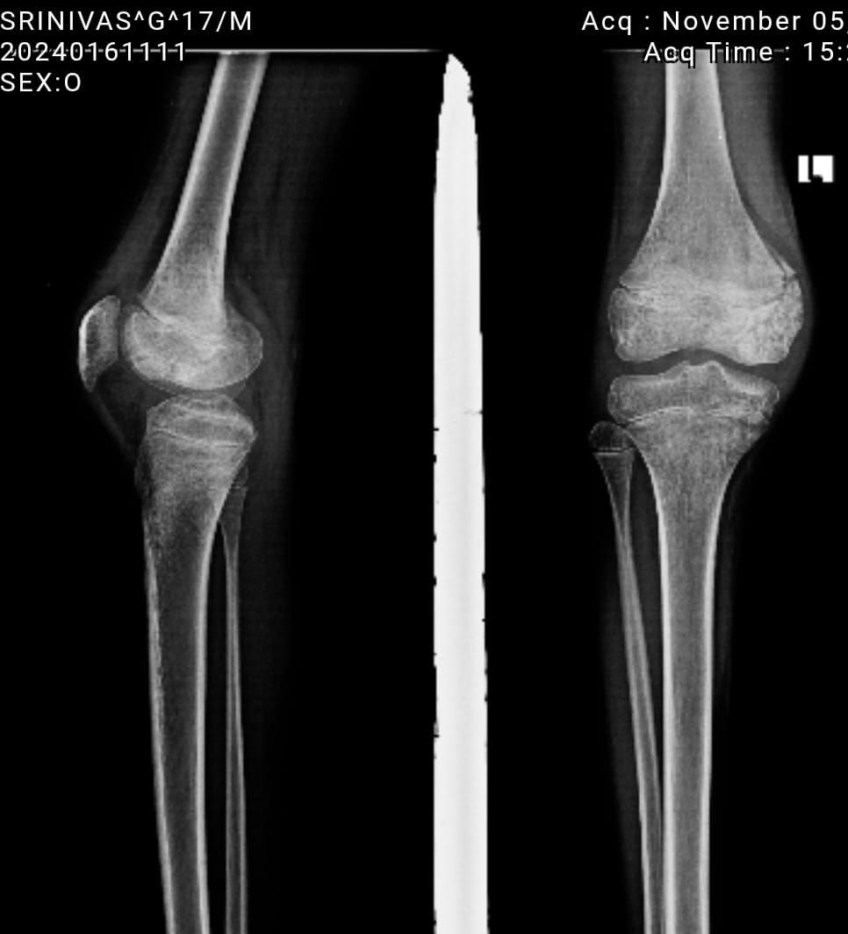
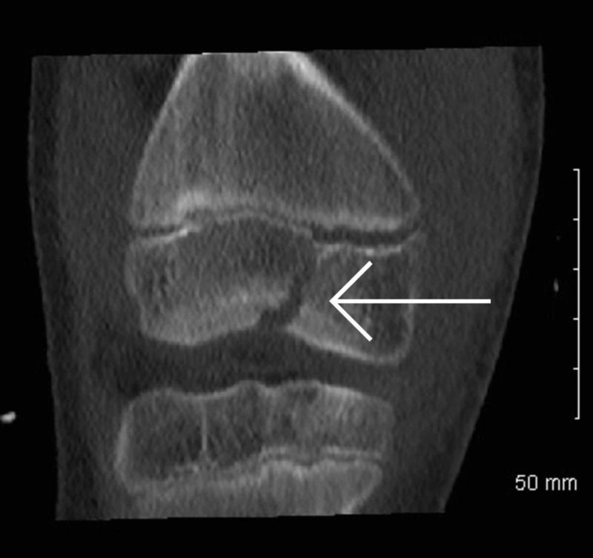
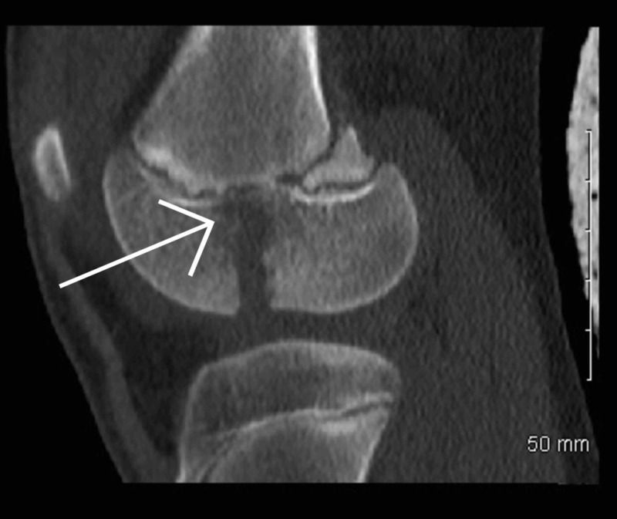
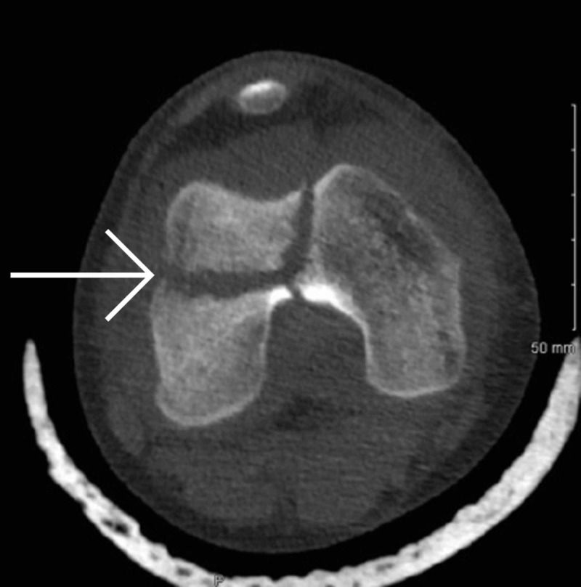
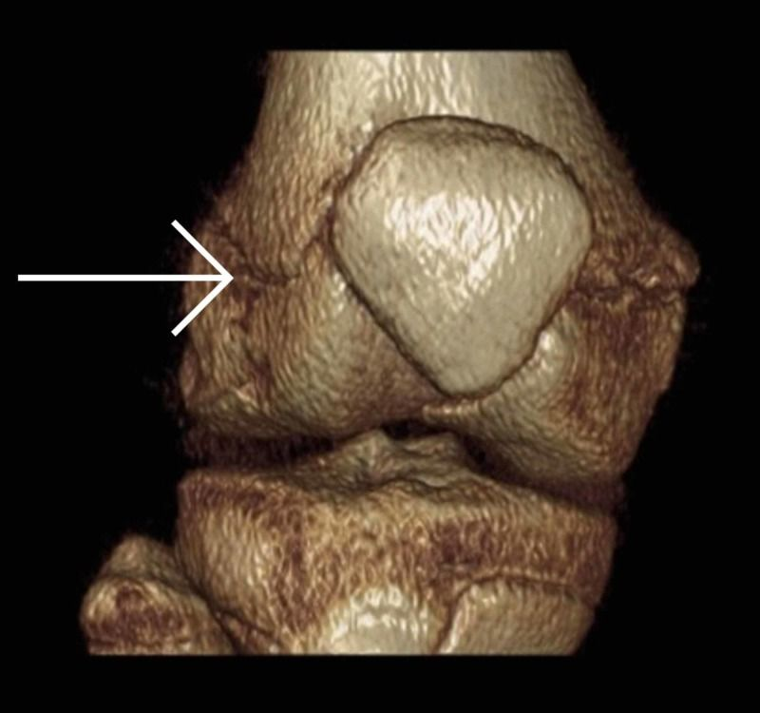
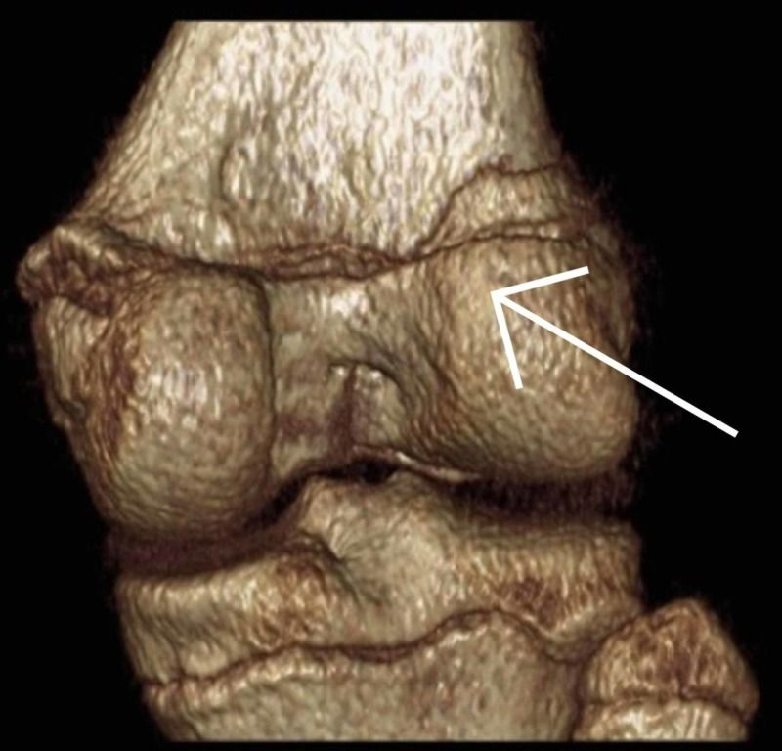
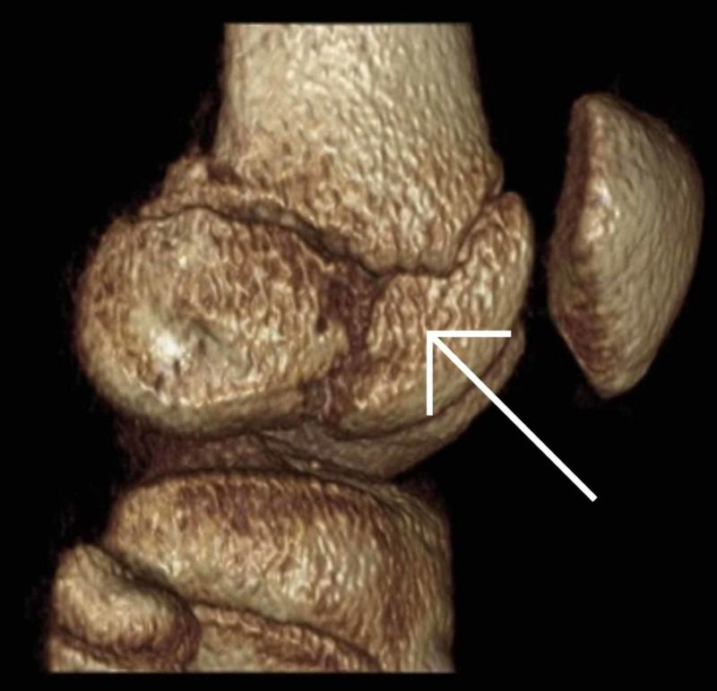
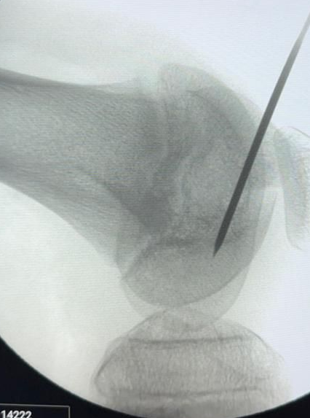
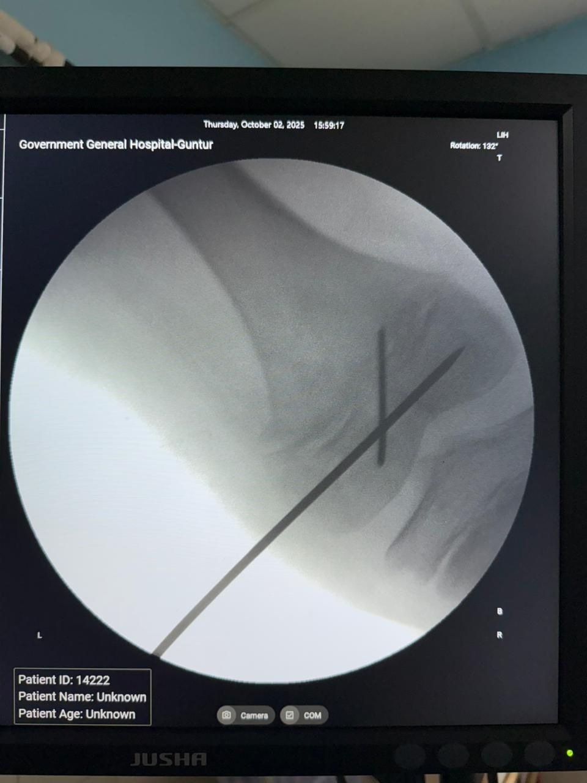
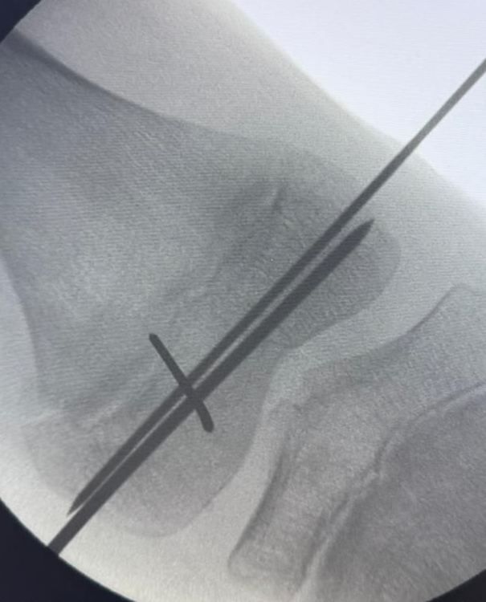
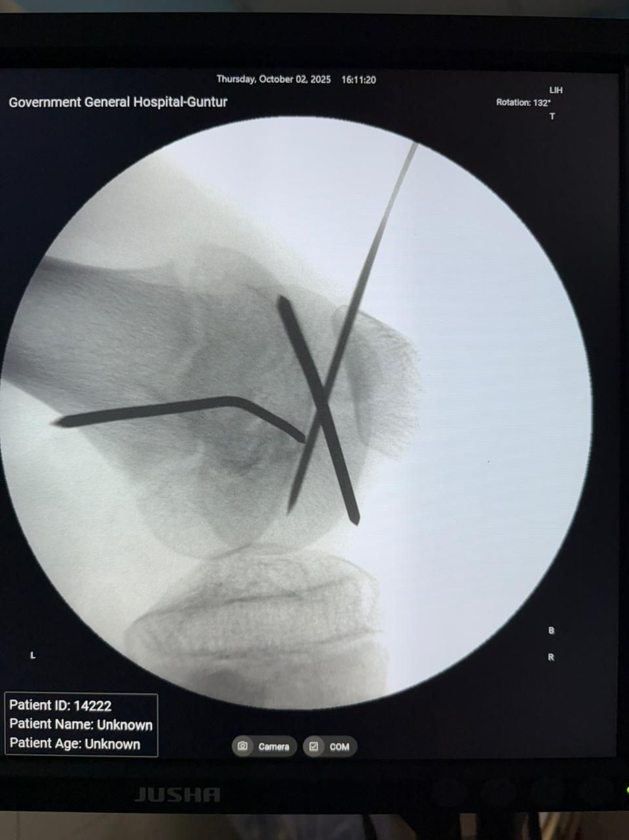
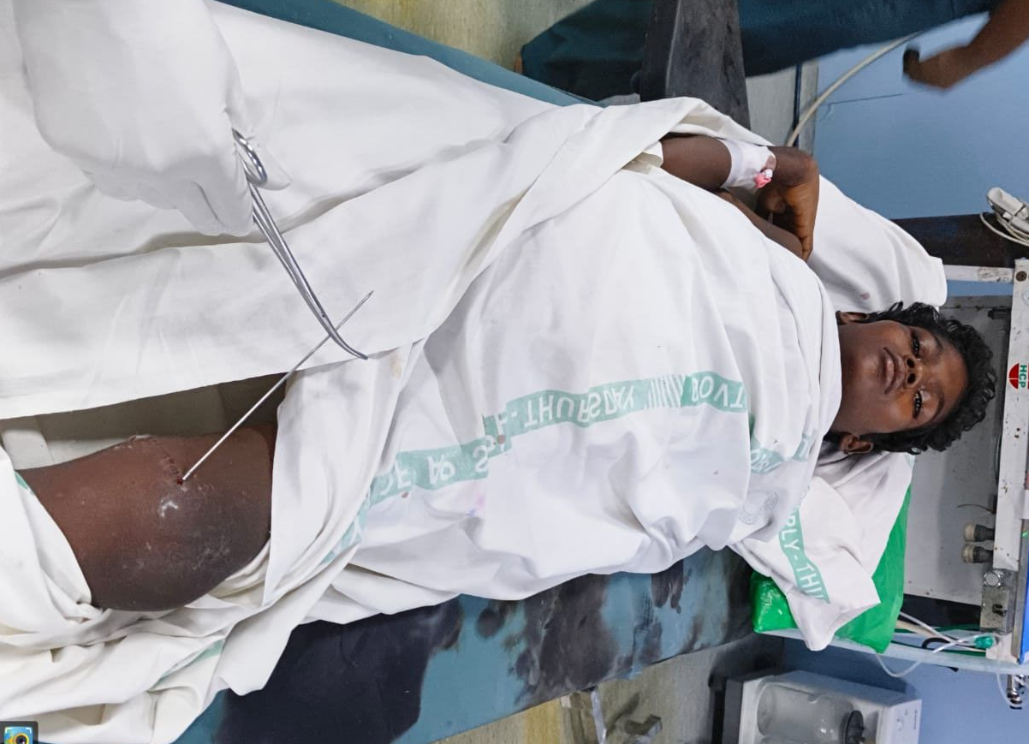
TRIPLANE FRACTURE OF THE DISTAL FEMUR IN
THE PAEDIATRIC POPULATION
OSSAP-195
  AUTHORS: Dr. TAPAS MAJUMDER ( PG )
  GUIDE: Dr. P ANIL BABU ( MS ORTHO)
  GUNTUR MEDICAL COLLEGE,GUNTUR
ABSTRACT
CASE REPORT
POST OPERATIVE PROTOCOL
Triplane fractures of the distal femur in Paediatric populations are extremely rare. Only three cases of paediatric triplane fractures of the distal femur are described in the literature. Our aim is to add to the scant literature on triplane fractures of the distal femur in the paediatric population. The majority of trauma and Orthopaedic surgeons are not expected to come across this injury throughout their careers. A CT is recommended to plan surgery, and subsequent follow up is crucial to provide the child with the best possible outcome. Particularly, follow up is important to monitor for any abnormal growth or deformities.
A 17-year-old boy injured his left knee due to fall from bike. He fall from pillion of bike dure skid of bike and sustained a direct blow to the left knee. He presented to emergency department of GGH Guntur due to left knee pain and an inability to weight-bear. After clinical examination, had plain film x-rays (Fig-1), and x-ray confirmed epiphyseal fracture. Once it was established that this was a closed fracture and he was neurovascularly
intact, his knee was immobilized in an above knee
Back slab. CT scan (Fig- 2 to 7) for a definitive
diagnosis of his left distal femur fracture. This
showed a triplane fracture of her distal femur.
Immobilization was performed with above knee back slab for 6 weeks until wires are removed(Fig-13). Quadriceps strengthening exercises and hip ROM exercises started consequently, weight-bearing and physio were commenced periodic radiographs were requested, evaluated by true AP and Lateral x-rays that were taken at 2,4,6,12 months post-operatively(Fig-14). The patient recovered from the injury without any initial post-operative complications.
The functional
Outcome was
measured with
the use of
ROWE score.
INTRODUCTION
Triplane fractures of the distal femur in children are extremely rare. Fractures to the growth plate of the distal femur have been recognized as significant injuries in the literature as far back as 1894 .
The epidemiology of distal femoral growth plate injuries is well described. They represent from one to five percent of all physeal injuries, and approximately seven percent of lower extremity injuries; less than one percent of paediatric fractures. Most are Salter-Harris type II fractures which occur in adolescents.
The fusion of the distal femoral growth plate occurs between 14 and 16 years of age for females, and 16 to 18 years of age for males. Due to the thicker perichondral ring and periosteum, it takes more energy to injure the growth plate of a child than an adolescent.
Fractures involving the distal femur growth plate can have severe implications for children. Complications include malunion, premature closure of part or all of the growth plates with the corresponding angular and/or rotational deformities, or leg-length discrepancies, and neurovascular injuries.
Triplane fractures are well described of the distal tibia, distal humerus, distal radius, and the hand. To date, only three cases have been reported of triplane fractures in the distal femur in the paediatric population. Only one of these cases involved a female, and only one case had a pre-operative computed tomography (CT) scan performed.
Our aim is to add to the scant literature on triplane fractures of the distal femur in the paediatric population. We describe our management and the challenges this case presented to us. In providing more information on triplane distal femoral fractures in the paediatric population, we hope to provide detailed information for surgeons who are planning to repair such fractures in the future.
FIG-1
FIG-13
FIG-14
DISCUSSION
FIG-2
FIG-3
FIG-4
FIG-5
FIG-6
FIG-7
OPERATIVE FINDINGS
Triplane fractures of the distal femur in the paediatric population are very rare. Pre-operatively the surgeon must anticipate potential complications and address these with parents. A CT is recommended to plan surgery, and subsequent follow up is crucial to provide the child with the best possible outcome. Regarding the operative technique, it is essential to aim for as much anatomical reduction as possible.
Operative Technique - Closed reduction was performed under C-ARM guidance.
Step 1: the Hoffa type lateral condylar fracture was reduced and fixed with a K-wire (Fig- 8).
Step 2: the medial condylar fragment was reduced and fixed with another 2mm K-wire (Fig- 9).
Step 3: another 1.5mm K-wire passed from lateral condyle to medial condyle (Fig-10to11).
Anatomic reduction of the articular surface was performed. There is no medial physis comminution. These wires were subsequently removed six weeks later.
FIG-2
FIG-8
FIG-9
CONCLUSION
Our case is an example of a rare triplane distal femur epiphyseal fracture. We present pre-, peri- and post-operative images of the management of this rare injury. It is imperative to achieve anatomical reduction. CT scanning is recommended to diagnose and manage this injury appropriately. Post-operative follow up is crucial to managing this patient as a limb length discrepancy and/or a deformity is expected.
FIG-10
FIG-11
FIG-12

