Slide 1
FUNCTIONAL OUTCOME OF PEDIATRIC BOTH BONE FOREARM FRACTURES TREATED WITH ELASTIC STABLE INTRAMEDULLARY NAILING
PRESENTER:DR. GAJULA VENKATA SAI ABHIRAJ
MODERATOR: DR. P. SUJITH DEVA PRASAD, DNB
PROFESSOR AND HOD
SANTHIRAM MEDICAL COLLEGE AND GENERAL HOSPITAL
NANDYAL

Slide 2
INTRODUCTION:
Diaphyseal fractures of the radius and ulna are one of the most common in the pediatric population.
Fractures of forearm of children are different than adults. Periosteum is thick and less likely to be torn.
The titanium elastic nailing system (TENS) provides the following four properties: flexural stability, axial stability, translational stability, and rotational stability. The elastic stable intramedullary nailing has benefits of immediate stability to the involved bone segment which permits early mobilization and returns to normal activities with low complication rate.
The rule of thirds:
If the fracture of the shaft is proximal to the insertion of the pronator teres, the forearm should be held in supination.
If the fracture is distal to the insertion of pronator teres, midprone position is advised.

Slide 3
AIMS AND OBJECTIVES:
To study outcome of management of both bone forearm fractures by closed reduction and internal fixation with Titanium elastic nailing system (TENS).

Slide 4
METHODS AND MATERIALS
A total of 20 patients aged 5-15 years with closed diaphyseal fracture of both radius and ulna were managed by closed reduction and internal fixation with titanium elastic nails under image intensifier was achieved in all of the patients.
.

Slide 5
Results were analysed in reference to age, sex, mode of injury, time of union and complications.
TABLE:1 AGE DISTRIBUTION
TABLE :2 SEX DISTRIBUTION
AGE | NUMBER OF PATIENTS | %
5-10 | 6 | 30
11-15 | 14 | 70
TOTAL | 20 | 100
SEX | NUMBER OF PATIENTS | %
MALE | 16 | 80
FEMALE | 4 | 20
TOTAL | 20 | 100

Slide 6
TABLE :4 TIME OF FRACTURE UNION
TABLE : 3 MODE OF INJURY
TIME OF UNION | NUMBER OF PATIENTS | %
<10 WEEKS | 8 | 40
10-12 WEEKS | 10 | 50
>12 WEEKS | 2 | 10
TOTAL | 20 | 100
MODE OF INJURY | NUMBER OF PATIENTS | %
FALL | 6 | 30
SPORTS | 4 | 20
RTA | 10 | 50
TABLE:6 RESULTS BASED ON PRICE et.al CRITERIA
TABLE:5 COMPLICATIONS
RESULTS | NUMBER OF PATIENTS | %
EXCELLENT | 16 | 80
GOOD | 3 | 15
FAIR | 1 | 5
POOR | 0 | 0
TOTAL | 20 | 100
COMPLICATIONS | NUMBER OF PATIENTS | %
INFECTION | 1 | 5
REFRACTURE | 0 | 0

Slide 7
CONCLUSION:
Better functional outcome with less complications were achieved with elastic stable intramedullary nailing with Titanium elastic nailing system (TENS).
Advantages of elastic nailing in pediatric forearm fractures is that it facilitates biological fixation of the fracture and promotes early fracture union.
The need for near perfect anatomical alignment is not always necessary because of the excellent remodeling in the growing bone of child, and hence open reduction is rarely indicated.
The design of the Elastic nails does not interfere with periosteal circulation to the extent the plating does so, early union takes place and postoperative osteoporosis does not occur.

Slide 8
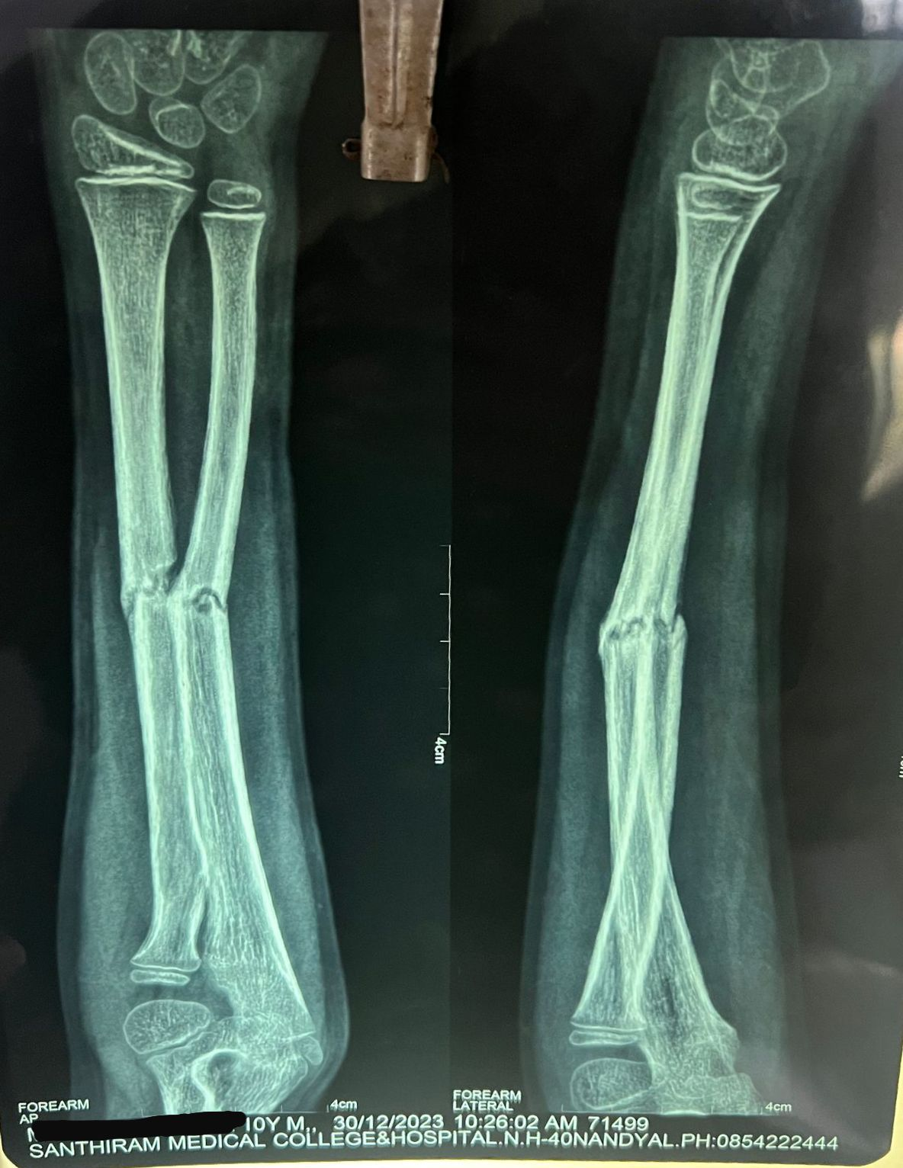
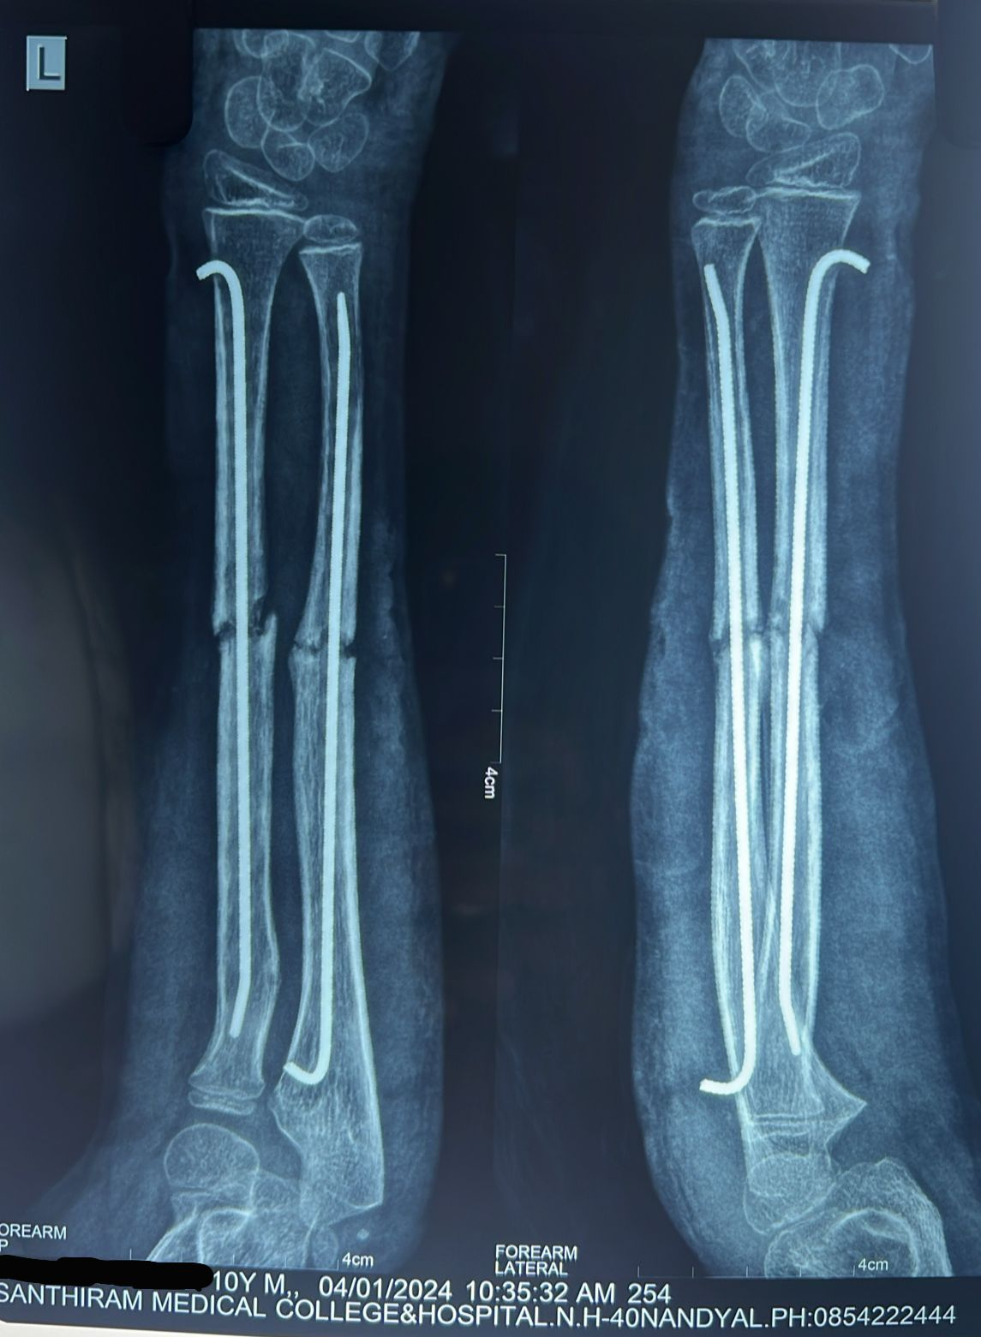
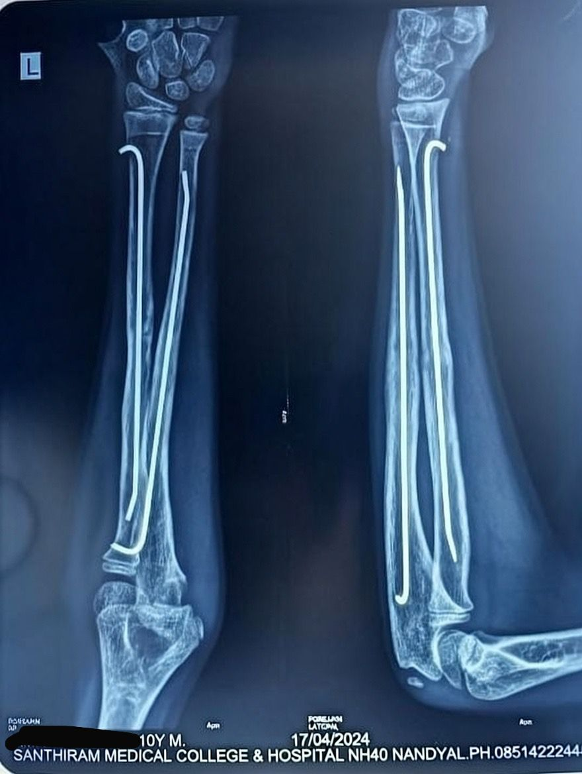
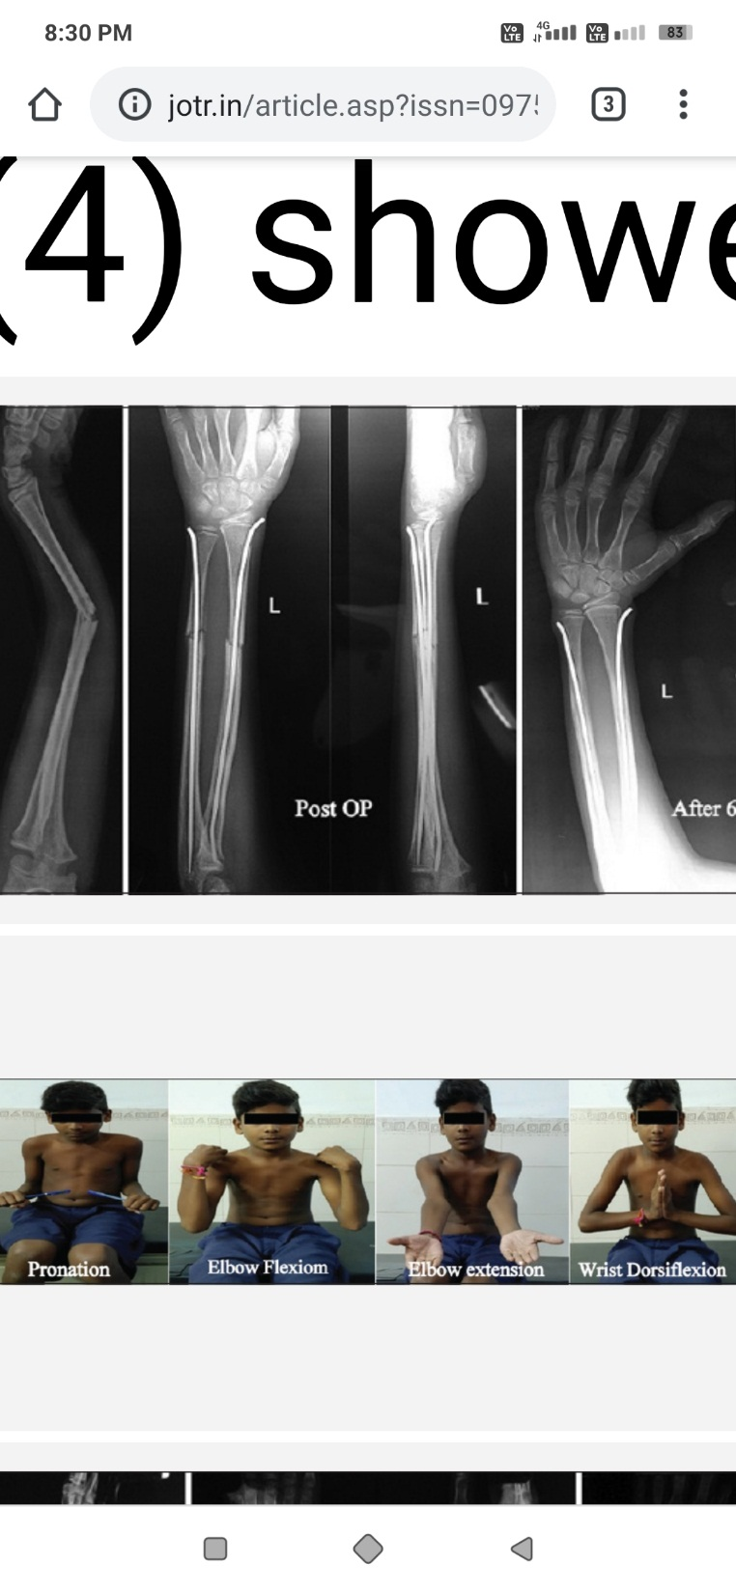
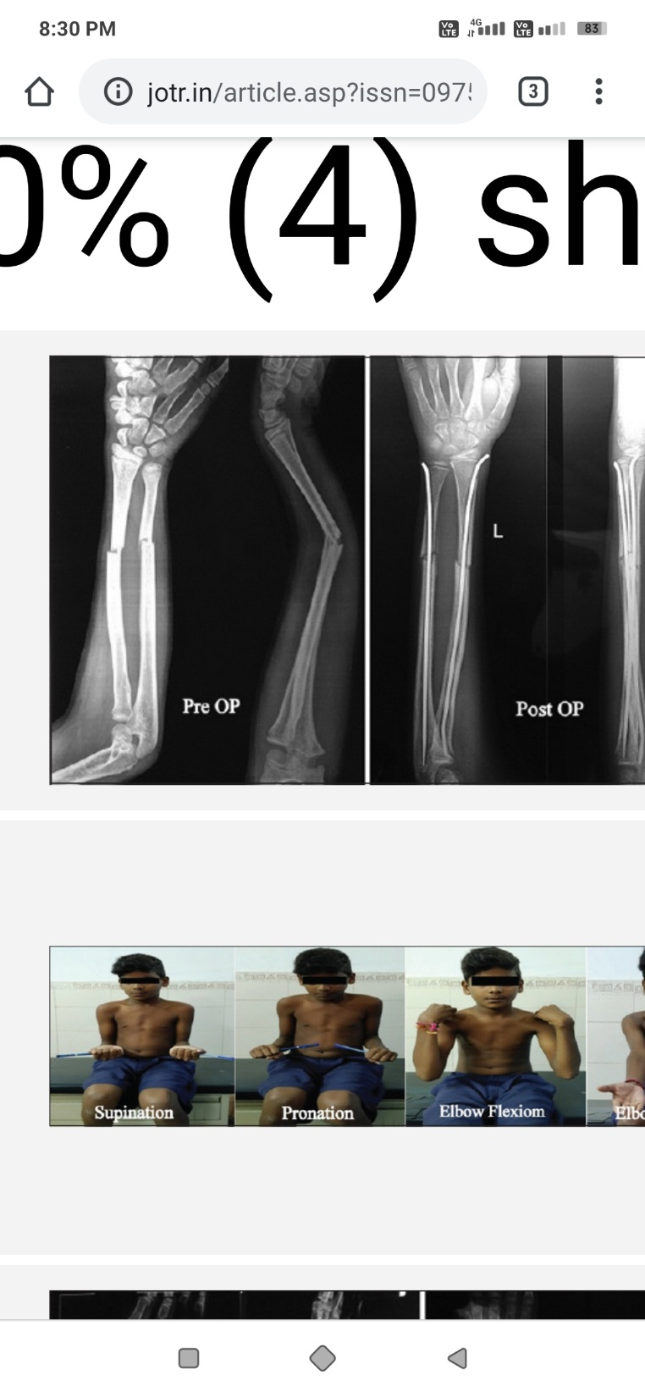
PRE-OPERATIVE
POST-OPERATIVE
AFTER 3 MONTHS
SUPINATION
PRONATION
FLEXION
EXTENSION

Slide 9
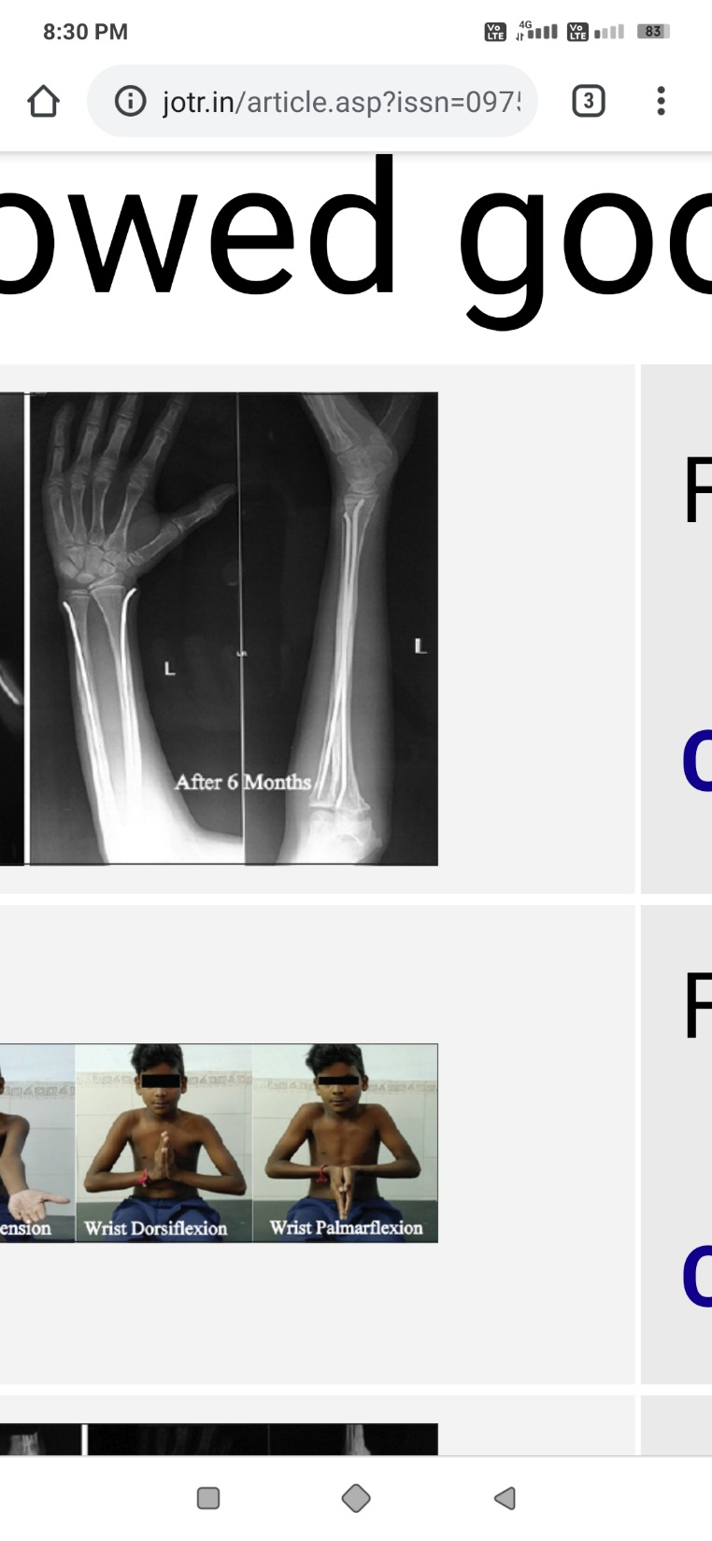
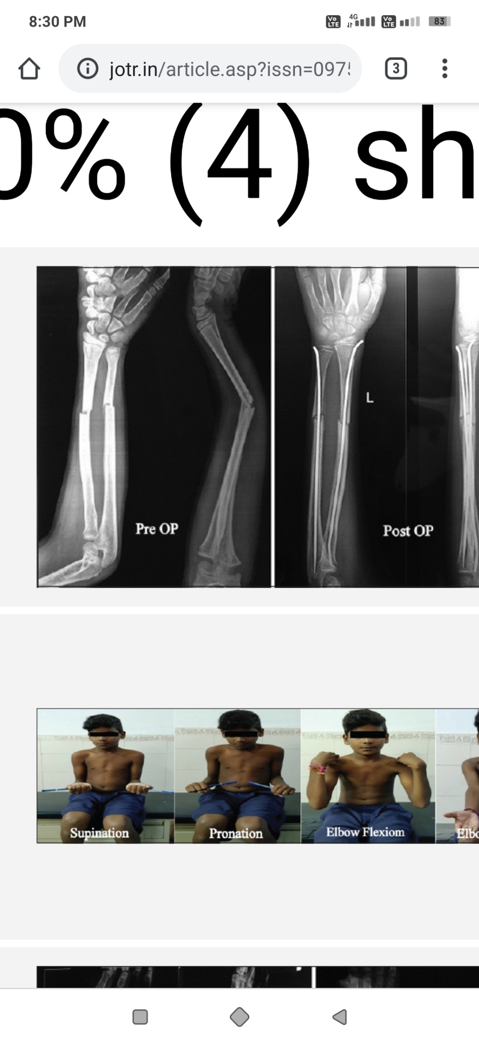
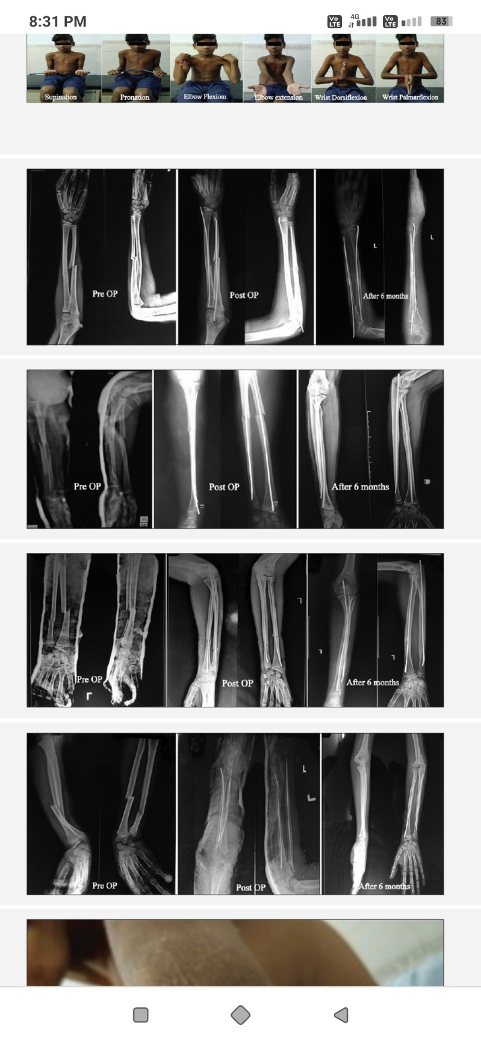
PRE-OPERATIVE
POST-OPERATIVE
AFTER 3 MONTHS
PREOPERATIVE
POST-OPERATIVE
AFTER 3 MONTHS

Slide 10
REFERENCES
Jones K, Weiner DS. The management of forearm fractures in children A plea for conservatism. J Pediatr Orthop 1999;19:811‑5.
Flynn JM, Waters PM, Skaggs DL. Rockwood and Wilkins Fractures InChildren. 8th ed. Philadelphia: Wolters Kluwer; 2015. p. 413‑72.
Metaizeau JP, Ligier JN. Surgical treatment of fractures of long bones in children: Interference between osteosynthesis and physiological process of consolidations: Therapeutic indications. J Chir (Paris) 1984;121:527‑37.
Johnson CW, Carmichael KD, Morris RP, Gilmer B. Biomechanical study of flexible intramedullary nails. J Pediatr Orthop 2009;29:44‑8.
Dietz HG, Schmittenbecher P, Illing P. Intramedullare Osteosyntheses Imwachstumsalter. Munchen: Urban and Schwarzenberg; 1997.
Bellemans M, Lamoureux J. Indications for immediate percutaneous intramedullary nailing of complete diaphyseal forearm shaft fractures in children. Acta Orthop Belg 1995;61 Suppl 1:169‑72.

Slide 11
THANK YOU

