Slide 1

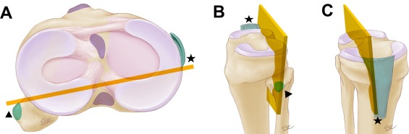
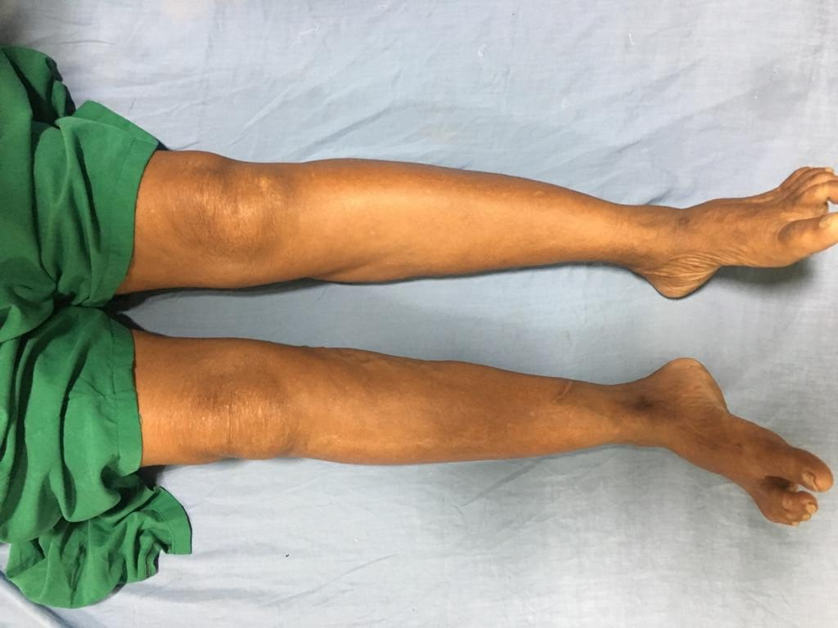
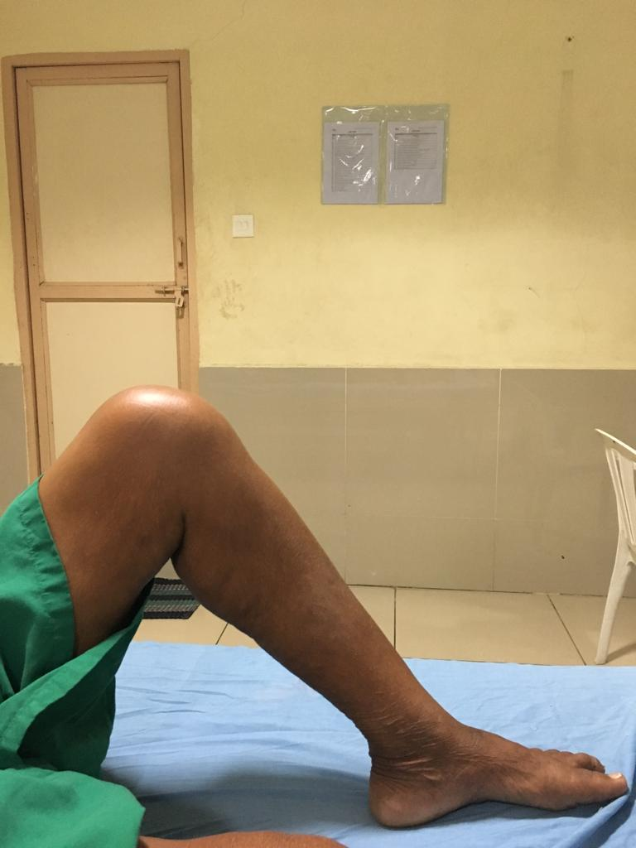
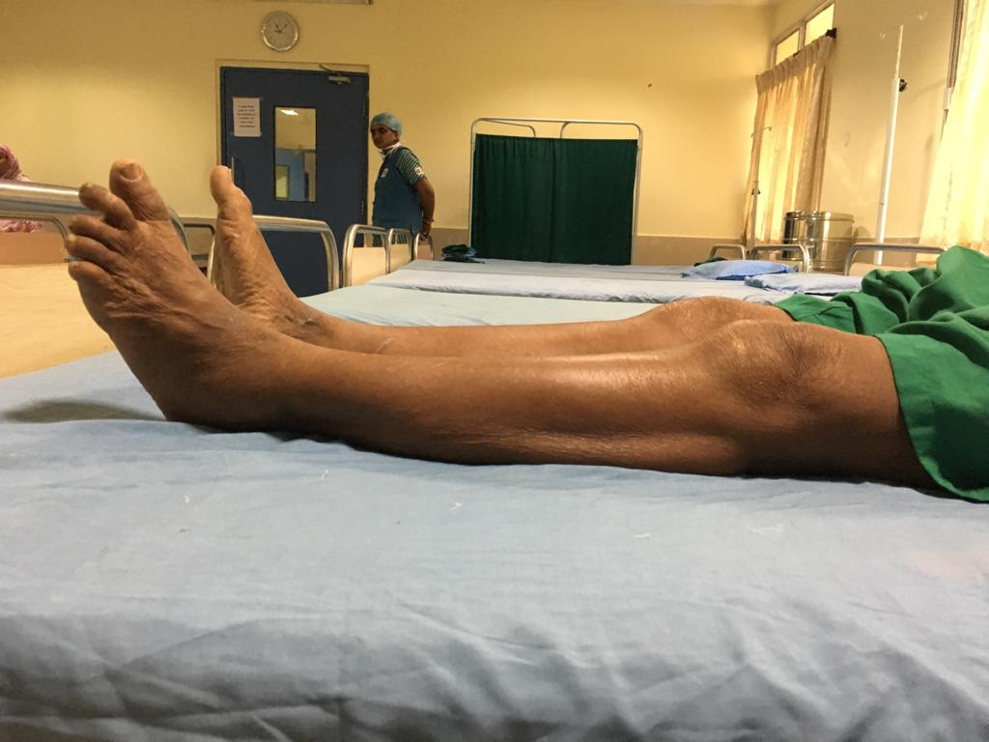
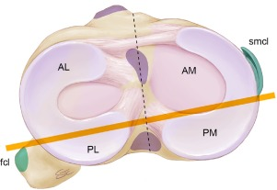
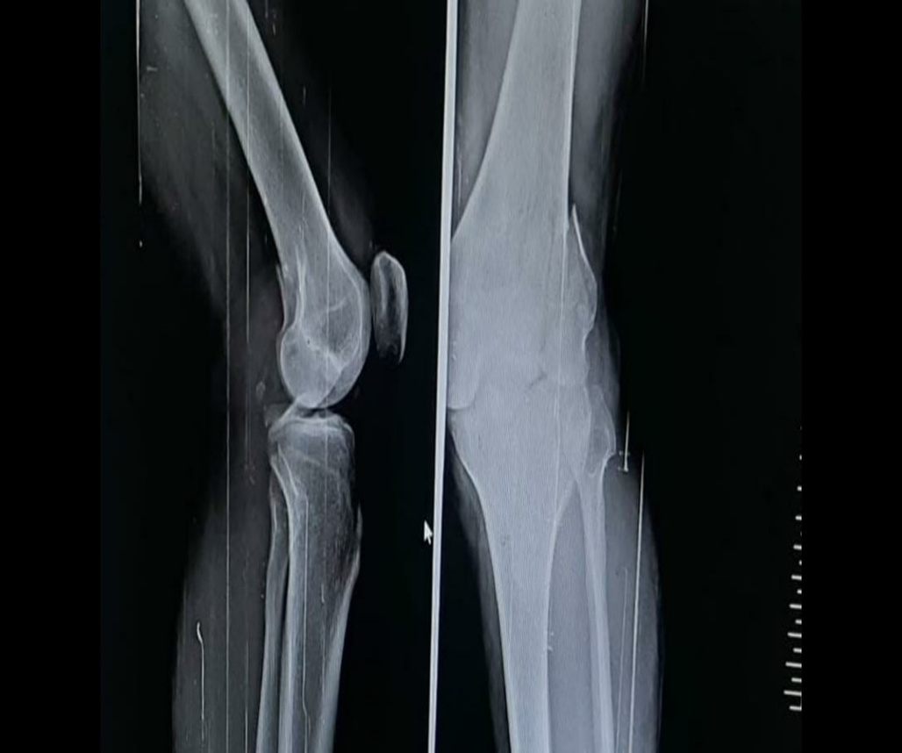
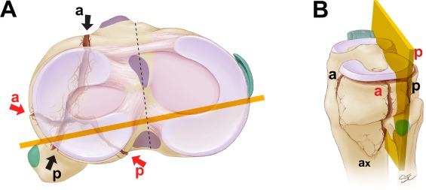
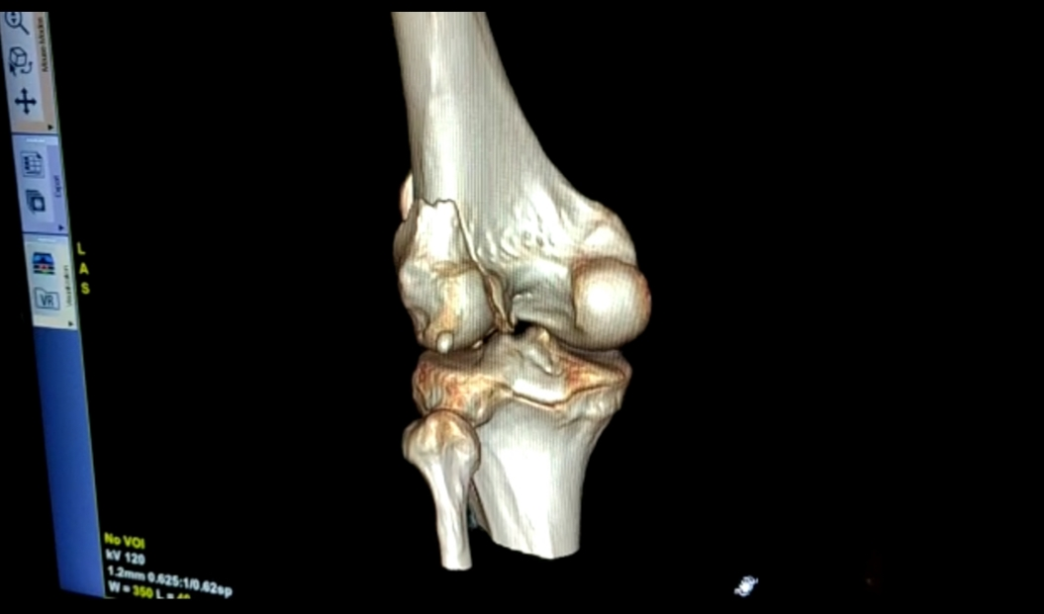
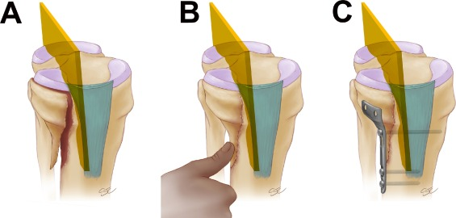
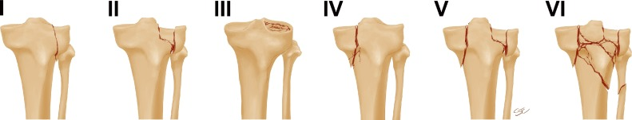
POSTERIOR TIBIAL PLATEAU FRACTURE: A CASE REPORT
LUO CF ET AL; THREE-COLUMN CLASSIFICATION FOR A BETTER UNDERSTANDING
OF THE FRACTURE MORPHOLOGY AND SURGICAL PLANNING
Dr Y.SURESH., Postgraduate, Dr.Riyaz Babu.Shaik. Professor and Hod.
Dept of Orthopaedics Dept of Orthopaedics
NRI Medical College. Chinakakani. NRI Medical College. Chinakakani.
CASE REPORT:
A 31yr/m patient was admitted at our hospital following a road traffic accident.
Antero-posterior plain radiographs were used for Schatzker classification.
CT imaging was used to further classify the fracture types with axial views dividing the
plateau into three columns: a lateral, medial, and posterior.
Posterior tibial plateau fracture (PTPF) was defined as a fracture with an independent
fragment of the posterior column
RADIOGRAPH :
THE LUO ET AL CLASSIFICATION:
Luo cf et al. utilizing computed tomography divided the surface of the tibial plateau into three columns, while emphasizing the relevance of coronal plane oriented fractures.
Tri dimensional imaging modalities allowed not only for the detection of fracture lines which were frequently not evident in plain radiographs but lead also to the development of new classification systems.
INTRODUCTION :
Posterior tibial plateau fracture is a relatively uncommon injury, with an incidence of 28.8%
Posterior tibial plateau fracture is caused when the posterior tibia plateau is stricken by the femoral condyle while the knee joint, in semi flexion position, suffers from a varus-valgus stress
This kind of fracture appears confusing on initial radiographs because of the small displacement, so it is a special injury pattern that is not sufficiently included in any type of the classification systems
Three-Column Classification can be used as a recent supplement to the conventional Schatzker Classification, which is useful for multiplanar fractures involving the posterior column.
These injuries form a special injury pattern of primarily posterior displacement is not well described by the AO/Orthopaedic Trauma Association classification or Schatzker classification systems
CASE REPORT
VIRTUAL EQUATOR OF THE TIBIAL PLATEAU:
Plane determined by joining the insertion of the fibular collateral ligament on the lateral tubercle of the fibular head and the posterior aspect of the insertion of the superficial medial collateral ligament, which is distal to the joint in the metaphyseal area and coincides with the posterior tibial crest.
QUADRANTS :
The virtual equator divides the tibial plateau condyles into two halves. The anterior one is designated by a capital “A”, and the posterior one is designated by a capital “P”. The tibial plateau has two columns, each one supporting its corresponding articular surface. The articular surfaces are separated by the extra-articular tibial spines. Since there are two columns which are split by a virtual equator, this results in the four anatomical quadrants, as follows: AL- anterolateral; AM – anteromedial; PL – posterolateral; PM – posteromedial
CLINICAL APPLICATION :
According to the three-dimensional anatomical classification this would be - one wedge anterior and one posterior.
The identification of the posterior wedge is of great importance.
To deal only with the anterior wedge would leave the joint unstable posteriorly.
A: A coronal plane-oriented fracture which compromise the posteromedial quadrant of the tibial plateau
B: The ideal location for a buttress plate coincides with the area where the surgeon would like to apply his thumb to keep the wedge in its place. In this case, the thumb has to be applied on the posteromedial aspect of the tibia
C: The best location for a buttress plate is parallel to the main fracture plane
CONCLUSION :
Posterior tibial plateau fracture (PTPF) is a special type of plateau fracture
Due to its special location, it is difficult to perform open reduction and internal fixation
If effective treatment is not provided, chronic collapse often occurs, which leads to significant limited range of knee flexion and extension
Luo et al. introduced the three-column concept with particular attention to the compromise of the posterior aspect of the tibial plateau.
Luo’s system enhanced the awareness about the compromise of the posterior rim of the tibial plateau
REFERENCES :
1. Zhu Y, Yang G, Luo CF, et al. Computed tomography based three-column classification in tibial plateau fractures: Introduction of its utility and assessment of its reproducibility. J Trauma Acute Care Surg 2012;73(3):731-7.
2. Luo CF, Sun H, Zhang B, Zeng BF (2010) Three-column fixation for complex tibial plateau fractures. J Orthop Trauma 24(11):683
3. Yang G, Zhai Q, Zhu Y, et al. The incidence of posterior tibial plateau fracture: an investigation of 525 fractures by using a CT-based classification system.
CT SCAN :
THE SCHATZKER CLASSIFICATION:
The six principle tibial plateau fracture types as described by Schatzker.
Type I, split wedge of the lateral tibial plateau;
Type II, split wedge depression of the lateral tibial plateau;
Type III, pure depression of the lateral tibial plateau;
Type IV: split wedge of the medial tibial plateau;
Type V: bicondylar tibial plateau fracture, where there is continuity between the epiphysis and the diaphysis;
Type VI: bicondylar fracture with complete dissociation between the epiphysis and the diaphysis.
The Schatzker classification was based on a two-dimensional representation of the fracture from antero posterior radiographs
Before the advent of the CT scan many of the fractures in the coronal plane, often the result of high velocity trauma, were not recognized.

