Slide 1
Minimally Invasive Repair of Neglected Tendoachilles Rupture Using Flexor Hallucis Longus Augmentation with Interference Screw
Presenting author : Dr. CHENNAPATNAM VIJAYA KRISHNA
Co-author : Dr. P.SUJITH DEVA PRASAD
SANTHIRAM MEDICAL COLLEGE AND HOSPITAL.

Slide 2
INTRODUCTION
The Achilles Tendon (tendo calcaneus) is the strongest and thickest tendon in the body and serves to attach the triceps surae (soleus and the two heads of gastrocnemius) to the calcaneus
Chronic ruptures of the Achilles tendon are debilitating injuries.
Repair is done using various procedures.
The flexor hallucis longus tendon is often harvested to augment the repair.
Hansen et al described the use of flexor hallucis longus tendon by harvesting it in the hindfoot through the same incision that is used for the repair of the Achilles tendon.

Slide 3
AIM of Study:
This aim of the study is to evaluate the efficacy of minimally invasive repair of neglected tendoachilles ruptures using flexor hallucis longus (FHL) tendon augmentation with interference screw fixation.
MATERIALS AND METHODS:
This is a prospective study carried out in Santhiram Medical college and hospital,Nandyal.
A total of 10 cases of neglected tendoachilles rupture were treated with flexor hallucis tendon augmentation with interference screw.

Slide 4
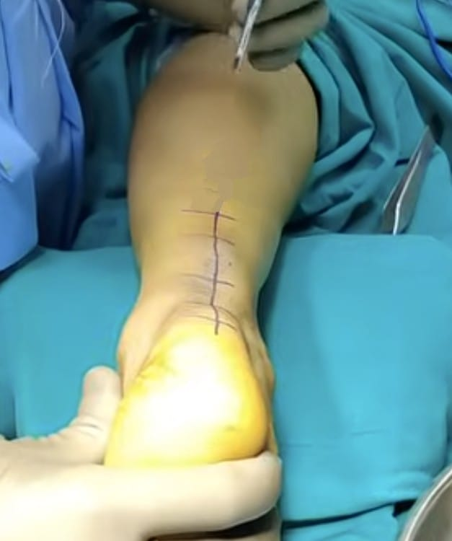
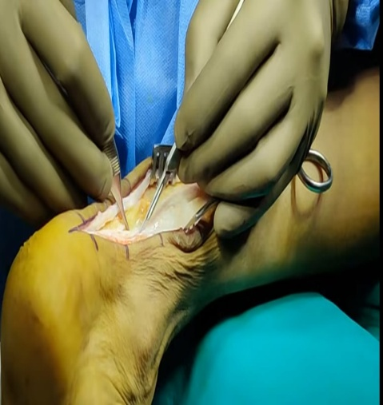
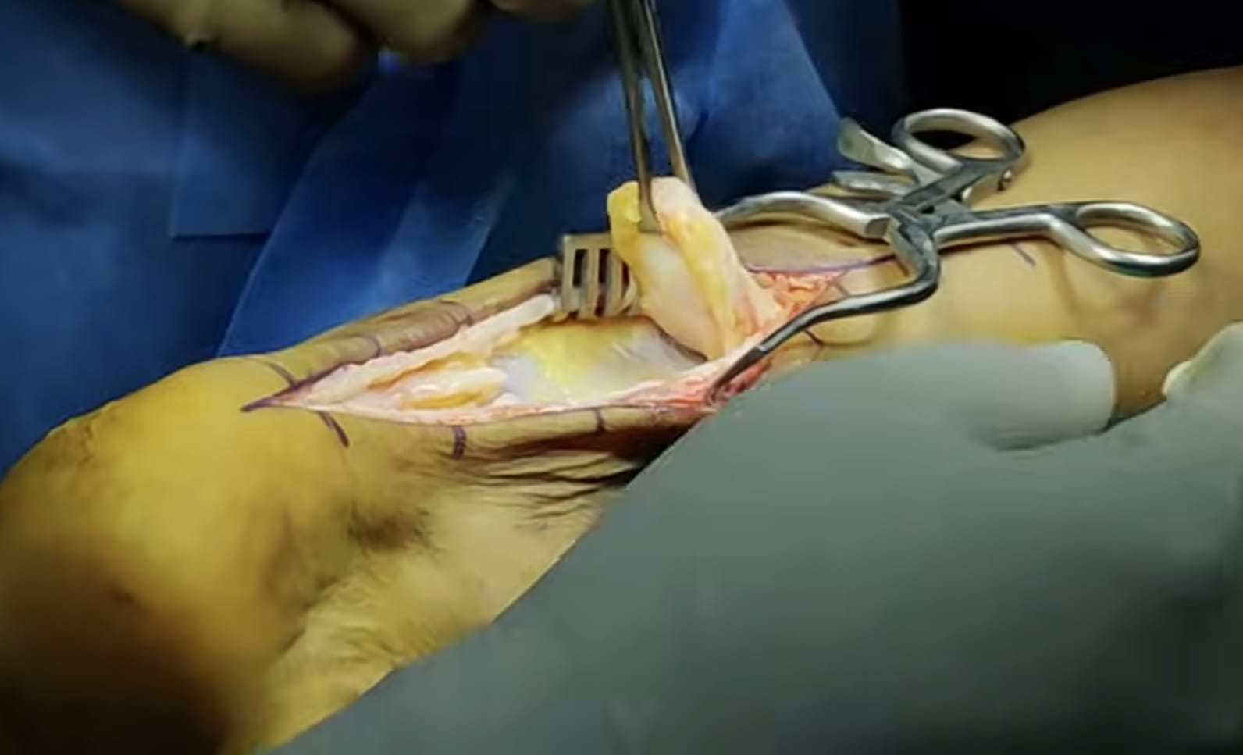
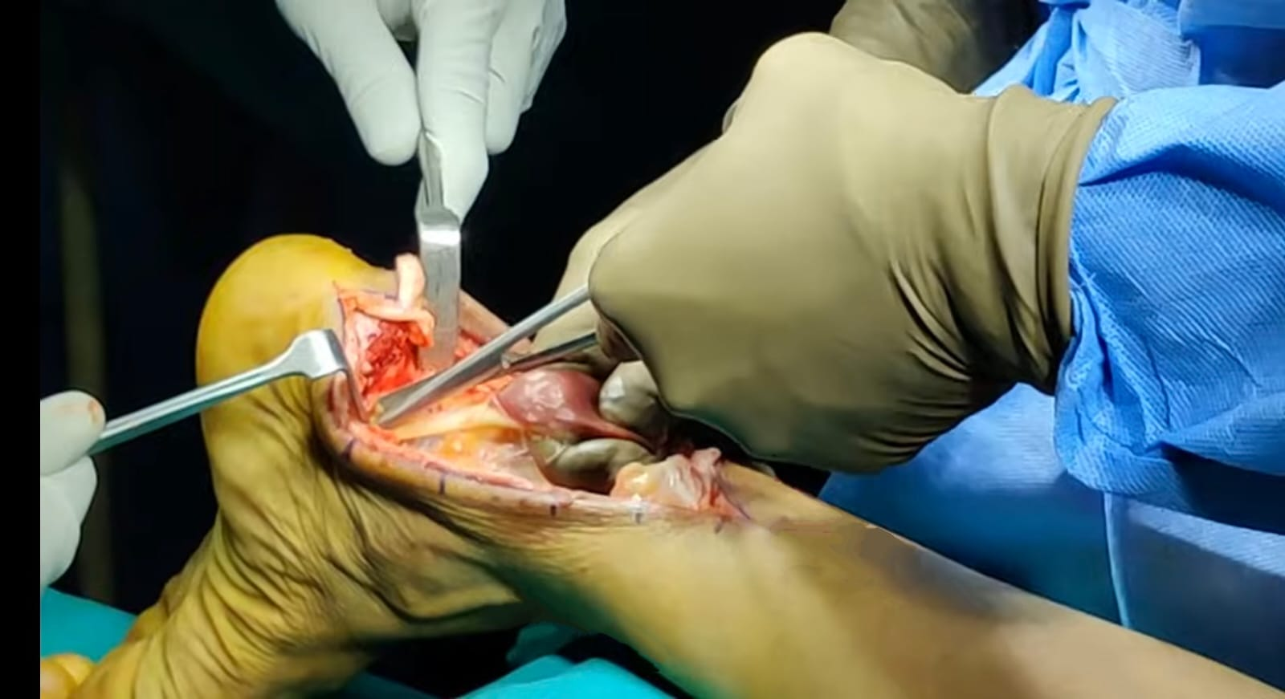
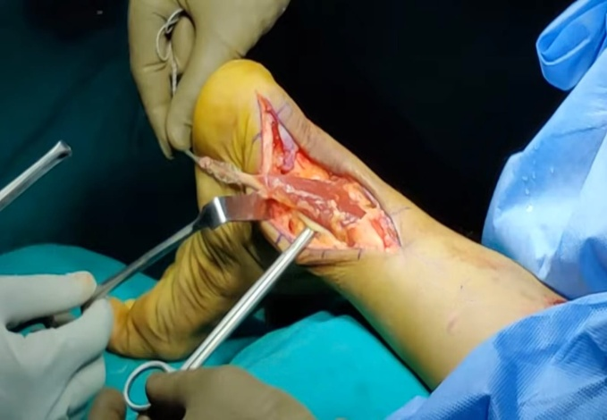
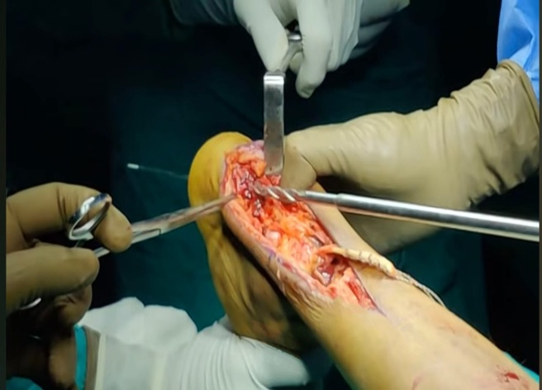
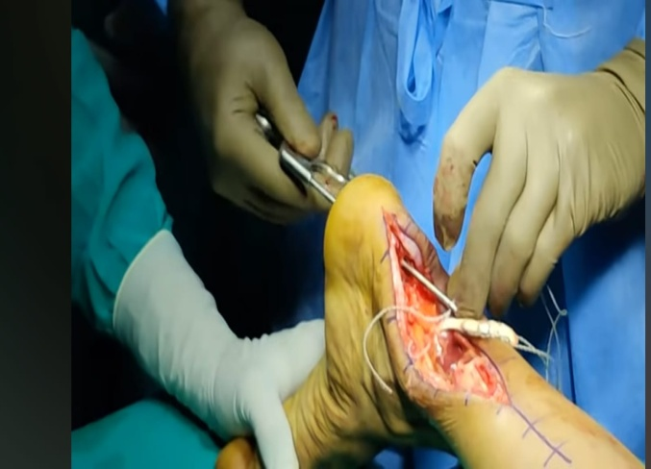
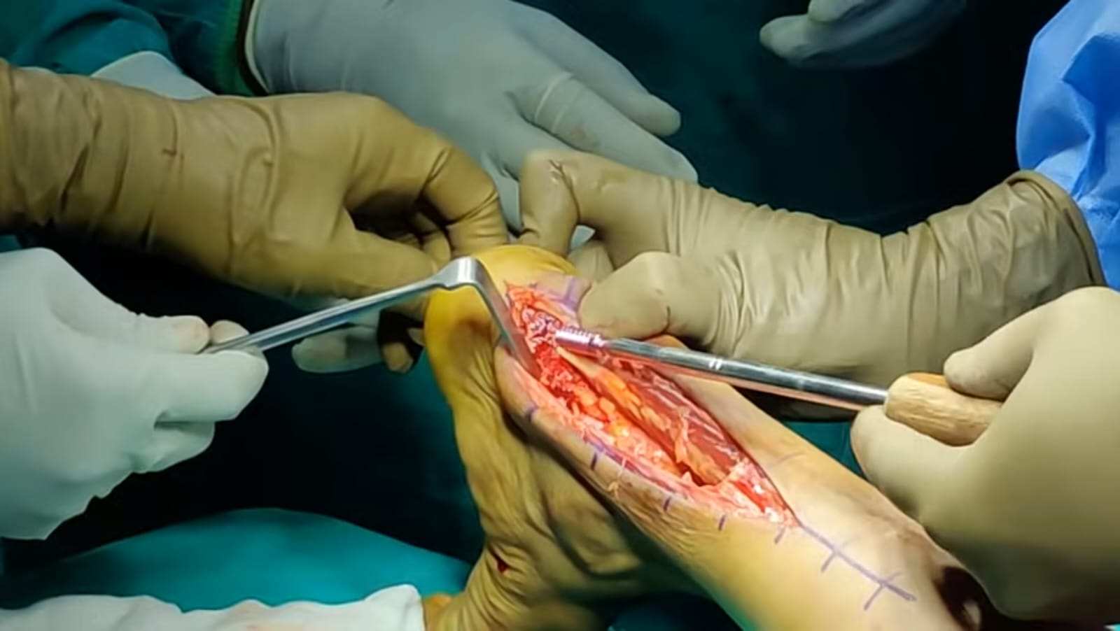
Surgical Technique Of FHL Transfer
Longitudinal incision placed along the medial border of the Achilles tendon.
The tendon sheath is incised in line of the incision.
The scar tissue in between the ends of the tendon is excised
flexor hallucis longus muscle is identified and incised proximal to master knot of henry expose the tendon.
Prepare FHL tendon
Interference screw fixation

Slide 5
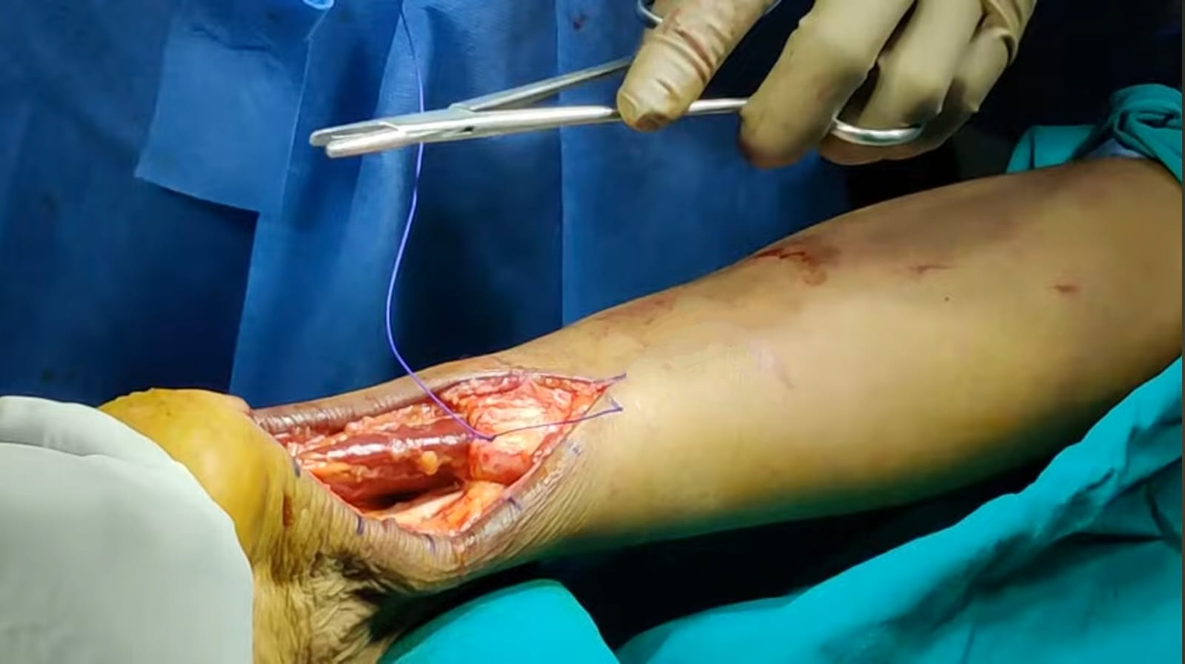
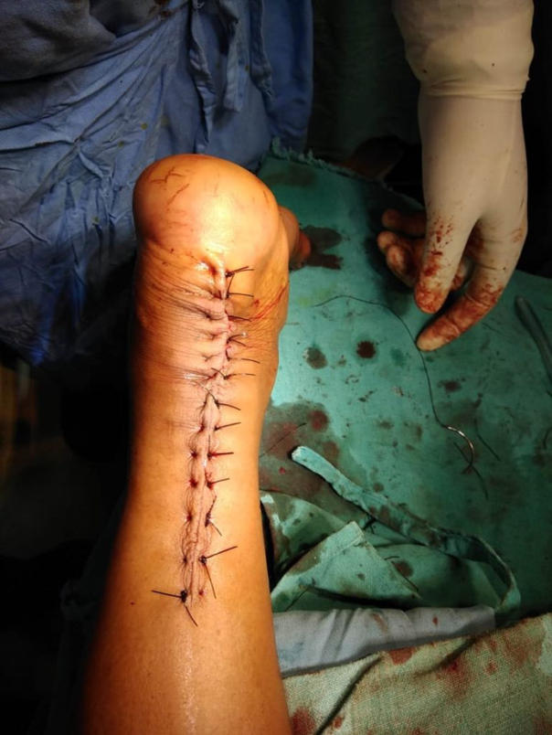
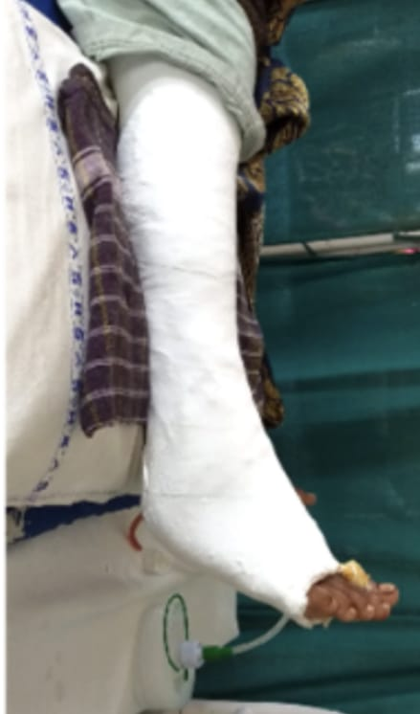
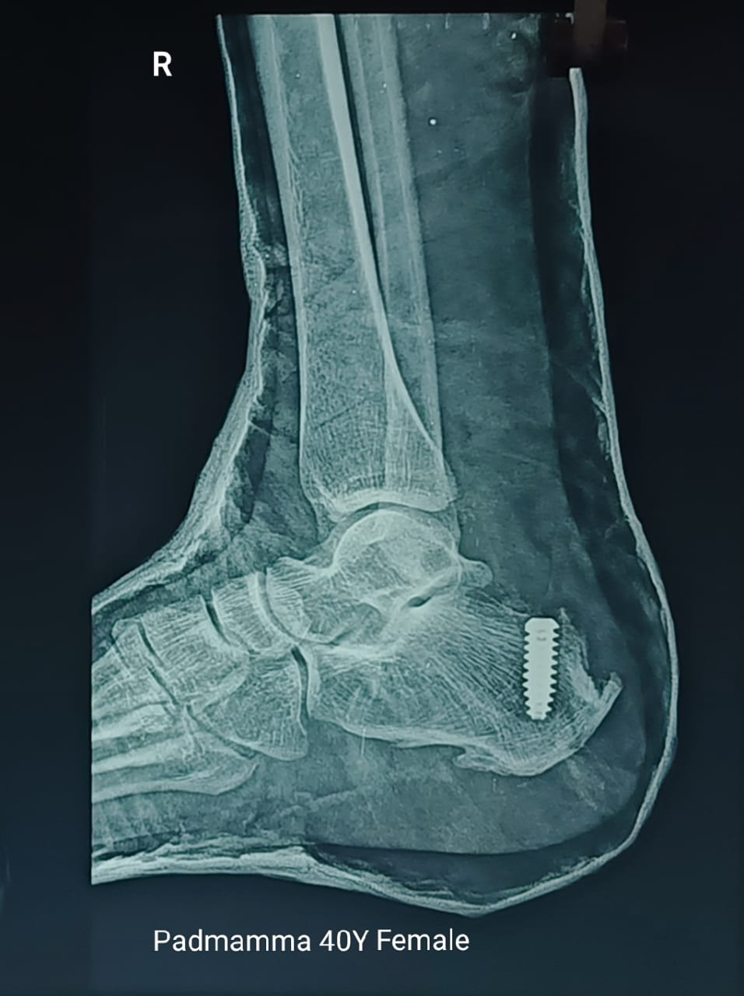
Application of above knee cast in 20 degrees of knee flexion and 5 degrees of plantar flexion
Post op x-ray

Slide 6
ADVANTAGES:
The flexor hallucis tendon is stronger than other tendons in posterior compartment of leg and easily accessible.
The axis of contractile force of the flexor hallucis longus most closely reproduces that of the Achilles tendon.
Its anatomic proximity makes the surgical technique easier and avoids the need to disturb the neurovascular bundle or lateral compartment muscles.
Relatively easier to perform in a patient lying prone.
No loss of great toe flexion because FHL incised proximal to master knot of henry.
COMPLICATIONS:
Wound infection
Wound dehiscence
Limited Ankle motion : FHL tendon transfer may not fully restore ankle motion potentially resulting in persistent stiffness or limited mobility.

Slide 7
RESULTS:
Single Limb Heel Rise: All the patients were able to perform single limb heel rise by 6 months.
Range of Motion(ROM): All patients achieved near-symmetrical dorsiflexion compared to the contra lateral side.
FHL Function: No patients reported significant morbidity or functional deficit related to Flexor Hallucis Longus at the great toe.
CONCLUSION:
FHL tendon transfer is a viable treatment option for patients with neglected chronic Tendoachilles tear
While the procedure offers several benefits, it also carries potential risks and complications.
Careful patient selection, meticulous surgical technique, and thorough postoperative care are essential for optimal outcomes.

Slide 8
References
Hansen ST. Trauma to the heel cord. In: Jahss MH, ed. Disorders of the Foot and Ankle, 2nd Ed. Philadelphia, PA: W.B. Saunders; 1991:2357.
Wapner KL, Pavlock GS, Hecht PJ, et al. Repair of chronic Achilles tendon rupture with flexor hallucis longus tendon transfer. Foot Ankle. 1993;14:443Y449.

