Slide 1




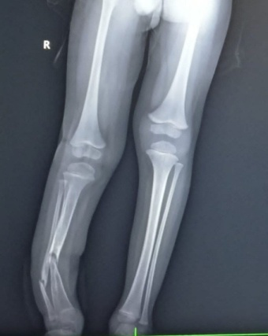
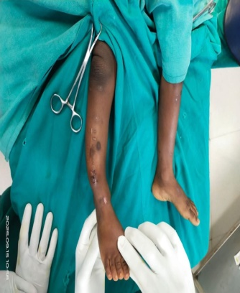
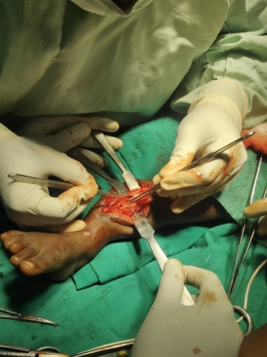
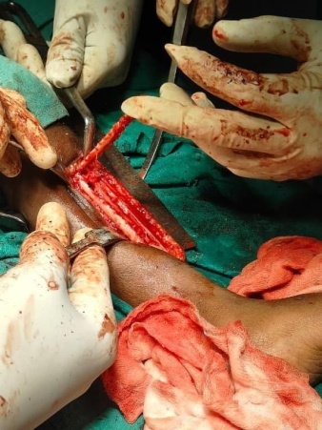
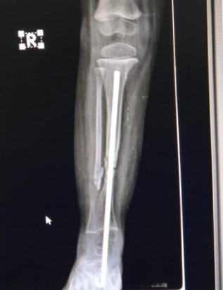
CONGENITAL PSEUDOARTHROSIS OF THE TIBIA:
CASE AND MANAGEMENT
PRESENTING AUTHOR –DR.ABISHEK MEGANATHAN.
GUIDE- DR.M.CHANDRASEKHARAM NAIDU [PROF OF ORTHOPAEDICS]
ANDHRA MEDICAL COLLEGE,VISAKHAPATNAM.
OSSAP -218
INTRODUCTION
OPERATIVE FINDINGS
DISCUSSION
Congenital pseudarthrosis of the tibia (CPT) involves nonunion of a tibial fracture occurring through dysplastic bone. The exact pathophysiology remains unclear, but it is known to involve pathologic periosteum resulting in abnormal bone turnover. CPT includes a range of clinical and radiographic presentations which may include pseudoarthrosis of the fibula. It is often associated with NF and fibrous dysplasia.Successful treatment includes achieving union and preventing re-fracture Emerging evidence suggests benefit of cross-union of tibia and fibula.
Procedure done:Pseudoarthrosis fibrous tissue excision with unicortical bone grafting harvested from contralateral Tibia fixed with RETROGRADE RUSH NAIL through Ankle joint.
Aim is to Achieve union,prevent refracture,correct limb length inequality & to Prevent ankle deformity and arthritis. Growth abnormalities of tibia,fibula include abnormal inclination of the proximal tibial physis, posterior bowing of proximal 3 rd of tibial metaphysis,proximal migration of lateral Mallolus,,fibulae hypoplasia,fibulae pseudoarthrosis ,ankle Valgus and calcaneum deformity.Ankle deformity and arthritis.STRATEGIES TO ACHIEVE UNION are the following procedures; Microvascular free fibular transfer, the illizarov technique and bone grafting with IM nailing .Irrespective of the method adopted it is recommended that excision of the pseudarthrosis should be an integral part of the procedure.
CONCLUSION
CPT remains one of the most challenging pediatric conditions. While modern techniques like Paley’s cross-union and Ilizarov fixation have significantly improved primary union rates, the long-term prognosis is guarded. Success requires achieving biological fusion, correcting limb length discrepancies, and providing continuous bracing to prevent refracture until skeletal maturity is reached.
CASE REPORT
A 3 yr old male child presented with right anterolateral bowing of Tibia with h/o TENS IM nailing for tibia fracture,diagnosed with CPAT without neurofibromatosis.

