Slide 1
MANAGEMENT OF LISFRANC INJURY BY OPEN REDUCTION AND INTERNAL FIXATION WITH CC SCREWS
PRESENTER:-Dr.R.PRAVALIKA
MODERATOR:-Dr.B.JOSEPH KARTHEEK

Slide 2
INTRODUCTION
Tarsometatarsal (TMT) joint complex injuries are rare, accounting 0,2% to 0,8% of all fractures.
Up to 20% of these injuries are missed on the initial examination.
Mechanism of injury can be either direct (high energy blunt trauma), or indirect by an axial or rotational force applied to a plantar flexed foot.
The medial column contains the first metatarsal and medial cuneiform.
The middle column contains the second, third metatarsal and middle and lateral cuneiform and the lateral one contains the fourth and fifth metatarsal with the cuboid.
Lisfranc ligament is an interosseous ligament between the medial cuneiform and the base of the 2nd metatarsal.

Slide 3
As toe extensors and dorsal ligaments are weak (compared to strong plantar ligaments and fascia), most dislocations are dorsal and secondary to plantar flexion injuries.
When dislocation occurs, the position and shape of tarsometatarsal joints tend to compress the foot in a longitudinal axis, bowing the foot dorsally at the tarsometatarsal joints and displacing the metatarsals dorsolaterally.
plantar ecchymosis sign and the fleck sign at the base of the second metatarsal are pathognomic of TMTdisruption

Slide 4
SURGICAL TECHNIQUE
The medial column was reduced through the dorsal approach.
A longitudinal incision lateral to the extensor hallucis longus tendon between the base of first and second metatarsals was made dorsally.
The dorsalis pedis artery and the deep peroneal nerve were isolated with a loop and retracted medially or laterally to visualise the Lisfranc joint.
Reduction of the second metatarsal cuneiform joint done

Slide 5
The intercuneiform screw was inserted from the medial to lateral direction from the medial cunieform.
The first and third metatarsal cuneiform joints were then reduced and fixed in a similar manner.
Stability of the fourth and fifth tarsometatarsal joints was assessed for spontaneous reduction.
If they remained unstable, they were fixed with Kirschner wires through a second dorsal incision parallel to the first incision dorsolaterally over the fourth intermetatarsal web space

Slide 6
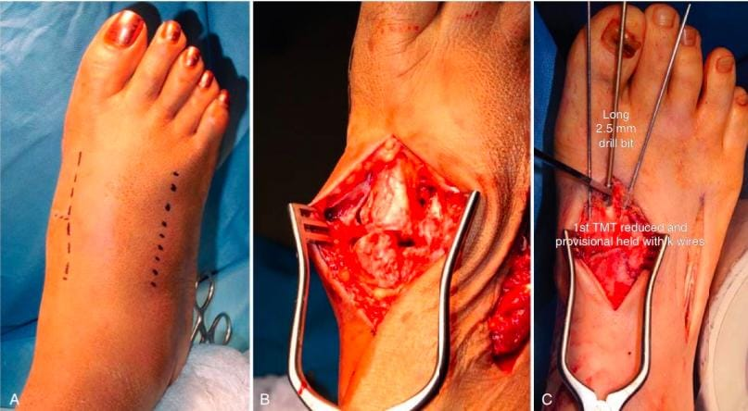
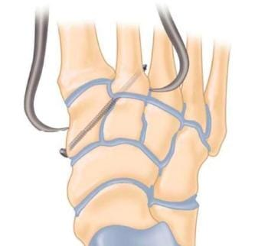

Slide 7
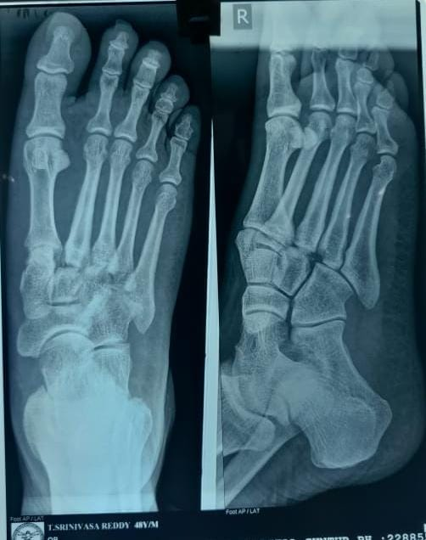
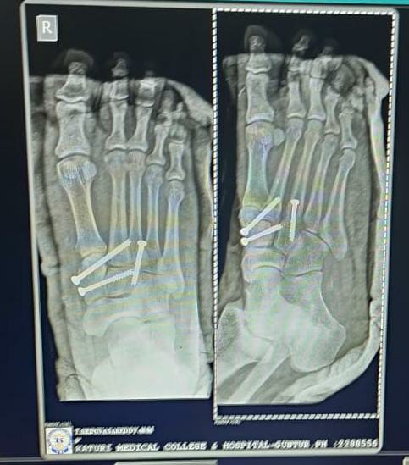

Slide 8
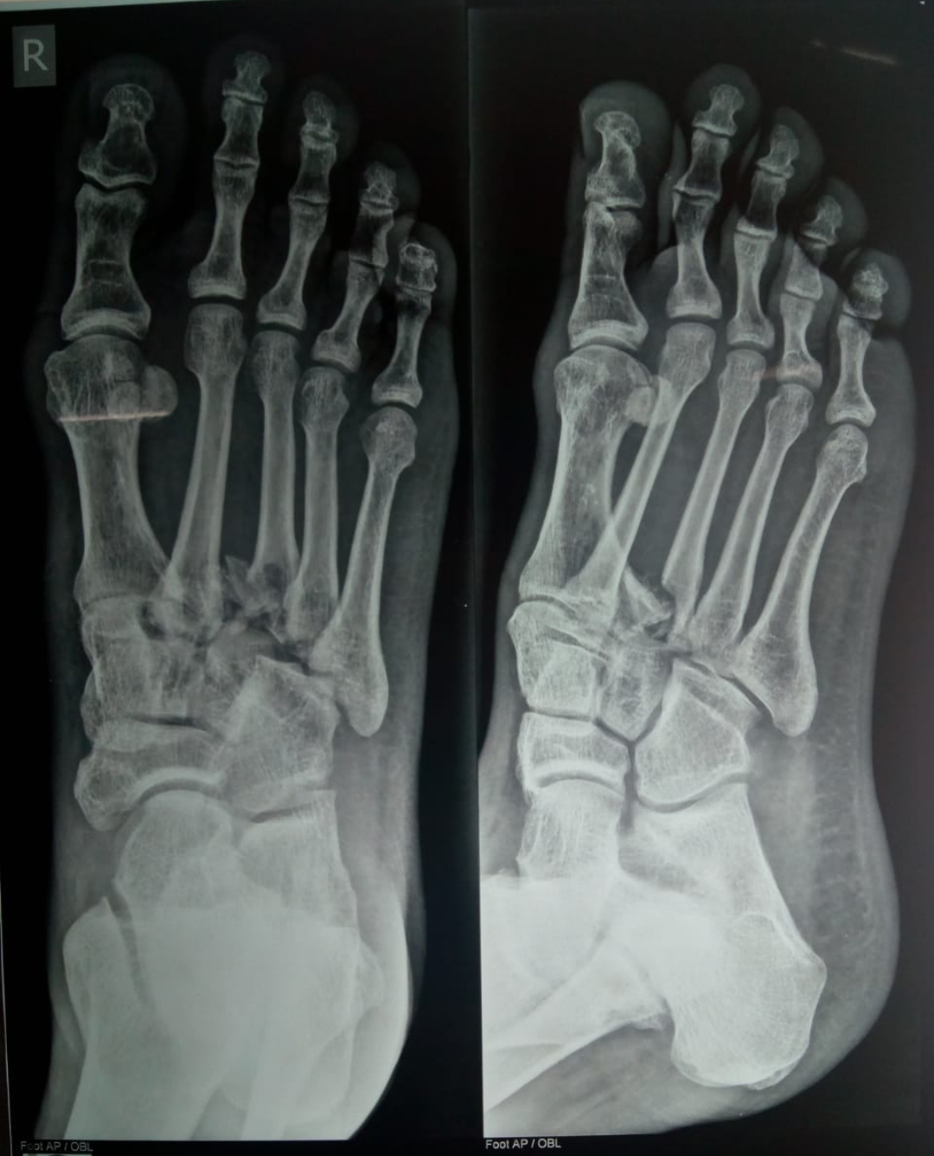
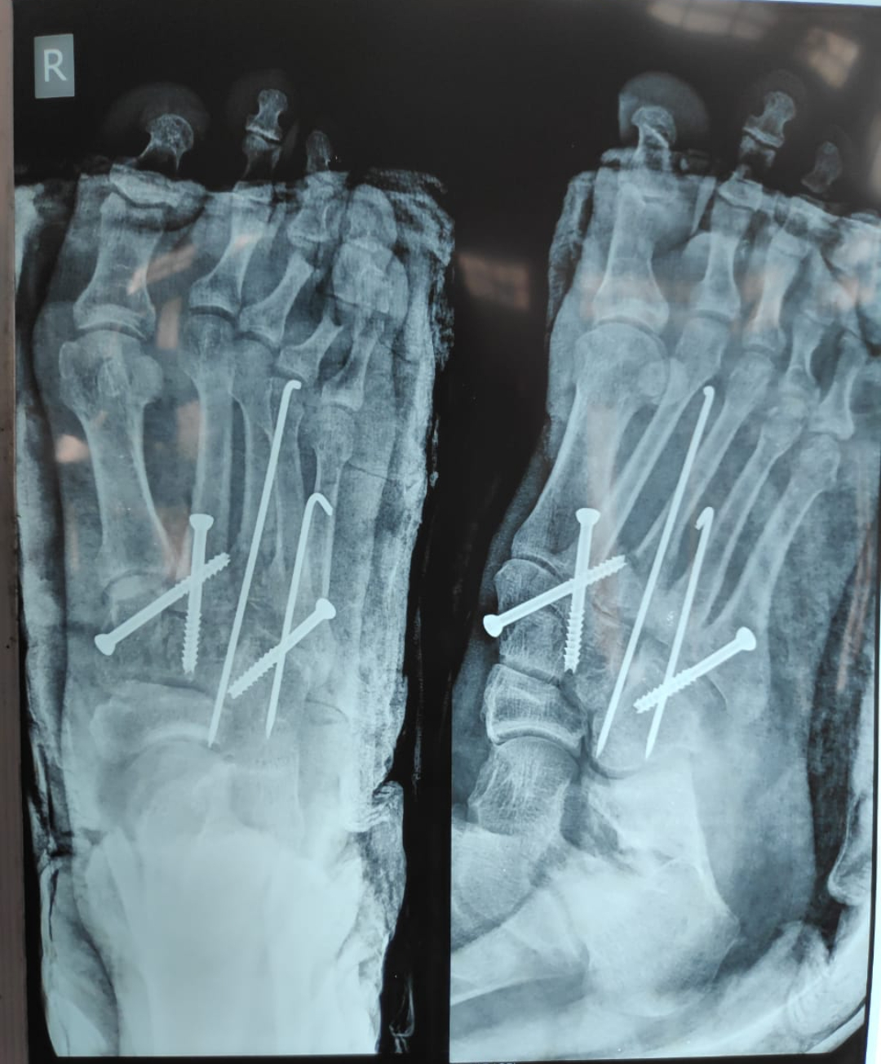

Slide 9
DISCUSSION
There are few debates in the literature regarding the most appropriate method of treatment.
Open reduction and internal fixation (ORIF) is the mainstay of treatment for displaced Lisfranc injuries, using either transarticular screws or dorsal bridge plating, which avoids cartilage violation.
Several authors reported better functional and radiological outcomes with transarticular screws, highlighting the importance of reduction as opposed to the used technique.
Primary partial arthrodesis (PPA) has also been proposed to treat Lisfranc dislocations. where PPA was found to be superior to ORIF only in terms of hardware removal.

Slide 10
RESULTS
Patients were followed up for 12 months
Maximum cases were fixed with screws alone, few with Kirschner wires and screws both.
Two patients developed post-traumatic arthritis.
No patients had deep venous thrombosis, painful neuroma, vascular insufficiency, or reflex sympathetic dystrophy.

