Slide 1




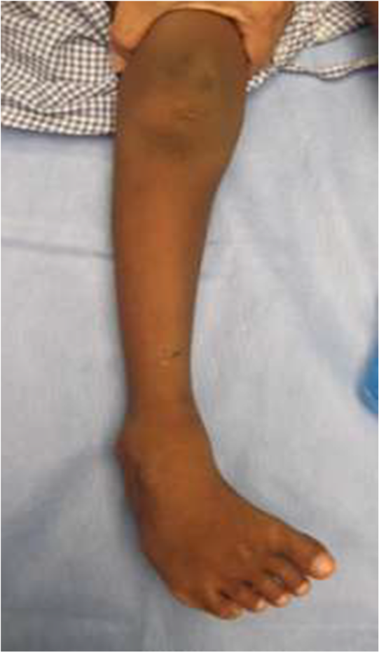
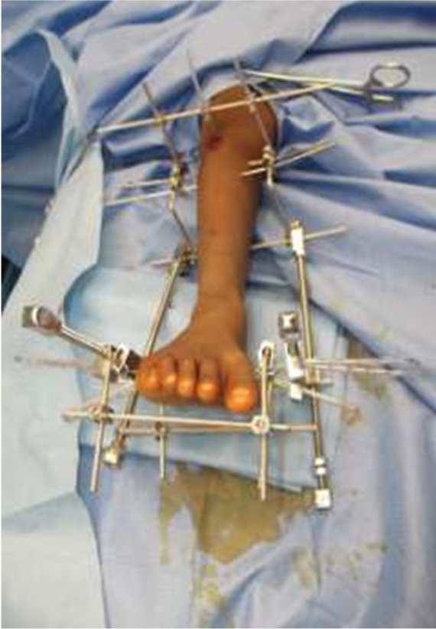
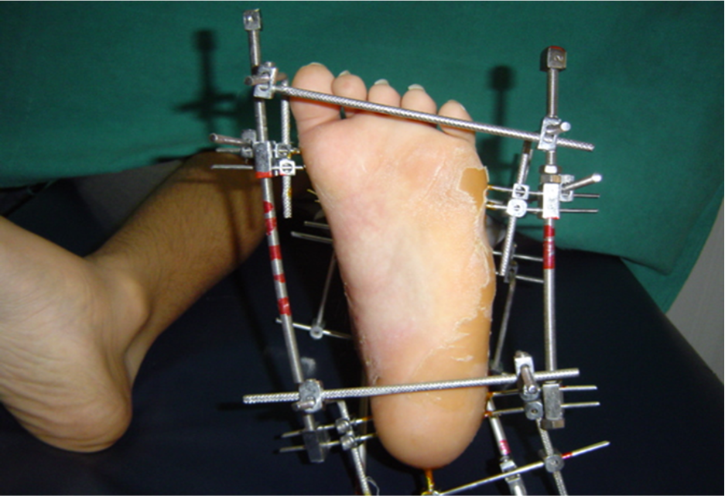
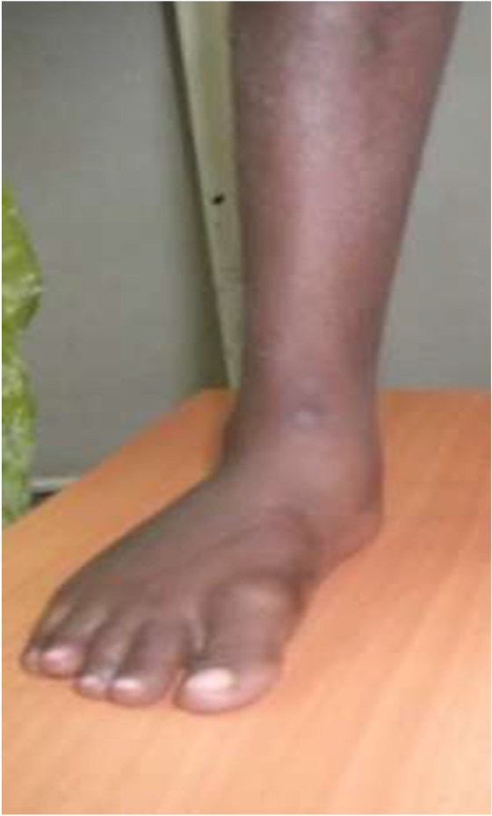
CORRECTION OF RESISTANT/NEGLECTED CLUB FOOT BY JOSHI EXTERNAL STABILIZTION SYSTEM FIXATOR
PRESENTER:- Dr. ANAND KUMAR KAMSETTY(3rd YEAR POSTGRADUATE)
GUIDE:- Dr. B. JOSEPH KARTHEEK(PROFESSOR) ,KATURI MEDICAL COLLEGE & HOSPITAL
INTRODUCTION
OPERATIVE FINDINGS
DISCUSSION
Congenital talipes equinovarus (CTEV) that is resistant to conservative treatment or neglected due to late presentation poses a significant surgical challenge. These feet are often rigid, painful, and associated with secondary bony and soft-tissue deformities. Conventional extensive soft-tissue releases may lead to stiffness, scarring, and recurrence. Joshi’s External Stabilization System (JESS) offers a minimally invasive, gradual correction method based on the principle of ligamentotaxis, allowing safe, controlled deformity correction with preservation of foot anatomy.
Under anaesthesia, multiple K-wires were inserted into the tibia, calcaneum, and metatarsals following standard JESS protocol. The external fixator was assembled to allow differential correction of cavus, adduction, varus, and equinus components. Gradual distraction was initiated postoperatively at a controlled rate. The deformity corrected sequentially without neurovascular compromise. Adequate plantigrade foot alignment was achieved, followed by frame removal and immobilization in a cast.
In the child we had done a posteromedial soft tissue release on the opposite side and this was used for comparison.
Deformity was well corrected in both feet but the ROM of ankle and subtalar joint was slightly but not significantly better in PMR foot compared to JESS foot.
Both sides required transfer of tibialis anterior.
Hence as far as the correction of deformity is concerned external fixator can achieve equally good results in comparison with PMR but feet may be stiffer.
Even though the deformity is well corrected<the feet are stiff which does not improve with time.
At the time of removal,the feet appear very supple but this stiffens over a period of 3 months.
But the children manage to squat and play well probably because of compensatory movements in the midtarsal and tarsometatarsal joints.
Children adjust very well to the fixator and there was no long term psychological implications of applying the fixator.
CASE REPORT
CONCLUSION
A 8 year-old child presented with neglected/resistant bilateral clubfoot, with difficulty in ambulation and footwear use. The patient had previously undergone failed conservative treatment . Clinical evaluation revealed rigid equinus, varus, adduction, and cavus deformities. Radiological assessment confirmed severe deformity with altered talo-calcaneal relationships. The patient was planned for gradual correction using the JESS frame after counseling and informed consent.
Resistant and neglected clubfoot requires a balanced correction strategy to avoid complications associated with extensive surgery.
JESS works on the principle of gradual soft-tissue stretching and joint realignment, reducing the risk of skin necrosis, stiffness, and recurrence.
It allows three-dimensional correction and is particularly useful in older children and neglected cases.
Studies have demonstrated good functional and cosmetic outcomes with minimal complications when proper technique and patient compliance are ensured.
Importantly parents of these children are immensely satisfied with the correction.

