Slide 1
RECONSTRUCTION WITH VASCULARISED PROXIMAL FIBULAR AUTOGRAFT POST–EN-BLOC RESECTION OF BENIGN TUMOURS AT VARIOUS SITES OF THE UPPER LIMB
PRESENTER:-Dr.ANAND KUMAR KAMSETTY
MODERATOR:-Dr.B.JOSEPH KARTHEEK(PROFESSOR)

Slide 2
BENIGN BONE TUMORS
Bone tumors account for only a very small fraction of the malignant and benign tumors of the body.
The exact incidence of benign bone tumors cannot be estimated as many of these tumors may remain asymptomatic through out life.
By virtue of their rarity , they often pose both diagnostic and therapeutic dilemmas and their complex presentations clinically , radiologically and histologically present an enormous challenge to the Orthopaedic surgeon,the Radiologist and the Pathologist.
An integrated multispeciality approach to the diagnosis and treatment leads to rational and logical management with the best chance of obtaining an optimal result.

Slide 3
The patients with a bone tumor initially complains of pain with an alteration in his/her functional capability irrespective of presence or absence of palpable mass.
Though HPE plays a major role in establishing the diagnosis , biopsy should only be the final step in arriving to the diagnosis.
Correlation of clinical data such as the age of the patient , the site of disease , and the radiological imaging helps to narrow the prospective diagnosis.
Diagnostic imaging provide more accurate information if they are done before biopsy.
Communicating all this relevant information to the pathologist also helps in arriving at an accurate diagnosis.

Slide 4
BENIGN TUMORS
INVESTIGATIONS
TISSUE OF ORIGIN | BENIGN TUMORS
CARTILAGE | Osteochondroma , chondroma , chondroblastoma , chondromyxoid fibroma
OSTEOID | Osteoid osteoma , Osteoblastoma
FIBROBLASTIC | Fibroma , desmoplastic fibroma
UNKNOWN | GCT , Benign fibrous histiocytoma , Aneurysmal bone cyst
Plain xrays are the gold standard for arriving at a diagnosis.
MRI-to determine normal anatomical boundaries, relation with adjacent neurovascular structures.
PET scan for early identification of metastatic or multifocal disease.

Slide 5
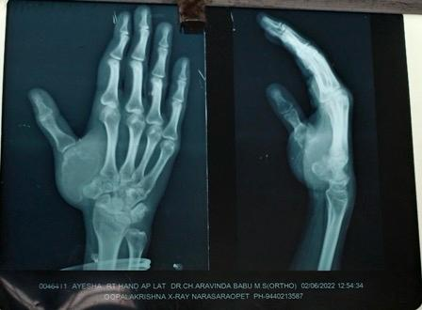
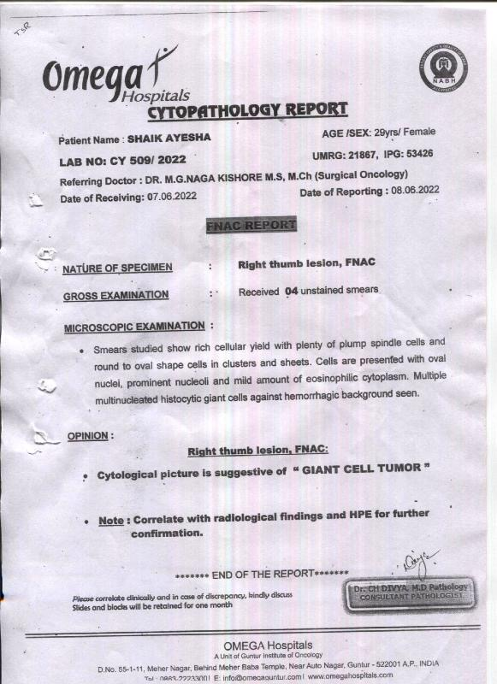
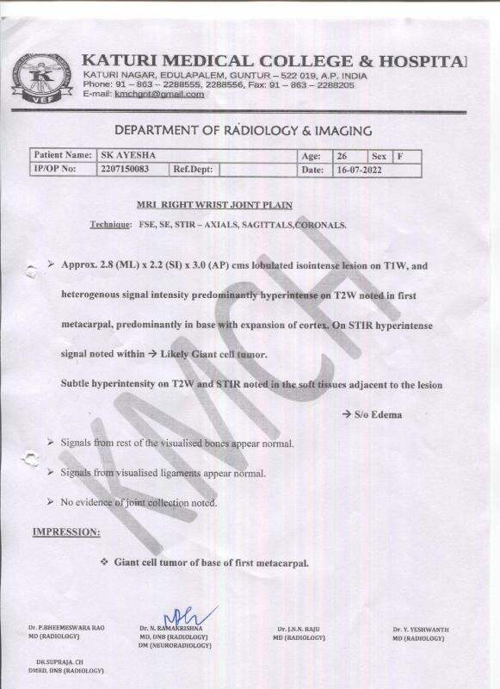
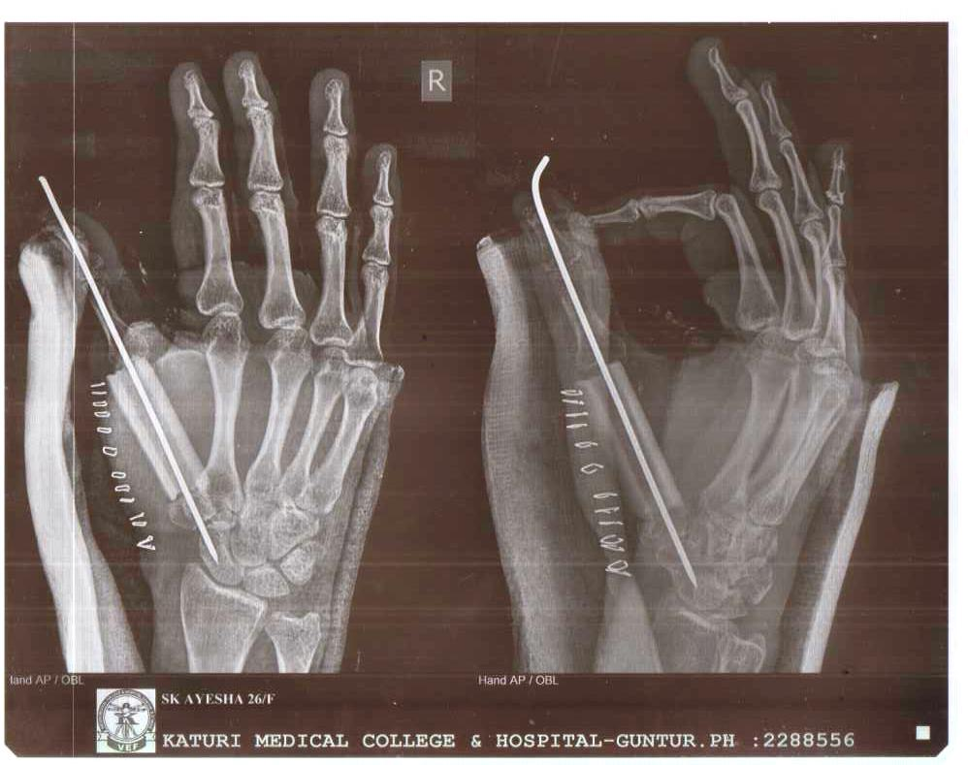
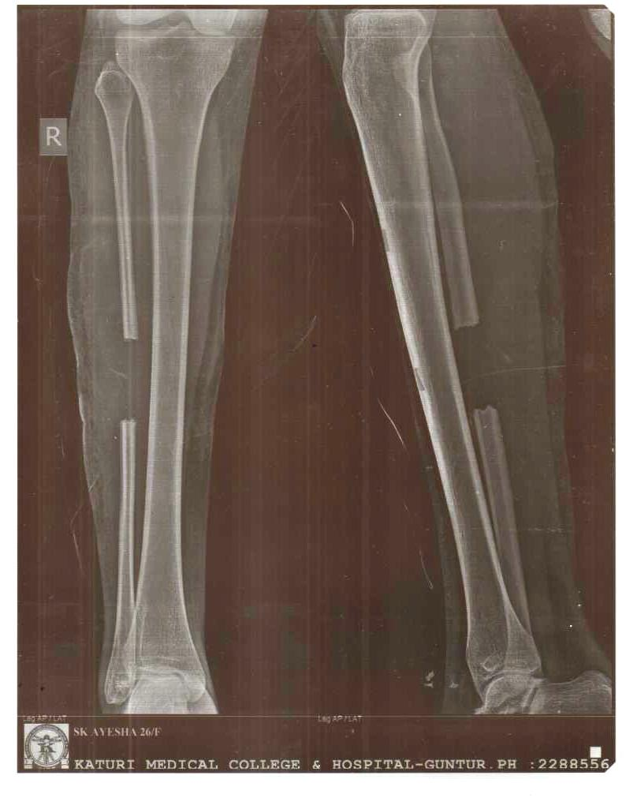
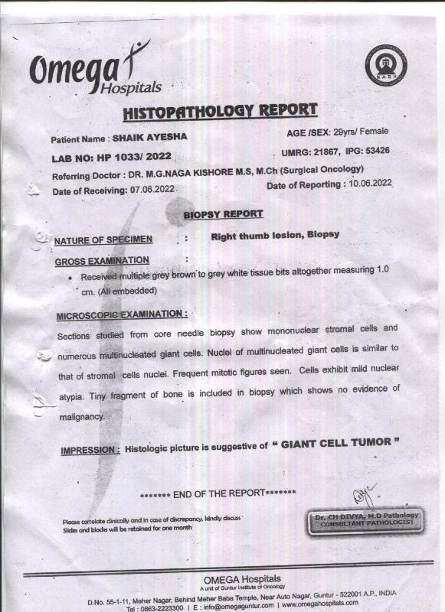
GIANT CELL TUMOR OF RIGHT THUMB
PRE-OP XRAY
FNAC REPORT
MRI REPORT
POST OP XRAY
GRAFT HARVESTED SITE
BIOPSY REPORT

Slide 6
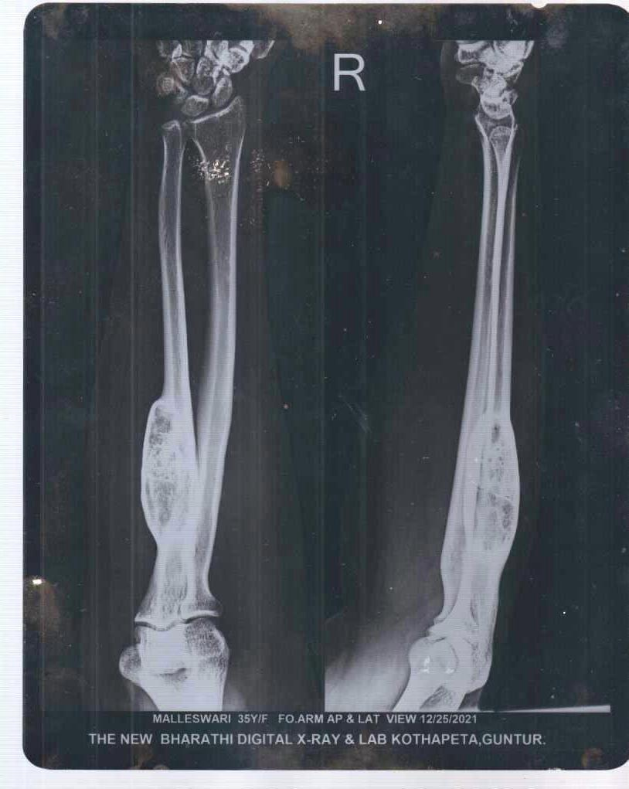
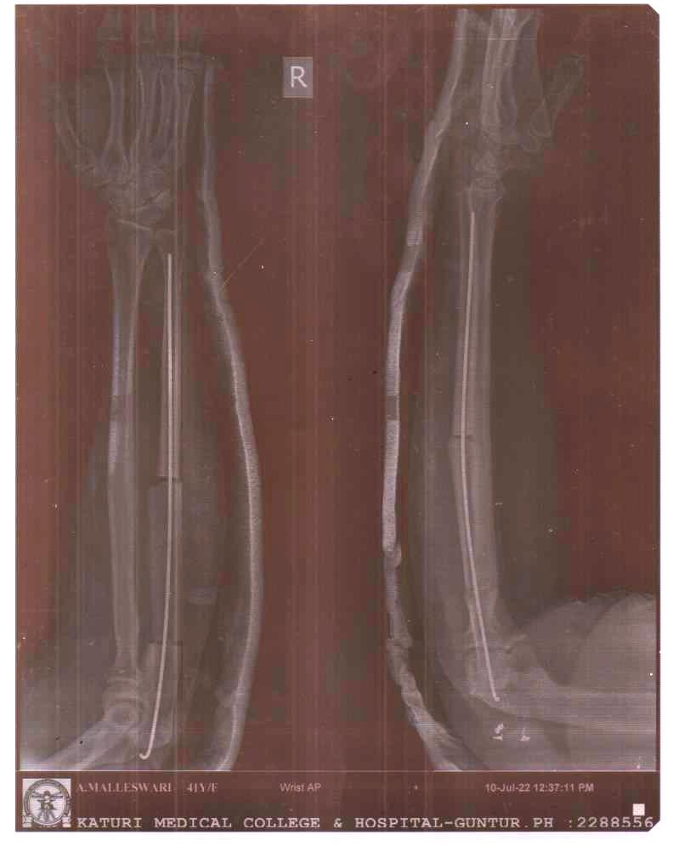
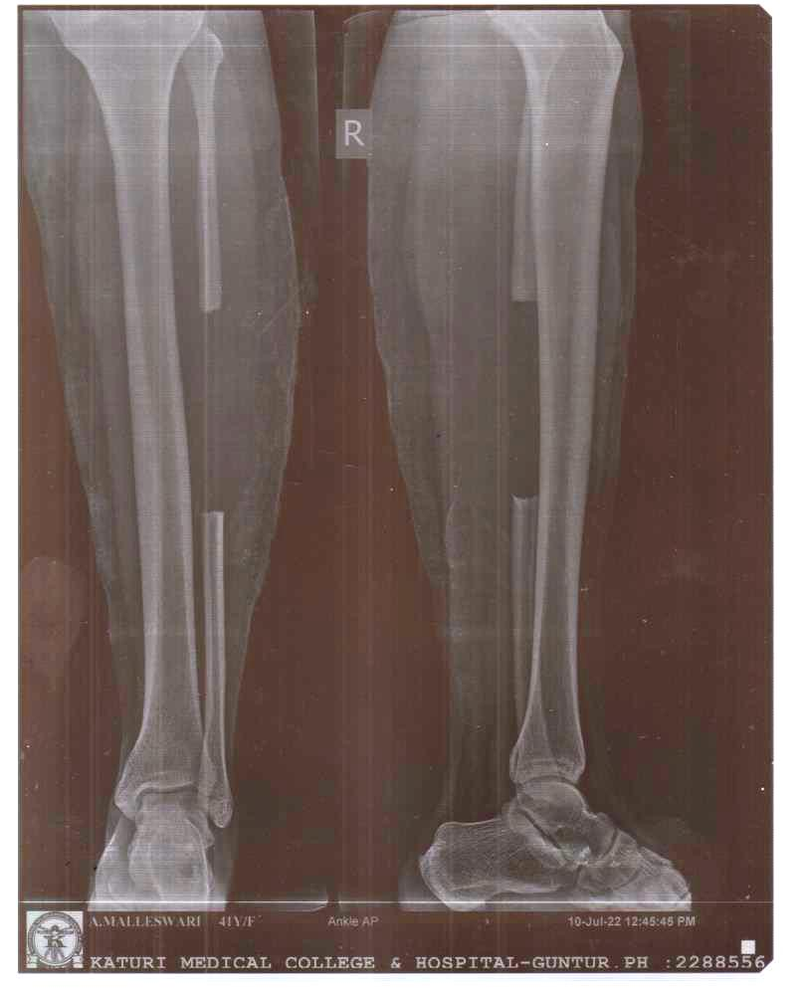
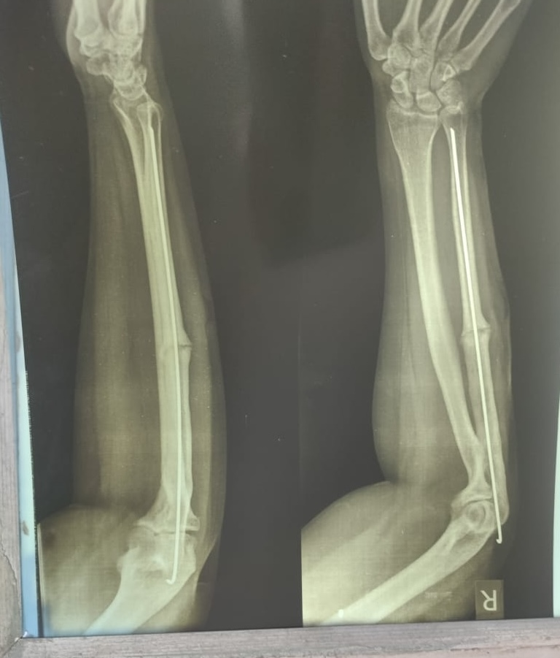
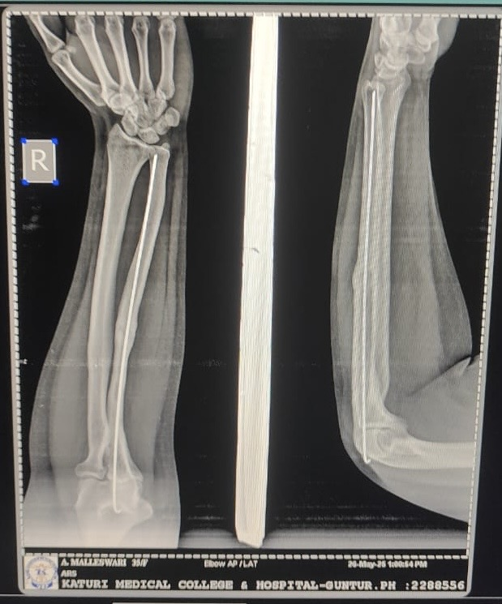
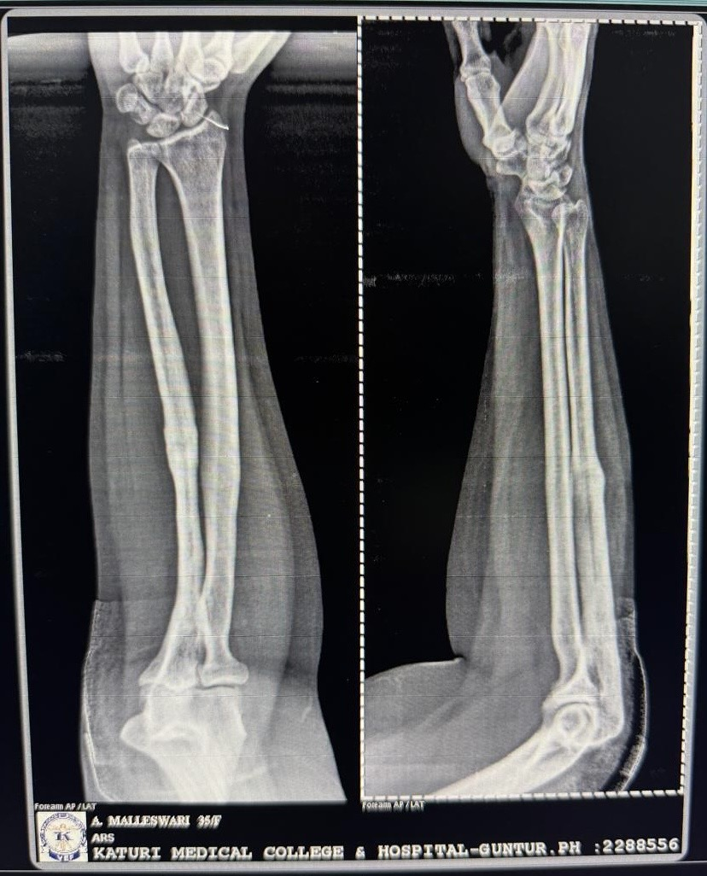
BENIGN OSTEOMA OF RIGHT ULNA
PRE-OP XRAY
POST –OP XRAY
GRAFT SITE
3 MONTHS FOLLOW UP
1 YEAR FOLLOWUP XRAY
2 YEARS FOLLOWUP XRAY

Slide 7
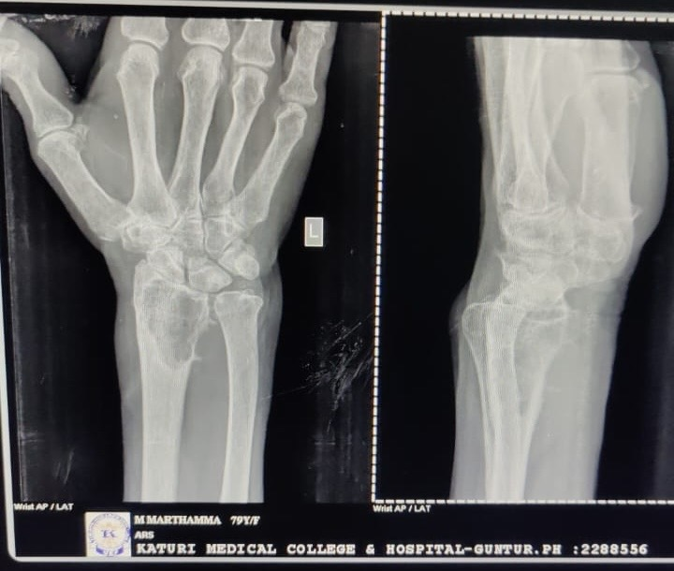
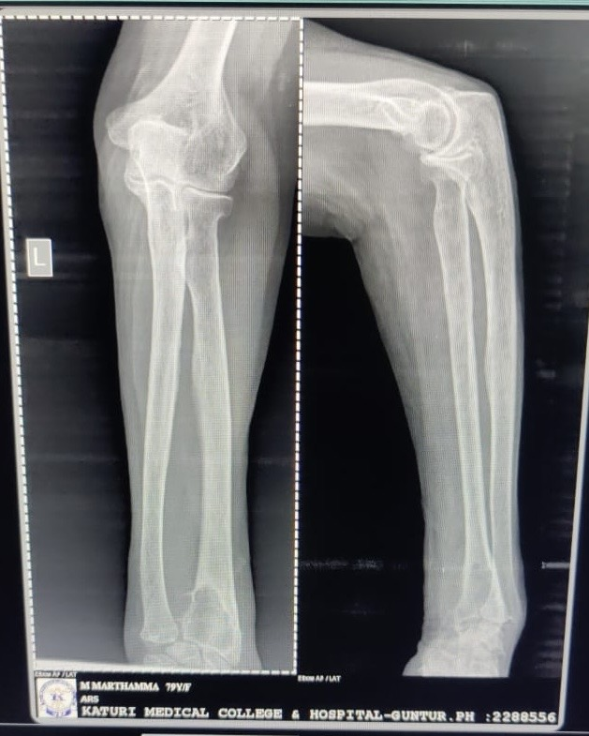
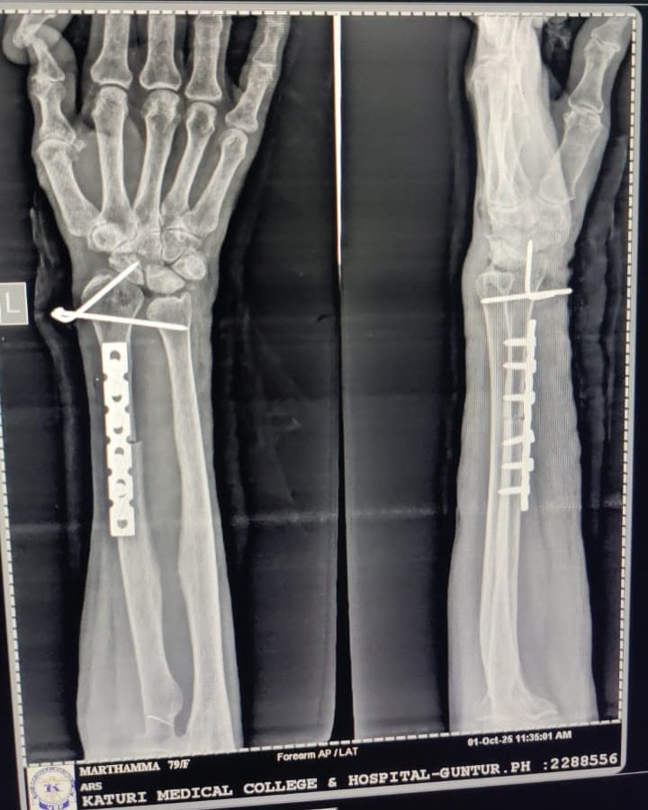
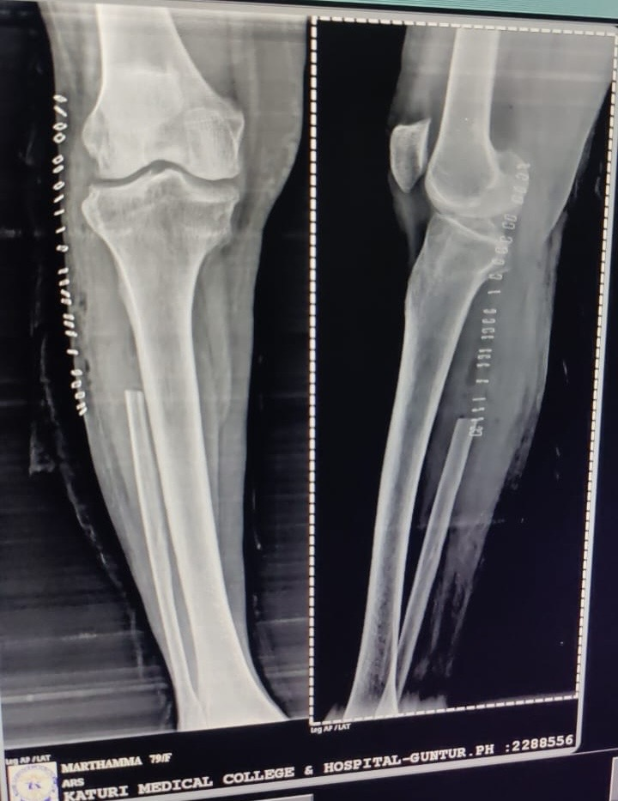
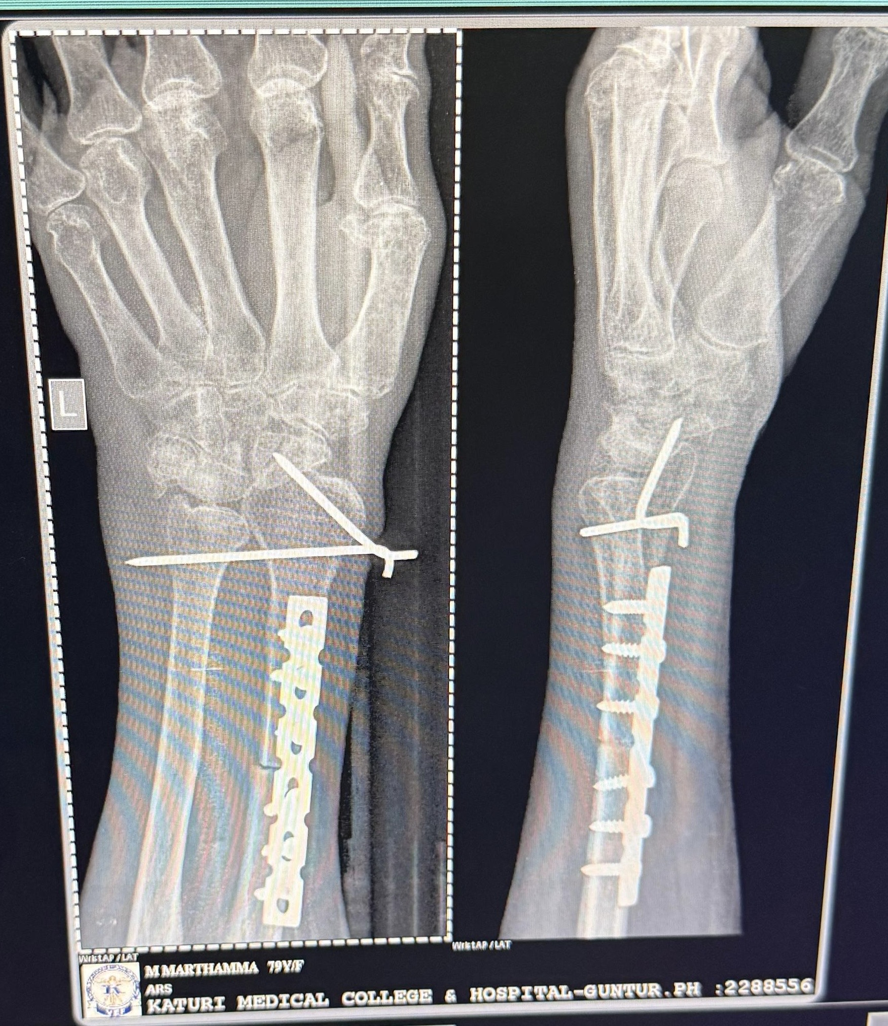
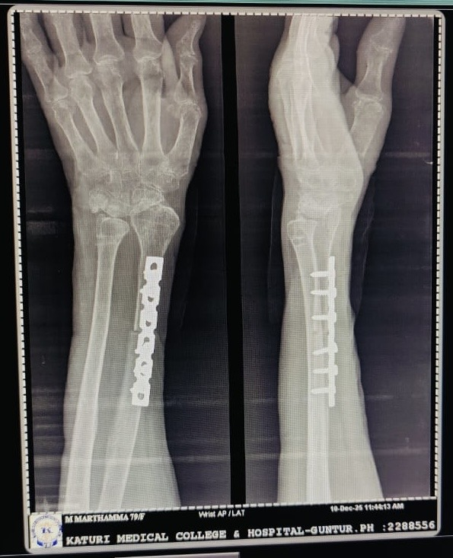
GIANT CELL TUMOR OF LEFT RADIUS
PRE-OP XRAY’S
POST-OP XRAY
GRAFT SITE
1 MONTH FOLLOWUP XRAY
3 MONTHS FOLLOW UP XRAY

Slide 8
POSTOPERATIVE EVALUATION
We monitored bone healing by comparing preoperative and follow-up radiographs.
We removed the splint 6weeks after the surgery , at which time , the patient was permitted to perform gentle ROM exercises.
During follow-up we evaluated pain intensity , functional status and ROM

Slide 9
RESULTS
The average follow-up duration was 3years(range: 6months to 3years).
All the patients had achieved bony union between 3 to 5months after the surger.
None of the patients had a recurrence by the time of last follow up.
Clincial assessments did not reveal lung metastasis.
No patient had discomfort at the fibular donor site and no patient complained of instability of the knee.
Neither postoperative infections nor neurovascular complications ocuured in the patients.

Slide 10
CONCLUSION
En-bloc resection of the tumor and reconstruction with a vascularized proximal fibular autograft is effective for local tumor control and function preservation.

