Slide 1
Functional Outcome of Comminuted Distal Radius Fractures Managed with External Fixation
PRESENTER Dr.V.SRI RAM KUMAR
MODERATOR- Dr.G.VARAPRASAD SIR

Slide 2
INTRODUCTION
Distal radius fractures account for 8–15% of all adult bone injuries and are the most common upper limb fractures.
The incidence is increasing, with reported rates of 178.1–252.4 per 100,000 person-years.
The most common mechanism of injury is a fall on an outstretched hand (FOOSH).
These fractures show a bimodal age distribution:
  Young adults (18–25 years) – usually high-energy trauma
  Elderly (6th decade) – low-energy falls, often osteoporotic
Colles’ fracture, first described by Abraham Colles in 1814, remains the classic distal radius fracture pattern.

Slide 3
Common fracture patterns include:
  Colles’ fracture (dorsal tilt)
  Smith’s fracture (palmar tilt)
  Barton’s and reverse Barton’s fractures (dorsal/volar lip involvement)
  Chauffeur’s fracture (radial styloid)
  Die-punch fracture (articular depression)
Intra-articular and unstable fractures require anatomical reduction and stable fixation.
Inadequate fixation may lead to malunion, nonunion, carpal subluxation, and early post-traumatic arthritis, resulting in poor wrist function.
External fixation was developed to manage displaced, unstable, and comminuted distal radius fractures.
It is a minimally invasive technique that provides subchondral support and achieves reduction through ligamentotaxis.

Slide 4
AIM
To study the functional outcome of external fixation in the treatment of comminuted distal radius fractures and complications .
METHODS
Patients with distal radius fracture admitted in our institute after meeting the inclusion and exclusion criteria will be taken up.
All patients will be evaluated preoperatively by clinical and radiological examination.
Patients will be informed about the operative procedure and consent will be taken.
DESIGN : PROSPECTIVE STUDY
SAMPLE SIZE :30

Slide 5
INCLUSION CRITERIA
Comminuted extra articular fractures
Comminuted intra articular Fractures
TYPE 1 Compound fractures
Age 20-70 years
EXCLUSION CRITERIA
Compound injuries grade2 and grade3 are excluded from the study.
Elderly people & osteoporotic fractures were excluded.
Patients who are not willing
Active infection
Age > 70 years

Slide 6
RESULTS
Our study consists 30 cases of extra and intraarticular distal radius fracture treated by external fixation.
The results were assessed both clinically and radiologically
AGE INCIDENCE
AGE IN YEARS | NO OF PATIENTS | PERCENTAGE
20-40Y | 9 | 30%
41-60Y | 16 | 53.3%
61-70Y | 5 | 16.66%

Slide 7
SEX INCIDENCE
FUNCTIONAL OUTCOME
SEX | NO OF PATIENTS | PERCENTAGE
MALES | 22 | 73%
FEMALES | 08 | 27%
TOTAL | 30 | 100%
RESULTS | NO OF CASES | PERCENTAGE
EXCELLENT | 13 | 43.3%
GOOD | 13 | 43.3%
FAIR | 4 | 13.4%
POOR | 0 | 0%

Slide 8
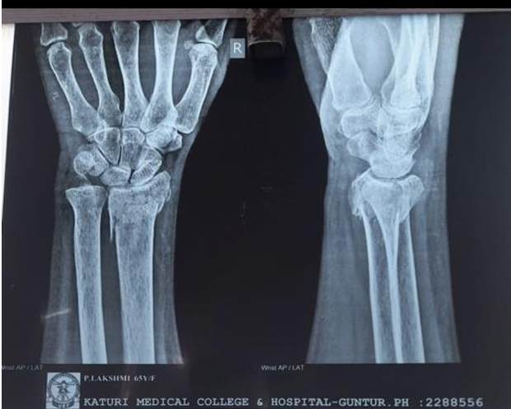
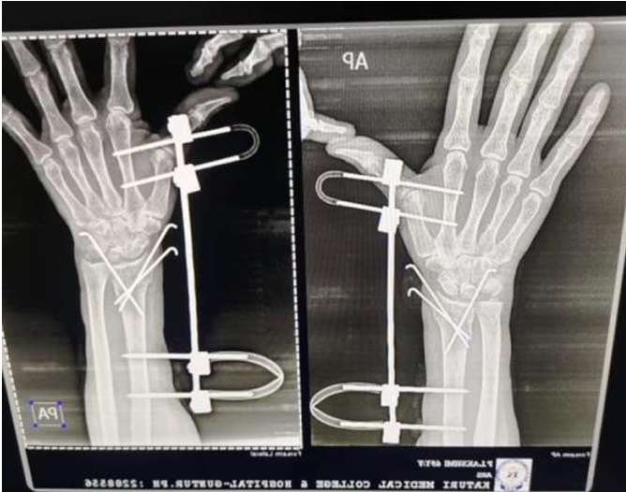
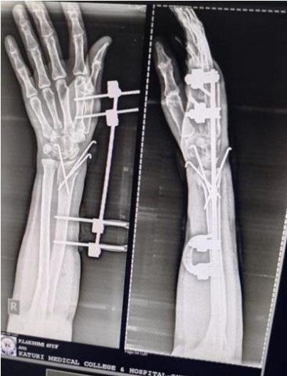
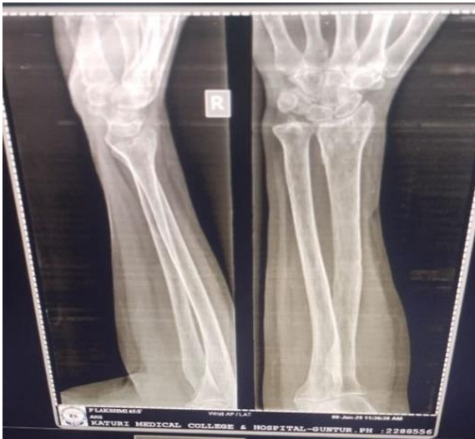
1 month follow up
PRE-OP
3 MONTHS
POST -OP

Slide 9
CONCLUSION
The present study was regarding the assessment of Functional Outcome Of comminuted Distal Radius Fracture Treated With the external fixation and the following conclusions were assessed.
External fixation produces Excellent to Good results with the lower complication rate and good outcome when compared to the other methods of treatment.
It is a simple, easy, rapid, reliable and effective method for the treatment of distal radius fracture above 50years, with minimum operative time, less loss of blood, shorter stay at hospital, and reasonable time to bone healing.
Because of early mobilization, rapid healing and minimal disturbance of bony growth.
Use of external fixation in the distal radius fractures are effective in correcting and maintaining of anatomy of distal radius.
By the use of this external fixators, joint movements & daily functioning are recovered in a shorter time.
Thus, we conclude that comminuted distal radius fractures treated with external fixation have the good radiological and functional results, as 90 % of our patients went back to their daily activities with good recovery.

Slide 10
REFERENCES
1. Nellans KW, Kowalski E, Chung KC. The epidemiology of distal radius fractures. Hand Clinics. 2021;28(2):113-125. (Comprehensive review of incidence, bimodal distribution, and mechanisms of injury)
2. Fernandez DL, Jupiter JB. Fractures of the Distal Radius: A Practical Approach to Management. 3rd ed. New York, NY: Springer; 2020. (Standard textbook covering historical classification systems including Colles, Smith, and Barton fractures)
3. Lafontaine M, Hardy D, Delince P. Stability assessment of distal radius fractures. Injury. 2019;20(4):208-210. (Classic paper on predictors of instability in distal radius fractures)
4. Orbay JL, Fernandez DL. Volar fixed-angle plate fixation for unstable distal radius fractures in the elderly patient. Journal of Hand Surgery American. 2021;29(1):96-102. (Seminal paper on volar plating techniques for elderly patients)
5. Slutsky DJ, Osterman AL. Fractures and Injuries of the Distal Radius and Carpus: The Cutting Edge. Philadelphia, PA: Saunders Elsevier; 2019. (Comprehensive textbook with emphasis on surgical techniques and fracture classification)
6. Handoll HH, Madhok R. Surgical interventions for treating distal radial fractures in adults. Cochrane Database of Systematic Reviews. 2020;3

