Slide 1




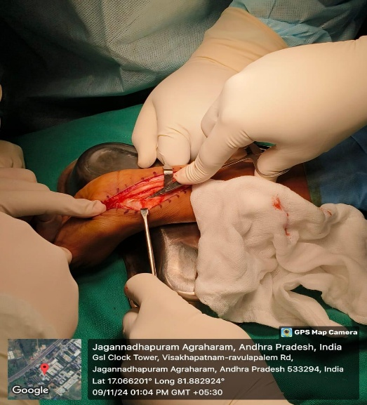
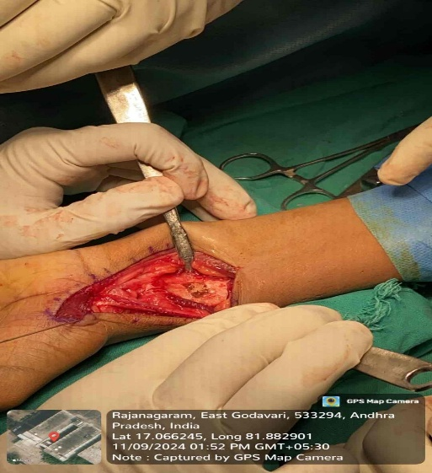
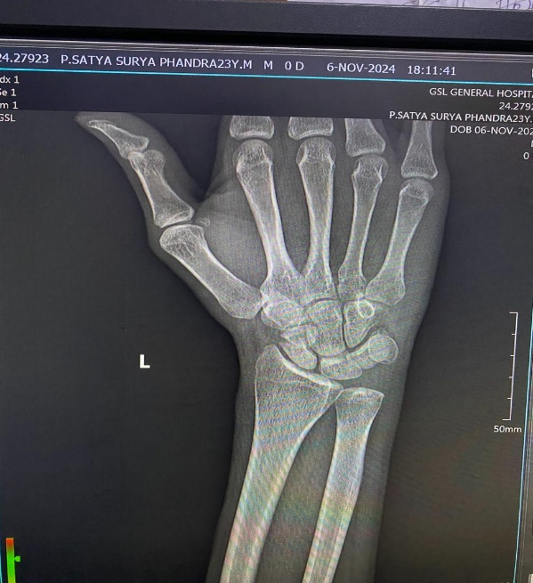
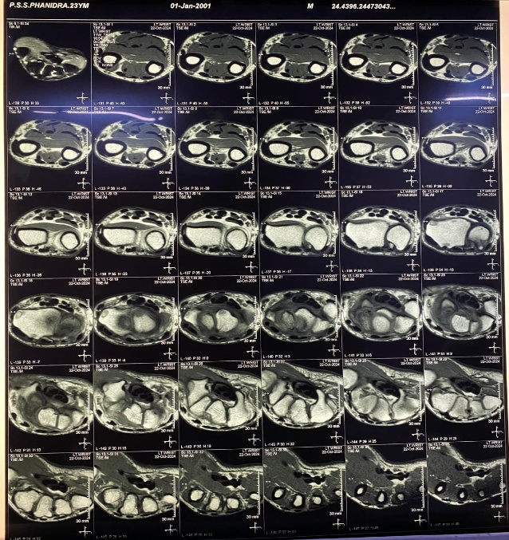
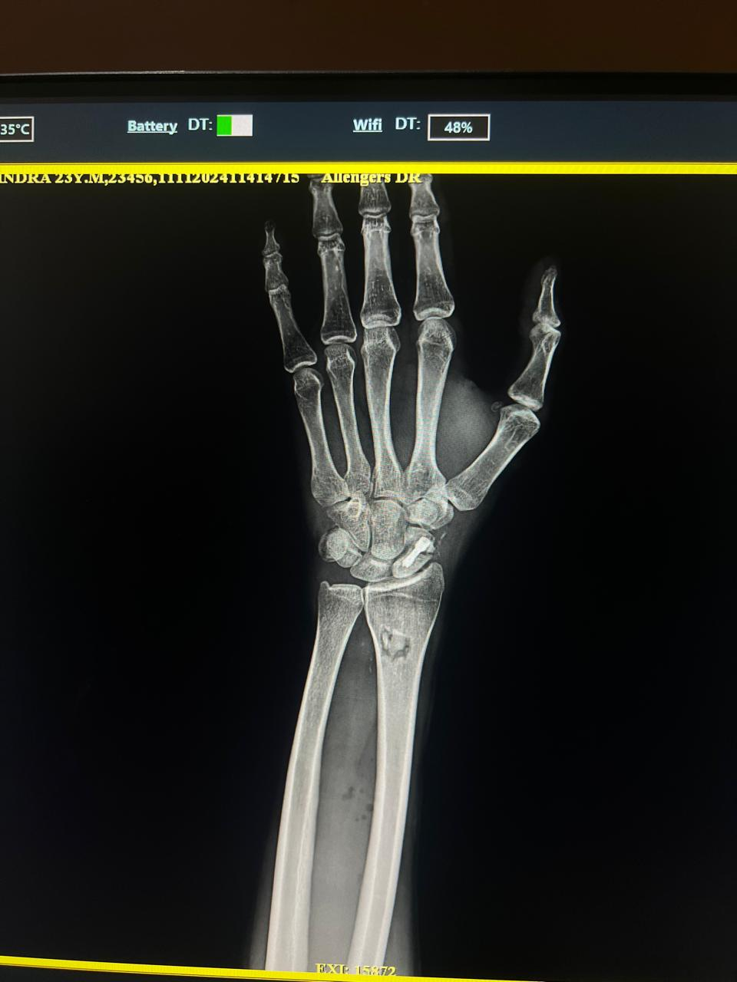
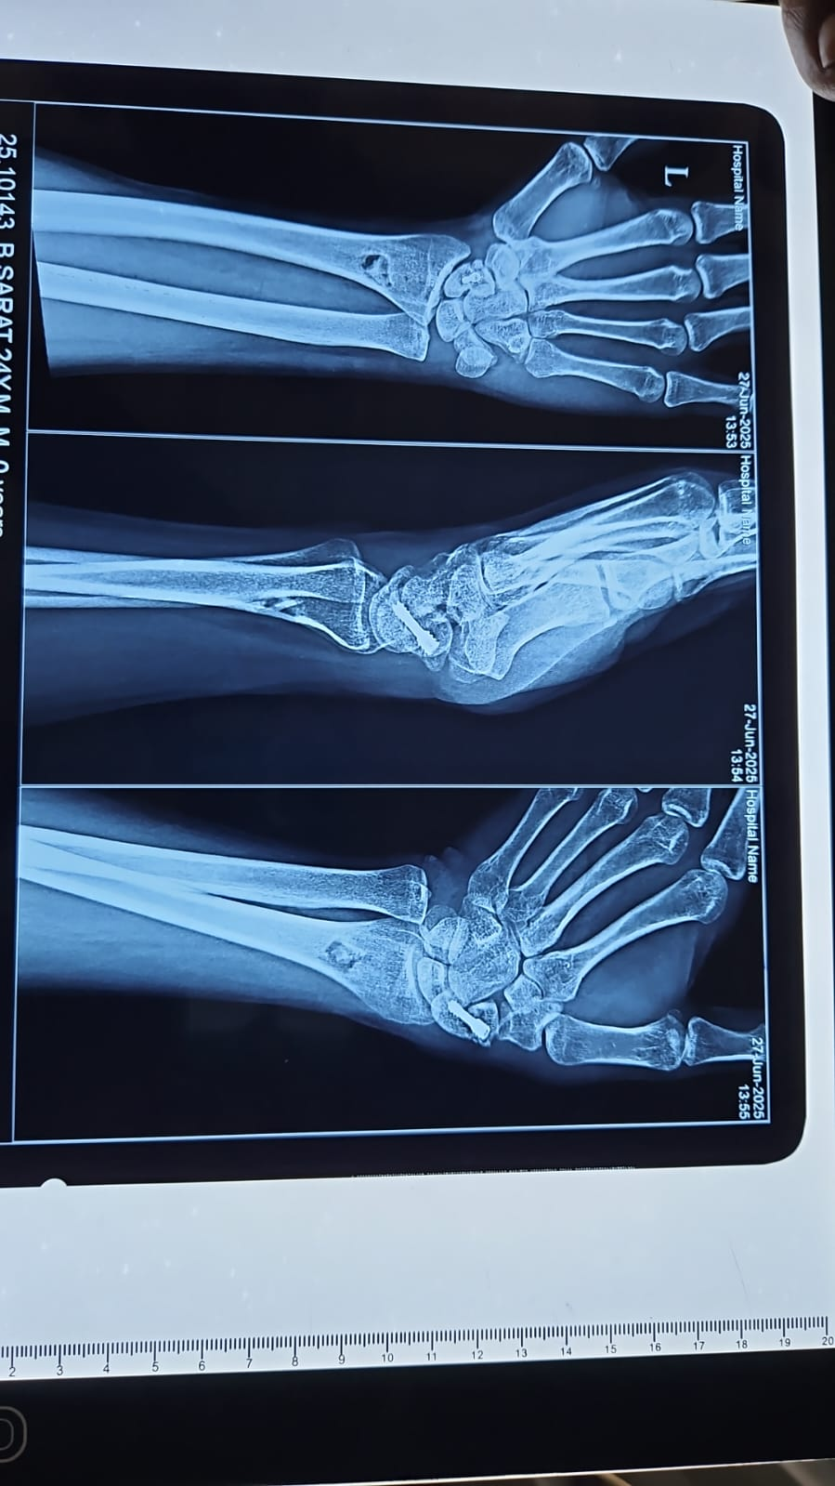
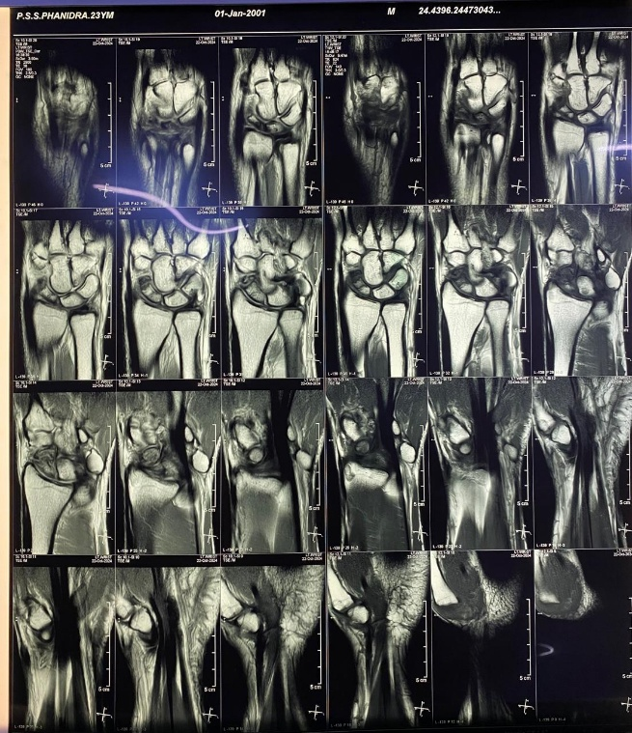
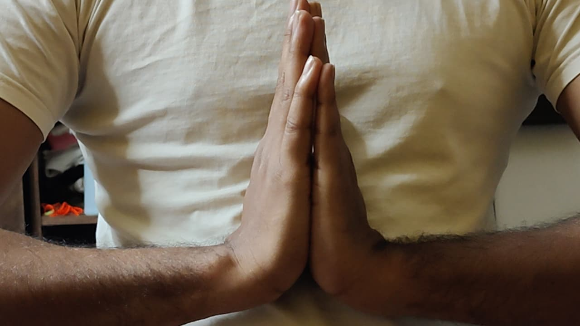
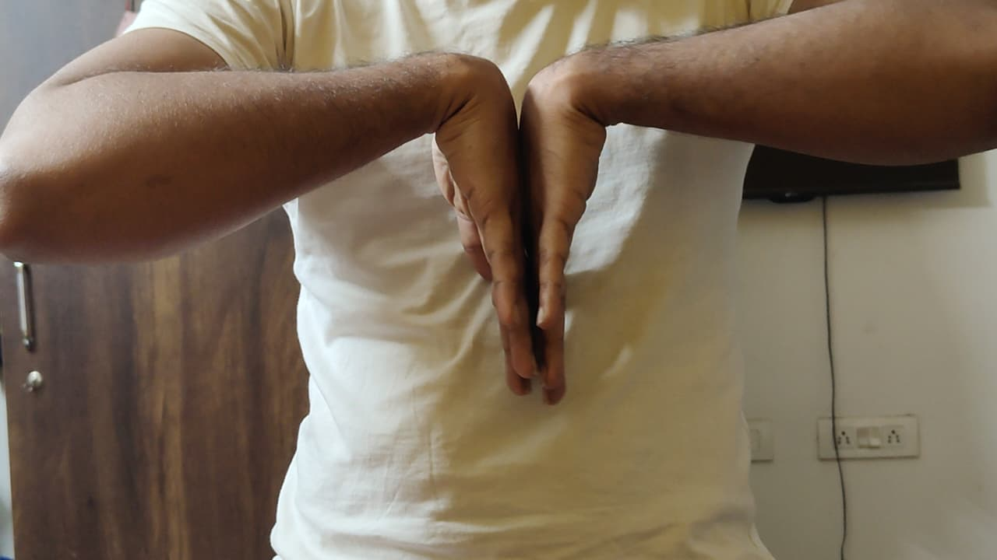
A Rare case of Functional Outcome of Scaphoid Avascular Necrosis Treated with Herbert Screw Fixation – A Clinical Study
AUTHOR: Dr SOURAB SINGH THAKUR
CO-AUTHORS: DR SHANHNAWAZ HUSSAIN,
DR V NAGESWARA RAO
INTRODUCTION
OPERATIVE FINDINGS
DISCUSSION
Scaphoid fractures are common in young active individuals and its management is controversial in various occasions. The main treatment modalities includes scaphoid cast immobilization, percutaneous K-wire fixation, bone grafting techniques with immobilization and herbert screw fixation with or without bone grafting.These fractures frequently result in non-union, either due to treatment problems or due to failure in identifying the fracture in initial radiographs.The real incidents of non-union after conservative treatment of scaphoid is of 50%. The symptomatic non-union of scaphoid is really a disabling condition. Another important concern is that the majority of patients are young working class group and hence surgical intervention in this non-union case is very important especially for making them return to their jobs.
A 10 cm curved L-shaped incision was given over the volar aspect of the distal forearm extending up to the scaphoid tubercle. Skin and subcutaneous tissue were dissected and retracted. The flexor carpi radialis tendon was identified and retracted. Distally, the scaphoradial ligament was identified, incised, and reflected. Proximally, the radial artery was identified and protected. Pronator quadratus was identified and elevated to expose the distal radius. The radiocarpal joint was opened to expose the scaphoid. Intraoperatively, fibrous non-union with features suggestive of avascular necrosis was noted. The non-union site was curetted and freshened. Cancellous bone graft harvested from the distal radius was packed into the defect. A 1 mm guide K-wire was passed from distal to proximal pole under fluoroscopic guidance. The scaphoid was drilled using a 3.2 mm cannulated drill bit, and an 18 mm × 1 Herbert screw was inserted over the guidewire to achieve compression. Adequate fixation was confirmed under image intensifier. Wound was closed in layers and a thumb spica splint was applied.
The scaphoid is prone to avascular necrosis due to its retrograde blood supply, particularly involving the proximal pole. Stable internal fixation with a Herbert screw provides compression at the fracture site, promotes union, and allows early rehabilitation. The outcomes observed in this study are comparable with those reported in standard literature and previous clinical studies.
RESULTS
Radiological union was achieved within an average duration of 10–14 weeks. There was significant improvement in pain relief. Wrist function was assessed by ROM and grip strength was greatly improved. Functional assessment scores showed good to excellent outcome. Complications were minimal, with occasional cases of delayed union and no implant failure.
CASE REPORT
Case Presentation
A 23-year-old male presented with a chief complaint of pain in left wrist since 6 months and difficulty in gripping objects. Pain aggravated on daily activities and relieved on rest and medication.
Clinical Examination
The patient had tenderness over anatomical snuff box with restricted range of motion and painful flexion and extension of left wrist.
TAKE HOME MESSAGE
Early diagnosis is crucial—scaphoid fractures have a high risk of non‑union and avascular necrosis due to their retrograde blood supply.
Herbert screw fixation with bone grafting provides stable compression, promotes vascular ingrowth, and supports reliable union.
High union rates (10–14 weeks) and good functional outcomes can be achieved when surgery is performed in appropriately selected patients.
PRE-OP IMAGING
CONCLUSION
Herbert screw fixation and bone grafting is an effective and reliable method for treating scaphoid avascular necrosis, offering high union rates, satisfactory functional recovery, and low complication rates when performed in appropriately selected patients. Patient will return to job with pain free joint.
POST-OP IMAGING
ACKNOWLEDGEMENT
I sincerely thank Dr. V. Nageswara Rao, Head of the Department of Orthopaedics and Dr. K. Ravikanth, Professor along with the faculty of Orthopaedics and the Department of Radiology, GSL Medical College & General Hospital, for their guidance and support.
REFERENCES
Canale ST, Beaty JH. Campbell’s Operative Orthopaedics, 13th ed.
Green DP, Hotchkiss RN, Pederson WC. Green’s Operative Hand Surgery.
Herbert TJ, Fisher WE. Management of the fractured scaphoid using a new bone screw. J Bone Joint Surg Br.

