Slide 1




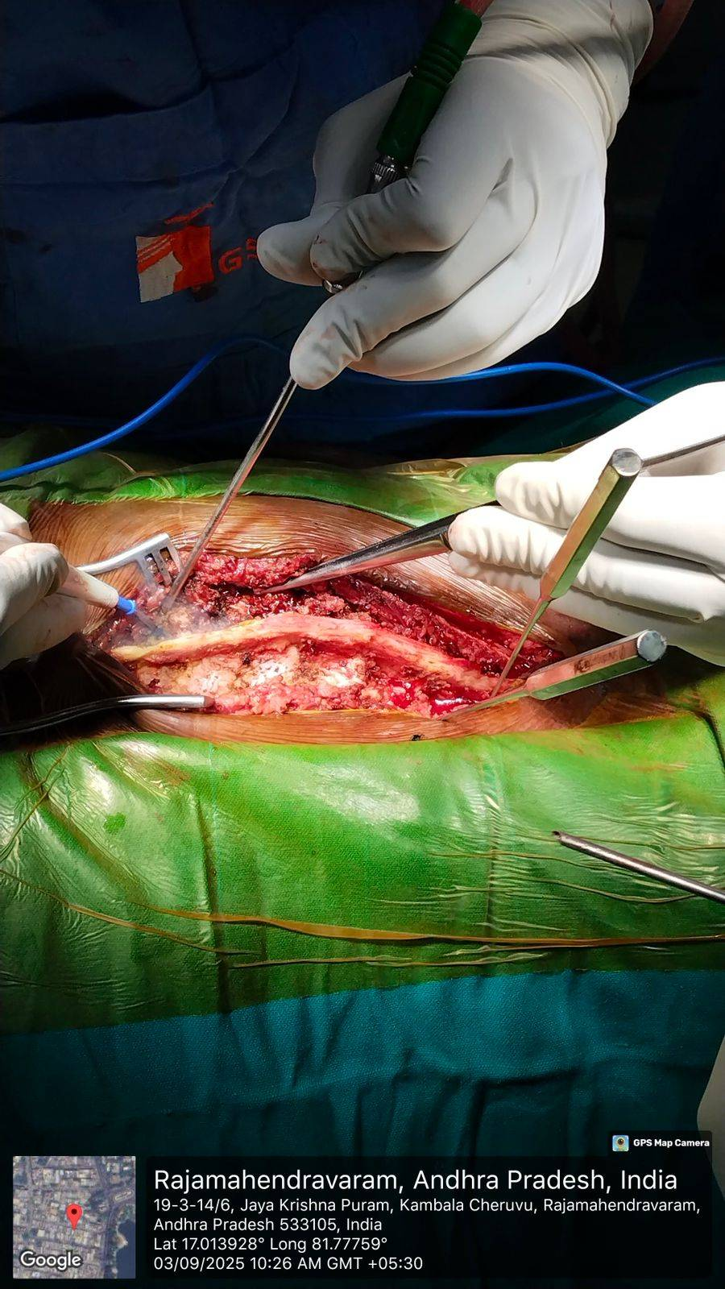
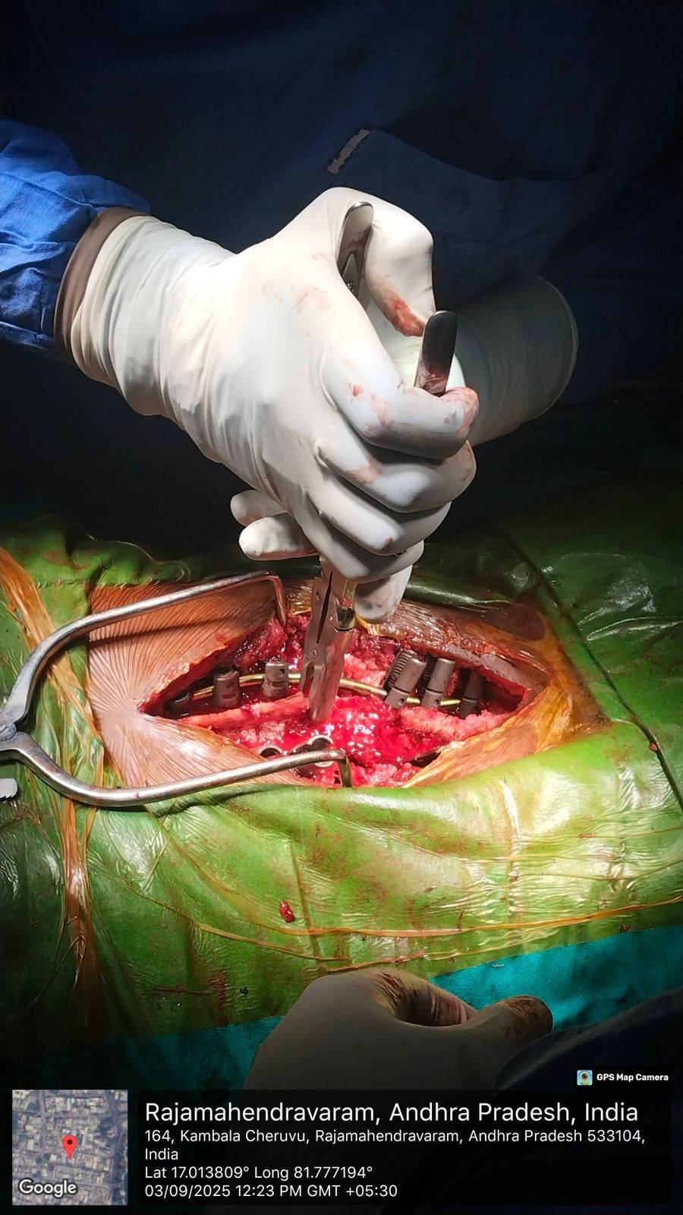
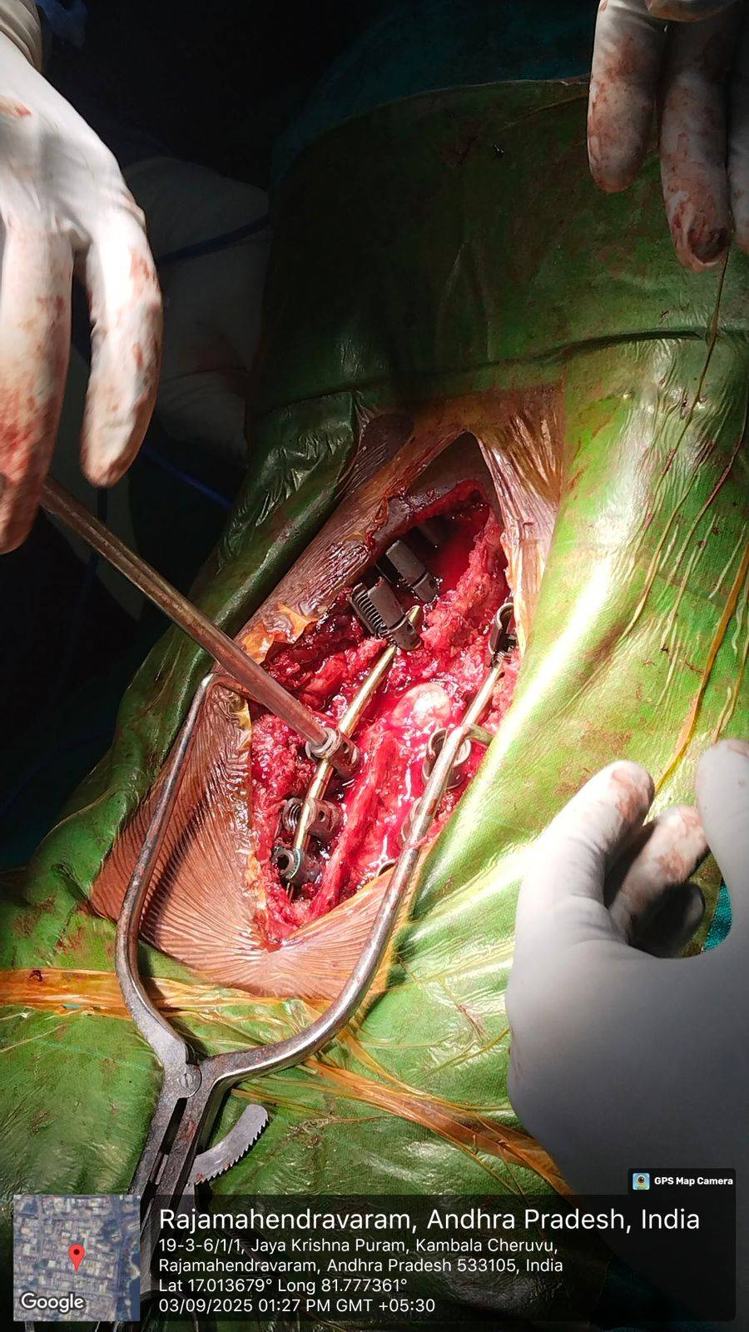
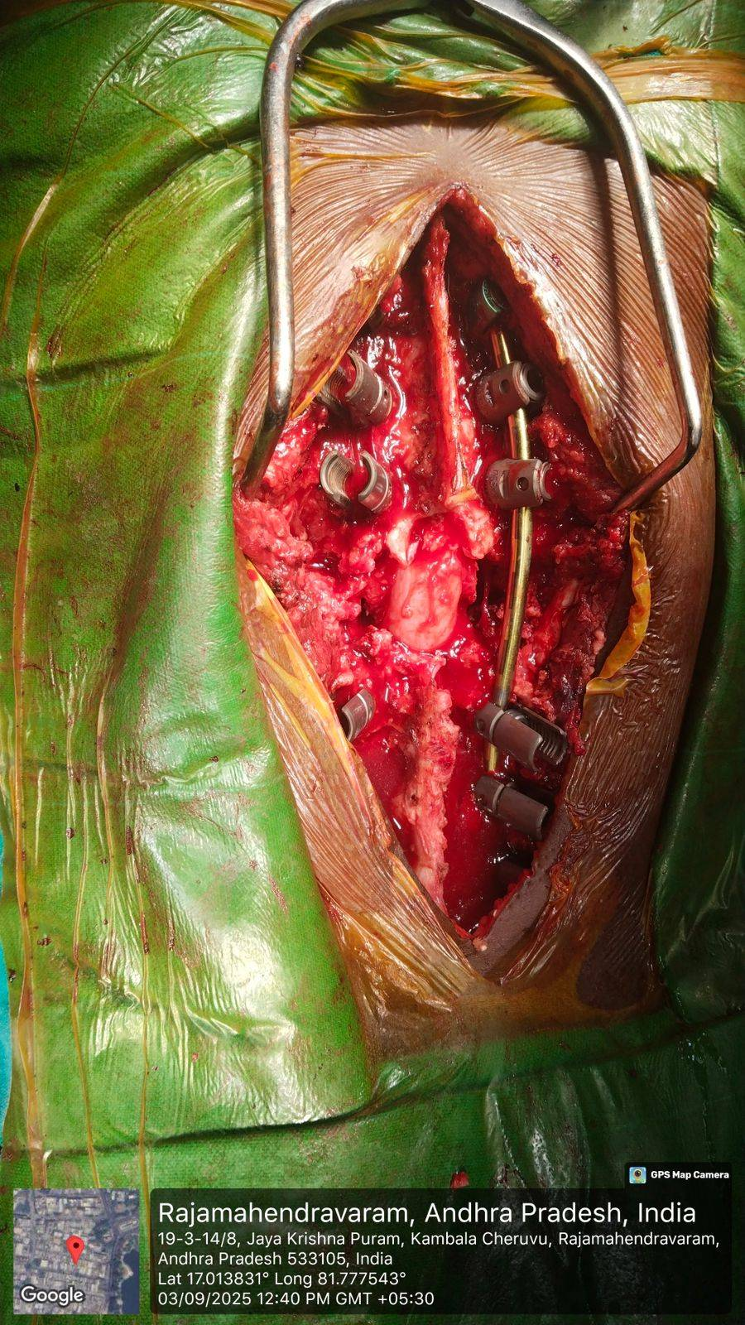
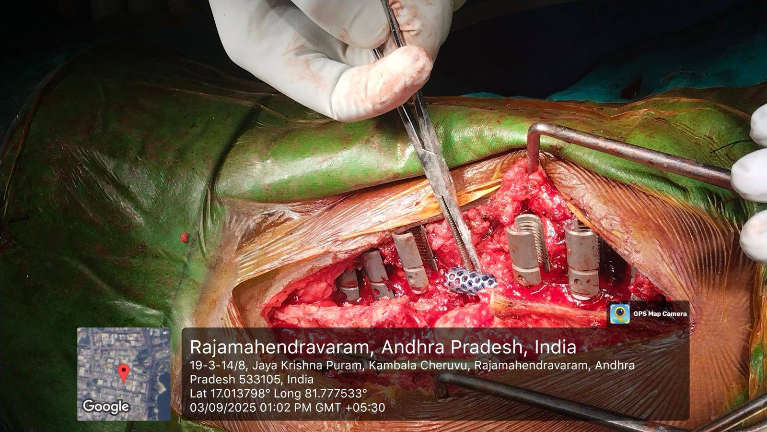
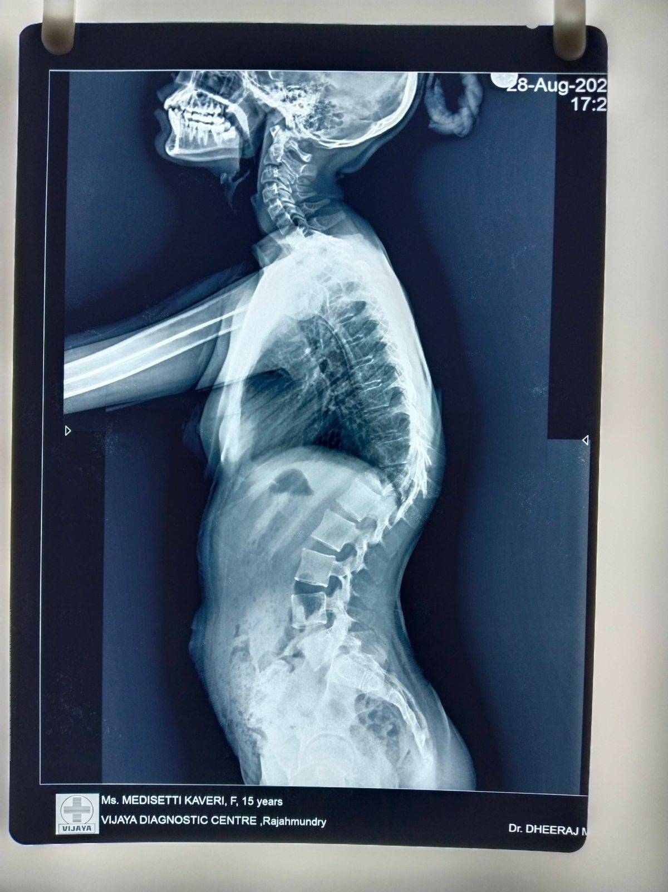
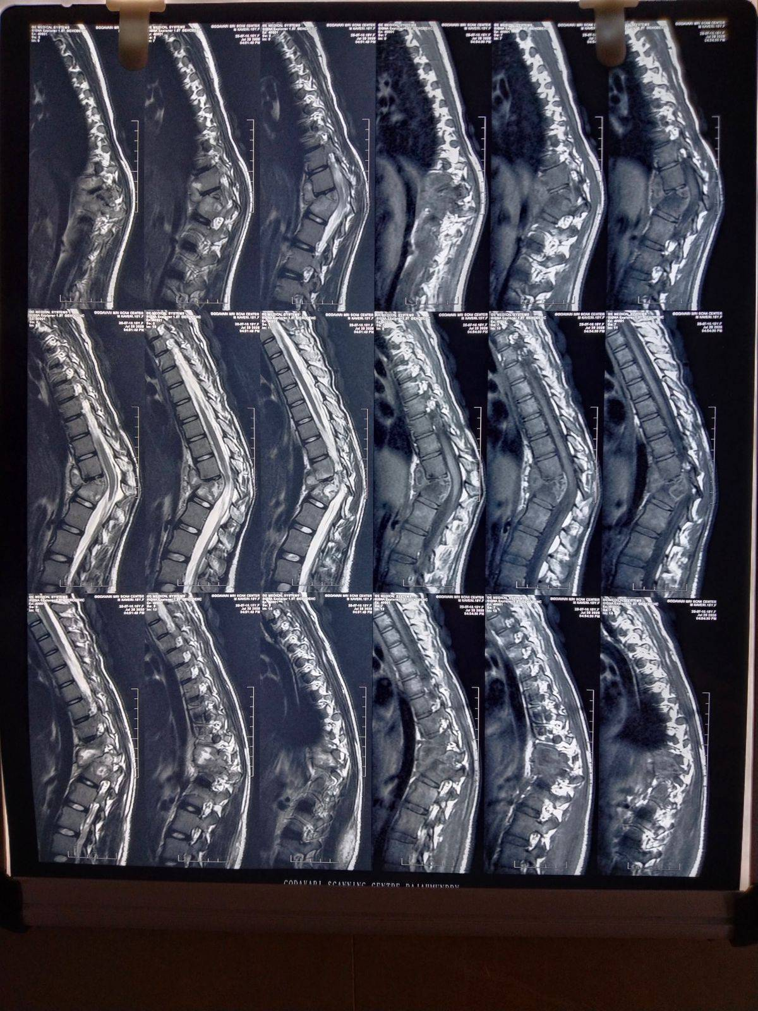
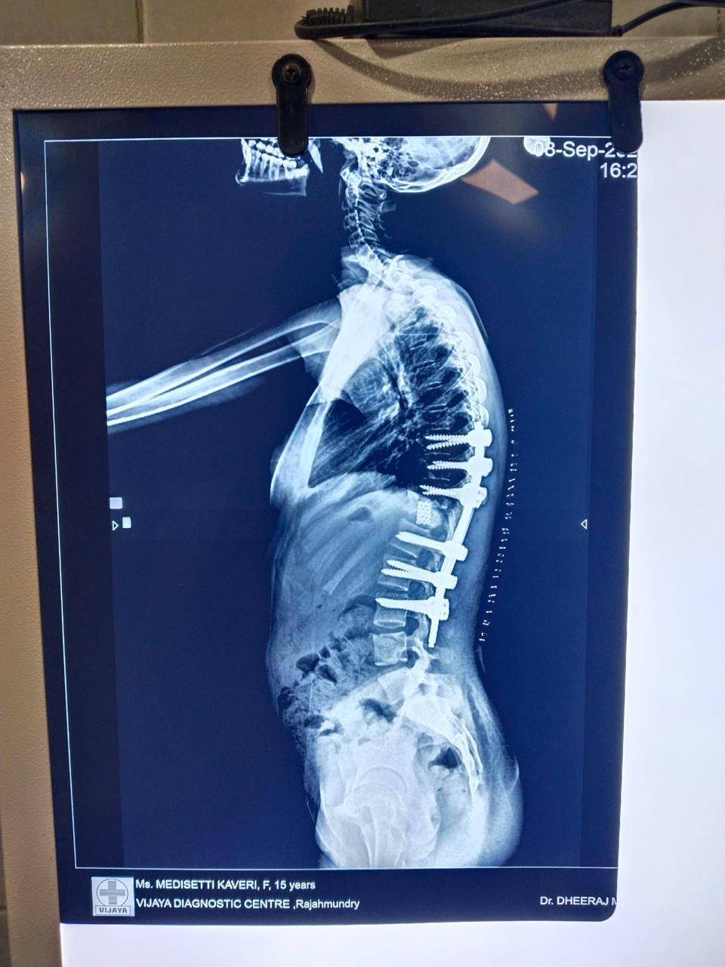
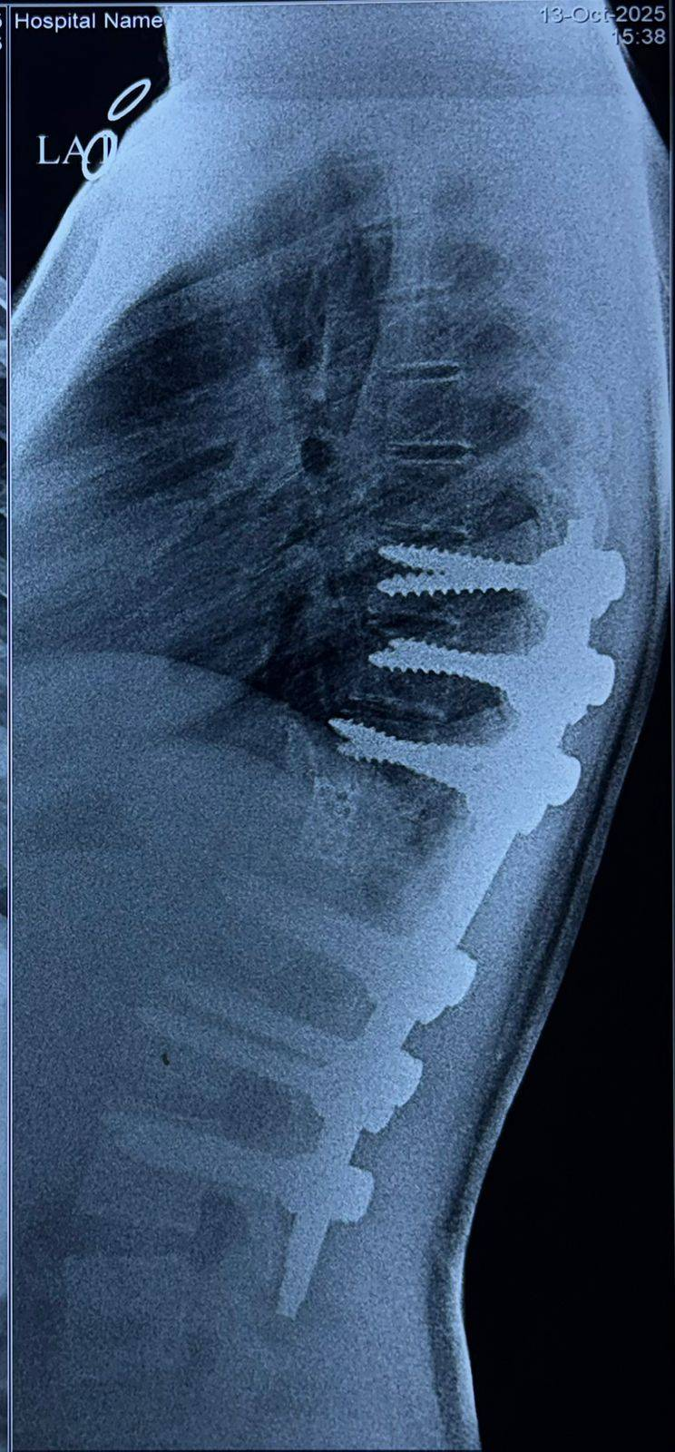
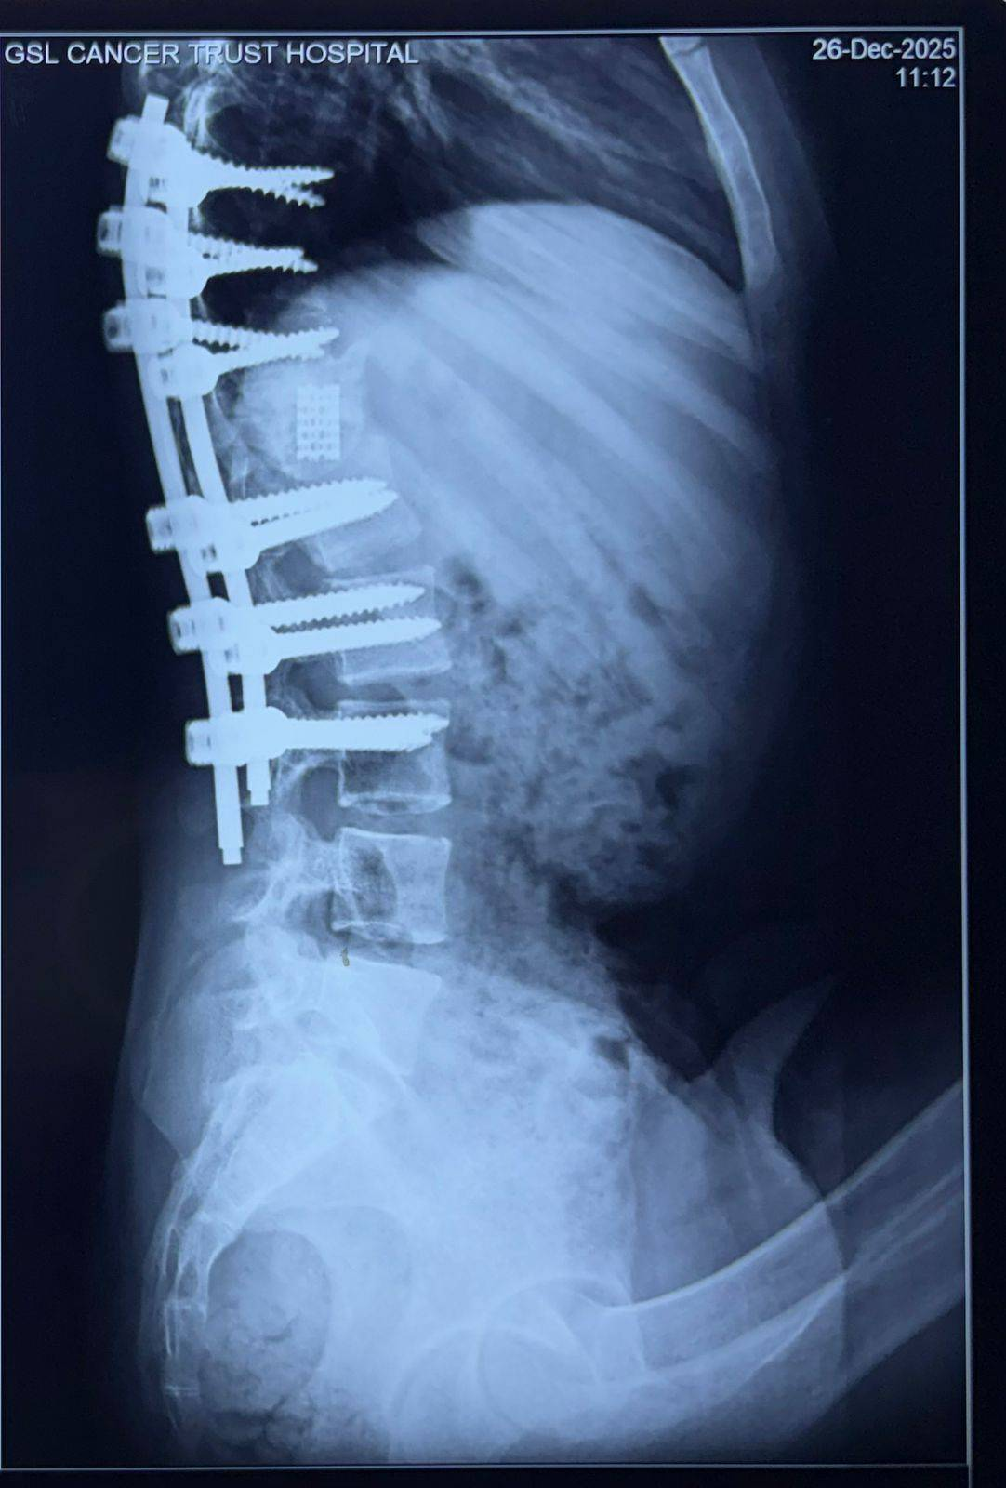
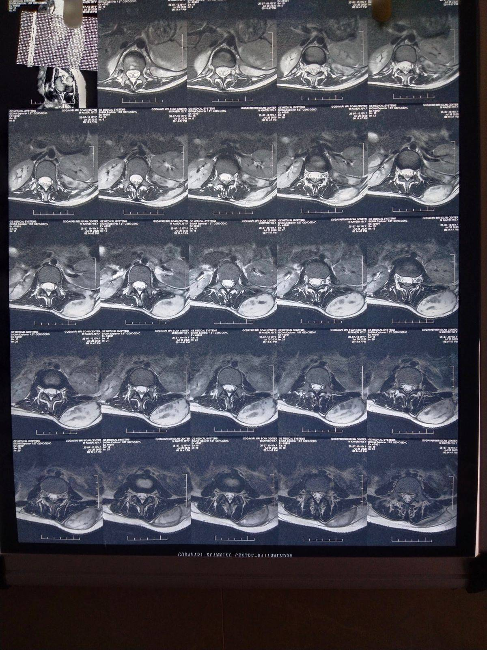
55th Annual Conference of Orthopedic Surgeon Society of Andhra Pradesh
Date 6 – 8 February,2026, Venue : Kurnool Medical College
Organized by : Department of Orthopaedics, Kurnool Medical College Kurnool
Surgical Correction of Post-Tubercular Dorsal
Kyphotic Deformity
AUTHOR: Dr. MOHAMMED MUZAFFAR (POST GRADUATE)
CO-AUTHORS: Dr. M. DHEERAJ MANIKANTA (CONSULTANT SPINE SURGEON)
Dr. V. NAGESWARA RAO (HEAD OF DEPARTMENT OF ORTHOPAEDICS)
INTRODUCTION
OPERATIVE FINDINGS
DISCUSSION
Spinal tuberculosis commonly leads to angular kyphotic deformity due to anterior vertebral body destruction and collapse.
Kyphosis may progress even after healed disease, resulting in sagittal imbalance and cosmetic deformity.
Severe deformity causes chronic pain and functional disability.
.Long-standing kyphosis may lead to cardiopulmonary compromise and late-onset neurological deficits due to cord stretch and internal gibbus.
.Thoracolumbar junction involvement poses greater biomechanical challenges.
Surgical correction is required in selected cases with progressive deformity.
General anesthesia, prone position with neural-monitoring
Posterior midline approach was chosen (D8–L3)
Paraspinal muscle elevation and posterior element exposure were done
Bilateral pedicle screw insertion from D8 to L3 under fluoroscopy
Temporary rod stabilization
Resection of posterior elements with ligation and division of D11 nerve roots
Complete vertebral column resection of D11–D12
Placement of titanium cage (~2.5 cm) packed with bone graft between D10 inferior endplate and L1 superior endplate
Final rod fixation with deformity correction and fusion
Hemostasis, drain placement, layered closure
Extubated with intact neurology.
Post-tubercular kyphotic deformity arises from anterior vertebral body collapse and is associated with progressive sagittal imbalance and neurological risk. Posterior vertebral column resection allows single-stage circumferential decompression, deformity correction, and stable reconstruction. Complete excision of D11–D12 with cage reconstruction and long-segment posterior fixation achieved satisfactory alignment and stability. Intraoperative neuromonitoring and temporary stabilization were critical in minimizing neurological complications. Posterior-only VCR is a reliable technique for managing severe post-tubercular kyphosis.
CASE REPORT
RESULTS
Case Presentation: A 15-year-old female with 3 months of back pain and 2 months of increasing stooping of the back, associated with fever and weight loss. History of left thoracolumbar paraspinal abscess drainage; currently on antitubercular therapy.
Clinical Examination: Ambulatory with forward bending posture and angular thoracolumbar kyphosis. Healed left paraspinal sinus present. Restricted spinal movements with tenderness. Sensory loss below the infra-umbilical level; motor power intact in both lower limbs.
X-ray Findings: Severe (Rajasekaran kyphosis severity grading) angular kyphosis at the D11–D12 level with anterior vertebral body collapse and near complete loss of intervening disc space.
MRI Findings: Destruction of D11–D12 vertebral bodies with severe angular kyphotic deformity and paravertebral collections extending from D11 to L1, consistent with healed spinal tuberculosis.
Postoperative recovery was uneventful. The patient was followed up at 1 week, 1 month, and 3 months. Clinical and radiological assessment demonstrated maintained correction of kyphotic deformity with satisfactory sagittal alignment. At 3 months follow-up, functional outcome as per Modified Macnab criteria was graded as “Excellent.” The patient was ambulatory without support and remained neurologically intact. Radiographs confirmed stable implant and cage position with no loss of correction or implant-related complications.
TAKE HOME MESSAGE
Severe post-tubercular kyphosis can be effectively managed by single-stage posterior vertebral column resection.
Long-segment posterior fixation with cage reconstruction restores sagittal alignment and spinal stability.
Neuromonitoring and meticulous technique are essential for safe deformity correction with good functional outcome.
PRE-OP IMAGING
POST-OP IMAGING
POD-2 1 MONTH OF FOLLOWUP 3MONTHS OF FOLLOW UP
CONCLUSION
Single-stage posterior vertebral column resection with cage reconstruction and long-segment fixation is a safe and effective technique for correcting severe post-tubercular kyphosis, providing stable alignment with good neurological and functional outcomes.
ACKNOWLEDGEMENT
I sincerely thank Dr. V. Nageswara Rao, Head of the Department of Orthopaedics, and Dr. Dheeraj Manikanta (Consultant Endoscopic Spine and Deformity Surgeon), along with the faculty of Orthopaedics and the Department of Radiology at GSL Medical College & General Hospital, for their guidance and support.

