Slide 1



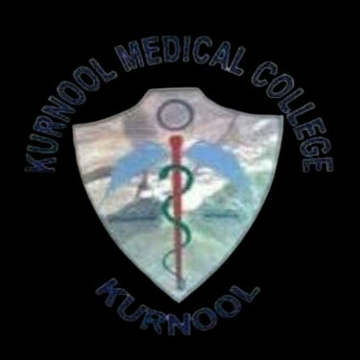
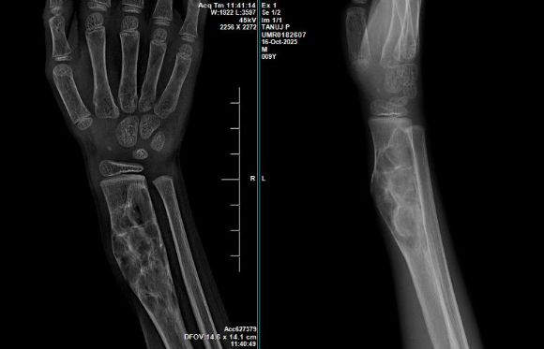
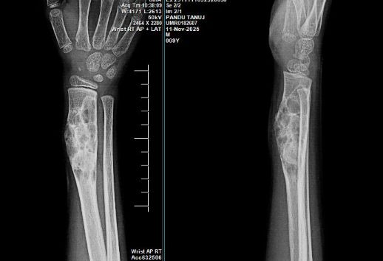
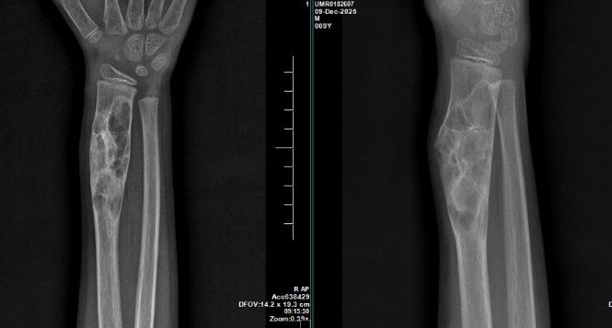
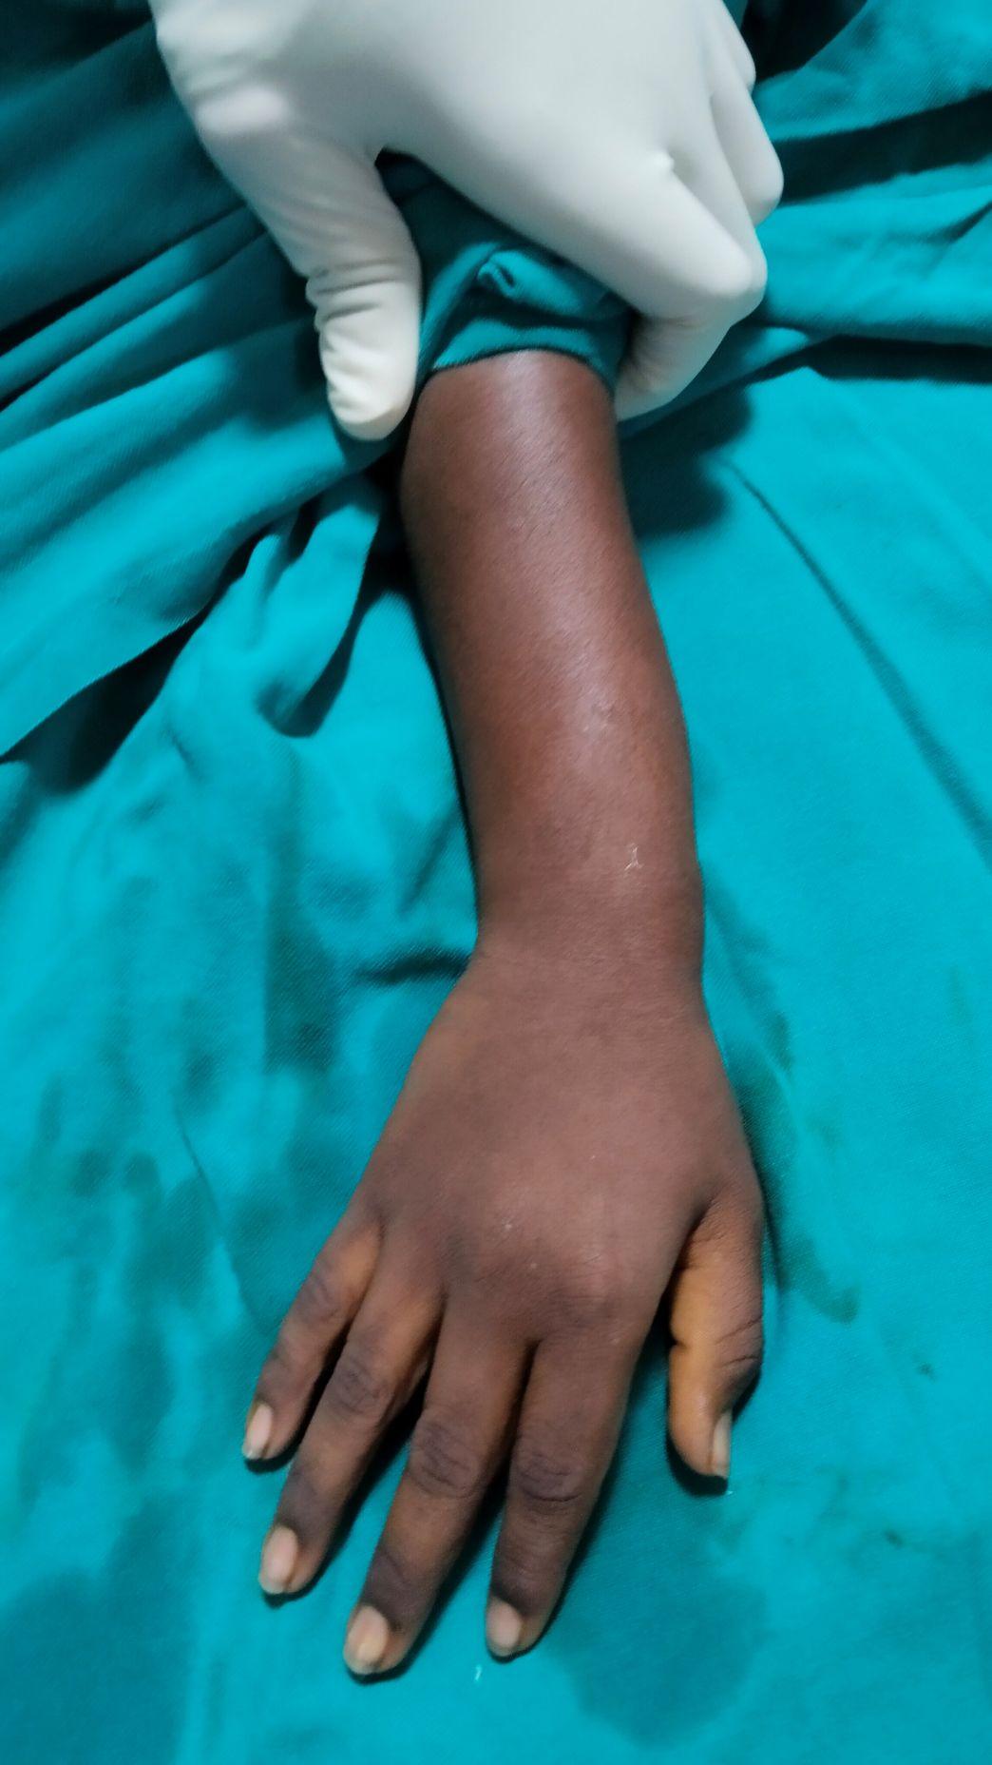
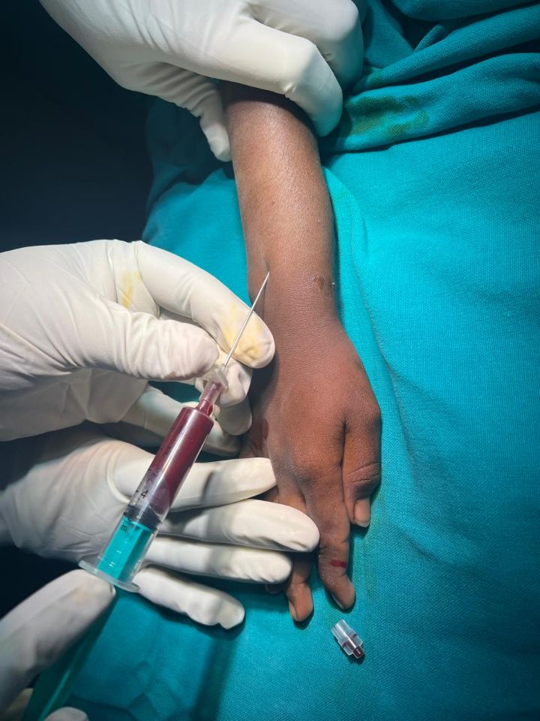
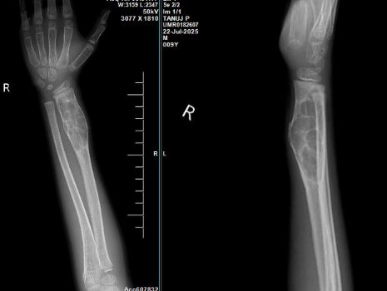
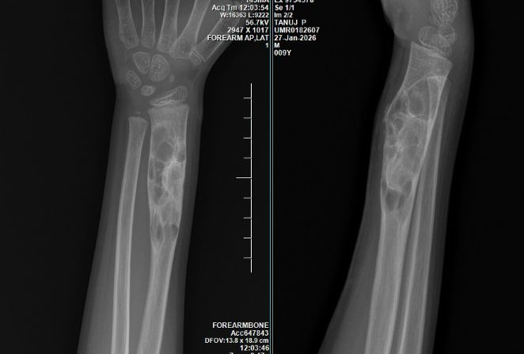
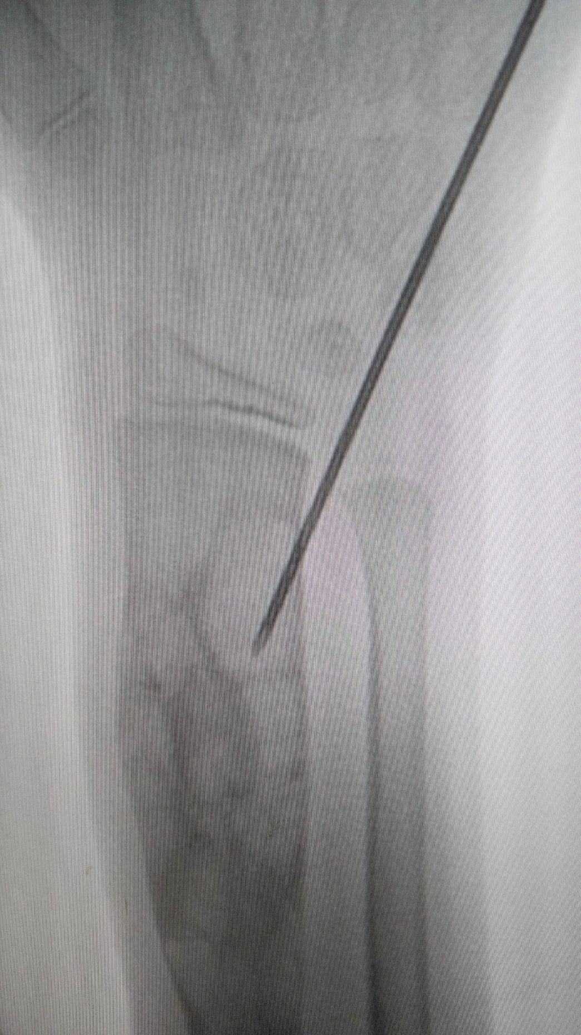
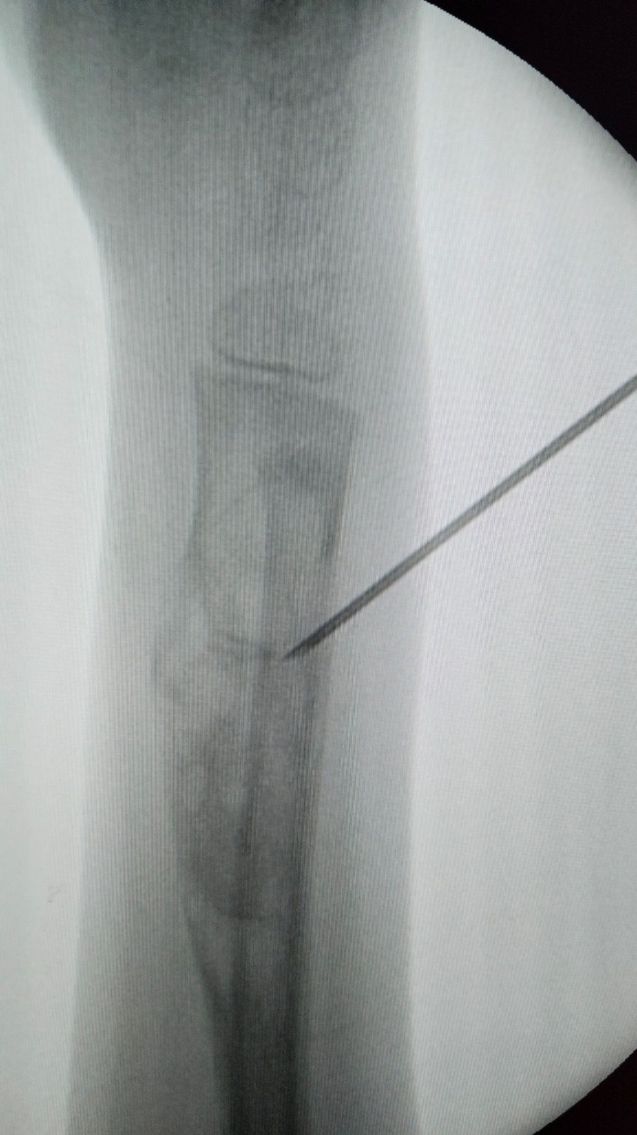
55th Annual Conference of Orthopedic Surgeon Society of Andhra Pradesh
A CASE REPORT ON MANAGEMENT OF
ANEURYSMAL BONE CYST OF DISTAL RADIUS
PRESENTING AUTHOR: DR ANTHATI YOGANAND
CO-AUTHORS : DR JAGADESH GUDARU MS.,MCH(ORTHO) ; DR K DEEPAK MS(ORTHO), DR AVINASH B DNB(ORTHO)
ID: OSSAP-264
INTRODUCTION
OPERATIVE FINDINGS
DISCUSSION
4months follow up
Aneurysmal bone cyst is a multilocular hematic cyst, locally aggressive benign lesion affecting long bones and spine in an immature skeleton.
It was first described and named by Jaffe and Lichtenstein in 1942.
Metaphysis of long bones and posterior elements of spine are the common sites.
Traditional treatment includes en bloc resection or intralesional curettage.
Recent evidences shows good outcomes with intralesional sclerotherapy.
Patient in supine position, under sedation right wrist draped under aseptic precautions.
Under fluoroscopic guidance lytic lesion of right distal radius identified.
16G canula passed percutaneously to the lesion and contents aspirated.
3% polidocanol injected through the canula into the lesion in the dosage of 2mg/kg body weight.
Backflow prevented by pushing normal saline and compression bandage applied.
Aneurysmal bone cysts are locally aggressive benign cystic lesions with high recurrence rates. En bloc resection provides least chances of recurrence but is invasive with post surgical complications.
Percutaneous sclerotherapy has gained popularity using sclerosants like polidocanol, tetracycline, alcohol.
After 3 doses of polidocanol injection given with one month interval between the doses, patient shows progressive decrease in size of the swelling, reduced pain, improved wrist range of movements and sclerosis of the lesion in radiographs without any post injection complications.
CASE REPORT
1month follow up
2months follow up
3months follow up
An 8yr old male child presented with pain and swelling over right wrist since 3years following trauma.
Radiographs and MRI revealed Aneurysmal bone cyst of right distal radius.
CONCLUSION
4months follow up
Percutaneous sclerotherapy with polidocanol is safe, cost effective with less morbidity and has high cure rates and can be performed on out patient basis.
Multiple injections and long term follow up needed for treating recurrence of the lesion.
4months follow up
Notes:
Acceptable alignments after fracture reduction are <5 mm translation, <5o–10o angulation, <10o rotational deformity, and <1 cm femoral shortening.

