Slide 1
INTRODUCTION
Knee osteoarthritis is a leading cause of pain and disability worldwide and constitutes a major proportion of orthopaedic outpatient visits in India.
The Kellgren–Lawrence (KL) grading system is the most widely used radiographic classification.
Recent advances in artificial intelligence (AI) and deep learning have enabled automated analysis of knee radiographs, offering potential improvements in diagnostic consistency and efficiency.
Evaluating the diagnostic accuracy and clinical utility of AI-assisted grading is essential before adoption in routine clinical practice, particularly in high-volume, resource-limited settings like India.
AIMS AND OBJECTIVES
Primary Aim
To compare AI-assisted knee osteoarthritis grading with standard radiographic KL grading in terms of diagnostic accuracy.
Secondary Objectives
To assess interobserver variability among human readers.
To evaluate agreement between AI grading and expert consensus.
To determine the potential clinical utility of AI as a decision-support tool in knee OA assessment.

Slide 2
INCLUSION CRITERIA
Patients aged ≥40 years
Patients presenting with knee pain or suspected osteoarthritis
Standard weight-bearing anteroposterior knee radiographs
Radiographs of adequate quality for interpretation
EXCLUSION CRITERIA
Previous knee surgery or arthroplasty
Acute fractures or post-traumatic arthritis
Inflammatory arthritis (e.g., rheumatoid arthritis)
Congenital or metabolic bone disorders affecting the knee
Poor-quality or non–weight-bearing radiographs

Slide 3
MATERIALS AND METHODS
Study Design
Comparative observational study
Study Material
Digital weight-bearing AP knee radiographs
Radiographic Assessment
Independent KL grading by:
  Multiple human readers (orthopaedic surgeons / radiologists with varying experience)
Expert consensus grading used as reference standard
AI Assessment
Automated KL grading using a validated deep learning–based AI model trained on large knee OA datasets
Statistical Analysis
Diagnostic accuracy of AI compared with expert consensus
Interobserver agreement assessed using Cohen’s kappa
Agreement between AI and human readers evaluated

Slide 4
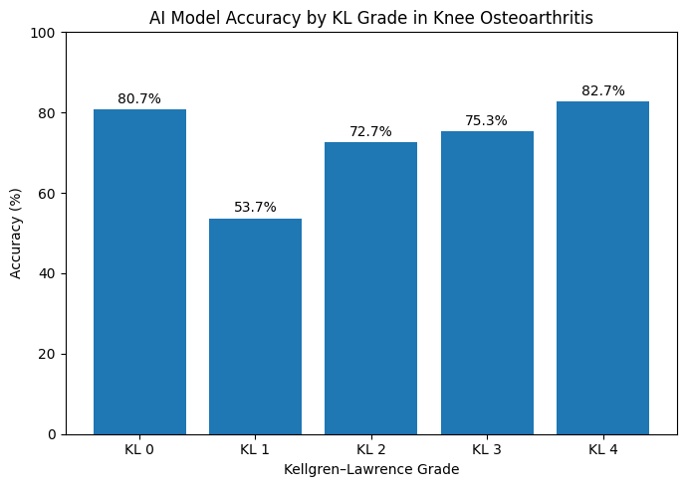
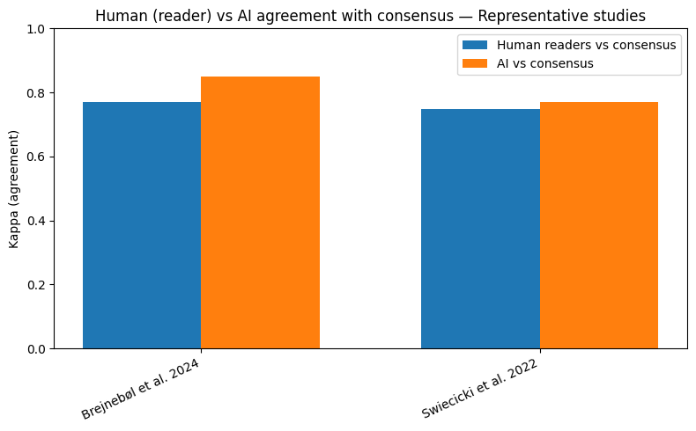
Accuracy by KL Grade
Agreement Comparison

Slide 5
AI Model Details
Model Architecture
Deep learning–based Convolutional Neural Network (CNN)
Uses transfer learning with pre-trained backbone (e.g., ResNet / DenseNet / EfficientNet)
Pre-training done on large-scale image datasets, followed by fine-tuning on knee OA radiographs
Input Data
Standard weight-bearing AP knee radiographs
Automated preprocessing:
  Image normalization
  Knee joint region localization
  Contrast enhancement
Output
Automated classification into Kellgren–Lawrence grades 0–4
Probability score generated for each KL grade
Final grade assigned based on highest confidence score

Slide 6
RESULTS
AI-assisted KL grading showed diagnostic accuracy comparable to expert human readers.
Interobserver variability among human readers was significantly reduced with AI assistance.
Agreement between AI and expert consensus was high across clinically relevant KL grades.
Performance was consistent in:
  Moderate and advanced OA
  High-volume clinical datasets
CLINICAL UTILITY
AI functions as a decision-support tool, not a replacement for clinicians.
Potential applications:
  OPD screening
  Standardized radiology reporting
  Follow-up comparison
  Triage in high-volume government hospitals
Particularly valuable in resource-limited settings where specialist availability is constrained

Slide 7
LIMITATIONS
Dependence on KL grading, which itself has inherent subjectivity
Class imbalance across KL grades
Retrospective radiographic assessment
Limited evaluation of clinical outcomes beyond radiographic grading
Need for external validation across diverse Indian populations and imaging settings
CONCLUSION
AI-assisted knee OA grading demonstrates diagnostic accuracy comparable to expert human readers.
Use of AI significantly reduces interobserver variability associated with conventional KL grading.
AI can serve as a reliable decision-support tool, particularly in high-volume, resource-limited clinical settings.
In the Indian context, where radiographs remain the primary imaging modality, AI-assisted grading has strong potential to improve consistency, efficiency, and triage in knee OA management.
AI should complement—not replace—clinical judgment.

Slide 8
References
Vaattovaara E, et al. Kellgren–Lawrence grading of knee osteoarthritis using deep learning: comparison with experienced readers. J Digit Imaging. 2025.
Li W, et al. Deep learning assisted knee OA detection with multiview radiographs. Quant Imaging Med Surg. 2023.
Tiulpin A, et al. Automatic knee osteoarthritis diagnosis from plain radiographs: deep learning approach. Sci Rep. 2018.
Brejnebøl MW, et al. External validation of AI tool for knee OA KL grading. 2022.
Choi JC, et al. AI model assists knee osteoarthritis diagnosis with DenseNet201, ResNet101 & EfficientNetV2. Diagnostics. 2025.
Pi SW, et al. Ensemble deep learning for knee OA KL classification. Sci Rep. 2023.
Swiecicki A, et al. Deep learning algorithm matches radiologists for knee OA severity. arXiv. 2022.
Mohammadi S, et al. Review of AI in knee OA detection & grading. 2024.
Kalpana V, et al. Transfer-learning models for knee OA classification. 2023.
Neubauer M, et al. AI-guided KL grading improves correlation with clinical severity. 2023.

