Slide 1
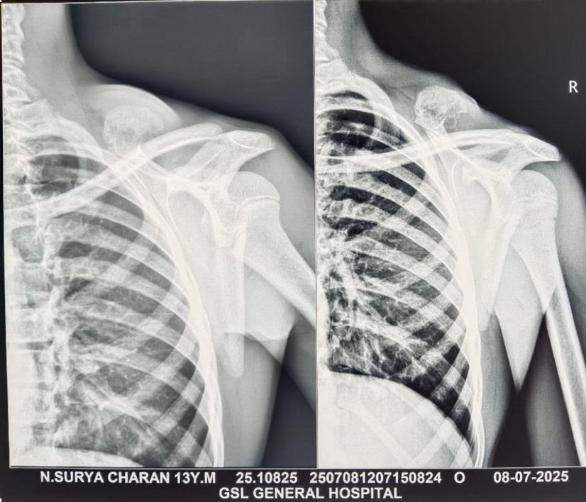
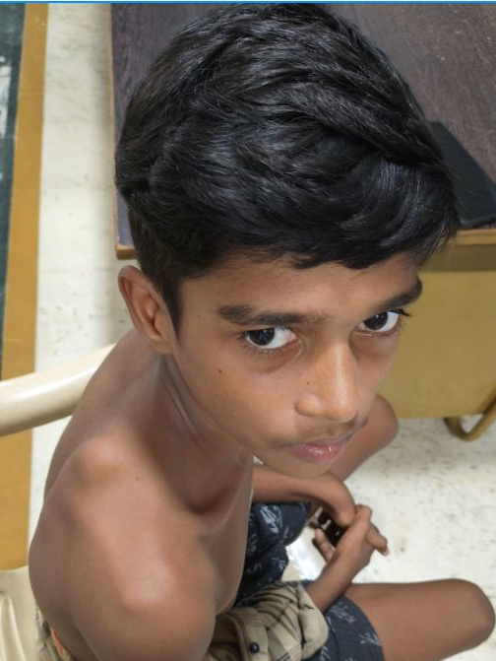
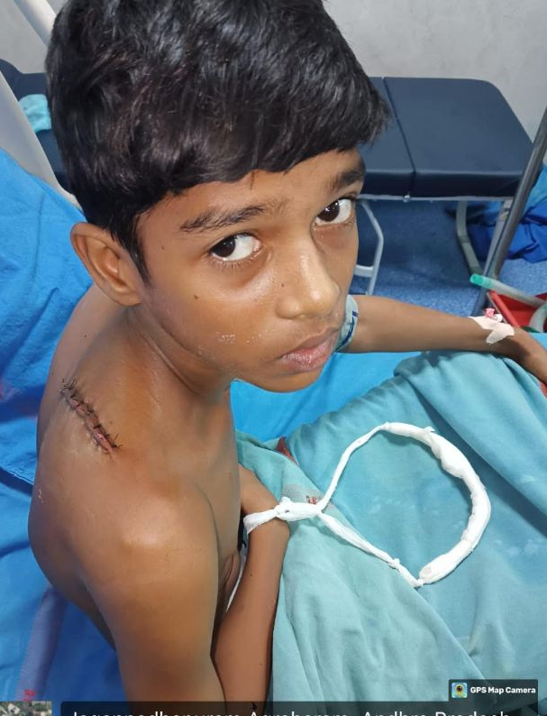
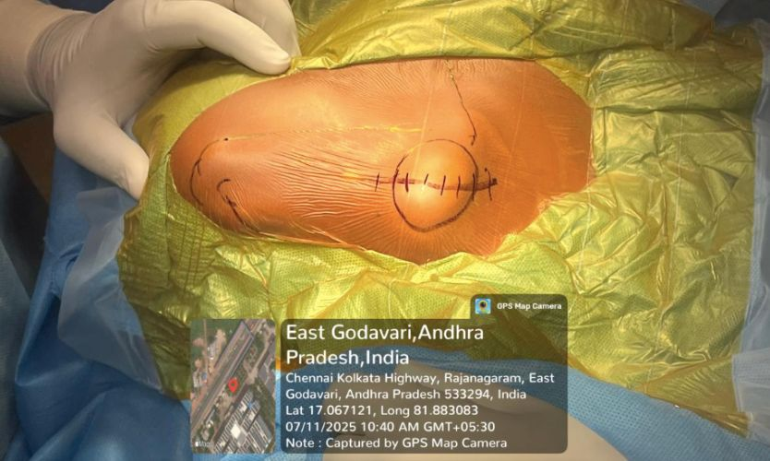
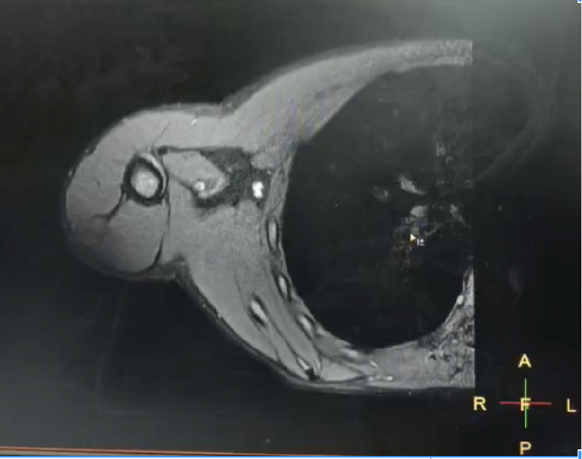
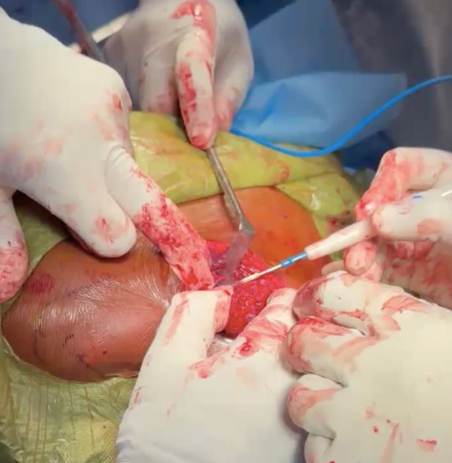
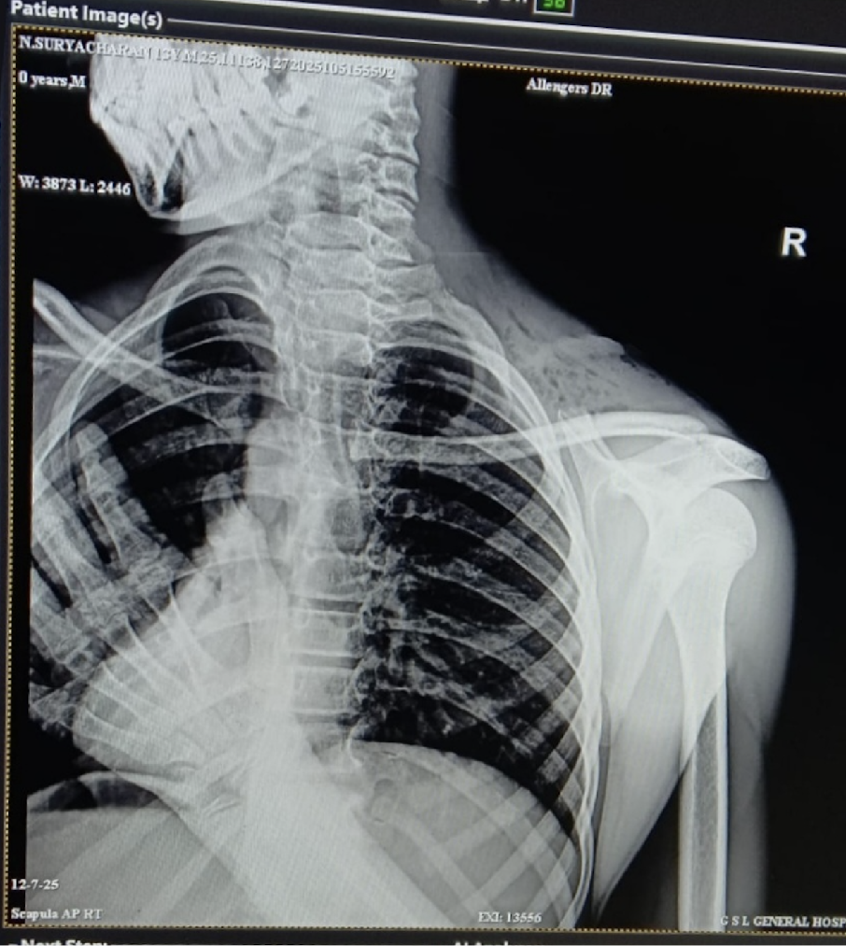
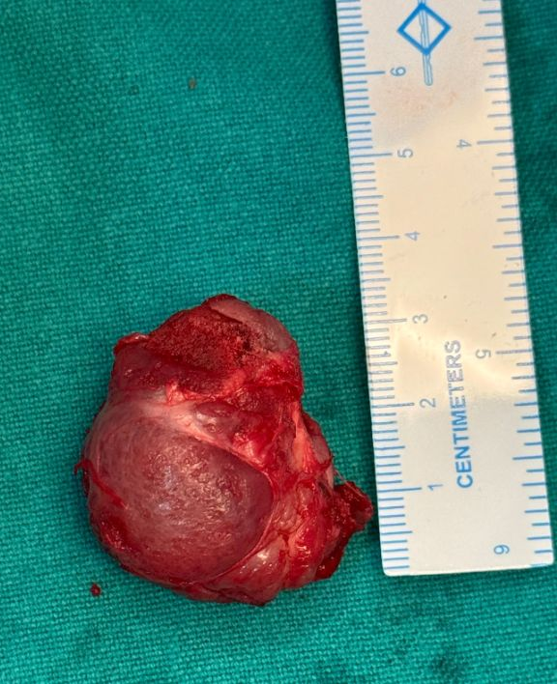
Introduction:
Osteochondroma is the most common benign bone tumour, usually arising from the metaphysis of long bones. Involvement of the scapula is uncommon, particularly in the paediatric population. Scapular osteochondromas may present as painless swelling and are often detected incidentally or due to cosmetic concerns. Surgical excision is indicated in symptomatic cases or when complications are suspected.
X ray AP lateral
DISCUSSION
Osteochondroma accounts for nearly 35–45% of benign bone tumours
Scapular involvement is rare (<5%), more commonly affecting the ventral surface
Dorsal scapular lesions often present as cosmetic swelling
MRI is crucial to:
  Assess cartilage cap thickness
  Exclude malignant transformation
Surgical excision is curative when:
  Lesion is symptomatic
  Cosmetic concern exists
  Cartilage cap is thickened
Abstract:
We report a case of a 12-year-old male presenting with a painless, progressively enlarging swelling over the scapula. Radiological evaluation revealed an osteochondroma arising from the spine of the scapula, which was successfully excised surgically. This case highlights the importance of considering osteochondroma in the differential diagnosis of scapular swellings in children and outlines the surgical management and outcome.
Before
After
MATERIAL & METHODS
Case Presentation
12-year-old male child came with a chief complaint of painless swelling over scapular region over months duration progressively increasing in size with no history of trauma
Clinical Examination
A 3 × 3 cm over scapular region over the spine of scapula which was hard immobile and non tender with no neurovascular deficits
RADIOLOGICAL EVALUATION
X-ray (Scapular Y view) suggestive of bony outgrowth arising from the spine of the scapula which has continuity with parent bone
MRI Right Shoulder Joint
Well-defined lobulated bony outgrowth from the postero-medial aspect of the upper scapula
T2 hyperintense cartilage cap ~5 mm continuity with cortex and medullary cavity findings suggestive of osteochondroma
MRI of Rt scapula
Intra op picture
CONCLUSION
Scapular osteochondroma in children is rare and may present as painless swelling
Careful clinical and radiological evaluation is essential
MRI helps confirm diagnosis and rule out malignancy
Complete surgical excision provides excellent outcomes
Early intervention prevents functional and cosmetic complications
TAKE HOME MESSAGE
Osteochondroma can occur in flat bones like the scapula, though rare
Painless progressive swelling in children warrants imaging evaluation
MRI is essential to assess cartilage cap and rule out malignancy
Complete surgical excision is curative with excellent prognosis
REFERENCES
Kitsoulis P, et al. Osteochondromas: review of the clinical, radiological and pathological features. In Vivo. 2008;22(5):633–646.
Unni KK. Dahlin’s Bone Tumors. 6th ed. Lippincott Williams & Wilkins; 2010.
Murphey MD, et al. Imaging of osteochondroma. Radiographics. 2000;20(5):1407–1434.
Bovée JVMG. Multiple osteochondromas. Orphanet J Rare Dis. 2008;3:3.
METHODOLOGY
An Incision 6 cm incision over the swelling, directed towards the acromion ,Plane developed between teres minor and infraspinatus ,Blunt dissection performed , Fascia over deltoid muscle split ,Tumour exposed and soft tissue attachments released ,Base of the lesion identified ,Osteotome used to separate the stalk , Lesion excised using saw blade ,Residual stalk removed with bone nibbler ,C-arm confirmation done to rule out residual pedicle
POST OP X RAY
RESULTS
Complete excision of the osteochondroma achieved
No intraoperative complications
Postoperative period uneventful
Good wound healing
No neurological deficit
Patient asymptomatic on follow-up
No evidence of recurrence
ACKNOWLEDGEMENT
I express my gratitude to HOD and faculty from department of orthopaedics,I sincerely thank the Radiology,GSL Medical College & General Hospital, for their guidance and support.

