Slide 1



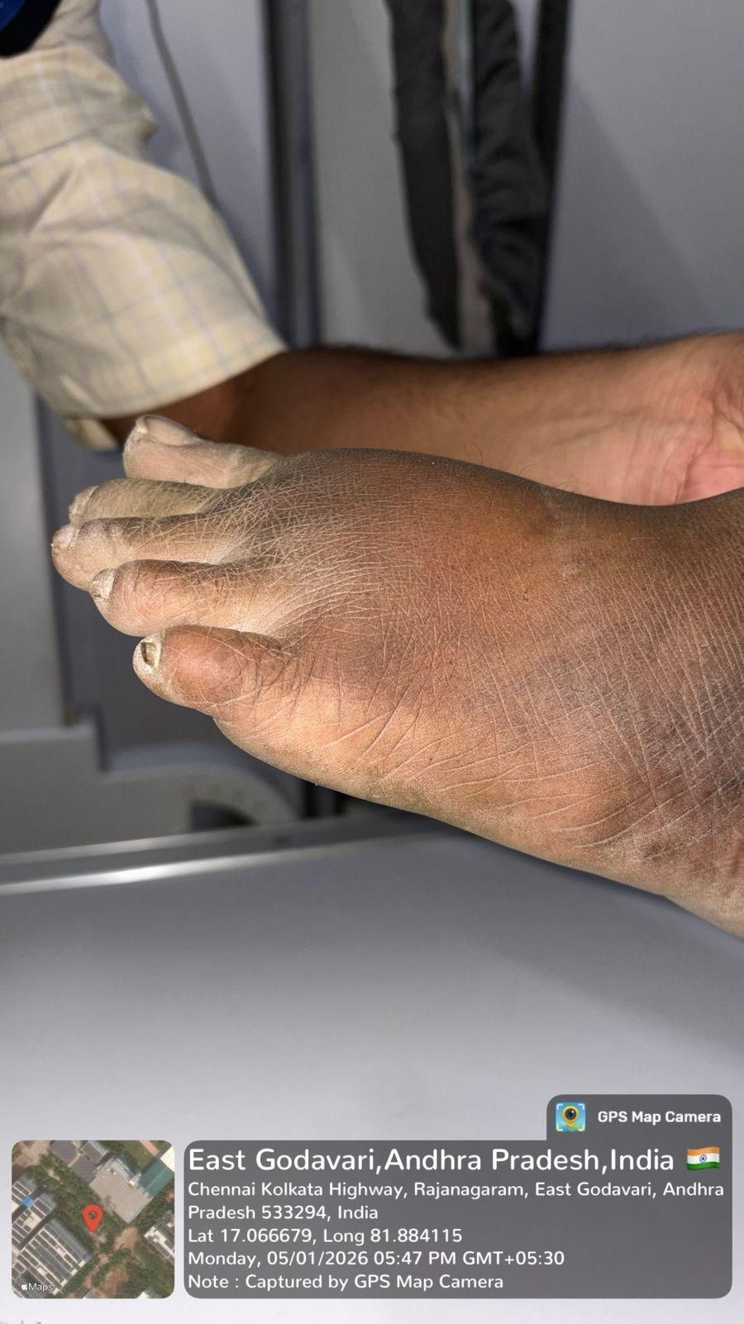
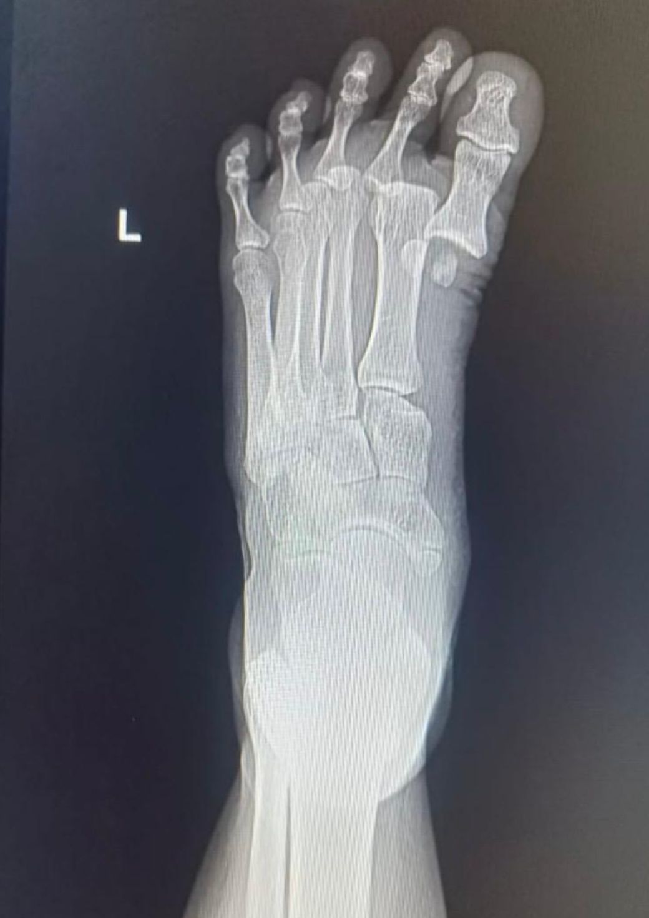
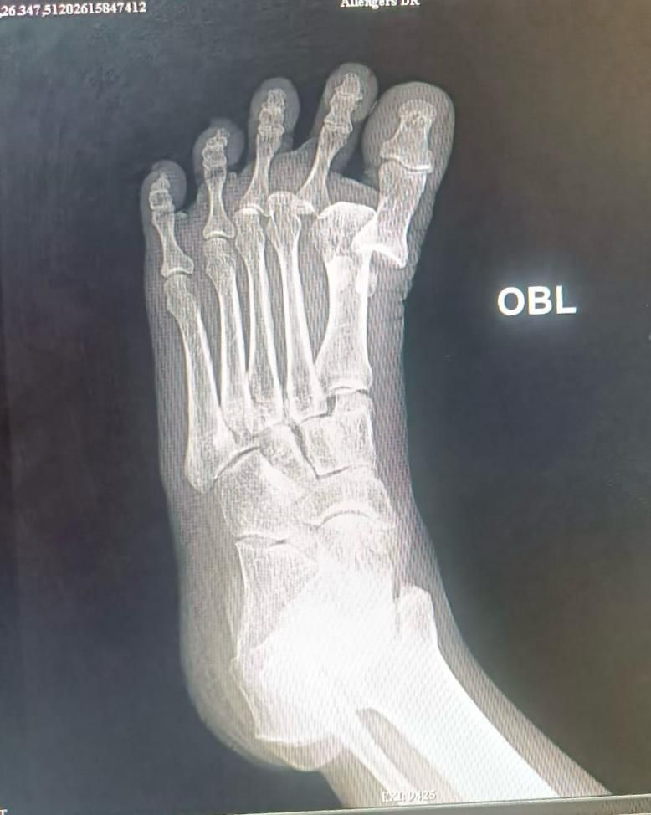
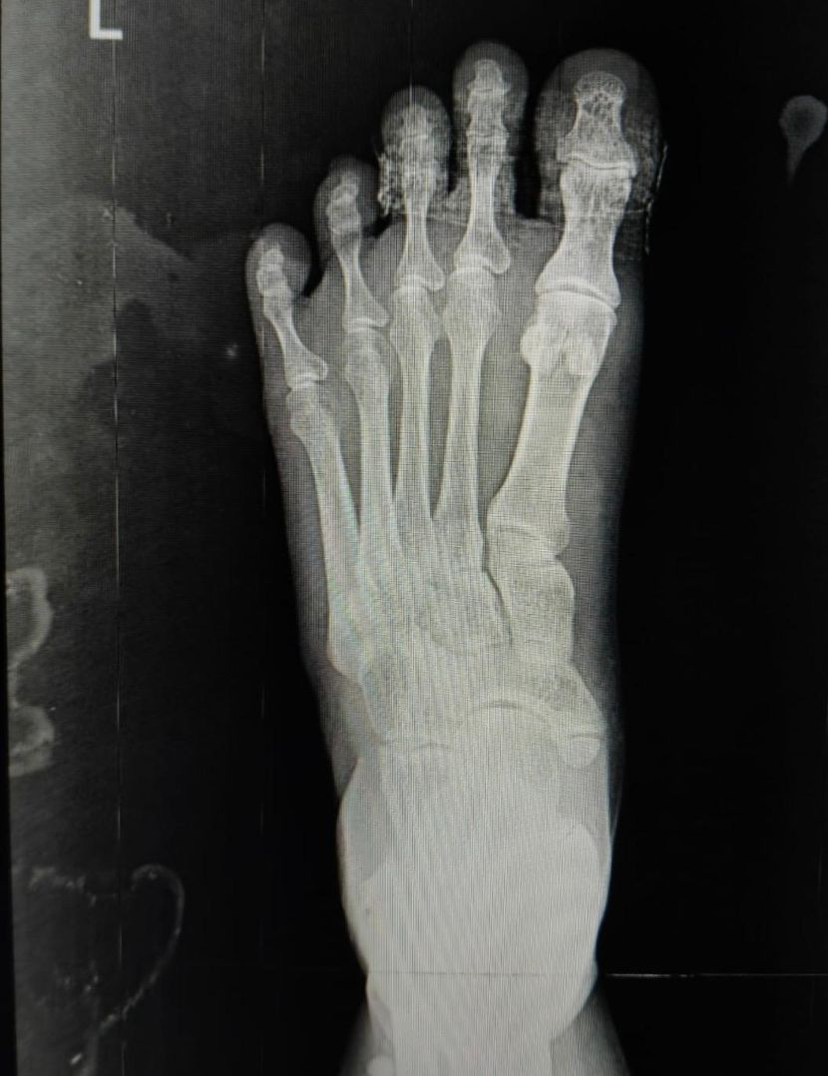
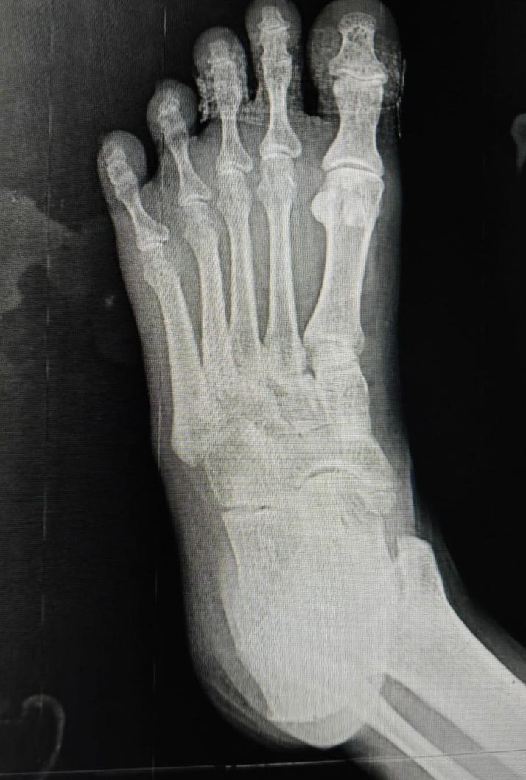
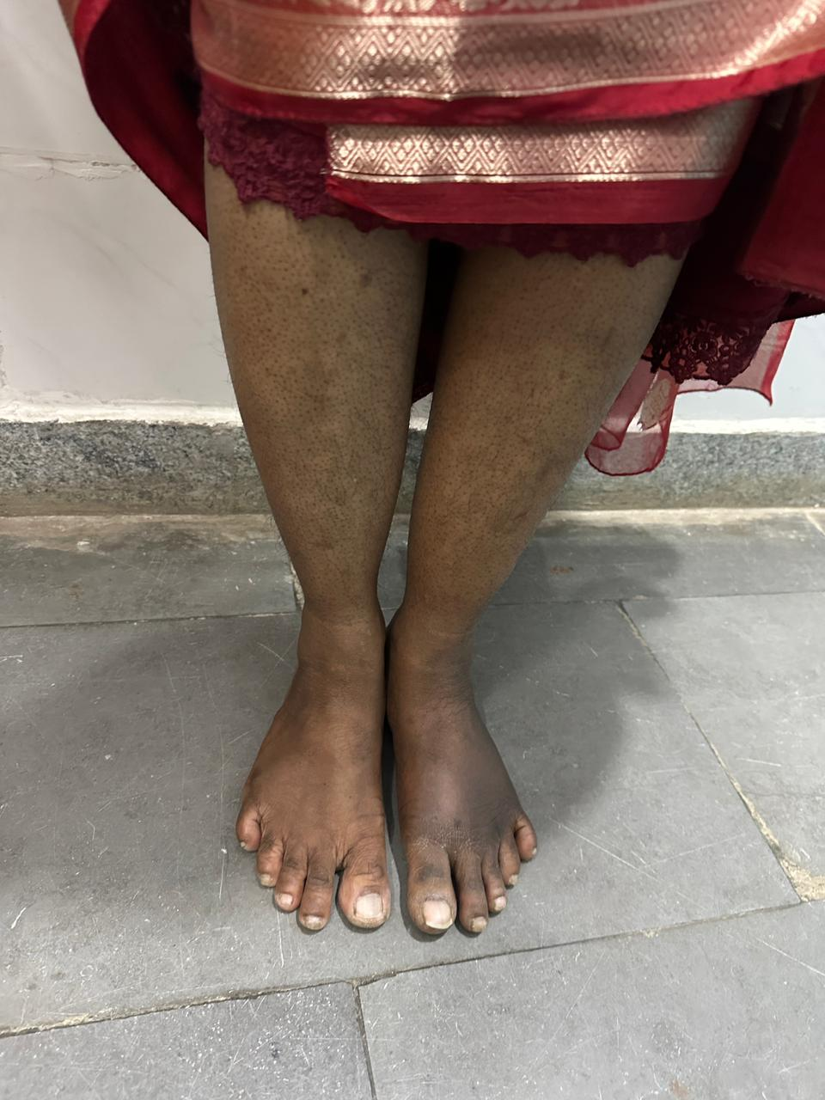
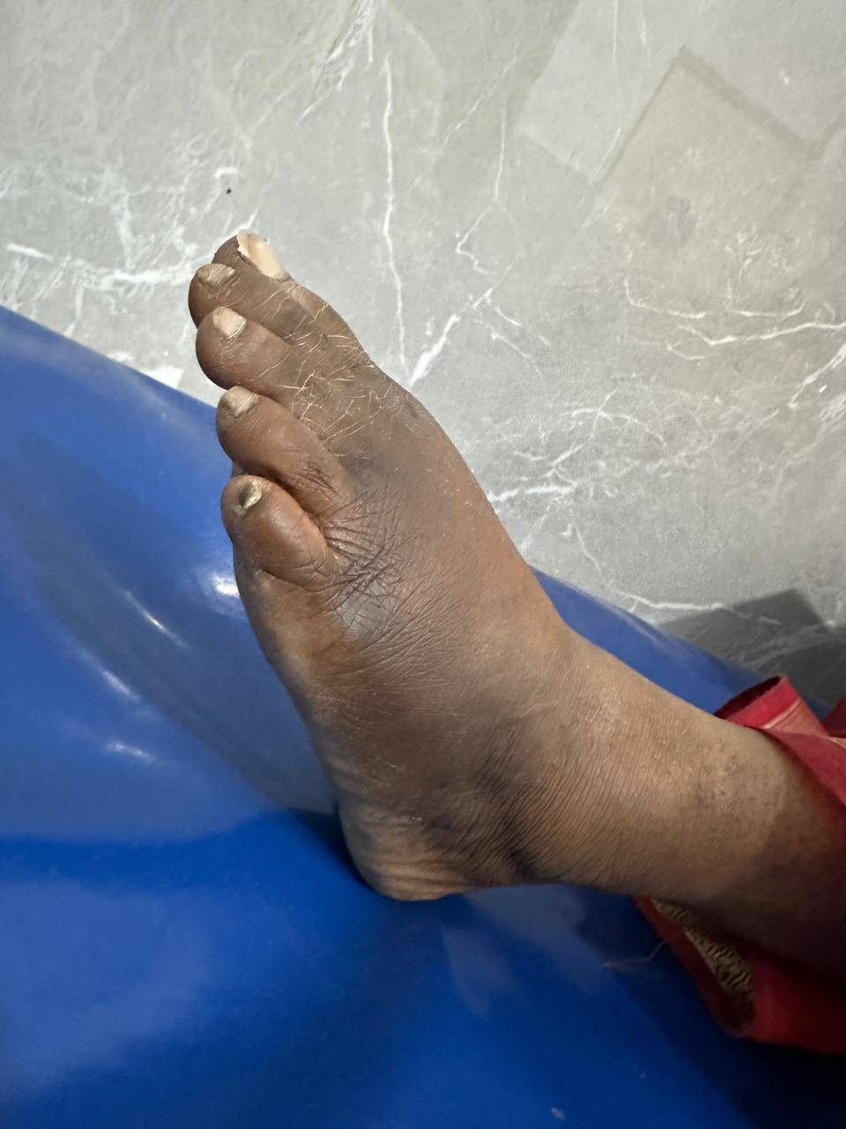
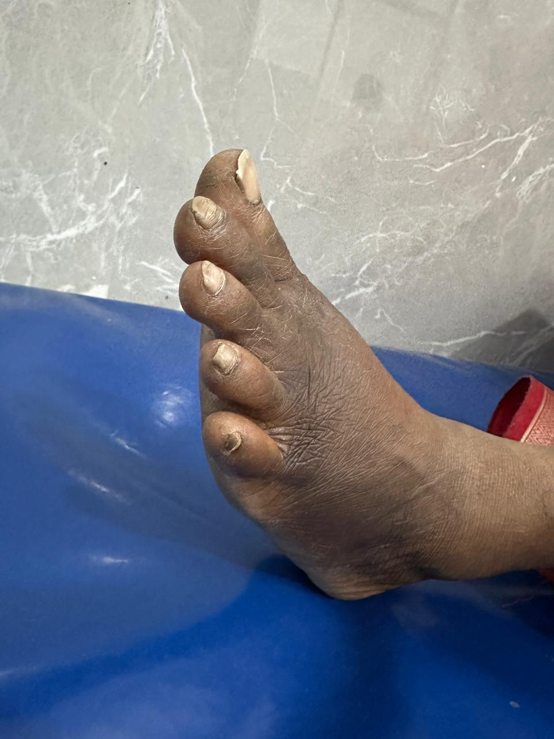
A RARE PATTERN OF MULTIPLE METATARSOPHALANGEAL JOINT DISRUPTIONS TREATED WITH CLOSED REDUCTION
AUTHOR – DR K.LITESH CHANDRA CHOWDARY (POST GRADUATE)
CO-AUTHOR – DR V.NAGESWARA RAO (HOD), DR SIVA PRAFUL (SENIOR RESIDENT)
DEPARTMENT OF ORTHOPAEDICS, GSL MEDICAL COLLEGE AND GENERAL HOSPITAL
INTRODUCTION
PRE REDUCTION IMAGING
DISCUSSION
Metatarsophalangeal (MTP) joint dislocations are uncommon injuries, most frequently involving the first MTP joint. Simultaneous disruption of multiple MTP joints is extremely rare and usually associated with high-energy trauma. Early diagnosis and prompt reduction are crucial to restore joint congruity and prevent long-term complications such as stiffness, instability, and post-traumatic arthritis. We present a rare case of multiple MTP joint disruptions successfully managed with closed reduction.
Plain radiographs of the foot (anteroposterior, oblique) revealed dorsal dislocation of 1st ,2nd metatarsophalangeal joints and 3rd metatarsal subluxation without fracture(Jahss classification type 2A).Loss of joint congruency and dorsal displacement of proximal phalanges relative to the metatarsal heads were evident.
Multiple metatarsophalangeal (MTP) joint dislocations are uncommon due to the strong plantar plate and ligamentous support. Dorsal dislocations most commonly result from hyperextension forces. These injuries often require open reduction because of interposition of the plantar plate, surrounding soft tissues or associated sesamoid fractures. However, closed reduction may be successful when performed early. In the present case, reduction was achieved by applying countertraction over the leg with the knee maintained in flexion eliminating gravity, along with longitudinal traction applied over the toes and gentle manipulative maneuver. This case highlights that even multiple MTP joint dislocations, which are usually managed operatively, can be treated conservatively with timely and appropriate intervention.
TAKE HOME MESSAGE
CASE REPORT
• Multiple MTP joint dislocations, though uncommon, should be suspected in high-energy forefoot trauma
• Early recognition and prompt closed reduction can avoid surgery
• Post-reduction imaging is essential to confirm joint congruity
Case Presentation
A 44 yr old female patient with alleged history of fall from bike presented following a high-energy traumatic event with pain, swelling, and deformity of the forefoot. The patient was unable to bear weight on the affected limb.
Clinical Examination
•Diffuse swelling over the forefoot
•Visible deformity at the metatarsophalangeal joint level
•Tenderness over involved MTP joints
•Restricted and painful toe movements
•Distal neurovascular status intact
POST REDUCTION IMAGING
Post-reduction radiographs demonstrated successful concentric reduction of the involved MTP joints with restoration of normal joint alignment and articular congruity. No residual subluxation or instability was noted.
CONCLUSION
Simultaneous multiple metatarsophalangeal joint disruptions are rare injuries. Early diagnosis and closed reduction can result in excellent functional outcomes when there is no associated fractures. Awareness of such injury patterns is important for optimal management
PROCEDURE STEPS
REFERENCES
Reduction manoeuvre :
• Procedure performed under adequate analgesia
• Longitudinal traction applied to the affected toes against counter traction over leg with knee in flexion eliminating gravity
• Gentle plantar translation of the proximal phalanges
• Sequential reduction of each involved MTP joint
• Confirmation of reduction clinically and fluoroscopically
• Immobilization in a below-knee slab and buddy strapping applied to 1,2,3, toes.
1.Bassil GF Sr, Nader F, Lajmi A, Missaoui Z. Dorsal dislocation of the first and second metatarsophalangeal joint: a case report and literature review. Cureus. 2023;15(9)
2.Jahss MH. Classic article: foot & ankle 1:15, 1980 traumatic dislocations of the first metatarsophalangeal joint. Foot Ankle Int. 2006 Jun;27(6):401-6.
RESULTS
• Successful closed reduction of all involved MTP joints
• Stable joints on follow-up
• Pain relief and restoration of toe alignment
• Gradual return to weight bearing and function
ACKNOWLEDGEMENT
I express my gratitude to Dr.V Nageswara Rao (HOD), Dr.Siva Praful (SR) and faculty from Department of Orthopaedics, GSL Medical College & General Hospital, for their guidance and support.

