Slide 1
Use of antibiotic cement impregnated intramedullary nail in the treatment of infected non union of long bones
Presenter : Dr. G. MANOJ BHASKAR
Moderator : Dr D. HARI KISHAN(Associate Professor)
Department of ORTHOPAEDICS
Alluri Sita Ramaraju Academy of Medical Sciences, ELURU.

Slide 2
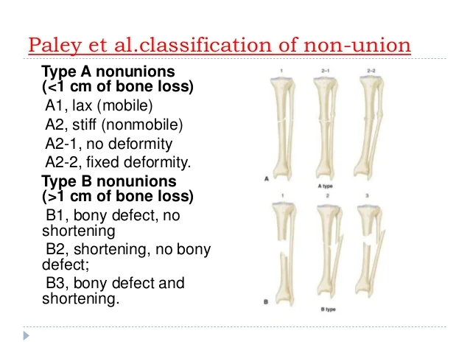
Introduction
Causes of infected non-union are generally inherent to the fractures, like compound wound, loss of soft tissue or bone, severe comminution and gross displacement.
Generally treatment of infected non-union involves 2 staged procedure
1) Debridement with/without antibiotic cement bead insertion + Systemic antibiotics to convert infected non-union into aseptic non-union.
2) Achieving stability with either by external fixation or internal fixation + Bone grafting.

Slide 3
Aim of the Study
To study the functional and radiological outcome of treating infected non union of long bones with antibiotic cement impregnated intramedullary nail

Slide 4
Materials and Methods
This prospective study was conducted in the Department of Orthopaedics [Asram Medical College and Hospital, Eluru] from December 2023 to December 2025. A total of 10 patients with infected non union were included and divided into three groups after adequate debridement : Group A (bone defect <4cm, n=4), Group B (bone defect 4-6cm, n=4), Group C (bone defect >6cm, n=2).
Inclusion criteria included infected non-union of long bones with age 20–60 years.
Exclusion criteria included aseptic non-union of long bones with age 20-60 years.
All patients underwent standard clinical and radiological evaluation. All patients were followed up, with average follow-up time of 18 months at intervals of 2nd, 6th, 12th, 26th, 38th, 52nd, 68th week until clinical and radiological union.

Slide 5
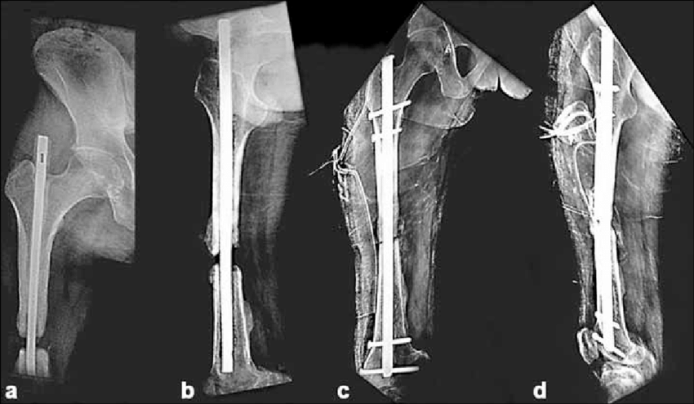
Anteroposterior (a) and lateral (b) radiograph of right thigh including hip depicting a gap non-union of femur with infection treated with antibiotic impregnated intramedullary nail
Anteroposterior (c) and lateral (d) radiograph of the same patient showing exchange interlock nailing performed after control of infection along with bone grafting

Slide 6
Results
Patient no. | Age/Sex | Bone | Classification | Initial treatment | Infection duration |  | Bone defect | Infection | Infecion control | Secondary procedure | Union
GRP A | BONE | DEFECT | <4cms
1 | 58/M | Femur | Closed | ILN | 4 months |  | 2 cms | Controlled | 4 weeks | None | Yes
2 | 33/M | Tibia | I | Deb, ILN | 5 months |  | 0 cms | Controlled | 4 weeks | None | Yes
3 | 29/M | Femur | IIIA | Deb, UTPT, ILN | 8 months |  | 3 cms | Controlled | 7 weeks | ILN+BG | Yes
4 | 44/M | Femur | IIIB | Deb, Ex-fix | 7 months |  | 2 cms | Controlled | 8 weeks | ILN | Yes
GRP B | BONE | DEFECT | 4-6cms
5 | 35/M | Femur | II | Deb, UTPT, ILN | 6 months |  | 4.4 cms | Controlled | 8 weeks | ILN+BG | Yes
6 | 24/F | Femur | IIIA | Deb, Ex-fix | 10 months |  | 5 cms | Controlled | 6 weeks | Ilizarov fixator | Yes
7 | 23/M | Femur | IIIA | Deb, UTPT, ILN | 9 months |  | 4.5 cms | Controlled | 10 weeks | ILN+BG | Yes
8 | 28/M | Femur | IIIB | Deb, UTPT, ILN | 13 months |  | 5.1 cms | Controlled | 9 weeks | Ilizarov fixator | Yes
GRP C | BONE | DEFECT | >6cms
9 | 34/M | Femur | IIIB | Deb, Ex-fix, ILN | 14 months |  | 7.5 cms | Uncontrolled |  | Deb, Ilizarov fixator | No
10 | 25/M | Femur | IIIB | ILN, Deb | 6 months |  | 6 cms | Uncontrolled |  | Deb, Ilizarov fixator | Yes

Slide 7
Conclusion
ACIIN was a good procedure to achieve early primary infection control in cases of infected non-union with bone defect <4cm.
ACIIN is useful for infection control in case of bone defects from 4-6cms; however it takes a significantly longer time when compared to patients with lesser bone defect.
ACIIN should not be used in cases with bone defect >6cms, where it fails to achieve an adequate stability and infection control, and for these cases procedures like ilizarov fixator application with bone transport or lengthening with acute docking should be used

Slide 8
References
Toh CL, Jupiter JB. The infected nonunion of the tibia. Clin Orthop Relat Res 1995;315:176-91.
2) Court-Brown CM. Fractures of the tibia and fibula. In: Bucholz RW, Heckman JD, Court-Brown CM, editors. Rockwood and Green's fractures in adults. 6th ed. Lippincott Williams and Wilkins; 2006. p. 2080-146.
3) Patzakis MJ, Zalavras CG. Chronic posttraumatic osteomyelitis and infected nonunion of the tibia: Current management concepts. J Am Acad Orthop Surg 2005;13:417-27.
4) Chen CE, Ko JY, Wang JW, Wang CJ. Infection after intramedullary nailing of the femur. J Trauma 2002;55:338-44.
5) Maini L, Chadha M, Vishwanath J, Kapoor S, Mehtani A, Dhaon BK. The Ilizarov method in infected nonunion of fractures. Injury 2000;31:509-17.

