Slide 1




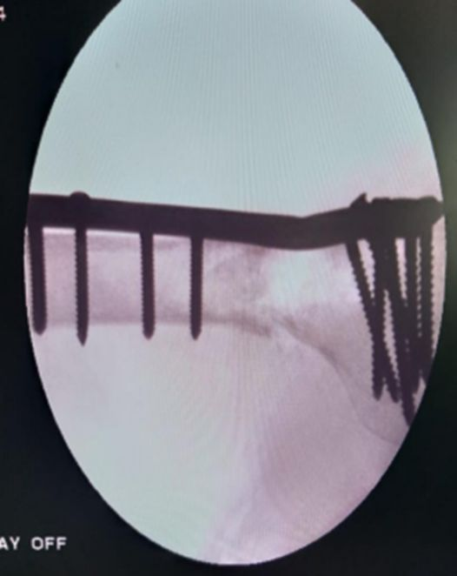
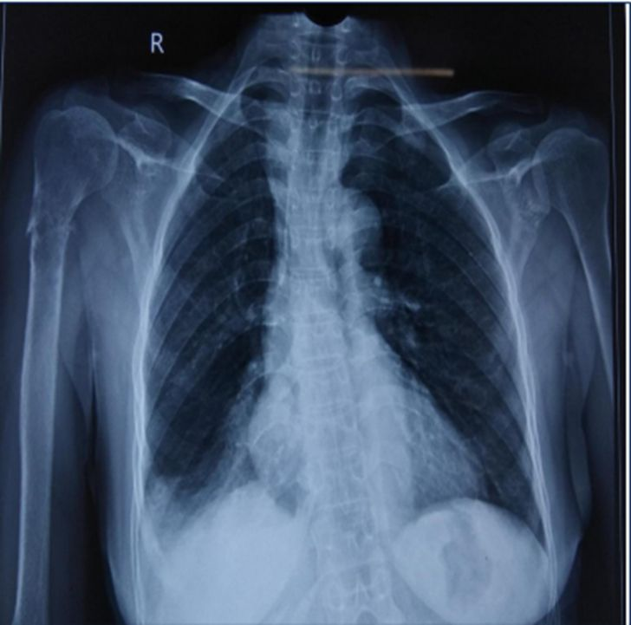
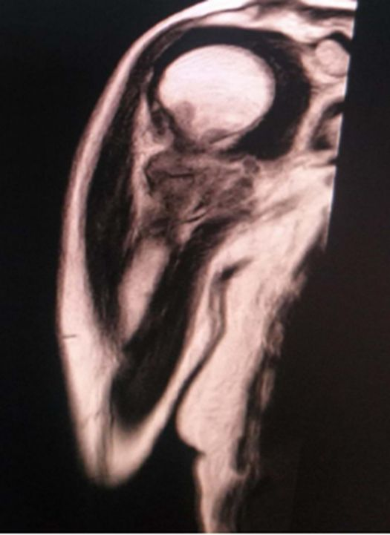
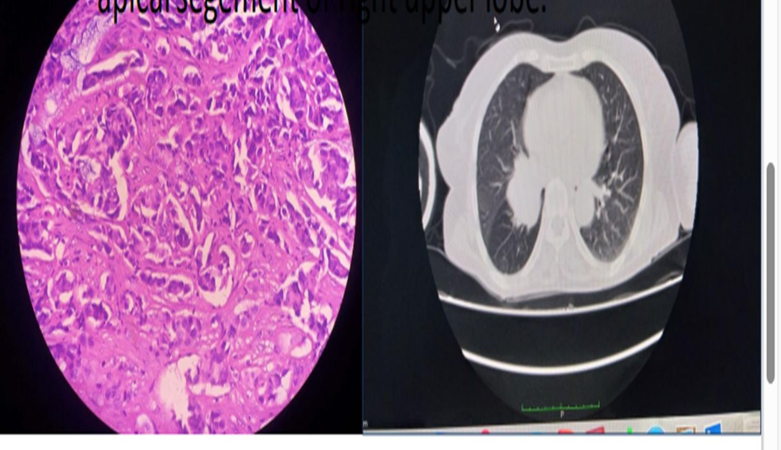
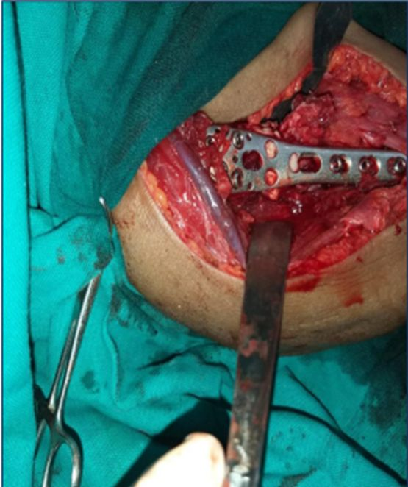
SURGICAL MANAGEMENT OF PATHOLOGICAL FRACTURE OF PROXIMAL HUMERUS WITH PHILOS PLATING AND BONE CEMENT – A CASE REPORT
AUTHOR : DR. G. MANOJ BHASKAR (JUNIOR RESIDENT)
GUIDE : DR. D. HARIKISHAN , M.S. (ORTHOPAEDICS), (Associate professor), DEPARTMENT OF ORTHOPAEDICS, ASRAM, ELURU
INTRODUCTION
OPERATIVE FINDINGS
DISCUSSION
Pathological fracture occur in abnormal bone. Weakened bone predisposes the patient for failure during normal activity or after minor trauma .
The vast majority of bony metastasis originate from cancers of breast,lung,prostate,thyroid and kidney.
The most common site of metastasis in skeleton include pelvis,skull,spine,ribs,proximal femur and proximal humerus.
A 75-year-old female presented with pain and swelling over the right shoulder following trivial trauma. Radiological investigations including X-ray and MRI revealed a pathological fracture at the metaphyseodiaphyseal junction of the proximal humerus. Histopathological examination confirmed metastatic adenocarcinoma. The fracture was surgically managed using PHILOS plate fixation with bone cement augmentation.
The management of pathological fractures, involves a multidisciplinary approach aimed at addressing both the mechanical instability and the underlying pathology. Surgical stabilization with techniques like PHILOS plating and bone cement augmentation is essential to restore function and alleviate pain. Accurate diagnosis through imaging, biopsies, and relevant laboratory tests is crucial to identify the underlying cause, often metastatic bone disease in adults over 40. Treating the primary malignancy concurrently is vital for improving the patient’s overall prognosis and quality of life.
CONCLUSION
CASE REPORT
Pathological fractures in patients over 40 years with discrete bone lesions are likely metastatic in origin. Surgical stabilization with PHILOS plating and bone cement provides effective mechanical stability and pain relief. Concurrent management of the primary malignancy is essential for improved prognosis and quality of life.

