Slide 1



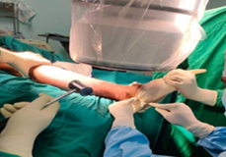
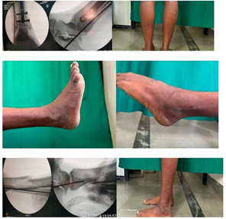
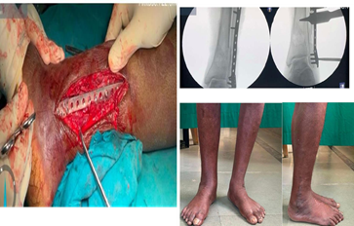
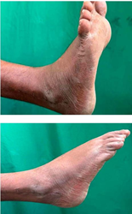
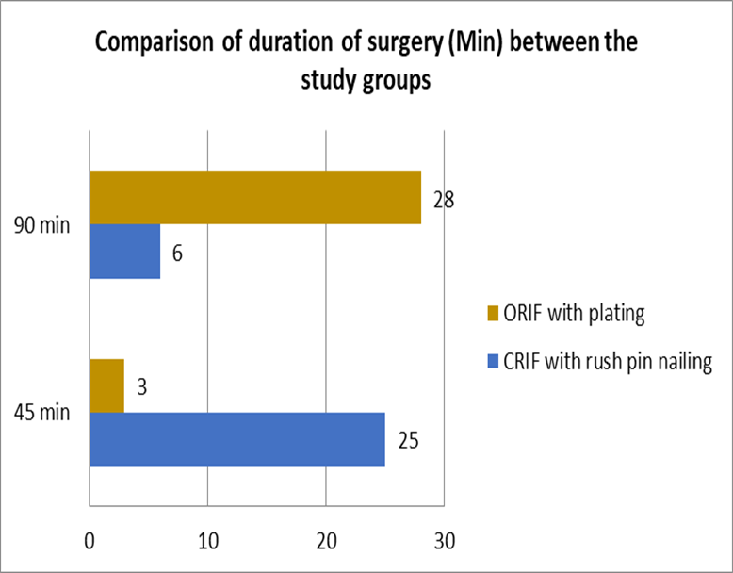
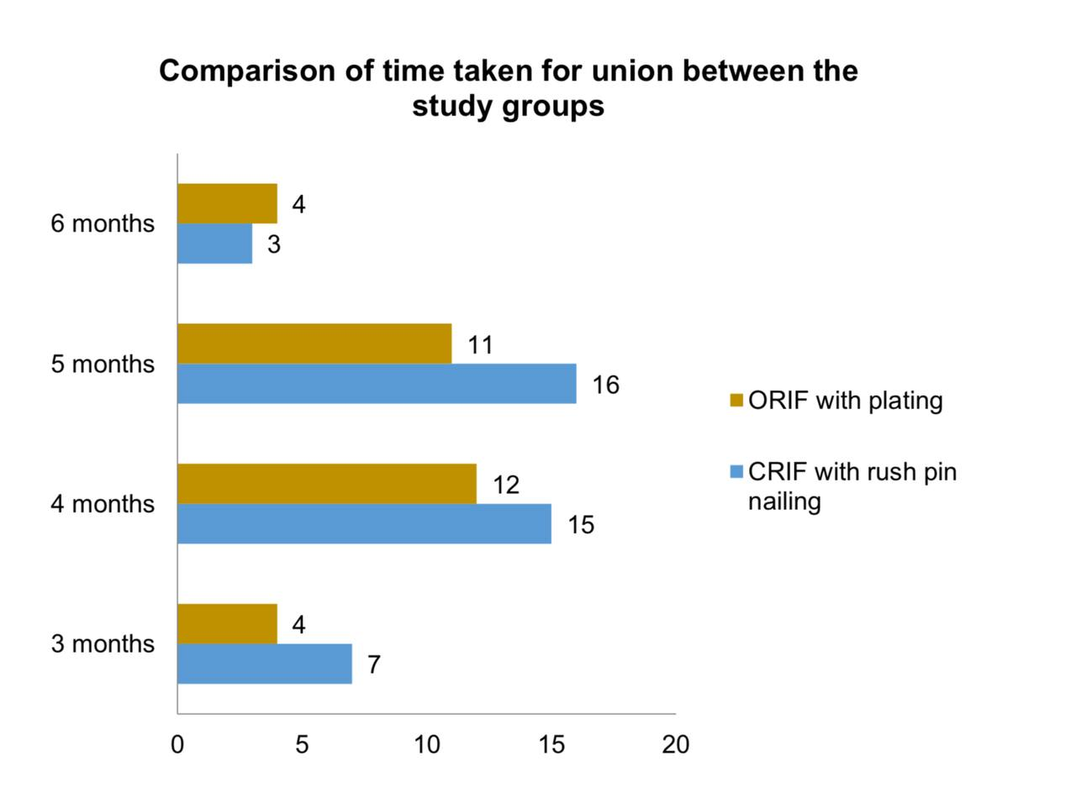
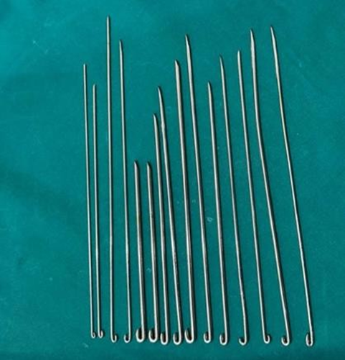
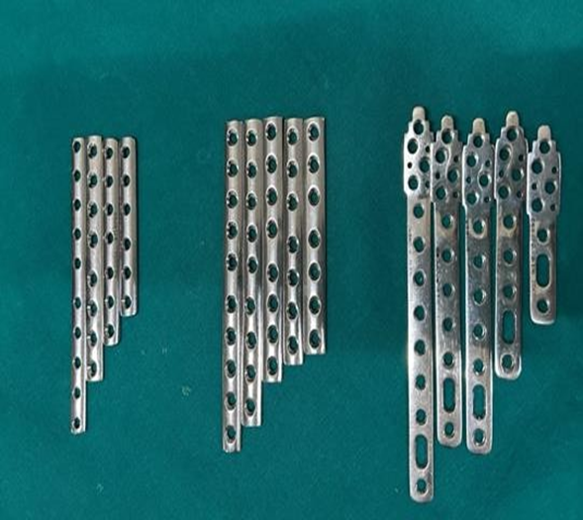

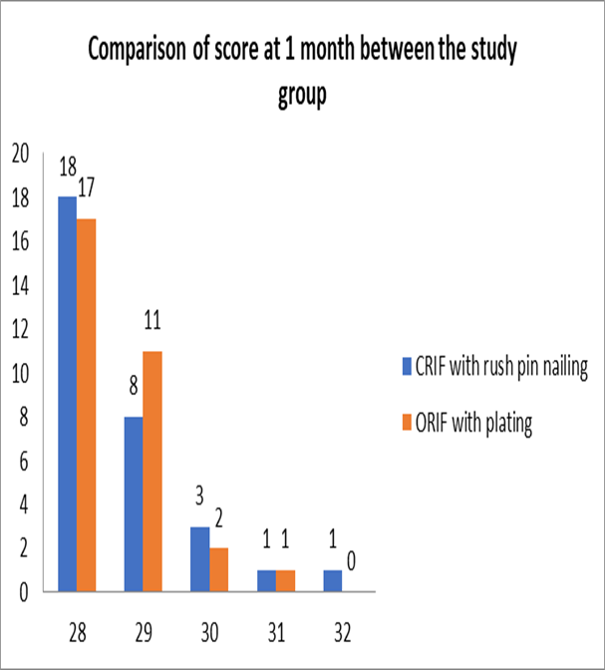
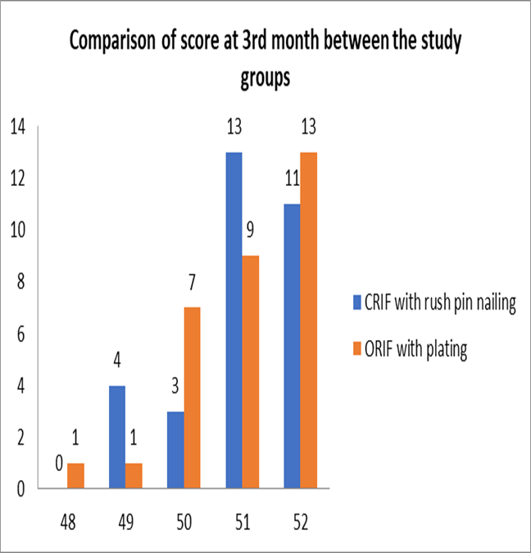
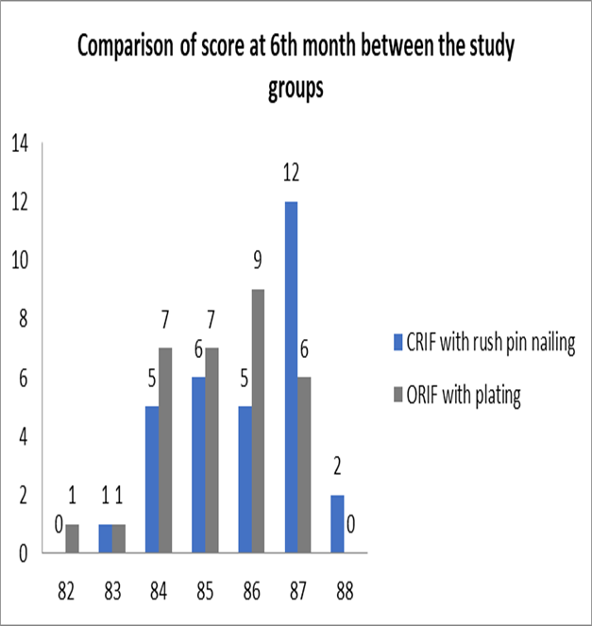
“Comparative Study of Clinical and Radiological Outcomes of Distal Fibular Fractures Treated with Rush Pin versus Plate Fixation”
[Presenting Author] : Dr. B KIRAN
{HOD}: DR. H UMANATHA RAO [Guide] : Dr. Patluri Rohit Raj (Associate Professor)
Viswabharathi Medical College and General Hospital, Kurnool.
OSSAP -284
INTRODUCTION
SURGICAL PROCEDURE
DISCUSSION
Ankle fractures are common injuries needing surgical treatment. They account for 9% of all fractures, with 70–85% involving the distal fibula. Plate fixation offers rigid stability and direct visualization.However, it is associated with wound complications and hardware irritation.The ideal fixation method remains controversial.Rush pin fixation preserves periosteal blood supply and reduces infection risk but provides less rotational stability; the optimal fixation method remains debated.
Surgical Duration & Complications In our Study Findings: CRIF (Rush pin) group had shorter surgical duration – 80.6% completed within 45 minutes. No intraoperative complications or DVT/implant failures in either group. Wound infection and delayed union (3.2%) occurred only in the ORIF group, but not statistically significant (p = 0.34). Similar findings reported in Mauffrey et al. (2012) and Kim et al. (2016) report shorter operative times and fewer wound complications with intramedullary fixation (like Rush pin) compared to plating. Functional Outcomes (FAAM Scores)
In our Study Findings:
1-month: CRIF significantly better (p = 0.008). 3-month: CRIF still superior (p < 0.001).6-month: CRIF slightly better, but not statistically significant (p = 0.058). Similar findings reported in Bhandari et al. (2001): ORIF provides good long-term results, but early recovery is delayed due to wound healing time Bugler et al. (2012): Patients treated with intramedullary devices like Rush pins had faster early mobilization and improved early functional scores.
RESULTS
CONCLUSION
MATERIALS & METHODS
Both Rush pin and plate fixation are effective in managing distal fibular fractures with satisfactory clinical and radiological outcomes. Rush pin fixation is minimally invasive, with reduced soft tissue complications and shorter operative time.Plate fixation provides rigid stability and is better suited for comminuted or unstable fractures. Functional outcomes (e.g., AOFAS scores) were comparable in both groups in simple fracture patterns.The choice of technique should be based on fracture type, soft tissue status, and surgeon’s judgment.
Study Design:Prospective comparative study.
Study Setting:Conducted at Viswabharathi Medical College and Genral Hospital , Kurnool. Study Period:April 2023 to April 2024 (1-year duration).
Study Population: Patients with distal fibular fractures who met the inclusion and exclusion criteria.
Sampling Method: Purposive sampling was used.
* 62 patients with minimum 6-month follow-up.
Group A:with Rush pin fixation
Group B:with Plate fixation
Inclusion Criteria (Short):
Age ≥ 18 years.
Distal fibular fractures (distal 8 cm).
Closed or Gustilo–Anderson type I fractures.
Isolated or associated tibial/ankle injuries.
Exclusion Criteria:
Open fractures (Gustilo II & III).
Medically unfit patients.
Age < 18 years.
.
LIMITATIONS
Predominantly RTA-related fractures.
No blinding, risk of assessment bias.
Limited radiological evaluation.

