Slide 1
OUTCOME OF WASHING MACHINE INJURY WITH PROXIMAL HUMERUS FRACTURE WITH SHAFT FRACTURE WITH FRACTURE BOTHBONE FOREARM TREATED WITH CRIF WITH K WIRE AND TENS
Presenter: DR.V PANNAGA SAI
1st YEAR POSTGRADUATE
DEPARTMENT OF ORTHOPAEDICS
GREAT EASTERN MEDICAL SCHOOL AND HOSPITALS

Slide 2
INTRODUCTION
Washing machine injuries are rare but part of every household .
There are various reports on upper extremity injuries due to inadequate safety precautions while operating the machine.
Most of these injuries occur when an attempt is made to remove the clothes from machine and hands get caught in the spinning and most commonly seen in children.

Slide 3
AIM OF STUDY
To know the outcome of washing machine injury with proximal humerus fracture, shaft of humerus fracture, fracture both bones of forearm especially in children.

Slide 4
MATERIALS AND METHODS
A 11 year old boy came to Emergency department with alleged history of washing machine injury and complaints of pain and restricted range of movements of right upper limb.
On further evaluation, the pateint was diagnosed to have, fracture right proximal humerus/ fracture right both bones forearm.
The pateint was worked up for surgery and CRIF with k wire fixation for proximal humerus, CRIF with TENS nailing for shaft humerus, CRIF With TENS nailing for both bone forearm was done.
Post operatively, regular follow up was done, k wires were removed after 1 ½ months and TENS were removed after 3 months.
Mobilisation was then started.

Slide 5
RESULTS
This reveals the functional outcome of washing machine injury managed surgically with k wire and TENS.
Pateint is able to perform the following movements:
SHOULDER: ELBOW:
FLEXION: 0-120degrees. FLEXION: 0-150 degrees
EXTENSION: 0-65 degrees. EXTENSION: 150-0 degrees
ABDUCTION:0-180 degrees. SUPINATION: 90-75 degrees
ADDUCTION:0-20 degrees. PRONATION: 75-90 degrees
EXTERNAL ROTATION: 0-90 degrees
INTERNAL ROTATION: 0-75 degrees

Slide 6
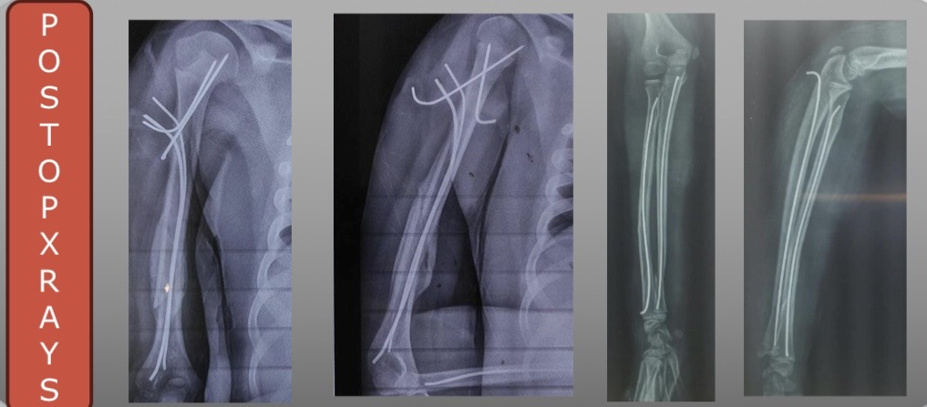
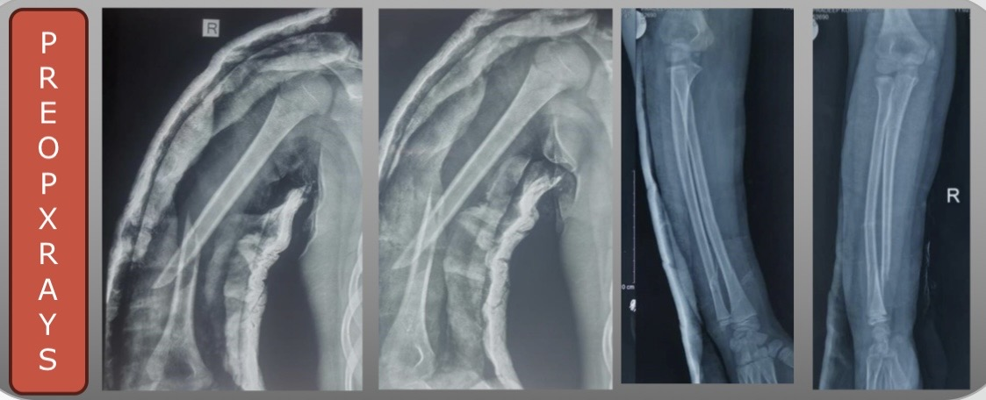
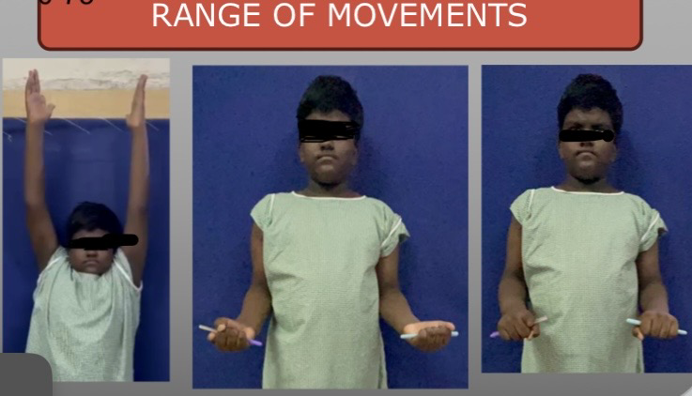
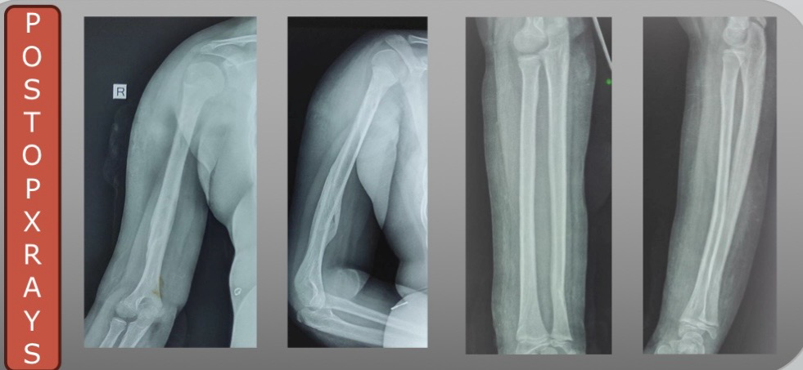

Slide 7
CONCLUSION
This Case concludes that the range of movements can be restored completely when the injury is managed properly and with adequate post operative physiotherapy.

Slide 8
REFERENCES
1.Albattat MY, Alhathloul H, Almohammed Saleh M, Althabit F. Pediatric Floating Elbow Caused by a Novel Mechanism: A Case Report. Cureus. 2022 Sep 13
2.Vergara ADN, Fretes AN. Floating elbow in children: Factors associated with serious complications. J musculoskeletal surgery Res, 2023,7: 259-64.

Slide 9
THANK YOU

