Slide 1




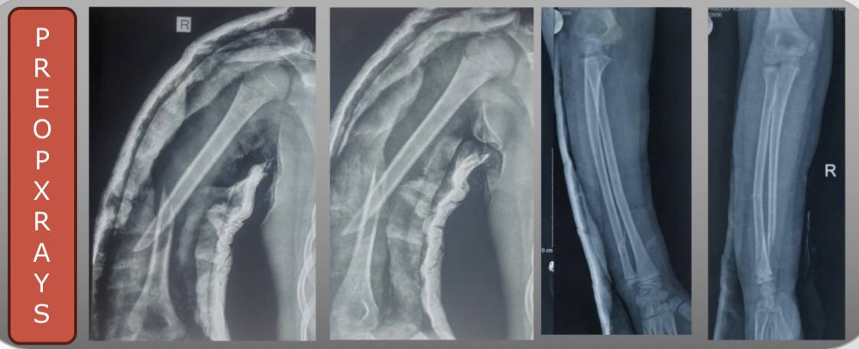
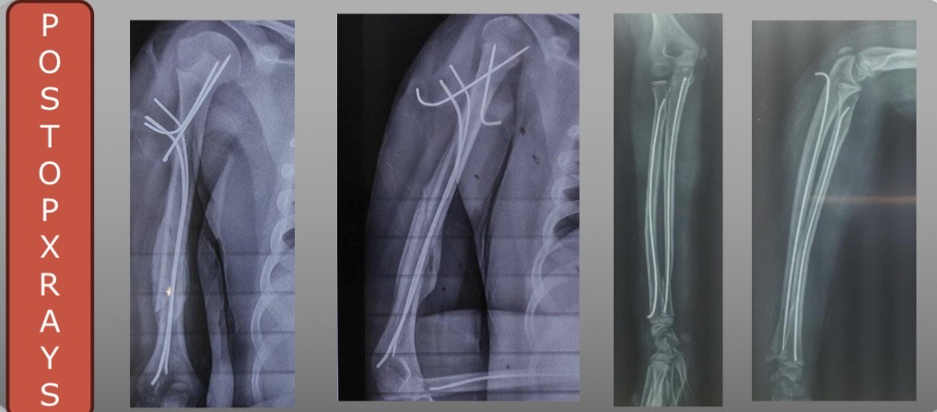
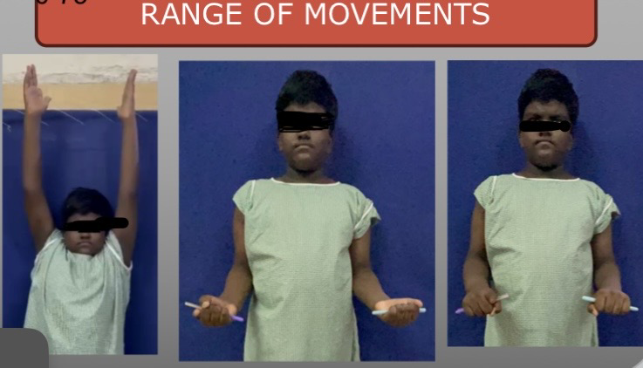
55th Annual Conference of
Orthopedic Surgeon Society of Andhra Pradesh
Date 6 – 8 February,2026, Venue : Kurnool Medical College
Pateint was worked up for surgery and CRIF with K wire fixation for proximal Humerus, CRIF with TENS nailing for shaft of Humerus, CRIF with TENS nailing for both bones forearm was done. Postoperatively, regular follow up was done. K wires were exited after 1.5 months and TENS nails were exited after 3months.
Organized by : Department of Orthopaedics, Kurnool Medical College Kurnool
INTRODUCTION
OPERATIVE FINDINGS
DISCUSSION
Washing machine injuries are rare but part of every household .
•There are various reports on upper extremity injuries due to inadequate safety precautions while operating the machine.
•Most of these injuries occur when an attempt is made to remove the clothes from machine and hands get caught in the spinning and most commonly seen in children.
Intraoperatively, extensive soft tissue injury was noted involving arm & forearm consistent with high energy rotational injury.A proximal humerus fracture was identified.The shaft of humerus showed displaced,unstable fracture.Aditionally, both bone forearm radius and ulna fracture at diaphyseal level.No major arterial injury noted.The Radial,median and ulnar nerve were identified and preserved throughout the procedure.After through wound wash given and reduction is acheived under c arm.
CONCLUSION
CASE REPORT
11 year old male child came to TAEI ward with alleged history of washing machine injury and complaints of pain and restriction of movements over right upper limb.
This report concludes that the range of movements can be restored completely when the injury is managed properly and with adequate post operative physiotherapy.

