Slide 1



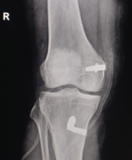
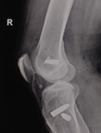
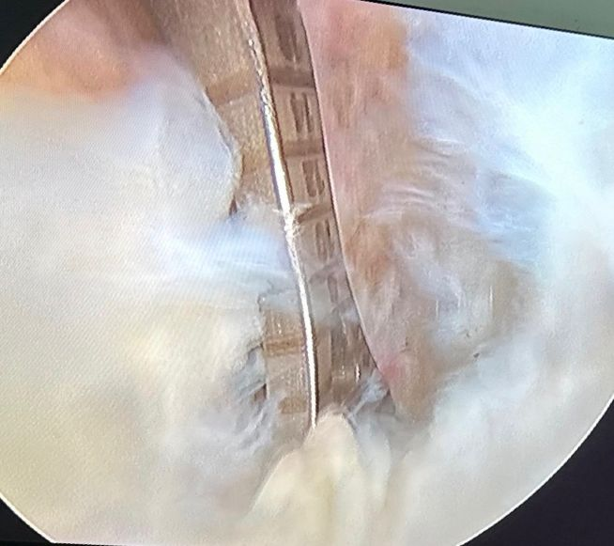
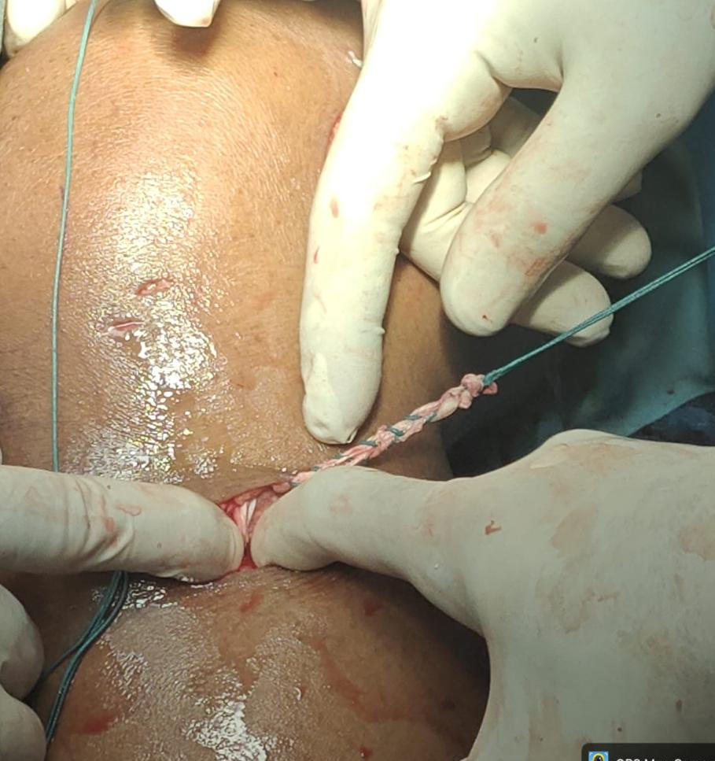
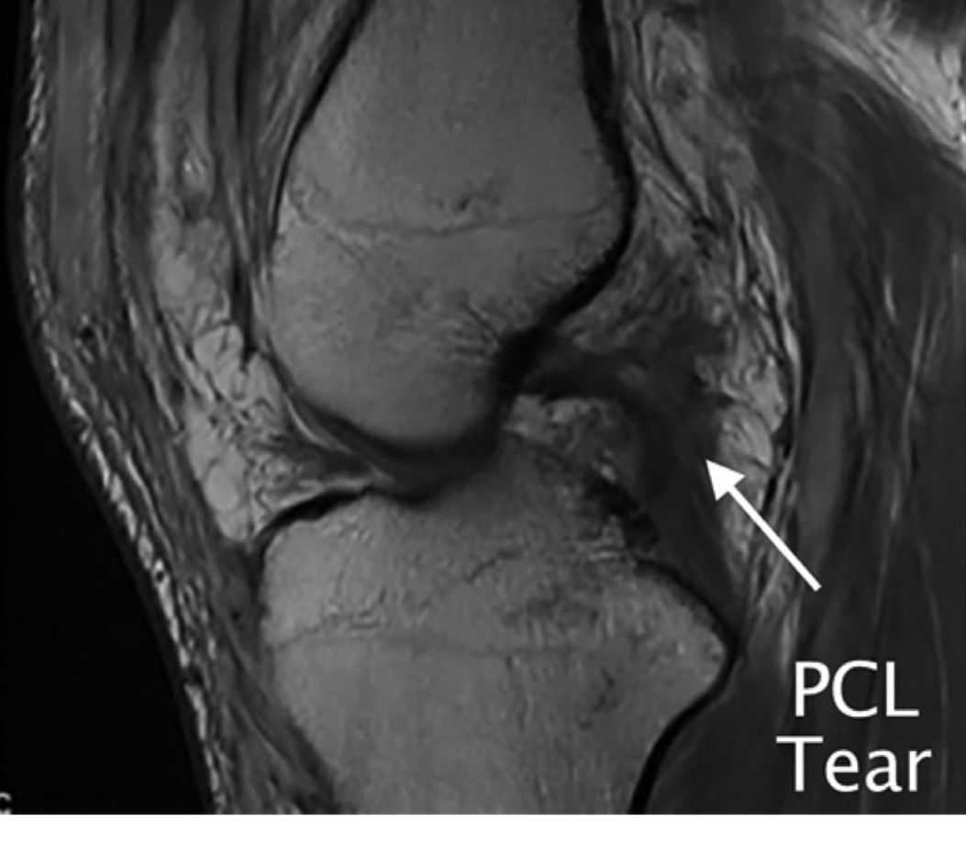
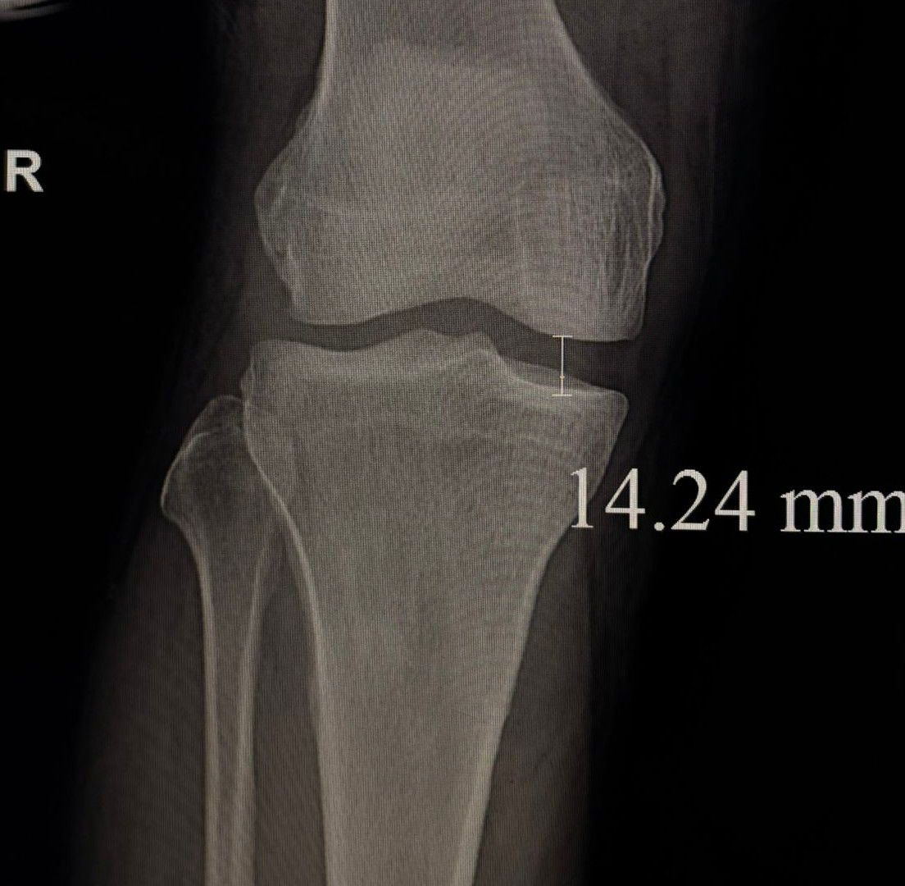
Single-Stage Reconstruction of Combined Posterior Cruciate Ligament and Medial Collateral Ligament Injuries Using Tendon Autografts
AUTHOR – DR B . SANDEEP , GSL MEDICAL COLLEGE
CO – AUTHOR – DR V NAGESWARA RAO,DR SATYA SRI PHANI
INTRODUCTION
OPERA TIVE FINDINGS
DISCUSSION
Posterior Cruciate Ligament and Medial Collateral Ligament represent a subset of multi-ligament knee injuries , which are complex and often result from high-energy trauma such as knee dislocations, sports injuries, or twisting falls. These injuries lead to significant posteromedial instability, abnormal knee kinematics, pain, swelling, and functional limitations. combined PCL + MCL injuries typically require surgical intervention to restore stability
A Skin incision was given over posterior to the lateral malleolus , peroneus longus tendon was identified, and harvested .
standard anterolateral, anteromedial, and posteromedial portals; Anatomic tibial and femoral tunnels were created and the graft was passed and fixed femorally with an adjustable-loop cortical suspensory device. ForTibial fixation a 9 × 30 mm interference screw was used . Then for mcl reconstruction semitendinosus tendon harvested with its tibial attachment preserved and the semitendinosus tendon was passed beneath the MCL insertion and sutured to it. The graft was then routed proximally beneath the sartorial fascia and fixed at the femoral attachment using an 8 × 25 mm interference screw. And remaining graft rerouted as POL and Fixed at the tibial attachment using an 7 × 25 mm interference screw.
Single-stage anatomic reconstruction using autografts addresses these issues by restoring native biomechanics especially in combined injuries. Techniques like this avoid tunnel convergence and allow anatomic placement .In this acute case single-stage approach.
This single –staged reconstruction is effective technique that restores knee stability, achieves satisfactory intraoperative medial stability, and minimizes surgical burden. IKDC score of 81,This case highlights the efficacy of single-stage autograft reconstruction
A 41 year old male came with complaints of pain and instablity of right knee since 10 days and history of twisting injury to right knee Diagnosis was established via clinical laxity testing, stress radiographs magnetic resonance imaging
CASE REPORT
POST OP IMAGING
PRE-OP IMAGING
Acknowledgement
I sincerely thank Dr. V. Nageswara Rao, Head of the Department of Orthopaedics, Department of Radiology, GSL Medical College & General Hospital, for their guidance and support.
REFERENCES
Lau BC, Varsheya K, Morriss N, Wickman J, Kirkendall D, Abrams G. Single-Stage Surgical Treatment of Multi-ligament Knee Injuries Results in Lower Cost and Fewer Complications and Unplanned Reoperations Compared With Staged Treatment. Arthrosc Sports Med Rehabil. 2022 Sep 6;4(5):e1659-e1666. doi: 10.1016

