Slide 1




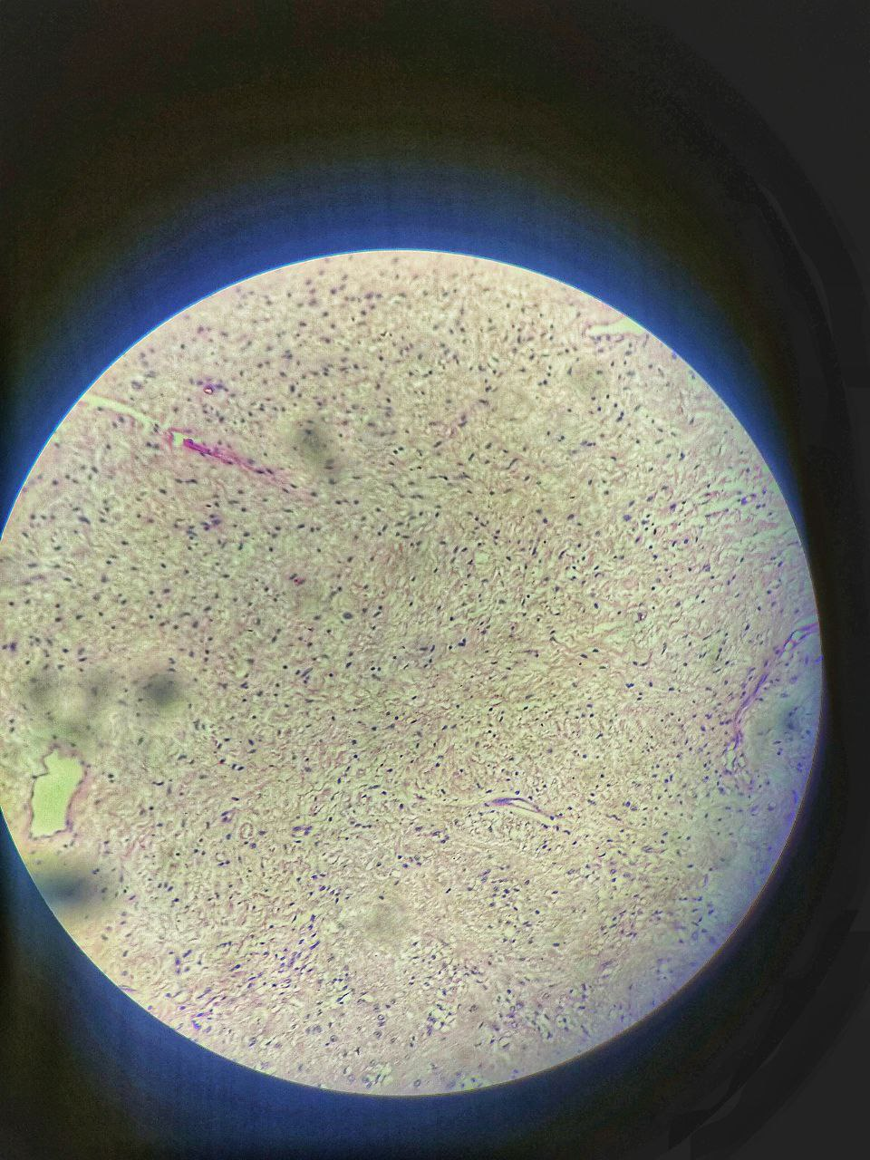
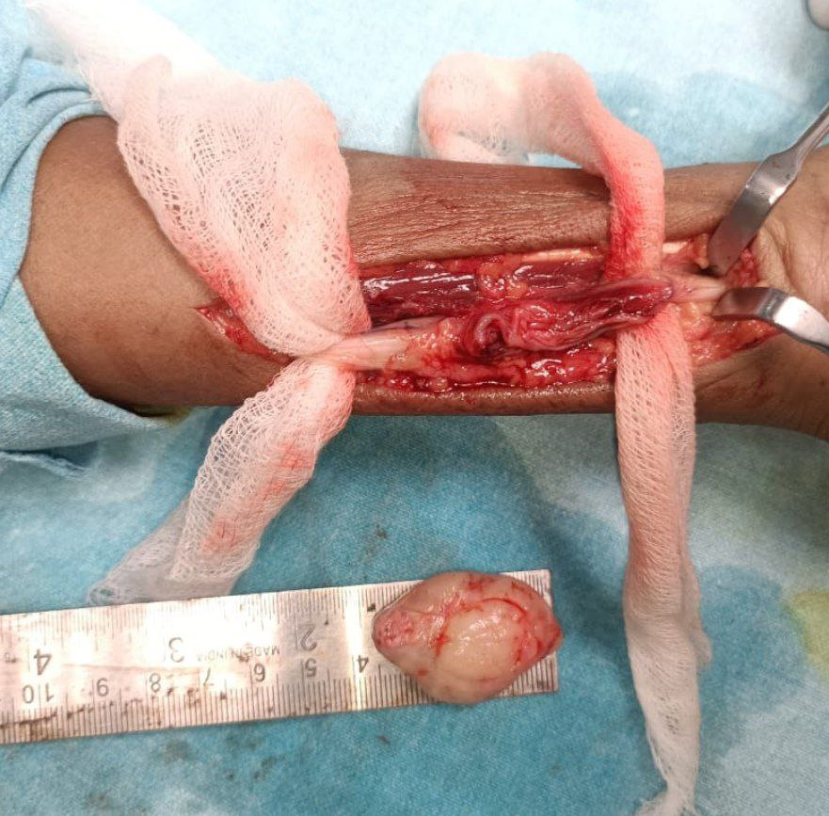
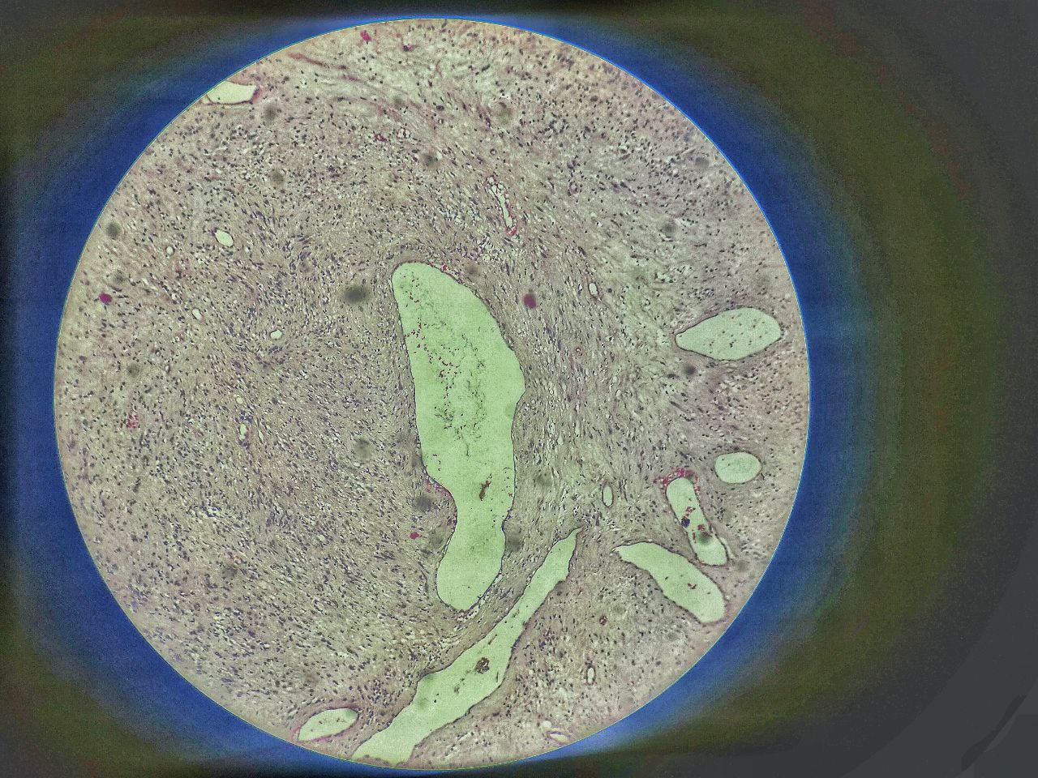
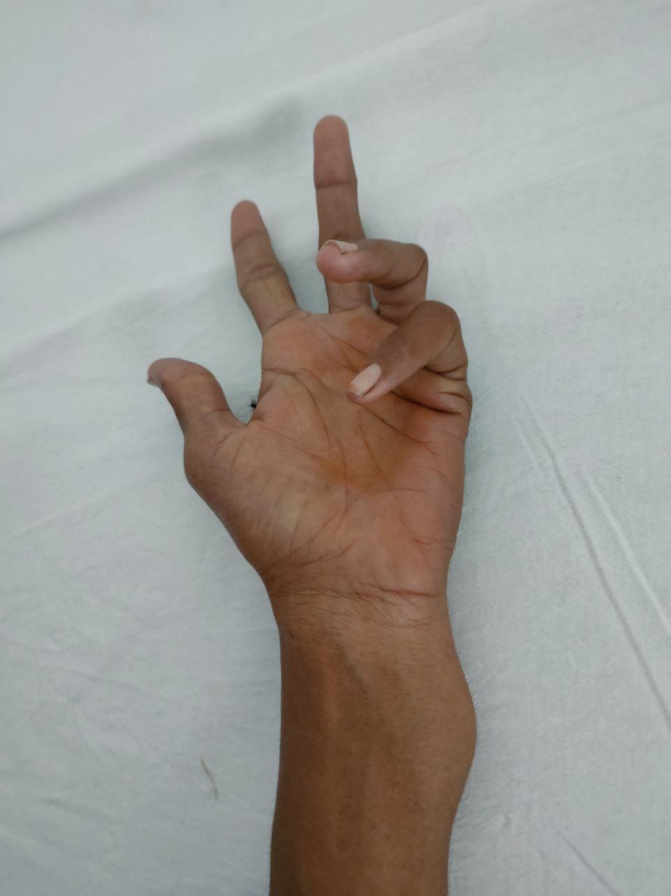
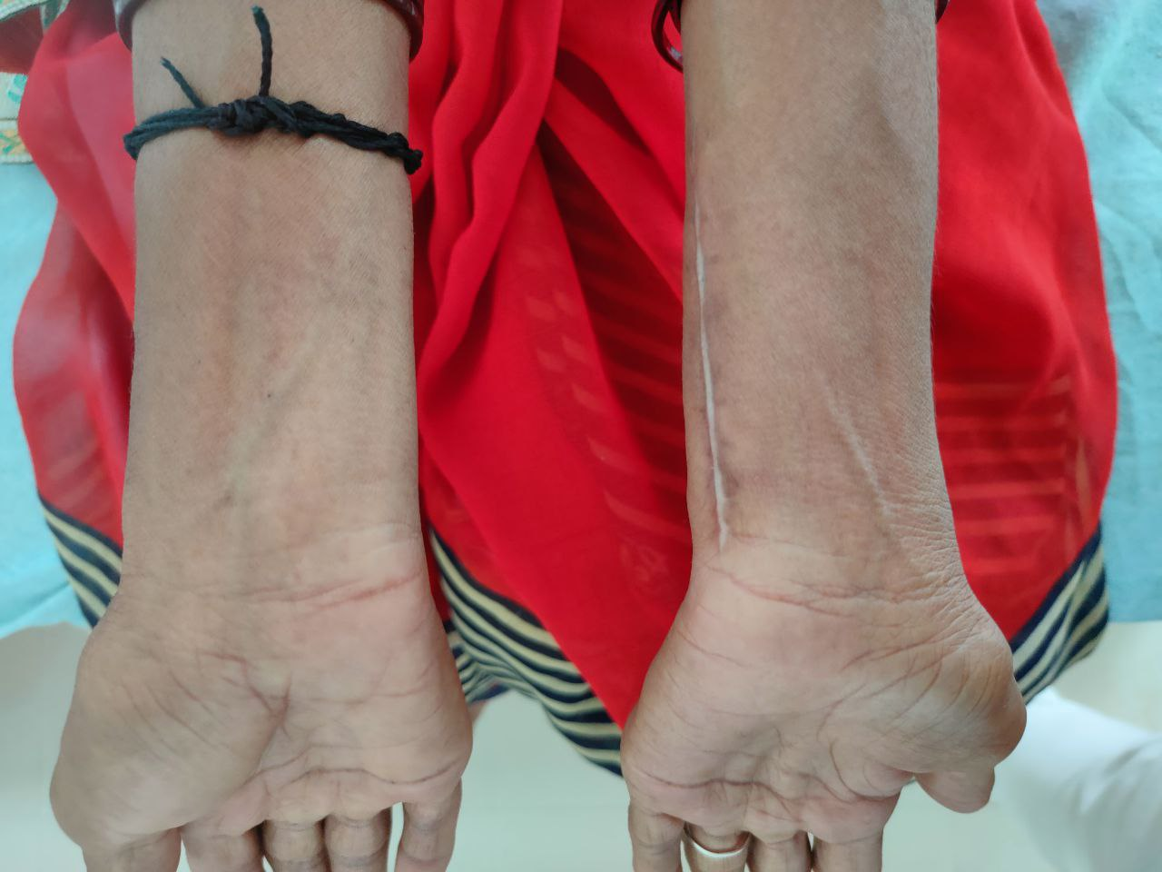
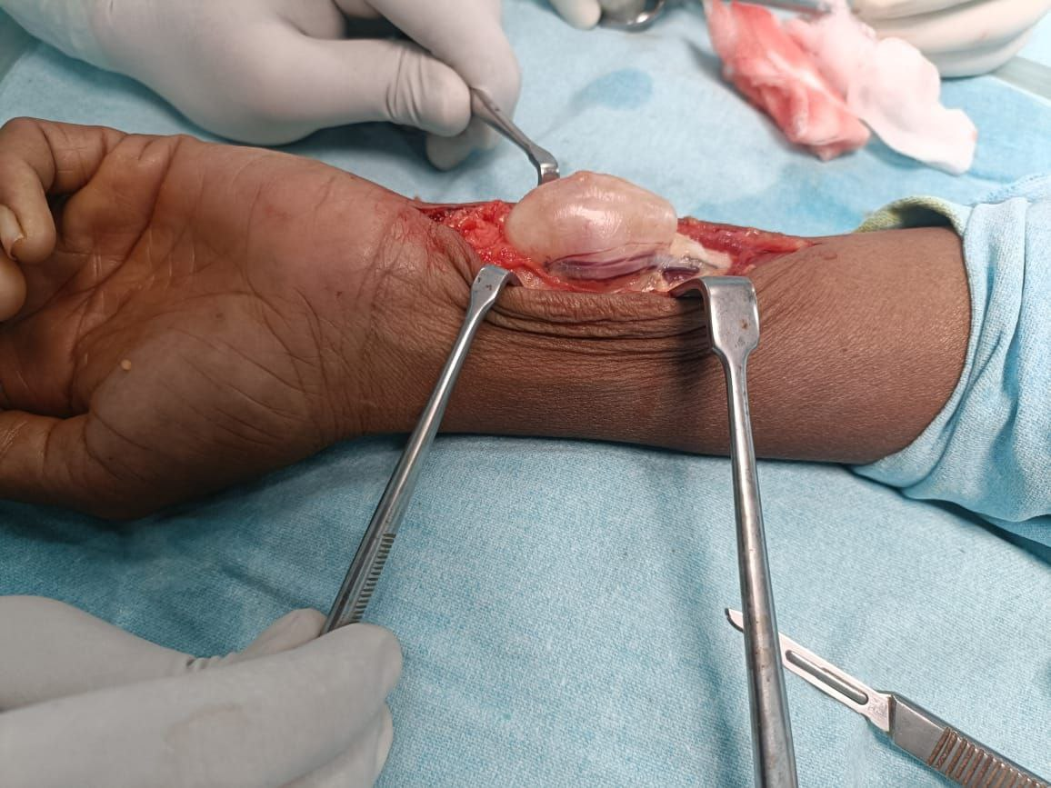
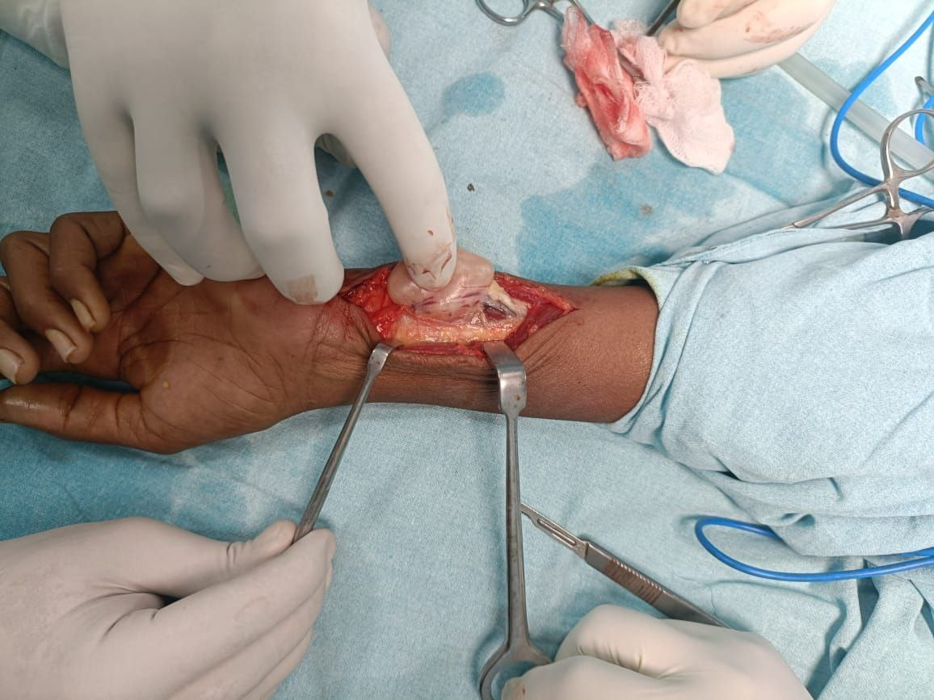
“ HIDDEN ALONG THE NERVE: ULNAR NERVE SCHWANNOMA’’
[Presenting Author] : Dr. Shaik Mohammed Afrid
[Guide] : Dr. Patluri Rohit Raj (Associate Professor)
Viswabharathi Medical College and General Hospital, Kurnool.
ID: OSSAP-292
INTRODUCTION
OPERATIVE FINDINGS
DISCUSSION
Schwannoma is a rare benign peripheral nerve sheath tumour, often presenting as a slow-growing mass with sensory symptoms, arising from Schwann cells derived from the neural crest. Meticulous nerve-sparing surgical excision is essential to achieve symptomatic relief while preserving nerve function.
A well-encapsulated, firm, oval mass was identified arising eccentrically from the ulnar nerve, located within the epineurium and causing splaying of the nerve fascicles. The tumor showed no infiltration into adjacent fascicles or surrounding soft tissues. Individual nerve fascicles were clearly identifiable and separable from the lesion. Complete excision was achieved with preservation of all functioning fascicles and no macroscopic nerve injury.
Ulnar nerve schwannomas are rare, benign, slow-growing tumours that may mimic other soft-tissue swellings. Preoperative imaging helps delineate the lesion, but intraoperative findings confirm the diagnosis. These tumours are typically eccentrically placed, allowing nerve-sparing excision. HPE confirms diagnosis with Antoni-A and B areas with spindle cells and verocay bodies. Complete Meticulous nerve sparing excision usually results in excellent symptomatic and functional recovery.
CASE REPORT
A female aged 41 years came with complaints of swelling over inner aspect of left wrist for 3 years followed by complaints of numbness and motor weakness over left ring and little finger for 6 months. On examination, a cystic oval swelling
of size 5*3cm noted over medial aspect of left wrist. USG shows an oval shaped hyperechoic lesion of size 4.5*2.5*2.2cm suggestive of Peripheral nerve sheath tumour.
CONCLUSION
Ulnar nerve schwannoma should be considered in patients with ulnar-sided limb masses.
Early diagnosis with ultrasonography and careful surgical management ensures excellent functional outcome with minimal morbidity.
Pre-Op
Post-Op

