Slide 1
“EVALUATION OF RESULTS IN LAMINECTOMY AND DISCECTOMY FOR SYMPTOMATIC LUMBAR INTERVERTEBRAL DISC PROLAPSE”
PRESENTER: Dr. P SAI KIRANMAI
(FINAL YEAR POSTGRADUATE )
GUIDE :Dr. CHINTAPETA RAVI
PROFESSOR & HOD ,DEPARTMENT OF ORTHOPAEDICS
MAHAVIR INSTITUTE OF MEDICAL SCIENCES

Slide 2
INTRODUCTION:
Approximate 2% of the general population present with low back pain as a presenting complaint. It is estimated that up to 70% of the population will experience back pain sometime in their life.
However, clinically significant sciatica due to lumbar disc prolapse occurs in 4-6% of the population. The people affected are most commonly below 40 years who are in economically productive age group.
The lumbar disc prolapse occurs after degeneration of intervertebral disc and it is remaining herniations.The presence of radicular pain and other symptoms depend on the site and degree of herniation.

Slide 3
AIM:
To study the clinical presentation of patients with lumbar intervertebral disc prolapse.
To evaluate and the clinical outcome of surgical treatment of lumbar disc prolapse by laminectomy and discectomy.

Slide 4
METHODS:
Under general anaesthesia the patient is positioned in a prone position.
A mid line skin incision is made centering over the spinous process as per the preoperative location of the level, soft tissues are elevated subperiosteally from the spinous process and lamina.
A window is made by incising the ligamentum flavum and nibbling the inferior margin of the lamina.
The dura and the nerve root are retracted to identify the disc pathology. The disc is removed extradurally.
Haemostasis is achieved and the wound is closed in layers

Slide 5
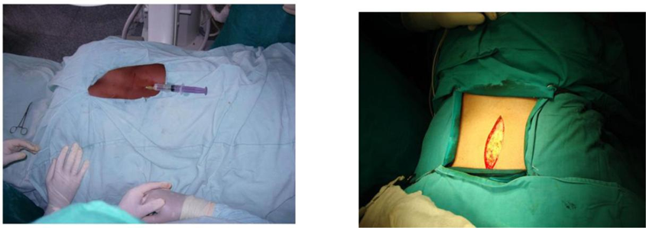
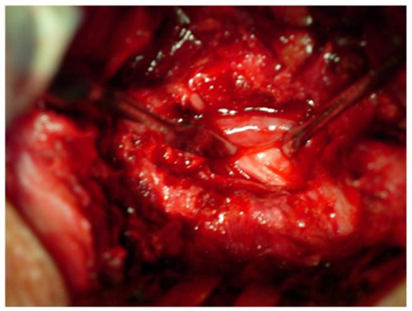
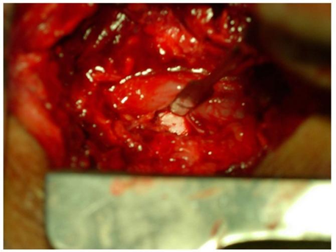
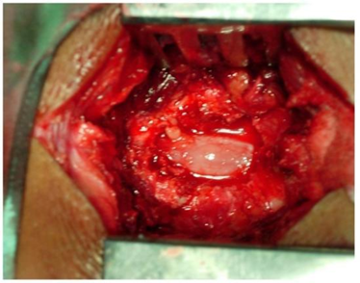
38
Thecal sac retracted to show the compressed root
Local infiltration with epinephrine solution
Midline skin incision over the lumbar spine
Root lying free after disc removal
Ligamentum flavum identified and incised

Slide 6
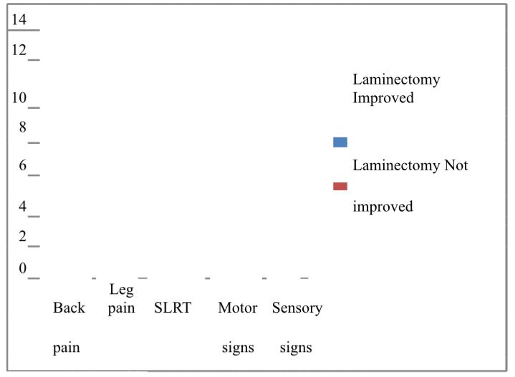
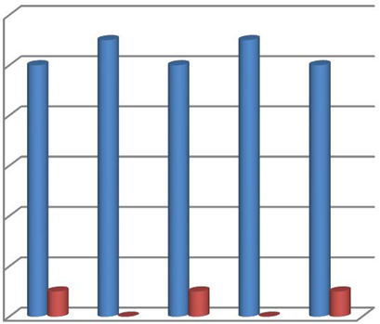
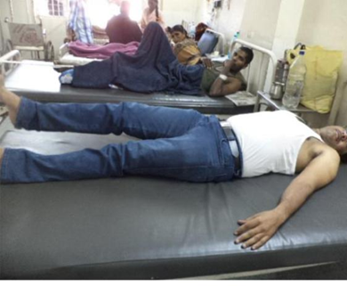
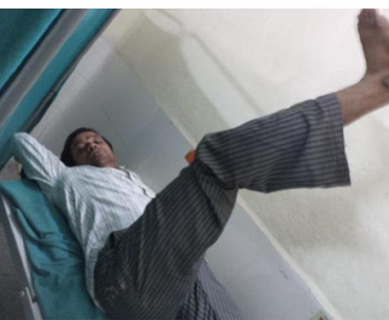
RESULTS:
The study includes 25 patients operated for lumbar intervertebral disc prolapse underwent routine laminectomy and discectomy. All patients were available for follow up for this prospective analysis. The minimum follow up duration was 6 months.
Pre-op SLRT: Post-op SLRT:

Slide 7
CONCLUSION:
There have been a lot of improvements in the surgical management of lumbar disc prolapse cases due to improvement in instrumentation, optics and techniques. This led to the transition from old technique for larger incision, wide exposure for laminectomy and discectomy to the less invasive micro lumbar discectomy to the minimally invasive micro endoscopic discectomy.
Lumbar laminectomy and discectomy still has a place for cases of lumbar disc prolapse with associated primary bony lumbar canal stenosis or secondary lumbar canal stenosis due to thickened ligamentum flavum hypertrophy.
In our study we achieved results comparable to that achieved with microdiscectomy

Slide 8
REFERENCES:
1. Campbell Operative orthopedics 11th ed, Vol. 2, chapter 34-41, page 1729-2328.
2.Abramovitz ZN,Neff S.Lumbar Disc Surgery: Results of prospective lumbar discectomy study of joint section on disorders of spine of peripheral nerves of American Association of Neurological surgeons and Congress of neurological surgeons. Neurosurgery 29: 301 – 308, 1991.
3.Finesson BE. Lumbar disc excision – Schidesk H.K., Sweet W.H. (eds). Operative Neurosurgical Technique, 3rd Ed., 1905 – 1924, 1995.
4.Rothman RH, Simeone FA. The Spine, 2nd ed. Philadelphia: Saunders, 1982.
5.Spangfort EV. The Lumbar disc herniation – a computer aided analysis of 2504 operation. Acta Orthop. Scand suppl 142:3-95, 1972

