Slide 1

Annual Conference of
₅₅th
Orthopedic Surgeon Society of Andhra Pradesh
Date 6 – 8 February,2026, Venue : Kurnool Medical College
Organized by : Department of Orthopaedics, Kurnool Medical College Kurnool
A PROSPECTIVE STUDY OF SURGICAL MANAGEMENT OF CHRONIC NEGLECTED TENDOACHILLES RUPTURE WITH TEUFFER TECHNIQUE
PRESENTER: Dr. BINGI MAURYA RAGHAV (FINAL YEAR POST GRADUATE)
GUIDE: Dr. CHINTAPETA RAVI
PROFESSOR & HOD DEPARTMENT OF ORTHOPAEDICS,
MAHAVIR INSTITUTE OF MEDICAL SCIENCES, VIKARABAD.

Slide 2
Annual Conference of
₅₅th
Orthopedic Surgeon Society of Andhra Pradesh
Date 6 – 8 February,2026, Venue : Kurnool Medical College
Organized by : Department of Orthopaedics, Kurnool Medical College Kurnool
INTRODUCTION
Achilles tendon is the largest and most powerful tendon in the ankle, formed from the fibers of two muscle units, the gastrocnemius muscle, and the soleus muscle.
Injuries of Achilles tendon are relatively common in middle aged athletes and one of most common tendon to be ruptured. The injury mechanism usually involves eccentric loading on a dorsiflexed ankle with the knee extended.
Achilles tendon rupture diagnosed 4 to 6 weeks after injury should be considered a chronic rupture and these are more difficult to treat than acute injuries.
The blood supply to this area is poor, and freshening of the tendon ends is necessary when they are shredded.
Hence, the repair of Tendo Achilles tendon should be augmented with tendon grafting, tendon transfer, or reinforcement with synthetic materials. The tendon of the flexor hallucis longus, plantaris, and peroneus brevis are used for augmentation.
Peroneus brevis tendon transfer was popularized by Perez-Teuffer.

Slide 3
Annual Conference of
₅₅th
Orthopedic Surgeon Society of Andhra Pradesh
Date 6 – 8 February,2026, Venue : Kurnool Medical College
Organized by : Department of Orthopaedics, Kurnool Medical College Kurnool
AIMS
To study the functional outcome and complications associated with Teuffer technique for chronic degenerative tendo Achilles rupture.
METHODS & MATERIALS
A Prospective study conducted at Department of Orthopaedics, Mahavir Institute Of Medical Sciences, Vikarabad
Study Size:10 Patients
Duration of Study: September 2024 to September 2025
Inclusion criteria : Age group between <60 years, > 4weeks old neglected-rupture, both type rupture - near tendon insertion & in watershed area, gap <5cm.
Exclusion criteria: Age > 60 years, acute rupture, associated with calcaneum fracture, gap >5cm, foot deformity, Neuromuscular deformity.

Slide 4
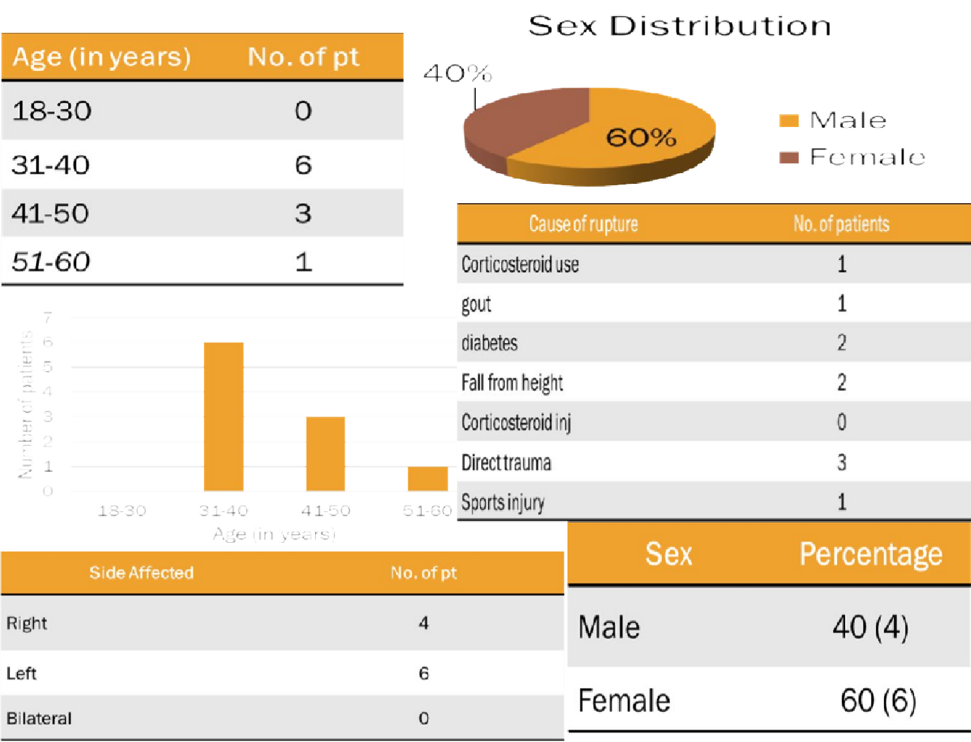
Annual Conference of
₅₅th
Orthopedic Surgeon Society of Andhra Pradesh
Date 6 – 8 February,2026, Venue : Kurnool Medical College
Organized by : Department of Orthopaedics, Kurnool Medical College Kurnool
DEMOGRAPHICS
Pre-operative procedure Clinical presentation Pain, snapping sensation, difficulty in walking and inability to run.
Clinical examination local site tenderness, inability to actively plantar flex the ankle
Positive Thompsons’ test &O'Brian's needle test.
Palpable defect at rupture site.
Ankle radiographs were obtained to rule out calcaneal fractures and USG to confirm complete rupture and gap between rupture ends.
Written informed consent.

Slide 5
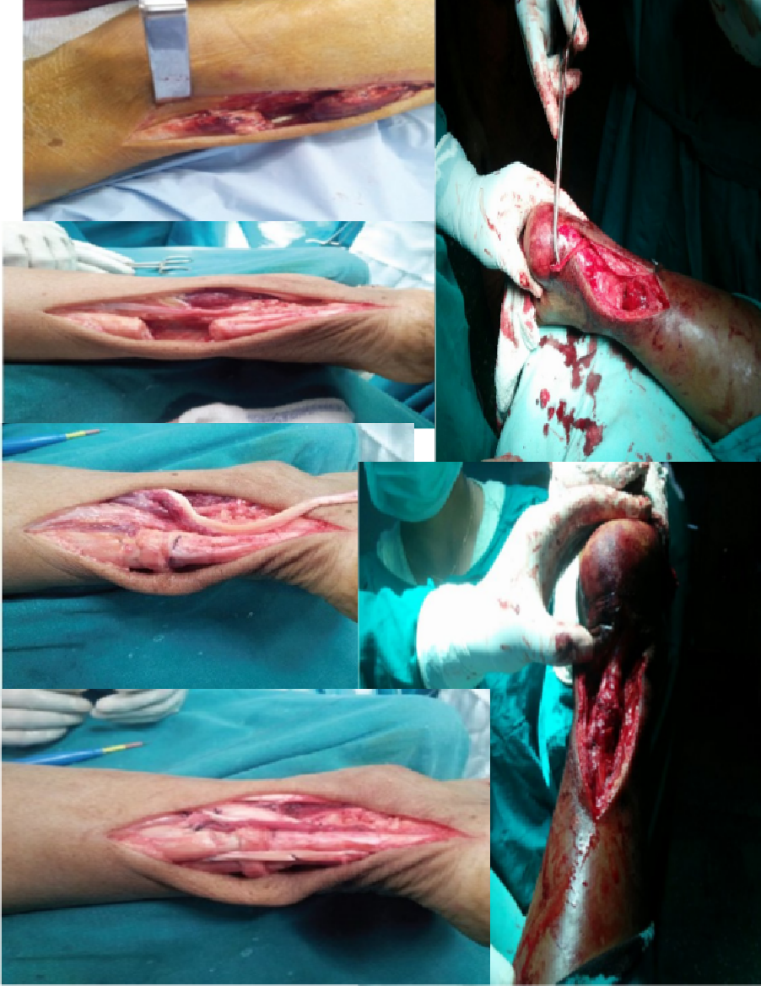
Annual Conference of
₅₅th
Orthopedic Surgeon Society of Andhra Pradesh
Date 6 – 8 February,2026, Venue : Kurnool Medical College
Organized by : Department of Orthopaedics, Kurnool Medical College Kurnool
SURGICAL TECHNIQUE &POST-OP PROTOCOL
Patient in prone position; Achilles tendon exposed via
posterolateral incision, sural nerve identified and protected
Peroneus brevis tendon detached at insertion through separate incision and transferred to primary wound
Scarred ends of Achilles excised; primary repair done using modified Kessler technique.
Calcaneal tuberosity drilled (4 mm), peroneus brevis passed through the hole lateral-to-medial and sutured proximally to form dynamic loop augmentation
•Immobilization: Above knee cast × 4 weeks in 10–15° plantar flexion → neutral cast × 4 weeks
Weight bearing from 6 weeks; cast removed at 8 weeks
Progressive rehabilitation; sports restricted for 5–6 months.

Slide 6
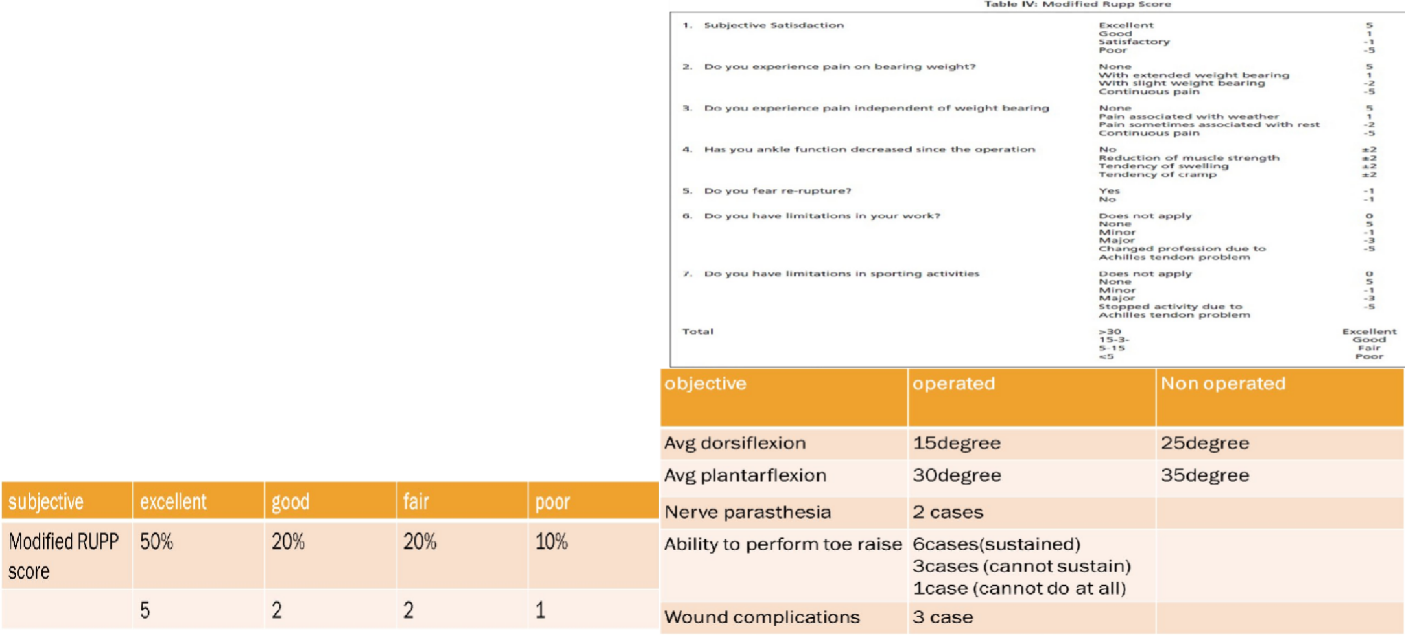
Annual Conference of
₅₅th
Orthopedic Surgeon Society of Andhra Pradesh
Date 6 – 8 February,2026, Venue : Kurnool Medical College
Organized by : Department of Orthopaedics, Kurnool Medical College Kurnool
RESULTS
All patients were examined using objective and subjective criteria.
Objective criteria- Ankle range of motion, Neurological status of the foot were examined& toe raise
Subjective criteria - the Rupp score, as modified by Kerkhoff's et al.
Results were rated as excellent (>30 points), good (15-30 points), fair (5-15 points) and poor (<5 points)

Slide 7
Annual Conference of
₅₅th
Orthopedic Surgeon Society of Andhra Pradesh
Date 6 – 8 February,2026, Venue : Kurnool Medical College
Organized by : Department of Orthopaedics, Kurnool Medical College Kurnool
CONCLUSION
There is increased risk of Achilles tendon rupture after local steroid
injection for inflammatory lesions of tendon or around the tendon.
Results of reconstruction of Achilles tendon ruptures using peroneus brevis tendon show a strong and stable repair that allows early weight bearing ambulation with favorable clinical results in most patients.
Care must be taken to prevent wound problems and deep infection that can necessitate more extensive dissection
Disadvantages of the procedure should be shared in detail with patients when obtaining informed consent.
Further studies that include professional athletes should be performed to confirm efficacy of this augmented technique

Slide 8
Annual Conference of
₅₅th
Orthopedic Surgeon Society of Andhra Pradesh
Date 6 – 8 February,2026, Venue : Kurnool Medical College
Organized by : Department of Orthopaedics, Kurnool Medical College Kurnool
REFERENCES
Demirel M, Turhan E, Dereboy F, Yazar T. Augmented repair of acute tendo Achilles ruptures with gastrosoleus turn down flap.Indian J Orthop. 2011; 45(1): 45-52.
Perez Teuffer A. Traumatic rupture of the Achilles Tendon. Reconstruction by transplant and graft using the lateral peroneus brevis. Orthop Clin North Am. 1974; 5(1): 89-93.
Kerkhoffs GM, Struijs PA, Raaymakers EL, Marti RK. Functional treatment after surgical repair of acute Achilles tendon rupture: wrap vs walking cast. Arch Orthop Trauma Surg. 2002; 122(2): 102-5.
Kannus P, Józsa L. Histopathological changes preceding spontaneous rupture of a tendon. A controlled study of 891 patients. J Bone Joint Surg Am. 1991; 73(10): 1507- 25.
Zafar MS, Mahmood A, Maffulli N. Basic science and clinical aspects of achilles tendinopathy. Sports Med Arthrosc. 2009;17(3): 190-7.

