Slide 1



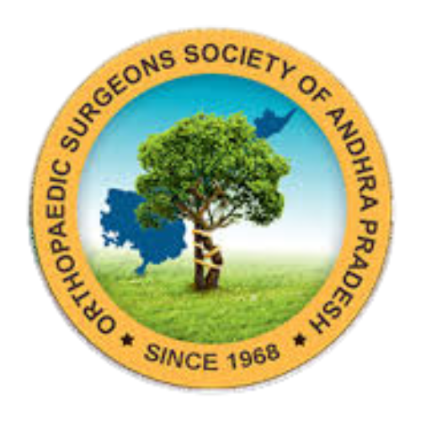
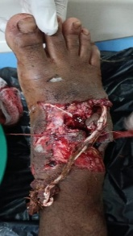
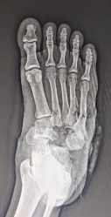
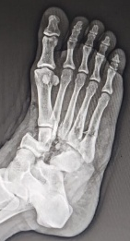
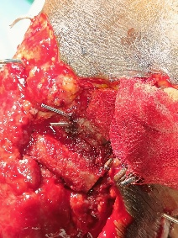
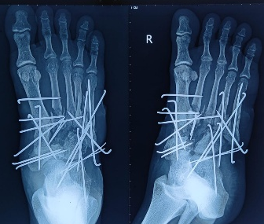
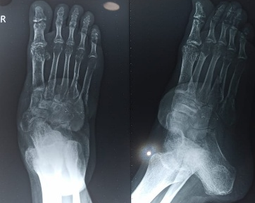
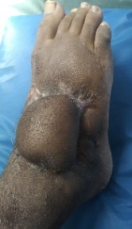
55th Annual Conference of Orthopedic Surgeon Society of Andhra Pradesh
MANAGEMENT OF COMPOUND FRACTURE DISLOCATION OF MID FOOT(GRADE 3B) WITH BONELOSS TREATED WITH MULTIPLE K-WIRES,TRICORTICAL BONE GRAFT AND FLAP; A CASE REPORT
Date 6 – 8 February,2026, Venue : Kurnool Medical College
Dr. KHAMBHAM KALYAN (3rd year PG)MS Orthopaedics
DEPARTMENT OF ORTHOPAEDICS ,KIMS MEDICAL COLLEGE ,AMALAPURAM ,Dr.B.R.AMBEDKAR KONASEMA DISTRICT, AP
INTRODUCTION
OPERATIVE FINDINGS
DISCUSSION
Compound fractures of foot are rare(<5% of foot injuries) and carry 17–30% amputation risk without early debridement, stable fixation, and timely soft-tissue coverage.
Lisfranc injuries occur at 9.2/100,000/year; Chopart injuries are rarer (2.2/100,000/year)
Combined Chopart–Lisfranc fracture-dislocations account for only 5.9% of cases, Common in young adults, often due to high-energy two-wheeler accidents
Associated with severe soft-tissue injury and contamination.
We present a rare case of a 22-year-old male with a Gustilo–Anderson grade IIIB open fracture–dislocation involving both the Chopart and Lisfranc joints of the right foot, highlighting the challenges and importance of timely multidisciplinary management in limb salvage.
The patient underwent immediate copious saline irrigation, administration of broad-spectrum intravenous antibiotics, and urgent surgical debridement. Initial stabilization was achieved using multiple Kirschner wires. One week later, reconstruction was performed using a tricortical iliac crest bone graft to replace the cuneiform defects, secured with K-wires, followed by split-thickness skin grafting due to dorsal foot necrosis.
As only 50% graft uptake was observed at two weeks,k wire removal & definitive soft-tissue coverage was achieved with a reverse soleus fasciocutaneous flap(8Weeks in total ) The extensor digitorum tendon could not be salvaged. The flap healed uneventfully, resulting in satisfactory wound coverage.
Complex foot trauma involves combinations of injuries such as pilon, talus, calcaneal, Chopart, and Lisfranc fracture-dislocations and is often complicated by high-energy compound wounds.
In our case, a road traffic accident resulted in a Gustilo–Anderson grade IIIB open foot injury with cuneiform bone loss and severe contamination. Such injuries carry a high risk of amputation due to infection, delayed intervention, and inadequate soft-tissue coverage.
Prompt management included urgent debridement within six hours, broad-spectrum intravenous antibiotics, and stable fixation using multiple K-wires to maintain medial and lateral column length, followed by early wound coverage.
In the second stage, iliac crest bone grafting was used to reconstruct the cuneiform defect, providing mechanical stability and biological support. Soft-tissue coverage was achieved using a reverse soleus fasciocutaneous flap.
At six months, fractures had united with excellent graft incorporation and good functional recovery, highlighting the importance of early intervention, stable fixation, effective bone reconstruction, and timely wound coverage in limb salvage.
CASE REPORT
CONCLUSION
A 22-years male sustained injury to the right foot due to RTA.Examination revealed a Gustilo–Anderson grade IIIB open fracture–dislocation involving both the Chopart and Lisfranc joints, associated with fractures of the bases of the 2nd,3rd,4th,5thmetatarsals, along with a cuboid body fracture.The wound was grossly contaminated with mud, sand, and vegetative debris.There was en masse bone loss of the middle and lateral cuneiforms.Distal neurovascular status was intact.
Prompt treatment in the form urgent debridement <6hrs,iv broad spectrum antibiotics on arrival.
Minimum but stable fixation and in second stage addressing issues like bone loss with iliac crest bone graft and flap covering can give optimum functional result with pain relief and reduces the chance of amputation in cases like grade 3B compound fractures with severe contamination

