Slide 1
POSITIVE REDUCTION IN INTERTROCHANTERIC FRACTURES IT'S POST OPERATIVE RADIOLOGICAL EVALUATION CORRELATION WITH FUNCTIONAL OUTCOME AND RATE OF UNION
Dr. Khambham Kalyan
3rd year Resident
KIMS&RF
Amalapuram.
Guide:-Dr.Y.Nageswara Rao(Prof. HOD)
Dr.J.S.S.N.Manohar (Asst.Prof)

Slide 2
INTRODUCTION
Intertrochanteric fractures are highly prevalent in the elderly accounting for about 34%-50% of all hip fractures with rising incidence due to increased life expectancy and osteoporosis, and are associated with high morbidity, mortality, prolonged hospital stay, and loss of independence. Nearly one-third of patients fail to regain pre-injury functional status
Surgical management is the standard of care with intramedullary devices (PFN) providing better biomechanical stability, minimal surgical exposure and blood loss, early mobilization and weight bearing, preferred over conservative treatment which is associated with complications of immobilization
Post-operative radiological reduction predicts stability, union, and function. Positive medial cortical support prevents varus collapse and implant failure. Good reduction correlates with faster fracture union, better pain relief and improved functional outcomes
Malreduction, excessive tip apex distance and varus collapse are associated with delayed union, implant cut-out, reoperation, poor function and prolonged rehabilitation

Slide 3
AIM AND OBJECTIVES
Aim:
To evaluate the correlation between post-operative radiological reduction quality with specific emphasis on positive medial cortical support and the functional outcome and rate of fracture union in patients undergoing surgical fixation for intertrochanteric fractures.
Objectives:
To assess the quality of reduction on immediate post-operative radiographs using predefined radiological parameters such as neck shaft angle, medial cortical continuity, tip apex distance and implant position.
To evaluate the rate and quality of radiological union during follow-up based on progressive callus formation and loss of fracture line visibility
To assess functional outcome using a standard scoring system (e.g., Harris Hip Score) at serial follow-up intervals.

Slide 4
MATERIALS AND METHODS
Study Design: Prospective observational study.
Study Setting: Conducted at KIMS Hospital, a tertiary care center
Study Population:All patients with intertrochanteric fractures of the femur who underwent surgical fixation were included in the study after fulfilling the eligibility criteria
Sample duration:18months
Sample size:45 patients

Slide 5
Inclusion Criteria:
Age ≥ 18 years.
Radiologically proven intertrochanteric fracture of the proximal femur.
Patients planned for operative management using intramedullary fixation (e.g., PFN).
Exclusion Criteria
Pathological fractures (except osteoporosis).
Polytrauma patients with multiple long-bone fractures.
Associated neurovascular injury around the fracture site.
Prior hip surgery on the affected side.
Patients unable or unwilling to comply with follow-up.

Slide 6
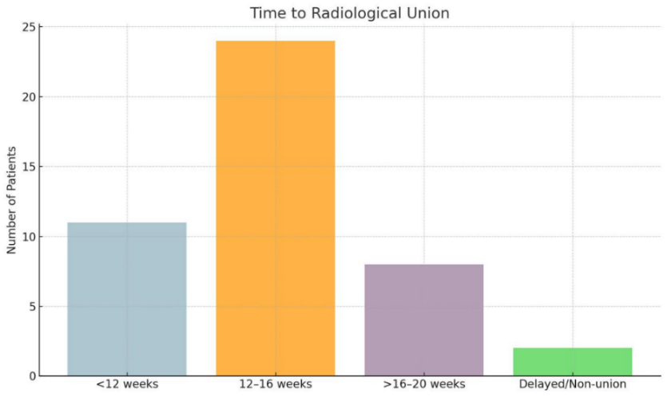
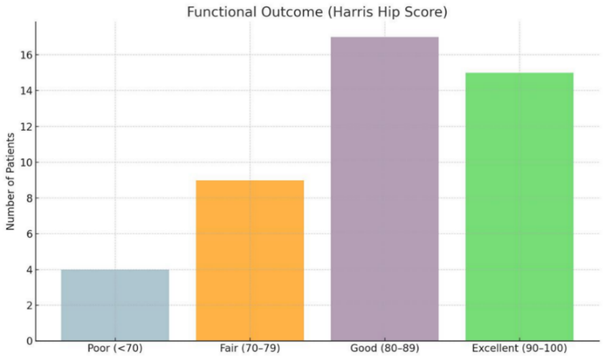
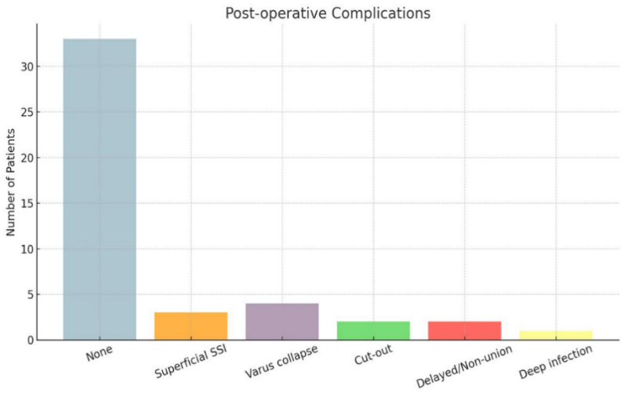
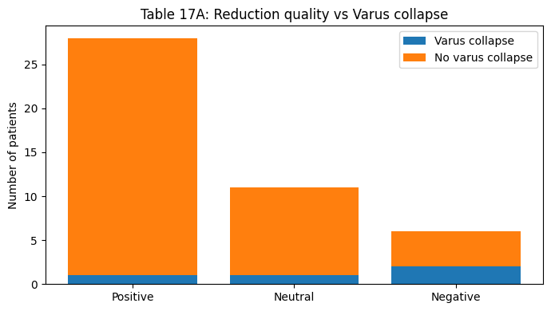
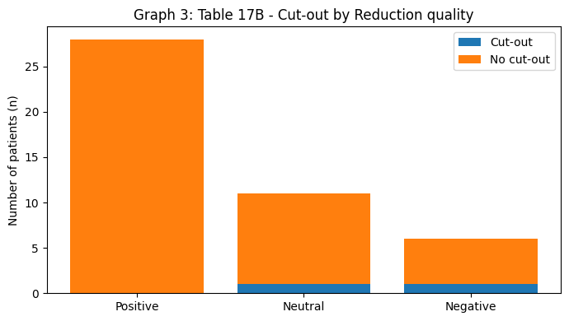
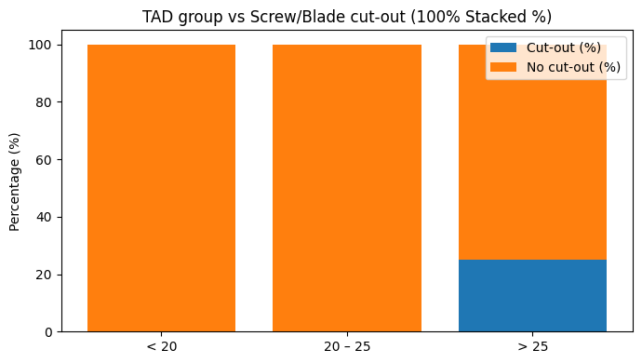
Quality of reduction on immediate post-op radiograph-positive(28),negative(11),neutral(6)
Time to radiological union
Functional outcome
Distribution of complications
(At 1 year)
53.3%
37.8%
73.3%
33.3%
24.4%
20.0%
17.8%
8.9%
8.9%
6.7%
4.4%
4.4%
2.2%
4.4%
Reduction quality vs complications
Reduction quality vs Screw/Blade cut-out
Tip–Apex Distance (TAD) vs Screw/Blade cut-out
3.6%
0.0%
0.0%
0.0%
25.0%
9.1%
9.1%
33.3%
16.7%

Slide 7
CONCLUSION
This study demonstrates that post-operative reduction quality, particularly the achievement of positive medial cortical support, has a significant influence on mechanical stability, fracture union, and functional outcome in intertrochanteric fractures treated with intramedullary fixation.
Patients with positive reduction showed earlier radiological union, better functional outcome, and fewer complications compared to those with neutral or negative reduction. Varus collapse and screw/blade cut-out were predominantly observed in cases with poor reduction quality and tip–apex distance greater than 25 mm. Restoration of a near-normal neck–shaft angle and optimal implant positioning contributed to improved outcomes.
Therefore, meticulous intra-operative reduction with emphasis on medial cortical support and optimal implant placement should be considered a primary surgical goal to optimize union, function, and overall patient outcomes.

Slide 8
REFERENCES
Fang C, Wong TM, Lau TW, To KK, Leung F. Optimizing stability in unstable intertrochanteric fractures. Injury. 2017;48(10):2114–2120.
Chang SM, Zhang YQ, Ma Z, et al. Fracture reduction with positive medial cortical support: a key element in stability reconstruction for unstable intertrochanteric hip fractures. Arch Orthop Trauma Surg. 2015;135(6):811–818.
Roux C, Briot K. Imminent fracture risk. Osteoporos Int. 2017;28(6):1765–1769.
Agarwal N, Gupta A, Yadav C, et al. Functional outcome of intertrochanteric fractures treated with proximal femoral nail. J Clin Orthop Trauma. 2019;10(2):320–326.
Kuzyk PR, Guy P, Kreder HJ, et al. Prediction of outcome following hip fracture fixation. J Orthop Trauma. 2012;26(2):76-80.
Dhanwal DK, Siwach R, Dixit V, et al. Incidence of hip fracture in the elderly population in India and related factors. Arch Osteoporos. 2011;6:123-127.

