Slide 1

₅₅th
Annual Conference of
Orthopedic Surgeon Society of Andhra Pradesh
Date 6 – 8 February,2026, Venue : Kurnool Medical College
Organized by : Department of Orthopaedics, Kurnool Medical College Kurnool
EVALUATION OF CLINICAL AND RADIOLOGICAL OUTCOMES OF SCHATZKER TYPE V AND VI TIBIAL PLATEAU FRACTURES MANAGED BY DUAL PLATING: A PROSPECTIVE ANALYTICAL STUDY
Presenting author :Dr .B . IMRAN
Final year post graduate Co-author : Dr . P. SUJITH DEVA PRASAD
Professor & HOD
Institute : SANTHIRAM MEDICAL COLLEGE AND GENERAL HOSPITAL,NANDYAL,ANDHRA PRADESH.

Slide 2
Annual Conference of
₅₅th
Orthopedic Surgeon Society of Andhra Pradesh
Date 6 – 8 February,2026, Venue : Kurnool Medical College
Organized by : Department of Orthopaedics, Kurnool Medical College Kurnool
INTRODUCTION:
Schatzker type V and VI tibial plateau fractures are complex injuries resulting from high-energy trauma, often associated with soft tissue damage with significant challenges in restoring joint congruity and function.
Aims and Objective:
This study aims to evaluate the functional outcomes of closed Schatzker type V and VI tibial plateau fractures managed by fracture specific dual plating, assessed using the Hospital for Special Surgery (HSS) knee scoring system.
It seeks to analyze the complications associated with this treatment method and assess its advantages and disadvantages as a fixation technique for managing such fractures.

Slide 3
Annual Conference of
₅₅th
Orthopedic Surgeon Society of Andhra Pradesh
Date 6 – 8 February,2026, Venue : Kurnool Medical College
Organized by : Department of Orthopaedics, Kurnool Medical College Kurnool
Materials and Methods:
This was a prospective analytical study conducted at the Department of Orthopaedics, SANTHIRAM Medical College and General Hospital, Nandyal, Andhra pradesh, from July 2024 to June 2025.
The study focused on Schatzker type V and VI tibial plateau fractures managed with dual plating.
Inclusion criteria:
Adult patients aged 18–60 years.
Closed Schatzker type V and VI tibia plateau fractures.
Patients willing to give consent to this study and follow up.
Exclusion criteria:
Open fractures.
Old fractures (> 4 weeks).
Fractures with neurovascular injury.
Patients unfit for surgery or unwilling to consent.

Slide 4
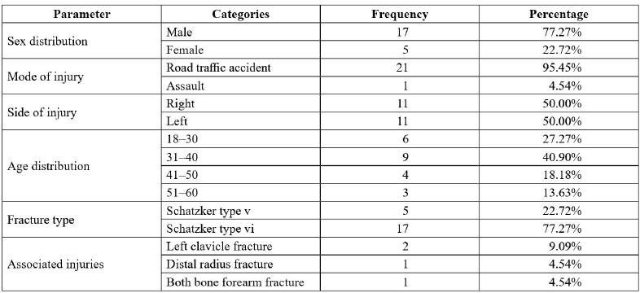
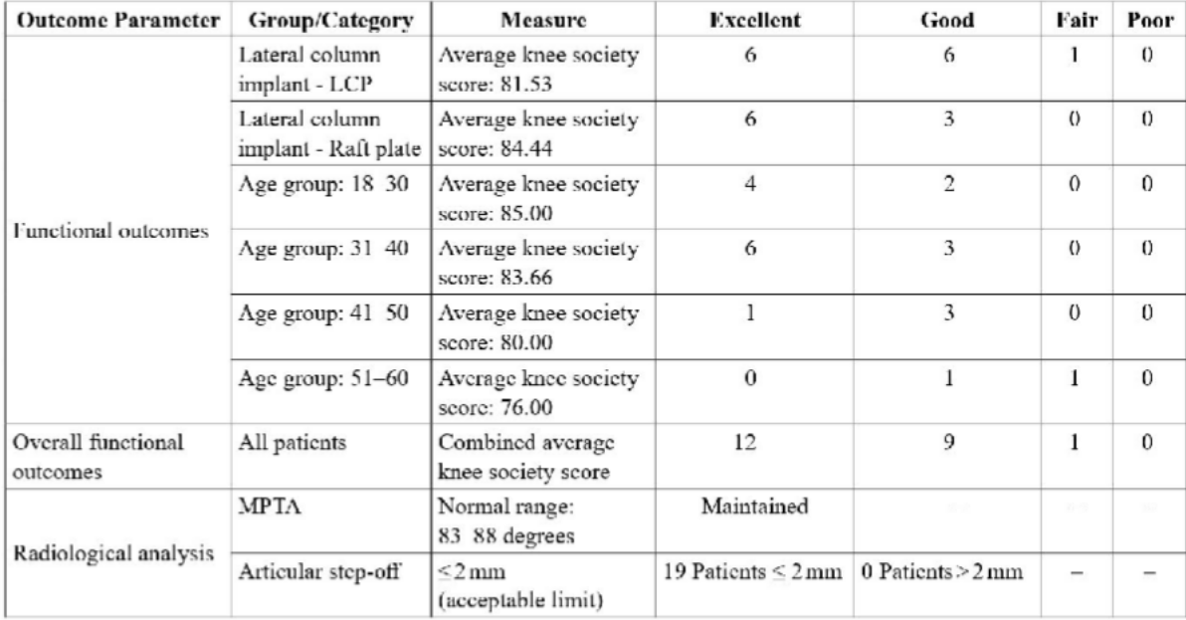
₅₅th
Annual Conference of
Orthopedic Surgeon Society of Andhra Pradesh
Date 6 – 8 February,2026, Venue : Kurnool Medical College
Organized by : Department of Orthopaedics, Kurnool Medical College Kurnool
RESULTS

Slide 5
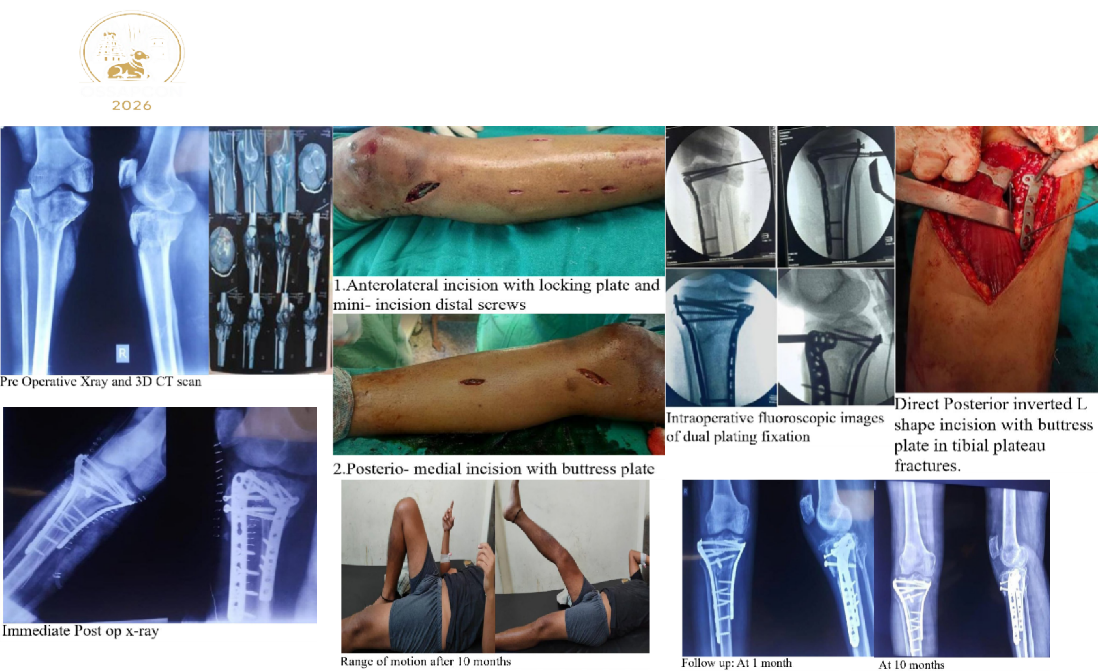
₅₅th
Annual Conference of
Orthopedic Surgeon Society of Andhra Pradesh
Date 6 – 8 February,2026, Venue : Kurnool Medical College
Organized by : Department of Orthopaedics, Kurnool Medical College Kurnool

Slide 6
Annual Conference of
₅₅th
Orthopedic Surgeon Society of Andhra Pradesh
Date 6 – 8 February,2026, Venue : Kurnool Medical College
Organized by : Department of Orthopaedics, Kurnool Medical College Kurnool
Conclusion:
The findings of this study support the use of dual plating for managing Schatzker type V and VI tibial plateau fractures. This approach ensures anatomical reduction, biomechanical stability, and early mobilization, leading to excellent functional and radiological outcomes. The low complication rates observed highlight the importance of minimally invasive techniques in optimizing patient outcomes while minimizing soft tissue morbidity.

Slide 7
Annual Conference of
₅₅th
Orthopedic Surgeon Society of Andhra Pradesh
Date 6 – 8 February,2026, Venue : Kurnool Medical College
Organized by : Department of Orthopaedics, Kurnool Medical College Kurnool
REFERENCES
Zeltser DW, Leopold SS. Classifications in Brief: Schatzker Classification of Tibial Plateau Fractures. Clin Orthop Relat Res. 2013;471(2):371–4. https://doi.org/10.1007/s11999-012-2451-z
Mills WJ, Nork SE. Open reduction and internal fixation of high-energy tibial plateau fractures. Orthop Clin North Am. 2002;33(1):177–98. https://doi.org/10.1016/s0030-5898(03)00079-8
Hoffmeyer P, Miozzari H, Holzer N. Non–hip/non-vertebral fractures – How to treat best? Best Pract Res Clin Rheumatol. 2019;33(2):236–63. https://doi.org/10.1016/j.berh.2019.03.019
Lansinger O, Bergman B, Körner L, Andersson GB. Tibial condylar fractures. A twenty-year follow-up. J Bone Joint Surg Am. 1986;68(1):13–9.
Higgins TF, Klatt J, Bachus KN. Biomechanical analysis of bicondylar tibial plateau fixation: How does lateral locking plate fixation compare to dual plate fixation? J Orthop Trauma. 2007;21(5):301–6. https://doi.org/10.1097/BOT.0b013e3180500359.
Eggli S, Hartel MJ, Kohl S, Haupt U, Exadaktylos AK, Roder C. Unstable bicondylar tibial plateau fractures: A clinical investigation. J Orthop Trauma. 2008;22(10):673–9. https://doi. org/10.1097/BOT.0b013e31818b1452
Weil YA, Gardner MJ, Boraiah S, Helfet DL, Lorich DG. Posteromedial supine approach for reduction and fixation of medial and bicondylar tibial plateau fractures. J Orthop Trauma. 2008;22(5):357–62.
Rohra N, Suri HS, Gangrade K. Functional and radiological outcome of schatzker type v and vi tibial plateau fracture treatment with dual plates with minimum 3 years follow-up: a prospective study. J Clin Diagn Res.

Slide 8
₅₅th
Annual Conference of
Orthopedic Surgeon Society of Andhra Pradesh
Date 6 – 8 February,2026, Venue : Kurnool Medical College
Organized by : Department of Orthopaedics, Kurnool Medical College Kurnool
THANK YOU

