Slide 1




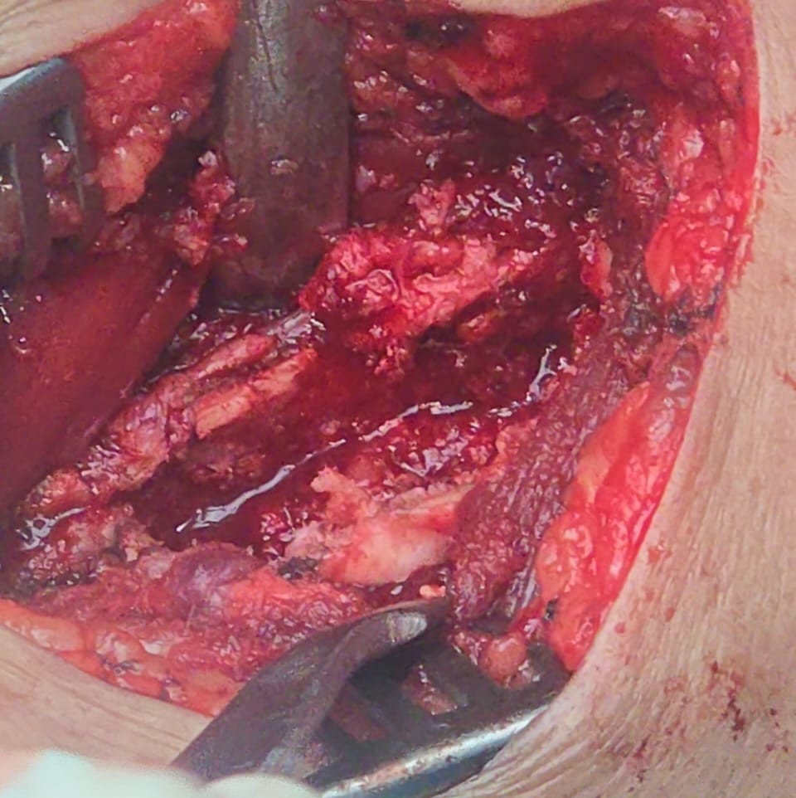
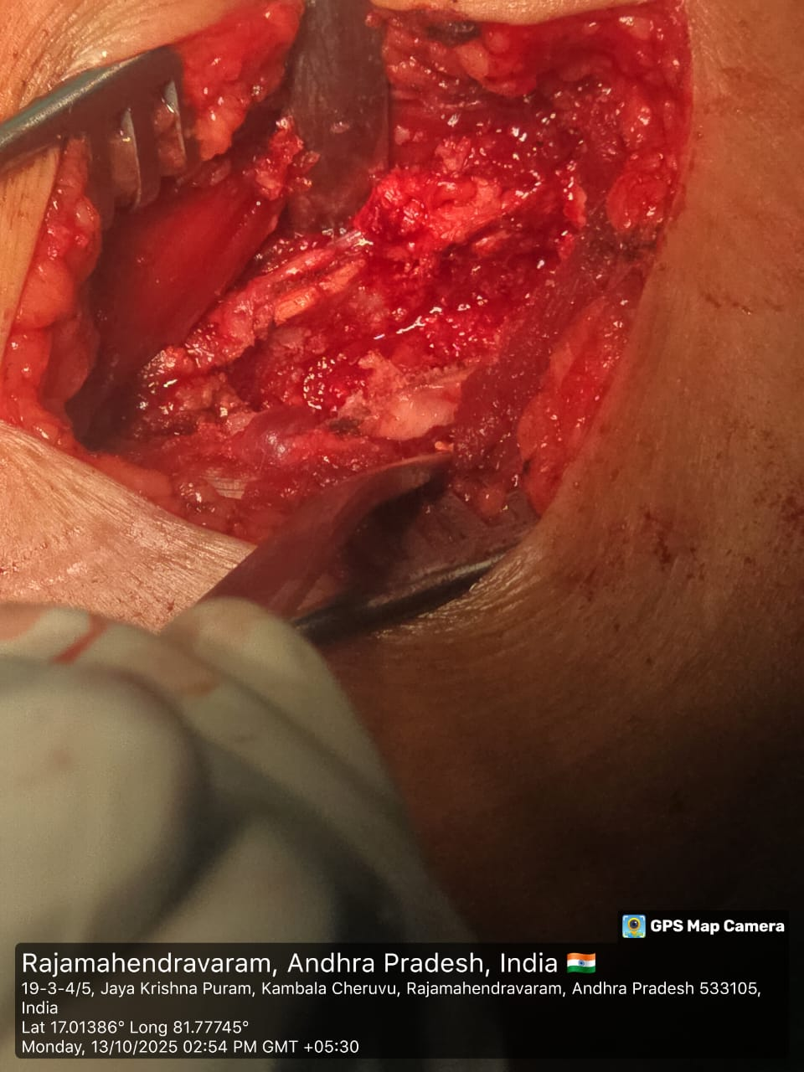
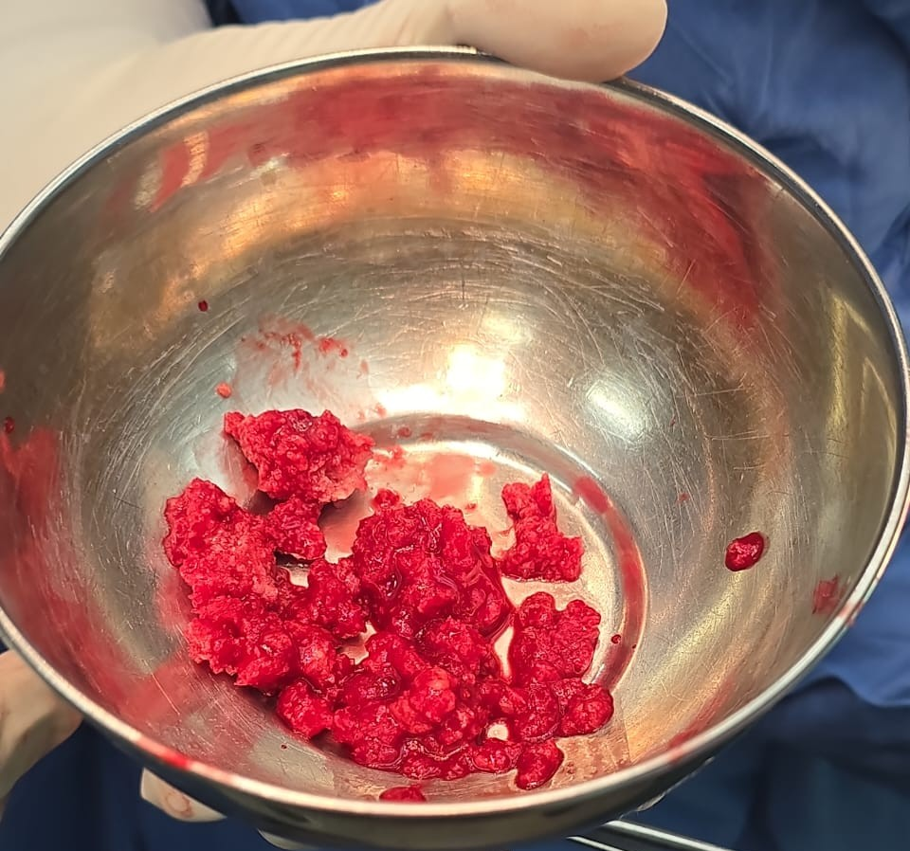
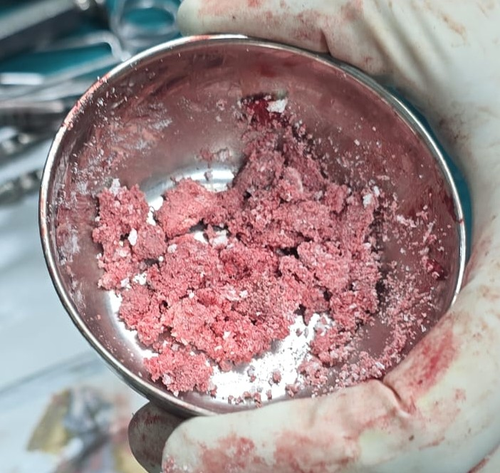
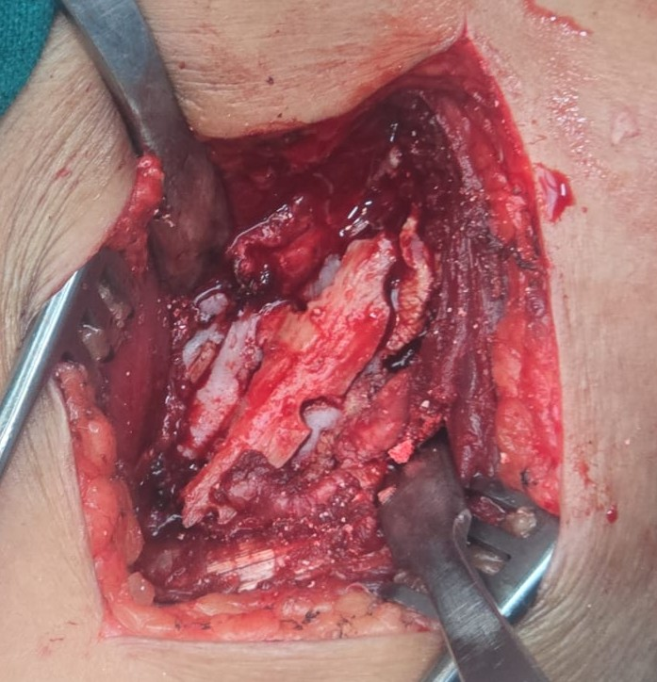
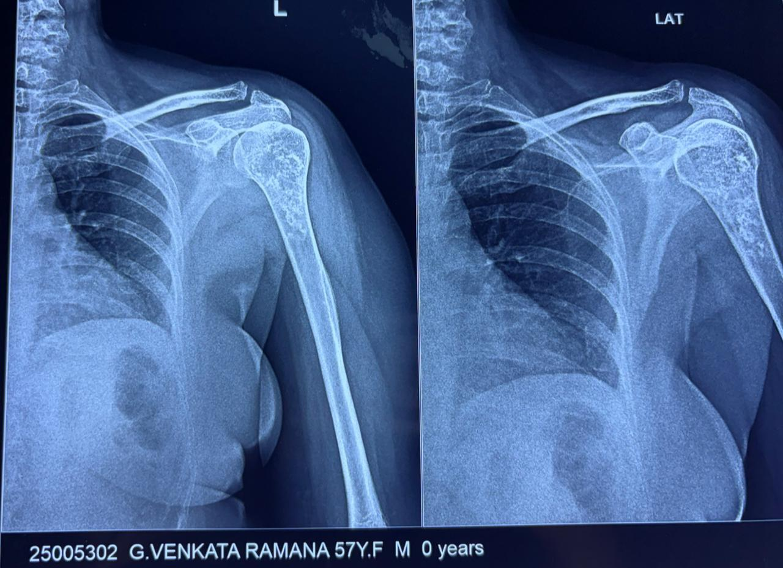
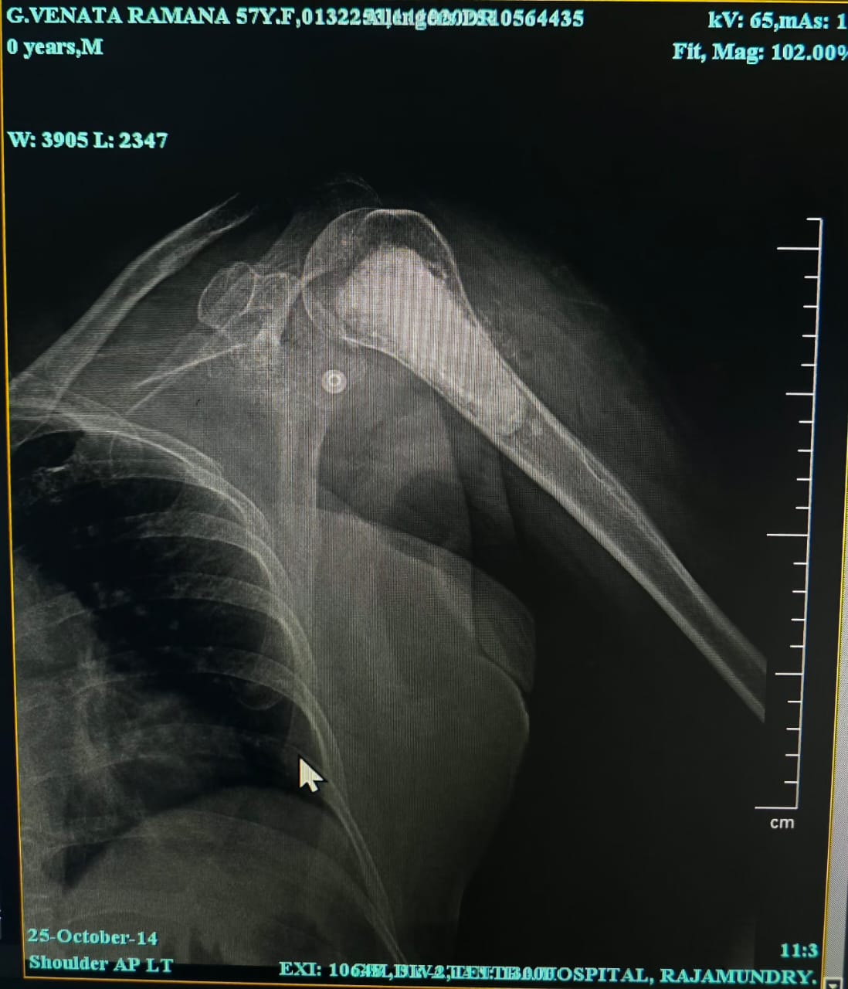
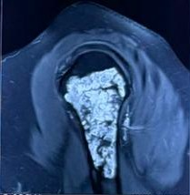
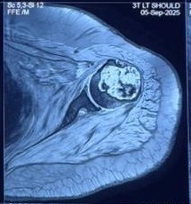
MANAGEMENT OF SYMPTOMATIC PROXIMAL HUMERUS ENCHONDROMA WITH CURRATAGE AND AUTOLOGOUS BONE GRAFTING AND CEMENTING
AUTHOR: Dr. HARI RAMA SATYA SANTHOSH P
CO-AUTHORS: DR. R. SATYA SRI TEJA, DR. V. NAGESWARA RAO
INTRODUCTION
OPERATIVE FINDINGS
DISCUSSION
Enchondroma is a benign intramedullary cartilaginous tumor, commonly involving long bones such as the proximal humerus.
Most lesions are asymptomatic, but some present with pain or pathological fracture, necessitating surgical intervention.
Intralesional curettage is the standard surgical treatment for symptomatic lesions.
Autologous bone grafting promotes biological healing, while bone cement provides immediate structural stability.
Procedure performed under general anesthesia in beach-chair position
Deltopectoral approach used to expose the left proximal humerus
Cortical window created over the lesion
Grayish-white cartilaginous tissue encountered within the medullary cavity and sent to histopathological examination.
Thorough intralesional curettage performed
High-speed burring of cavity margins done
Defect filled with autologous cancellous bone graft from ASIS
Bone cement augmentation provided structural stability
Adequate hemostasis achieved
Layered wound closure performed without complications
Enchondroma of the proximal humerus may become symptomatic following trivial trauma due to structural weakening and fracture risk.
Symptomatic lesions warrant surgical management, with intralesional curettage being the treatment of choice.
High-speed burring helps minimize residual tumor and recurrence.
Autologous bone graft with bone cement provides biological healing and immediate stability, enabling early functional recovery.
CASE REPORT
RESULTS
Case Presentation
A patient presented with complaints of pain in the left shoulder following a trivial trauma, which was gradually associated with swelling and progressive restriction of shoulder movements. The symptoms persisted despite initial conservative management, prompting further evaluation and definitive treatment.
Clinical Examination
Clinical examination revealed localized swelling and tenderness over the left proximal humerus with painful limitation of shoulder movements. There were no skin changes or signs of infection. Distal neurovascular examination of the affected limb was normal.
The postoperative course was uneventful, with no local or donor-site complications.
Pain and shoulder function improved significantly following surgery.
The Constant–Murley score improved from 42 preoperatively to 86 at 3-month follow-up, indicating good functional recovery.
Histopathological examination showed lobules of mature hyaline cartilage with chondrocytes in lacunae, confirming enchondroma, with no evidence of malignancy.
TAKE HOME MESSAGE
Intralesional curettage combined with autologous bone grafting and cement augmentation provides a safe, reliable, and effective treatment for symptomatic proximal humeral enchondroma, ensuring structural stability, pain relief, and excellent functional recovery with minimal complications.
PRE-OP IMAGING
CONCLUSION
Symptomatic proximal humeral enchondromas can cause pain, swelling, and functional limitation.
Intralesional curettage effectively removes the tumor while preserving bone.
Autologous bone grafting with cement augmentation restores structural integrity and allows early mobilization.
This approach results in excellent functional recovery with minimal complications.
Surgical management ensures durable outcomes and low recurrence risk.
POST-OP IMAGING
REFERENCES
Omlor GW, Lohnherr V, Lange J, Gantz S, Merle C, Fellenberg J, Raiss P, Lehner B. Intralesional resection and bone cement filling for enchondromas and atypical cartilaginous tumors of the proximal humerus: retrospective analysis of 42 cases with long‑term follow‑up. World J Surg Oncol. 2018;16:139.
Hakim DN, Pelly T, Kulendran M, Caris JA. Benign bone tumors: review of enchondroma diagnosis and management including curettage and grafting techniques. J Bone Oncol. 2015;4:37–41.
ACKNOWLEDGEMENT
I sincerely thank Dr. V. Nageswara Rao, Head of the Department of Orthopaedics and Dr. R. Satya Sri Teja, Associate Professor along with the faculty of Orthopaedics and the Department of Radiology, GSL Medical College & General Hospital, for their guidance and support.

