Slide 1
A PROSPECTIVE STUDY OF SURGICAL MANAGEMENT OF FRACTURES OF PROXIMAL FEMUR USING PROXIMAL FEMORAL NAIL
PRESENTER:DR.ATUL TOMAR
(FINAL YEAR POSTGRADUATE)
GUIDE:DR.CHINTAPETA RAVI
PROFESSOR&HOD,DEPARTMENT OF ORTHOPAEDICS
MAHAVIR INSTITUTE OF MEDICAL SCIENCES

Slide 2
INTR0DUCTION:
Proximal femoral fractures are commonly seen in patients over 70yrs of age. Incidence of these fractures has increased primarily due to increasing life span and more sedentary life style brought by urbanization. In younger population, proximal femoral fracture occurs due to high velocity trauma, whereas in elderly population, it is most often due to trivial trauma. Proximal femoral fractures comprise of intertrochanteric and subtrochanteric fractures. Incidence of trochanteric fractures is more in females compared to males due to osteoporosis.
Mortality ranges between 15%-20 %. Other risk factors include white race, neurological impairment, malnutrition, impaired vision, malignancy, and decreased physical activity.

Slide 3
AIM:
To evaluate the union rates with proximal femoral nail.
To evaluate the clinical outcome associated with this treatment modality, Hip Range of movements pain relief,Return to normal activities and work.
To identify appropriate entry point.

Slide 4
METHODS:
Proximal femoral nail consists of self tapping 6.5mm hip pin, self tapping 8mm femoral neck screw, 4.9 distal locking screw and an end cap.
Operative technique:
The patient is placed in supine position on fracture table with adduction of the affected limb by 10-15 degrees and closed reduction of the fracture was done by the traction and internal rotation.
Entry is made in tip of trochanter
Insertion of PFN followed by proximal and distal locking
Fixation confirmed under c-arm

Slide 5
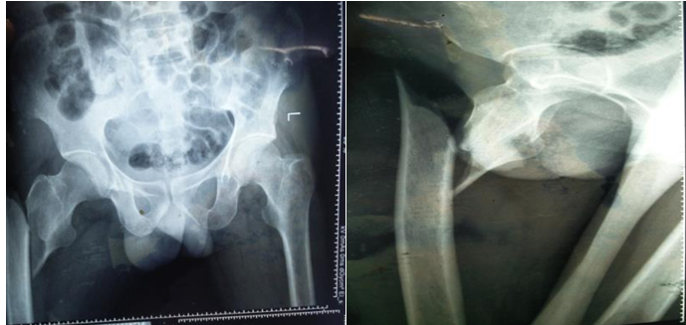
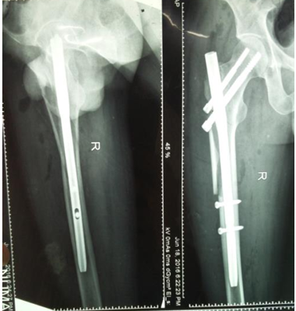
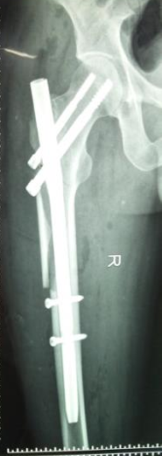
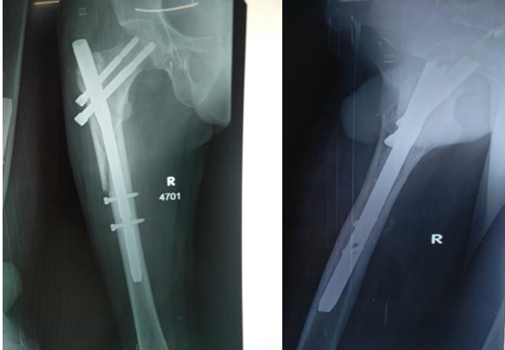
Pre-operative x-ray:
Post-operative xray:
6Weeks 3Months

Slide 6
RESULTS:
Anatomical results:
Anatomical results were assessed by presence or absence of deformities, shortening, and hip and knee range of motions. In our study one patient had shortening >1cm, two patients had varus malunion
Functional Results:
In our series of 30 operated cases Functional and anatomical results were assessed taking using Harris Hip scoring system (Modified)
-Intertrochanteric – 19
-Subtrochanteric - 11

Slide 7
CONCLUSION:
In the present study 30 patients with extracapsular proximal femoral fractures were surgically managed with proximal femoral nail:
Advantage of this device is it prevents excess collapse at fracture site thus maintaining neck length.
The entry point determination is the most crucial step in this procedure which is the tip of the trochanter. The device is fixed distally in both dynamic and static mode so in case of delayed union it can be dynamised.
The two neck screws should be placed in the centre of neck and head, the proximal one acts as derotation screw and the distal one as collapsing screw.
Hence I conclude, though the learning curve of this procedure is steep with proper patient selection, good instruments, image intensifier and surgical technique, PFN remains the implant of choice in the management of intertrochanteric and subtrochanteric fractures.

Slide 8
REFERENCES:
1.A prospective study of surgical management of fractures of proximal femur using proximal femoral nail Dr. Yathisha SR and Dr. Mohd Zeeshan Vasif
2. GS Kulkarni, Rajiv Limaye, Milind Kulkarni, Sunil Kulkarni. Intertrochanteric fractures. Indian journal of orthopaedics 2008;40:16-23.
3. Koval KJ, Aharonoff GB, Rokito AS, Lyon T, Zuckerman JD. Patients with femoral neck and intertrochanteric fractures: Are they the same? Clin Orthop 1996;330:166-172
4. Micheal W. Chapman’s "Chapman’s orthopaedic surgery", volume Lipincott Williams and wilkins company, 3, 618-665.
5. Bucholz, Robert W, Heckman, James D, Court-Brown, Charles M, Tornetta Paul. Rockwood and Green's Fractures in Adults, 7th Edition. Lippincott Williams & Wilkins; 2010;2(chapter 48):1597-1637.

