Slide 1




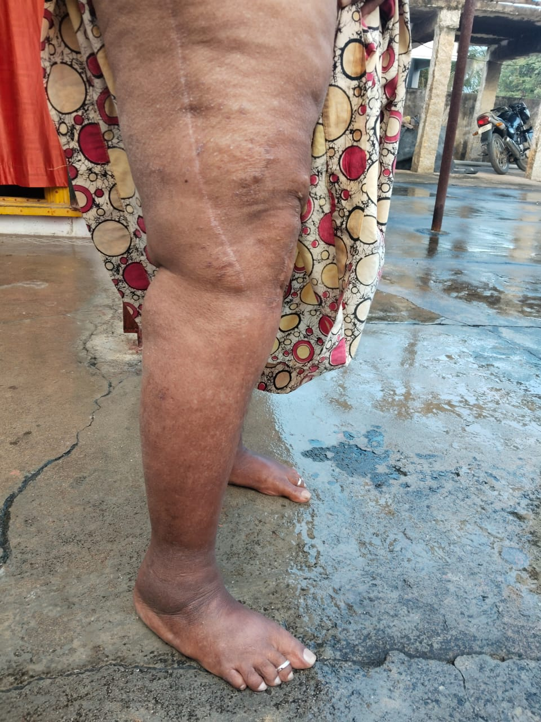
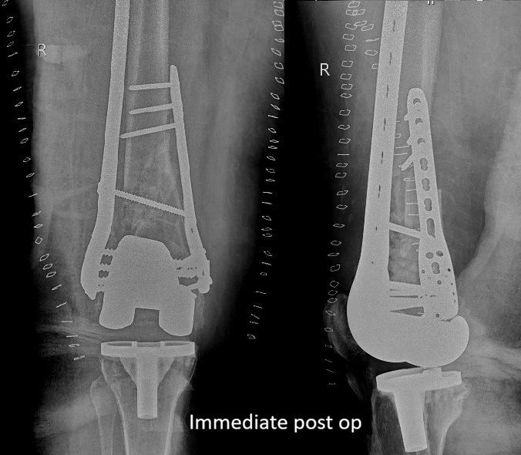
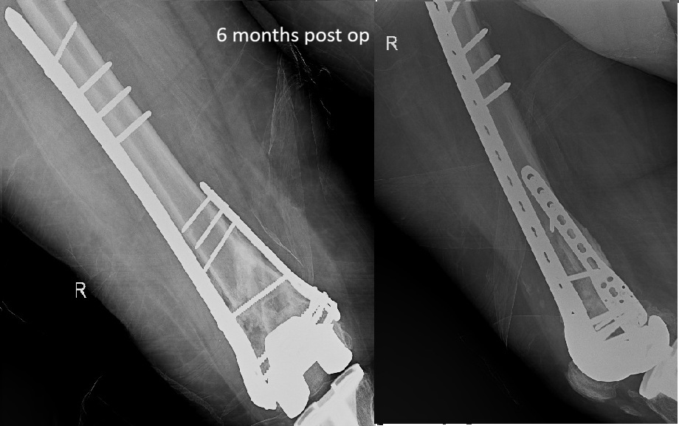
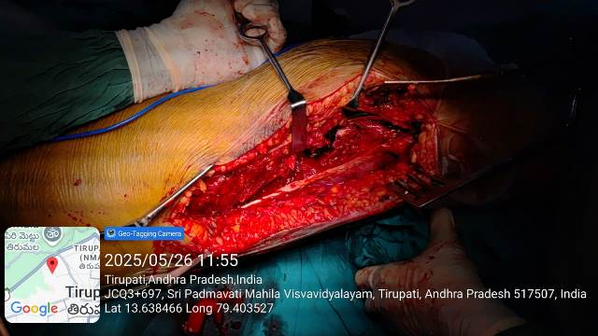
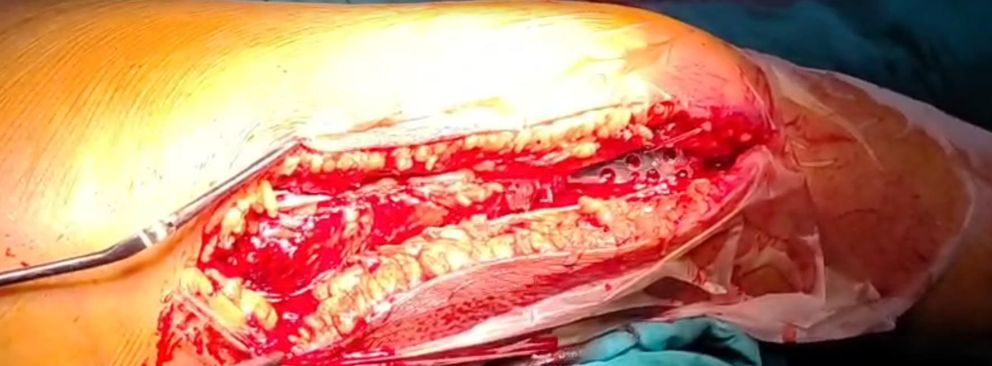
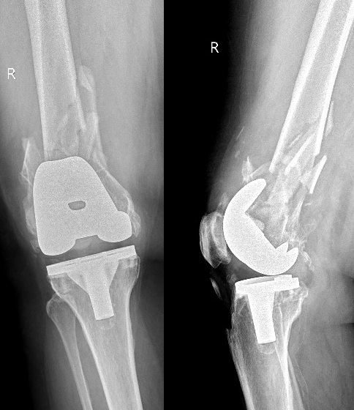
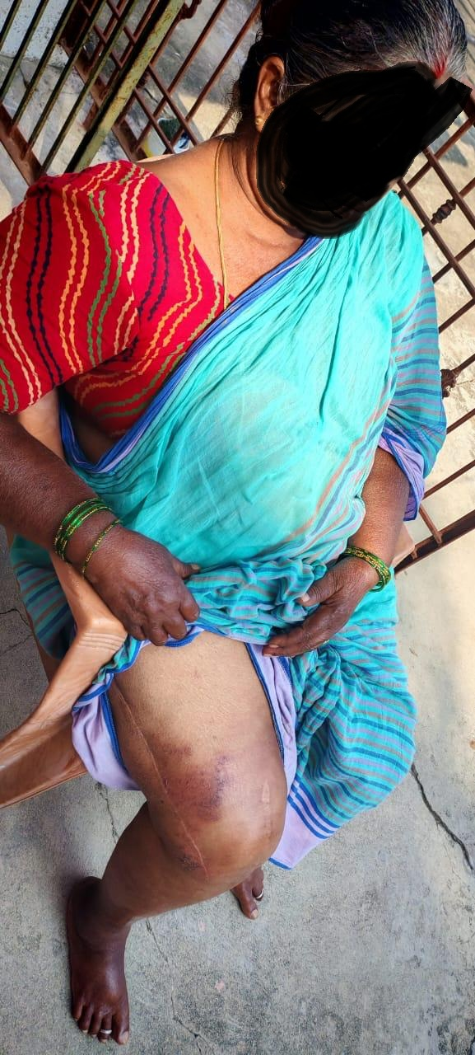
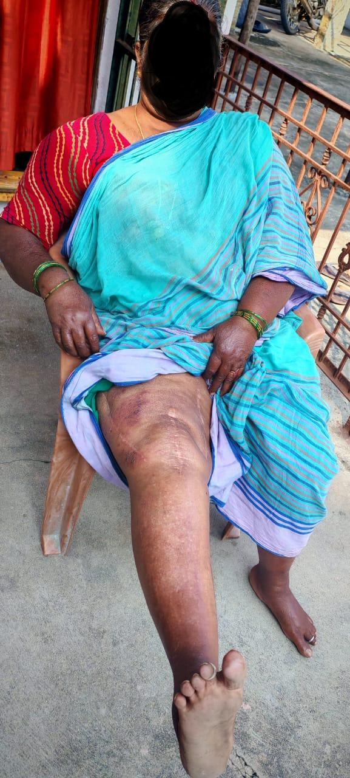
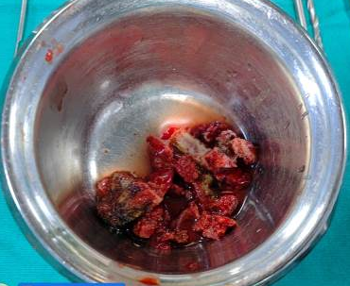
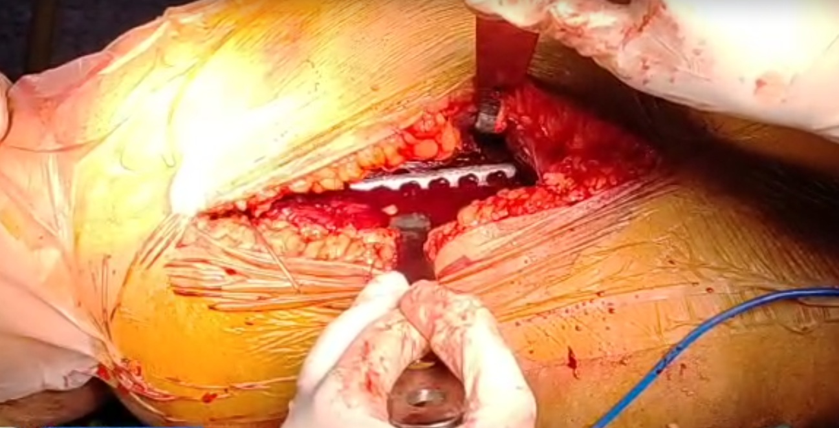



55th Annual Conference of Orthopedic Surgeon Society of Andhra Pradesh
A CASE REPORT ON MANAGEMENT OF
RORABECK TYPE III DISTAL FEMUR PERIPROSTHETIC FRACTURE
PRESENTING AUTHOR: DR. RAVEENDRA GOPI T
CO-AUTHOR : DR.JAGADESH GUDARU MS.,MCH(ORTHO) ; DR. DEEPAK MS.ORTHO, DR. RAKESH KIRAN Y MS. ORTHO
INTRODUCTION
OPERATIVE FINDINGS
DISCUSSION
Increasing rates of total knee arthroplasty have led to a rise in periprosthetic distal femoral fractures, particularly in elderly patients.
The Rorabeck and Tylor type III periprosthetic knee fracture is described as a non-displaced or displaced fracture with the prosthesis loose or failing,
Poor bone stock, preexisting implant and bone cement may impede fracture reduction and fixation, predisposing to nonunion or malunion.
Aim is to achieve a painless and stable knee with the proper alignment restoration, adequate patellofemoral function, maintained prosthesis fixation, and an early range of motion.
Patient in supine position, under sterile aseptic conditions double approach was made.
1st through lateral approach, loose periprosthetic fragments were removed with a curette, and the bone defect was washed thoroughly with normal saline.
Fragments were reduced and fixed with a 13 - hole distal femoral locking compression plate and screws.
2nd through medial approach, fragments were reduced fixed with 7 - hole Philos plate and screws.
Bone defect was filled with autologous graft from iliac crest bone.
the mediolateral stability of the knee, the implant, and the femoro-patellar tracking were checked.
Post operative period was uneventful, with progressive weight bearing on regular follow-up radiographs showed fracture union, stable femoral component. Patient showed no pain, knee ROM 0-90 degree and an unchanged Barthel Index.
The treatment of this fracture is affected by many factors, including fracture type, prosthesis stability, patient age and comorbidities.
Satisfactory clinical outcomes can be obtained with proper selection of fixation devices and surgical techniques.
CASE REPORT
CONCLUSION
Presenting a 58 years old female with injury to right knee, radiographs revealed comminuted distal femur periprosthetic fracture (Lewis and Rorabeck type III)
Dual locking plate fixation is an effective and reliable surgical option in Rorabeck type III fractures.
This avoids the need to do revision arthroplasty.
Notes:
Acceptable alignments after fracture reduction are <5 mm translation, <5o–10o angulation, <10o rotational deformity, and <1 cm femoral shortening.

