Slide 1




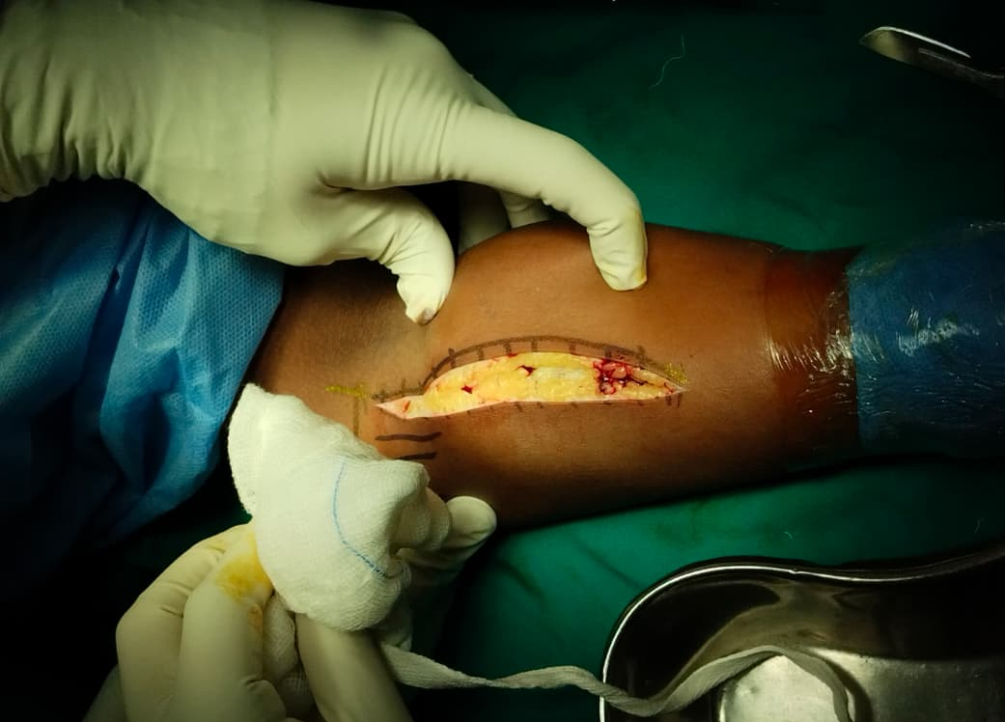
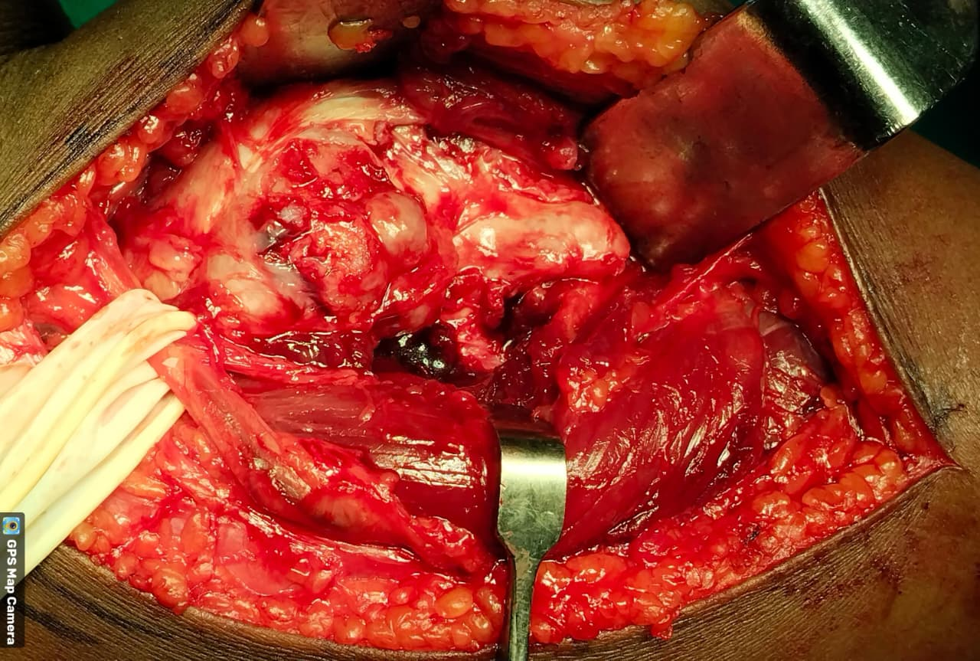
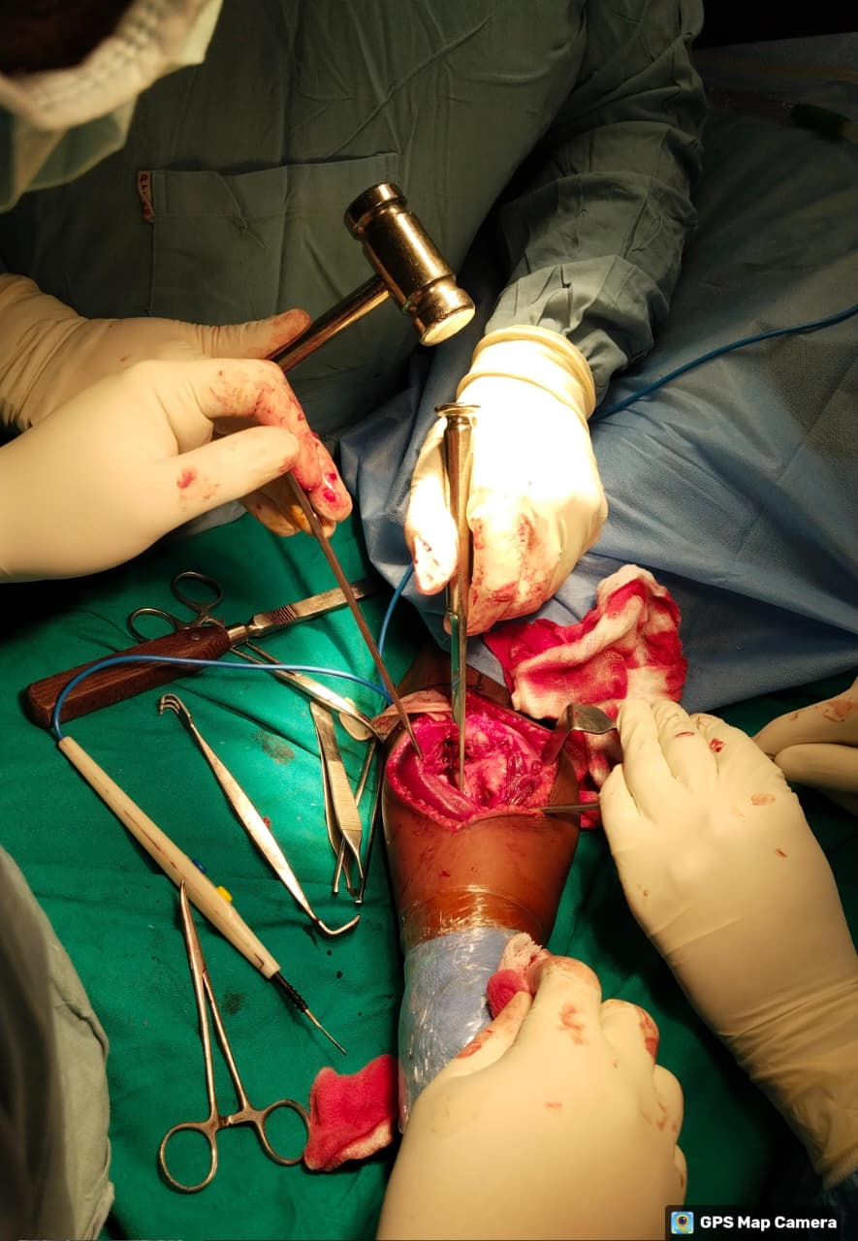
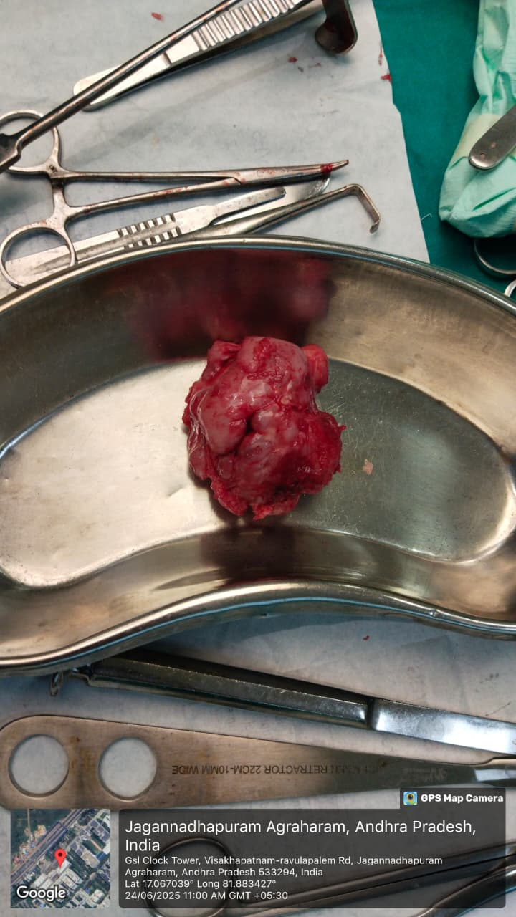
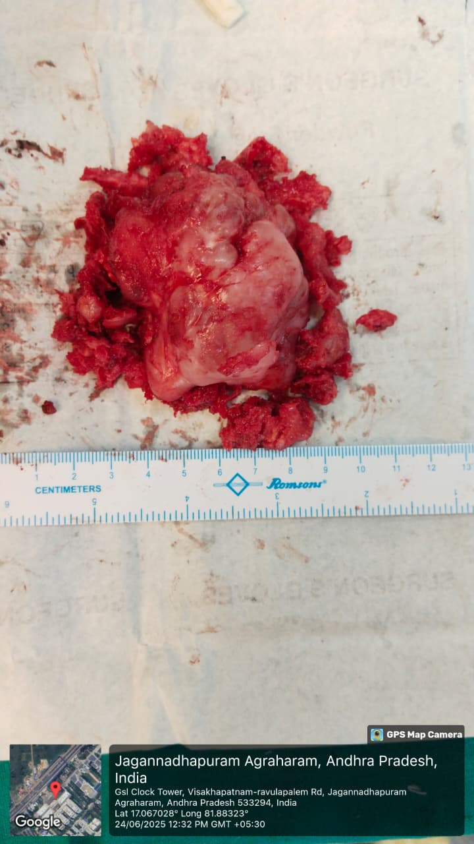
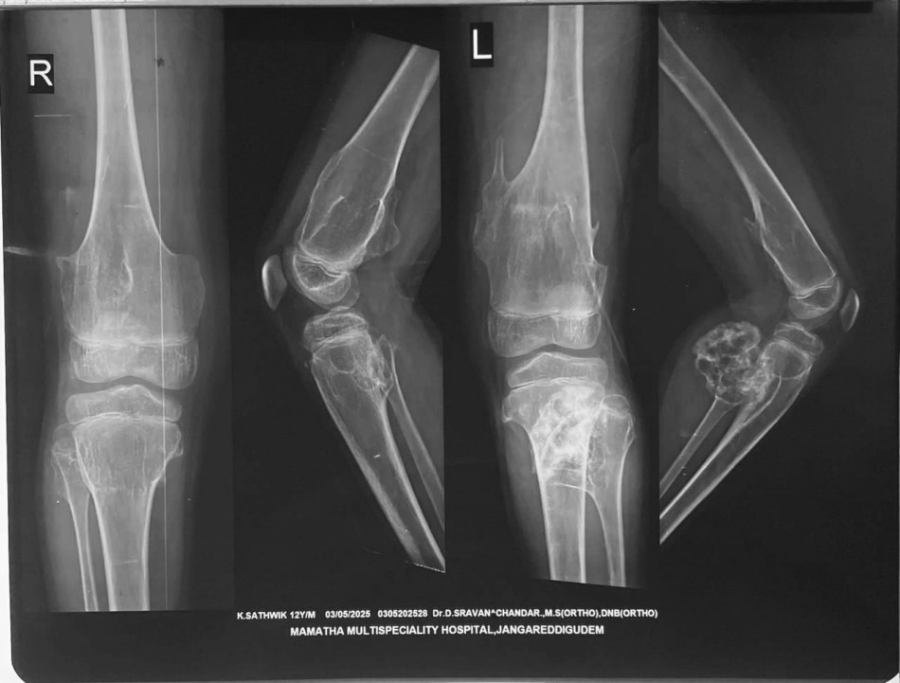
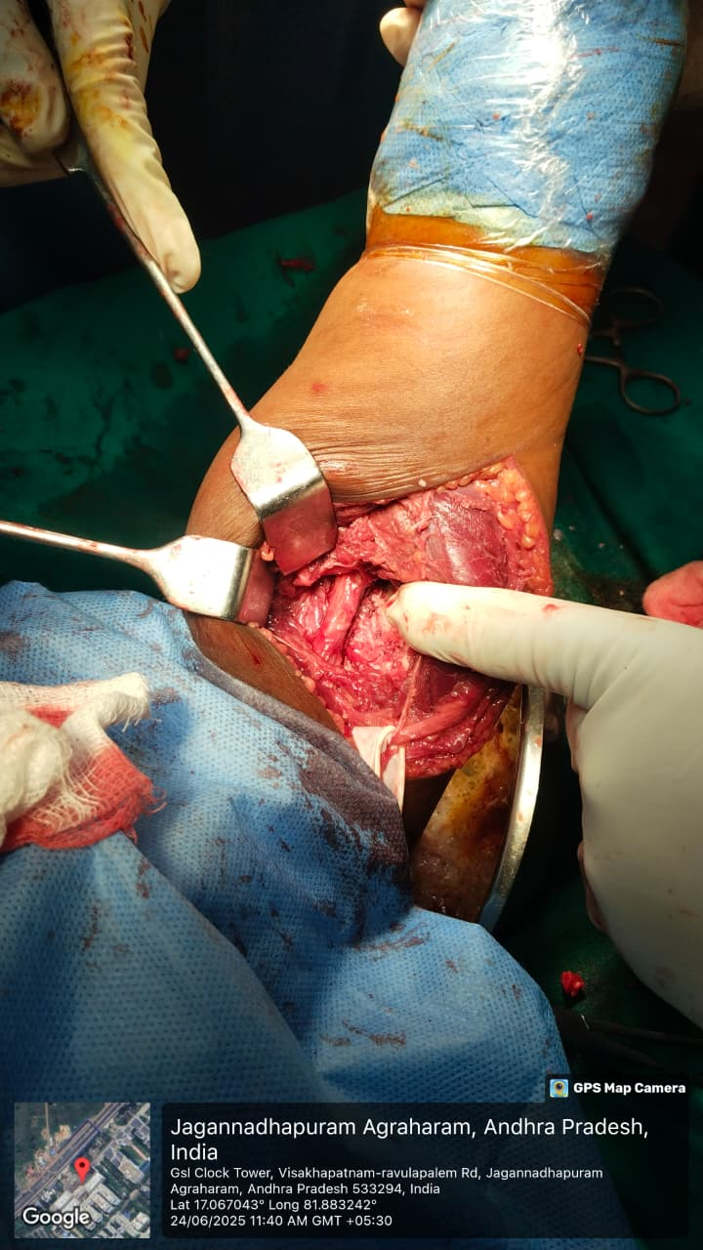
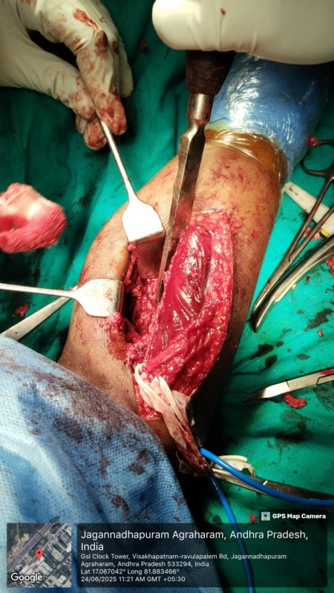
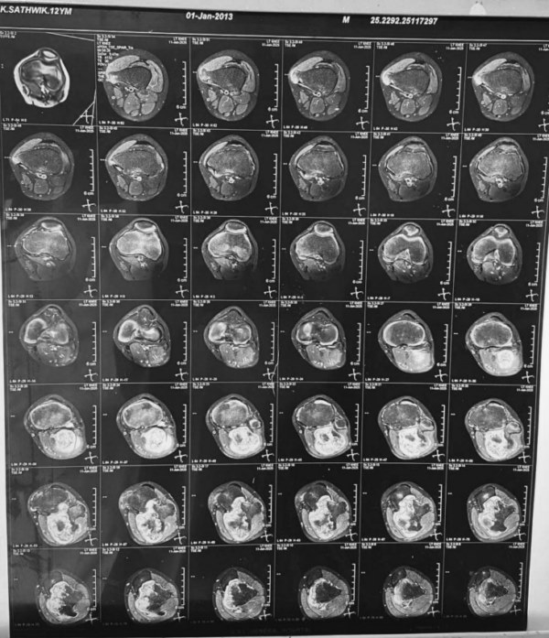
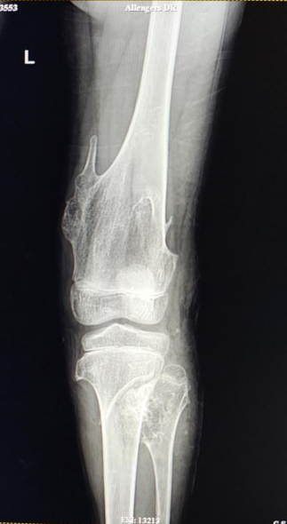
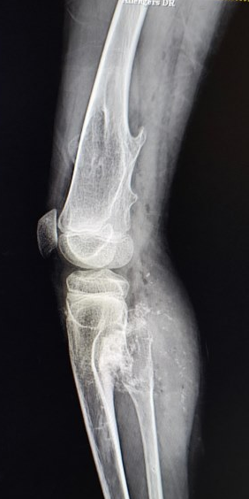
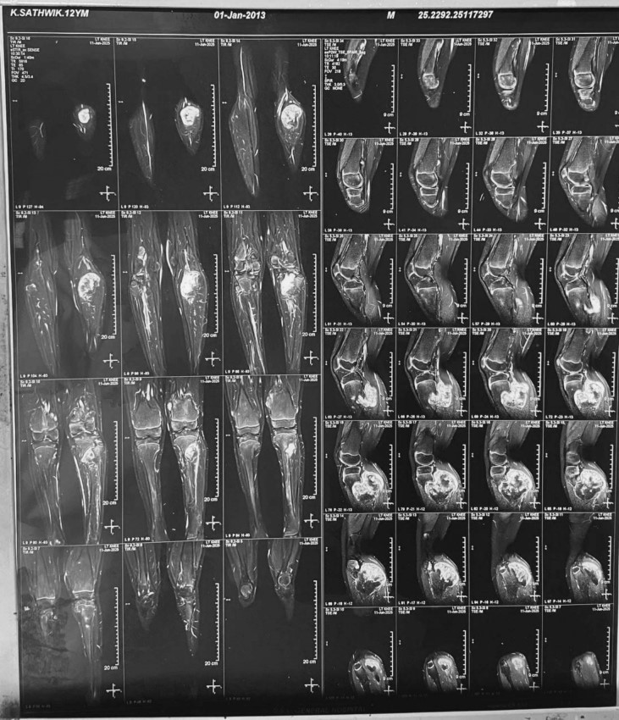
MANAGEMENT OF A RARE CASE OF A LARGE OSTEOCHONDROMA AT PROXIMAL FIBULA IN A 12 YEAR OLD CHILD
AUTHOR : Dr. P.V.SUKUMAR
CO-AUTHORS: Dr. V. NAGESWARA RAO
INTRODUCTION
OPERATIVE FINDINGS
DISCUSSION
Osteochondroma is the most common benign bone tumor, constituting nearly half of all benign bone lesions. It is characterized by a cartilage-capped bony outgrowth arising from the metaphyseal regions of the long bones .
They are commonly solitary, multiple lesions may occur as part of hereditary multiple exostoses. Most of them remine asymptomatic; however, lesions around the knee especially can become clinically significant due to pain, deformity, restriction of joint movement, or compression of adjacent neurovascular structures. Large osteochondromas of the proximal fibula in children are uncommon and pose unique surgical challenges because of the close proximity to the common peroneal nerve.
Surgical excision is indicated in symptomatic cases or when complications are suspected.
METHOD:
Under General anesthesia, the patient was positioned prone, and a pneumatic tourniquet was applied. The limb was scrubbed with Betadine, painted, and draped in a sterile manner.
Incision and Exposure : A 10–12 cm posterolateral incision was made over the swelling, using the fibular head and posterior knee crease as landmarks. Skin and subcutaneous tissue were dissected. The biceps femoris was identified and retracted, exposing the common peroneal nerve, which was meticulously dissected and protected throughout. The interval between peroneus longus and gastrocnemius was developed, exposing a large pedunculated bony outgrowth with a cartilaginous cap.
Excision:The osteochondroma was excised extraperiosteally using a mallet and osteotome.
• Specimen size: ~7 × 6 × 3 cm
• Sent for histopathological examination
Intraoperatively, a tibiofibular synostosis was also noted posteromedially. Beneath the gastrocnemius, the popliteal artery was found compressed but intact and was freed carefully.
Wound Care and Closure:The wound was irrigated thoroughly using:• Hydrogen peroxide• Betadine• Normal saline
A 12 mm Romovac drain was placed. C-arm imaging confirmed complete excision. The wound was closed in layers, a sterile dressing applied, and an above-knee slab applied.
Multiple osteochondromas are common benign lesions in children, but large lesions around the proximal fibula are rare.
They are clinically significant due to proximity to the common peroneal nerve and popliteal vessels. Posteriorly placed osteochondromas may remain asymptomatic despite causing significant neurovascular compression.
Surgical excision in this region is technically demanding and requires meticulous neurovascular identification and protection.
In our case, intraoperative findings revealed vascular compression despite normal preoperative neurology. Complete extra periosteal excision resulted in rapid symptom relief and excellent functional recovery.
RESULTS
Complete surgical excision of osteochondroma is achieved with securing common peroneal nerve.
Histopathology : multiple sections study showed cartilaginous cap composed of mature hyaline cartilage with overlying fibrous perichondrium suggestive of osteochondroma.
Clinical Course: Uneventful postoperative recovery with primary wound healing.
Follow-Up: Assessed at 1 week, 1, 3, and 6 months; patient achieved independent ambulation and able to do his daily activities starting from 6 weeks.
No evidence of recurrence.
No neurological deficits.
CASE REPORT
Case Presentation
A 12-year-old boy presented with a chief complaint of progressive swelling over posterior aspect of left knee over one year duration with no history of trauma.
Clinical Examination
A 6 x 5 cms bony hard swelling noted over posterior aspect of left proximal fibula which was hard immobile and non tender with no neurovascular deficits.
Posterolateral approach
Common peroneal nerve secured
PRE-OP IMAGING
EXCISION SPECIMEN
X-ray Knee – AP and Lateral Views
• Large sessile osteochondroma arising from the medial and posterior distal femur.
• pedunculated lesion over the proximal fibula.
• Cortical and medullary continuity with parent bone - classical for osteochondroma.
• Soft-tissue displacement without aggressive features.
These findings were consistent with multiple osteochondromas
TAKE HOME MESSAGE
Suspect: Painless progressive swellings in children warrants imaging evaluation.
Detect: Use MRI to identify cartilaginous cap rule out malignancy.
Treat: Complete surgical excision is curative with excellent prognosis.
POPLITEAL ARTERY DECOMPRESSED
CONCLUSION
Fibular osteochondroma in children is rare and may present as painless swelling.
Careful clinical and radiological examination is essential
MRI helps confirm diagnosis and rule out malignancy
Complete surgical excision gives excellent outcomes.
MRI LEFT KNEE:
A well defined lobulated bony outgrowth measuring 6.7 x 4.4 x4.7cm is noted in posteromedial aspect of upper end of proximal fibula
T2 HYPERINTENSE cartilaginous cap measuring approximately 5mm continuity with the cortex and medullary cavity of the fibula
Multiple similar lesions in the femur and tibia noted.
POST-OP IMAGING
REFERENCES
Postoperative plain radiograph of left knee (AP and lateral view)
shows complete excision of osteochondroma arising from metaphyseal region of proximal fibula with smooth margins and no residual lesion visible radiographically.
  Balaji PS. Giant osteochondroma of tibia in hereditary multiple exostoses: a case report. Int J Res Rev. 2023;10(3): Jilani LZ, Ishtiyaq M, Khurana ; An unusual giant osteochondroma of distal tibia: a case report with literature review. J Orthop Case Rep. 2024;14(11):84-91.
ACKNOWLEDGEMENT
I sincerely thank Dr. V. Nageswara Rao, Head of the Department of Orthopaedics, along with the faculty of Orthopaedics and the Department of Radiology, GSL Medical College & General Hospital, for their guidance and support.

