Slide 1




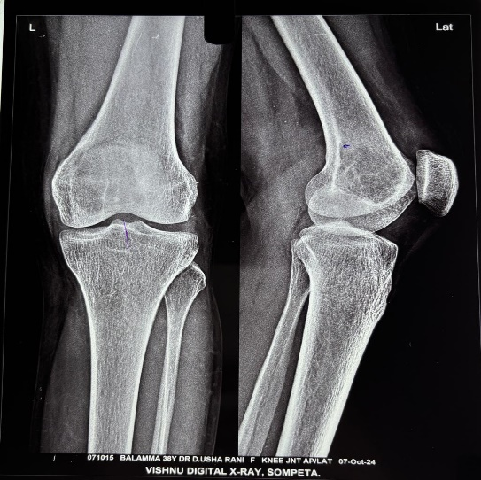
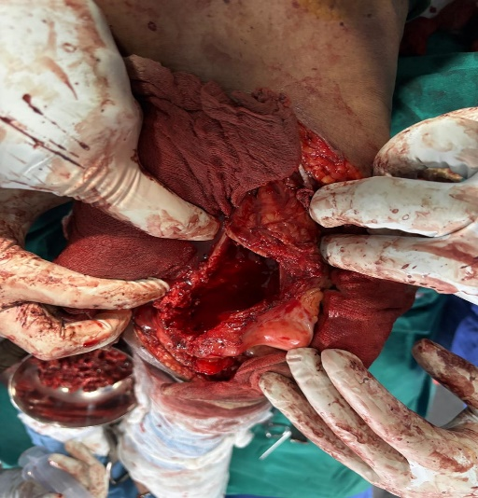
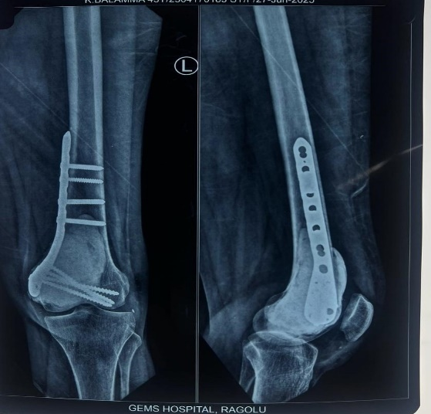
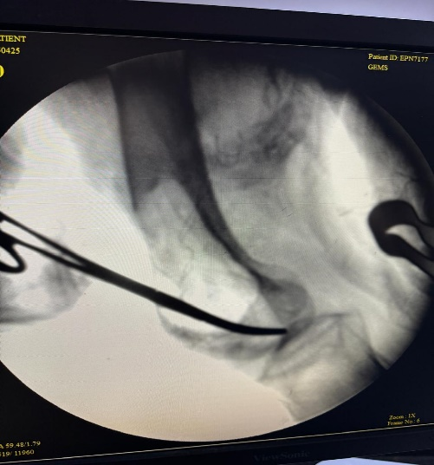
GIANT CELL TUMOR
PRESENTING AUTHOR :- Dr. CHALUMURU ANANTHA RAO (1ST YEAR PG)
Department of Orthopaedics
Great Eastern Medical School and Hospital, Srikakulam
GUIDE :- DR K KISHOR (ASSISTANT ROFESSOR) , DR S RAJESWARA RAO ID :- OSSAP- 375
INTRODUCTION
OPERATIVE FINDINGS
DISCUSSION
Giant Cell Tumor (GCT) is a benign but locally aggressive bone tumor
Which Accounts for ~5% of all primary bone tumors ~20% of benign bone tumors
Common age group: 3rd–4th decade of life Commonly involves epiphyseo-metaphyseal region of long bones . Most common sites are Distal femur, Proximal tibia, Distal radius . Peri-articular location causes, Significant bone destruction and Functional impairment . In weight-bearing bones, Large GCTs are prone to pathological fractures Recurrence rate is relatively high Metastasis occurs in 1–9% of cases .Aggressive growth and recurrence correlate with metastatic risk
Surgery performed under general anaesthesia Adequate exposure obtained
Large cortical window created
Extended intralesional curettage done using high-speed burr , Phenol crystal wash used as local adjuvant ,Reconstruction done with:
Bone grafting , Cementation using PMMA mixed with allograft ,Medial condylar plating done using titanium plate , Curetted tissue sent for Histopathological examination
GCT in peri-articular long bones poses a surgical challenge
Risk factors include Inadequate curettage , Iatrogenic fracture Local recurrence
Conventional curettage + cementing now augmented with adjuvants like Phenol
Liquid nitrogen, Hydrogen peroxide , Zinc chloride ,Argon beam cauterization
Studies show higher non-oncological complications with:
Liquid nitrogen + bone grafts (33%) , Liquid nitrogen + PMMA (27%)
Lower complications with: Phenol + PMMA (11%)
Phenolization is Effective and safe local adjuvant , Produces circumferential necrosis extending curettage margin
Denosumab s Used pre-operatively to reduce tumor size which Facilitates less morbid surgery
Literature review :- Klenke et al.: Mean recurrence at 16.3 ± 12.4 months
Saikia et al.: Recurrence rate 34.4%, mostly Campanacci Grade III
Two-year recurrence-free survival: 71.9%
CONCLUSION
CASE REPORT
Extended curettage with phenol crystal wash provides Better local tumor control
Reduced recurrence rates , Reconstruction with Bone grafting and Cementation
Internal fixation gives good functional outcome
No evidence of recurrence at 18 months follow-up
Phenol crystals are a safe and effective alternative to liquid nitrogen
Phenol reduces non-oncological complications such as:
Secondary osteoarthritis , Pathological fractures
A 38-year-old female came with Chief complaint of Pain and swelling above left knee for 2 years which is Insidious onset, gradually progressive swelling. swelling over right distal femur and local rise of temperature
X-ray, MRI are suggestive of GCT

