Slide 1





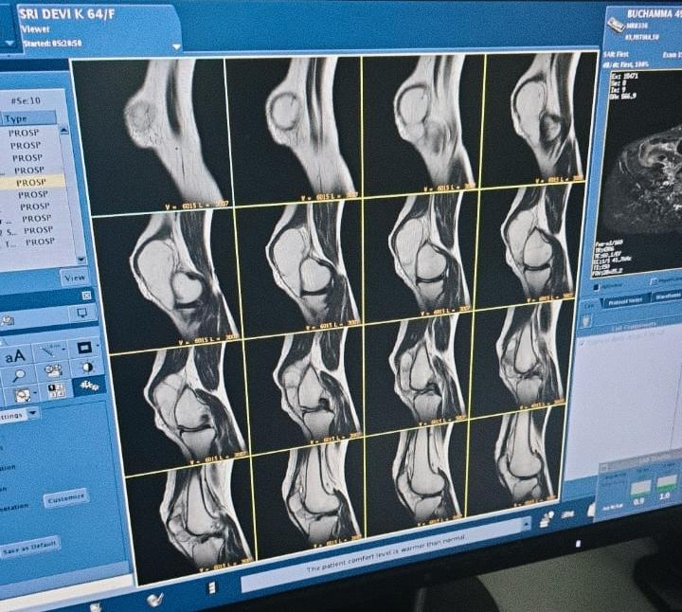
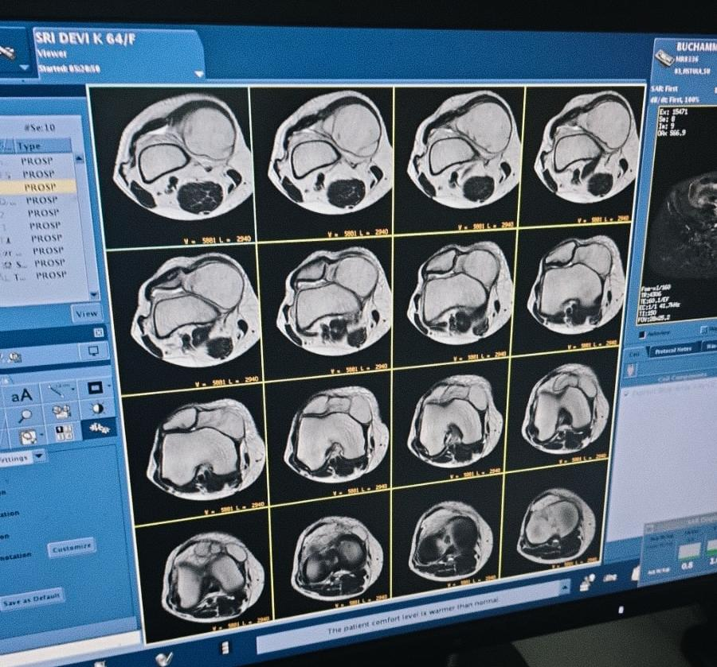
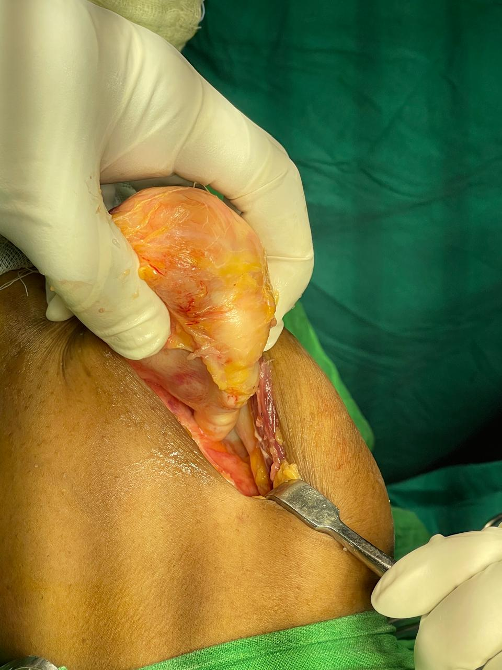
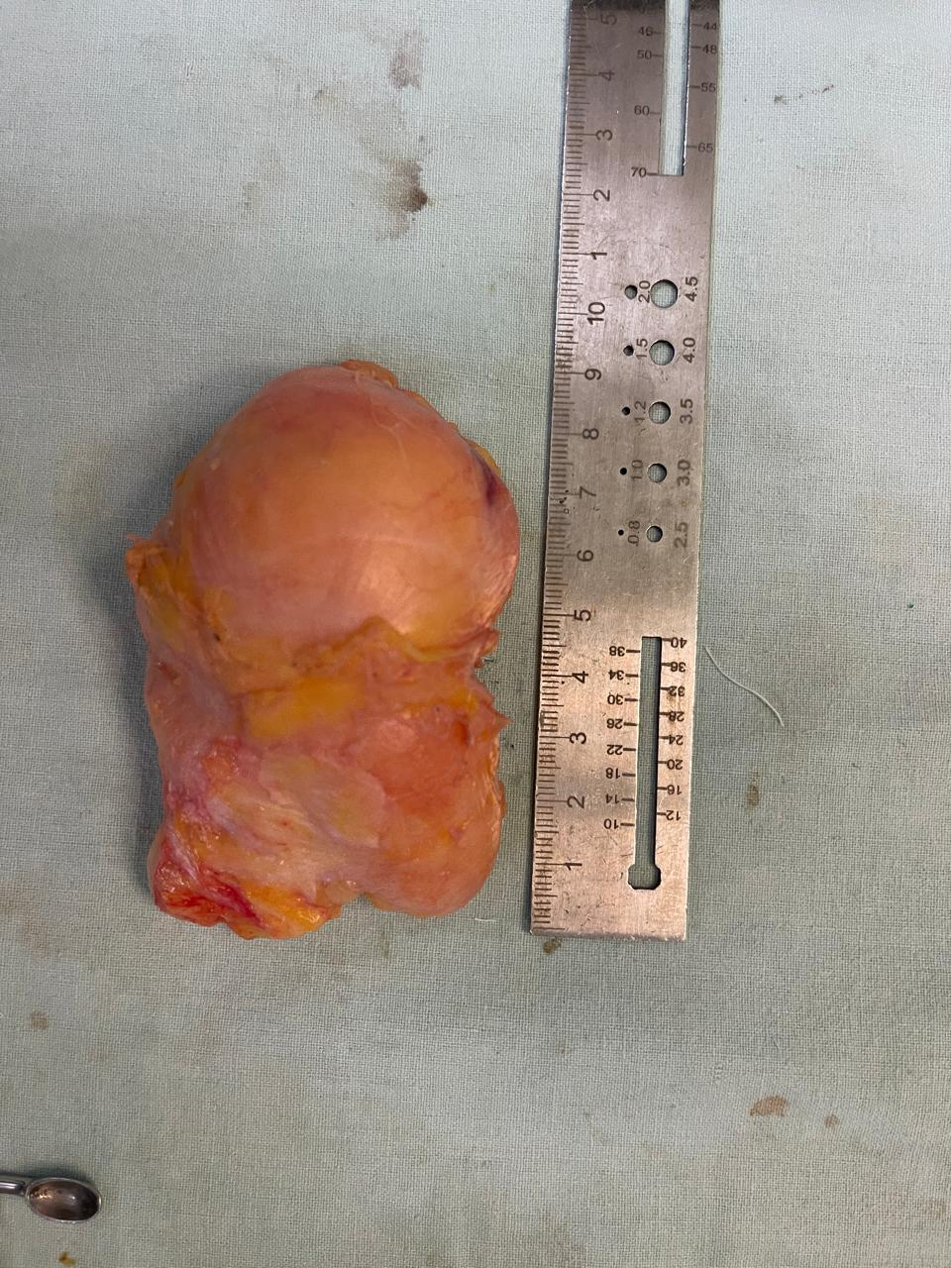
55th Annual Conference of
Orthopedic Surgeon Society of Andhra Pradesh
Date 6 – 8 February,2026, Venue : Kurnool Medical College
Organized by : Department of Orthopaedics, Kurnool Medical College Kurnool
Intraoperatively, a welldefined encapsulated lipomatous mass was identified with in the involved region The lesionwas yellowish lobulated andsoft in consistency, with no evidence of infiltration into surrounding structures.The mass was completely excised in total and sent for histopathology. Adjacenmuscles/joint structures were preserved and no neurovascular involvement was noted.
Intra-articular lipoma of the knee is a rare benign lesion
• Presents with non-specific symptoms: pain, swelling restricted movements • MRI shows a hypertense well-defined fatty lesion located anterior to distal femur and posterior to vastus medialis.
• Complete excision biopsy is done with excellent outcome and without recurrence.
Lipomas are the most common benign soft tissue tumors, occurring in almost
any part of the body and
prevalent in 2% of the population. The occurrence of intra-articular lipoma rare and mostly documented in the anterior compartment of the knee joint, like the Hoffman pad of fat and suprapatellar region.
INTRODUCTION
OPERATIVE FINDINGS
DISCUSSION
CASE REPORT
Intra-articular lipoma of the knee is a rare entity that should be considered in patients presenting with chronic knee pain and swelling. Early diagnosis and complete excision biopsy result in excellent functional outcomes and low recurrence rates.
Herein, the authors pre. Aof a 64-year-old- female with a history of chronic intermittent left knee jointpain and swelling for the last two years.
CONCLUSION

