Slide 1
COMPARATIVE ANALYSIS OF MPFL RECONSTRUCTION IN RECURRENT DISLOCATION OF PATELLA USING PERONEUS LONGUS GRAFT VERSUS SEMITENDINOSUS – A RETROSPECTIVE STUDY
AUTHOR:DR RAMKOUSHIK PARTHASARATHI-POSTGRADUATE
CO AUTHOR : DR.V. NAGESWARA RAO – PROF AND HOD
GSL MEDICAL COLLEGE,RAJAHMUNDRY

Slide 2
INTRODUCTION
Recurrent dislocation of the patella is a common cause of knee morbidity in young and active individuals.
The medial patellofemoral ligament (MPFL) is the primary passive restraint to lateral patellar translation in the first 20–30° of knee flexion, contributing nearly 50–60% of the restraining force.
Traumatic patellar dislocation invariably results in disruption of the MPFL, predisposing the patient to recurrent instability if not adequately addressed.

Slide 3
MPFL reconstruction has emerged as the standard surgical treatment for recurrent patellar instability in the absence of significant bony malalignment.
Various autografts have been described, among which semitendinosus tendon remains the most commonly used. However, concerns regarding hamstring weakness and donor-site morbidity have prompted evaluation of alternative grafts.
The peroneus longus tendon, with its high tensile strength, adequate length, and minimal functional deficit at the ankle, has been proposed as a viable alternative.
This retrospective study aims to compare the functional outcomes, complications, and donor-site morbidity of MPFL reconstruction using peroneus longus tendon graft versus semitendinosus tendon graft.

Slide 4
MATERIALS AND METHODS
This retrospective comparative study was conducted in GSL medical college and general hospital,rajahmundry. A total of 30 patients who underwent MPFL reconstruction for recurrent patellar dislocation between January 2022 and December 2024 were included.
Patients were divided into two groups:
•Group A (n = 15): MPFL reconstruction using semitendinosus autograft
•Group B (n = 15): MPFL reconstruction using peroneus longus autograft
All surgeries were performed using a standardized technique. Minimum follow-up period was 12 months.

Slide 5
INCLUSION CRITERIA | EXCLUSION CRITERIA
Age between 15 and 40 years Recurrent lateral patellar dislocation (≥2 episodes) Failure of conservative management Normal TT–TG distance(<20 mm) | Acute first-time patellar dislocation Severe trochlear dysplasia Patella alta requiring distalization Associated ligament injuries of the knee Previous knee surgery Generalized ligamentous laxity

Slide 6
SURGICAL PROCEDURE -GROUP A – SEMITENDINOSUS GRAFT
The patient was positioned supine under spinal or general anesthesia with a thigh tourniquet.
The semitendinosus tendon was harvested through a 3–4 cm incision over the pes anserinus. Double strand graft of average 10cms was prepared.
A medial patellar incision was made, and a patellar tunnel was drilled at the junction of the upper and middle third of the patella.
Femoral tunnel placement was done at the anatomical MPFL insertion (Schöttle’s point) under fluoroscopic guidance.
The graft was passed in an extra-synovial plane and isometric point of MPFL was checked. Graft was fixed to the patella using transosseous tunnels and to the femur with an interference screw at 30° of knee flexion.

Slide 7
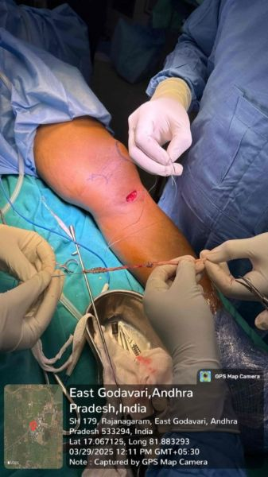
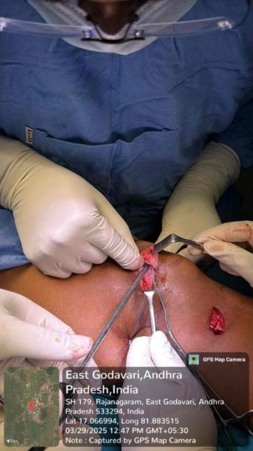
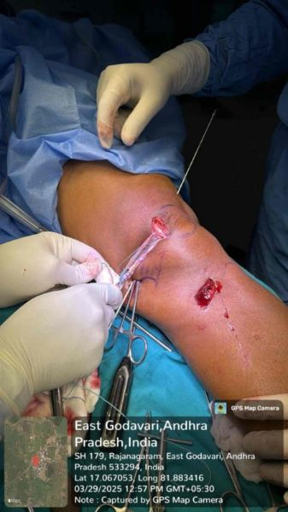
PATELLA TRANSOSSEOUS FIXATION
SEMITENDINOSUS GRAFT HARVEST
FIXATION OF GRAFT TO PATELLA AND SCHOTTLE POINT

Slide 8
GROUP B – PERONEUS LONGUS GRAFT
In this group, the peroneus longus tendon was harvested through a small incision posterior to the lateral malleolus. The graft was prepared similarly.
The MPFL reconstruction technique, tunnel placement, and fixation method were identical to Group A to eliminate procedural bias. Care was taken to avoid graft over tensioning.

Slide 9
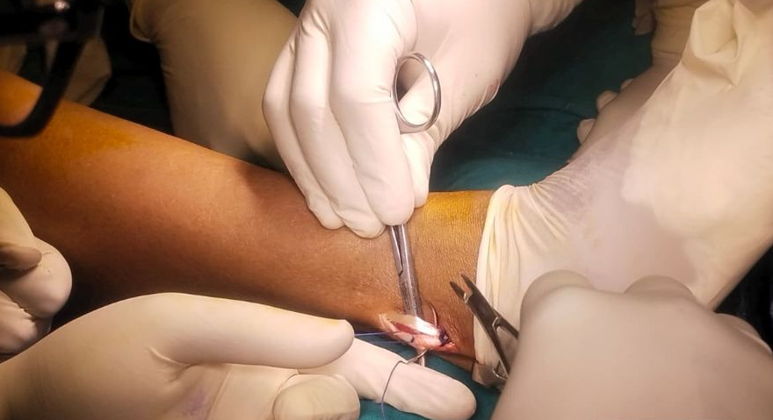
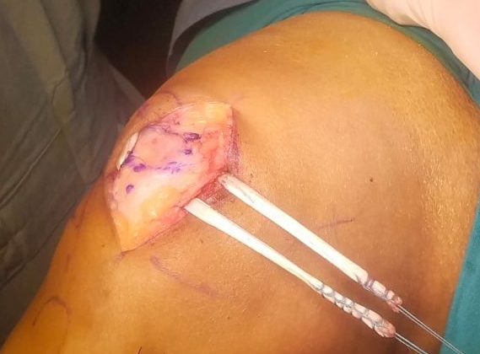
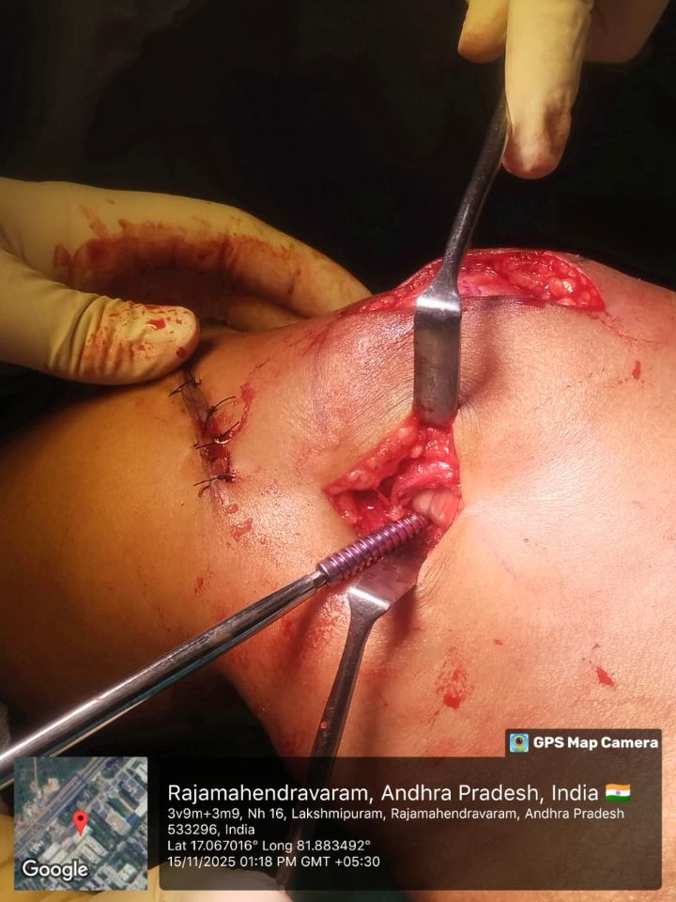
PERONEUS LONGUS GRAFT HARVEST
TRANSPATELLAR FIXATION
FIXATION OF GRAFT TO PATELLA AND SCHOTTLE POINT

Slide 10
POSTOPERATIVE PROTOCOL
Knee immobilizer for 2 weeks
Quadriceps strengthening from day 1
Passive range of motion initiated after 2 weeks
Partial weight bearing from 2 weeks, full weight bearing by 4–6 weeks
Sports activities allowed after 4–6 months

Slide 11
STATISTICAL ANALYSIS
Patient data were collected retrospectively from medical records.
Clinical outcomes were analyzed and compared between the two groups using KUJALA and LYSHOLM scores.
The data were compiled and analysed in Statistical package for socialsciences (SPSS) software version 26.0.
Quantitative data were described as means and standard deviation.
Students t test was done and p value less than 0.05 was considered statistically significant.

Slide 12
RESULTS
DEMOGRAPHIC PROFILE
Mean age in Group A: 24.6 ± 4.1 years
Mean age in Group B: 23.9 ± 3.8 years
No statistically significant difference (p = 0.71)
INTRAOPERATIVE PARAMETERS
Mean operative time was significantly lower in Group B (65 ± 8 min) compared to Group A (78 ± 10 min) (p < 0.01)
Mean intraoperative blood loss was significantly less in Group B (85 ± 15 ml) compared to Group A (120 ± 20 ml) (p < 0.01)

Slide 13
TENDON LENGTH , DIAMETER,STRENGTH
 | SEMITENDINOSUS GRAFT | PERONEUS LONGUS GRAFT
TENDON LENGTH | 22-26 cms (average in our study-23.6cms) | 28-32 cms(average -29.2cms)
TENDON DIAMETER | 5-6 mm | 4.5 to 5 mm
TENDON STRENGTH | ~1216–2422 N | ~1950–3224 N
TENDON STIFFNESS | ~150–200 N/mm | ~180–220 N/mm

Slide 14
KUJALA AND LYSHOLM SCORES
 | Semitendinosus (Group A) | Peroneus Longus (Group B) | P value,t score
Post-op Kujala | 82.4 ± 4.9 | 88.6 ± 4.2 | <0.001,3.77
Post-op Lysholm | 80.1 ± 5.7 | 87.2 ± 4.8 | <0.001, 3.67

Slide 16
DONOR SITE MORBIDITY
Knee flexor weakness noted in 4 patients (26.6%) in Group A
Hypoesthesia to anterolateral part of lower leg seen in 2 patients due to IPBSN injury seen in Group A
No significant ankle weakness noted in group B

Slide 17
DISCUSSION
MPFL reconstruction has consistently demonstrated excellent outcomes in treating recurrent patellar instability when anatomical reconstruction principles are followed. The choice of graft plays a critical role in postoperative function, rehabilitation, and patient satisfaction.
Camanho et al.demonstrated that specific MPFL reconstruction after the dislocation episode leads to more favorable results when compared with conservative treatment, with lower chance of recurrence.

Slide 18
Semitendinosus tendon has been widely used due to ease of harvest and reliable strength. However, studies have reported hamstring weakness, saphenous nerve injury, and delayed rehabilitation. In our study, 20 % patients in the semitendinosus group demonstrated knee flexor weakness, which impacted early functional recovery and satisfaction.
Peroneus longus tendon offers several biomechanical advantages. Its tensile strength exceeds that of native MPFL and partial harvest does not compromise ankle stability or gait mechanics. Our findings demonstrated superior Kujala and Lysholm scores in the peroneus longus group in early followup, reflecting better patellofemoral function and pain relief.

Slide 19
Wang Q et al found that single and double bundle MPFL reconstruction can improve the stability of the patella,but the double bundle has an angular synergistic effect, simulating the wide footprint of MPFL in the patella, which makes it have a stronger ability to resist patellar dislocation
The load to failure of the MPFL in biomechanical studies was 178 ± 46 N, while the AHPLT showed an average failure load of 322.35 ± 63.18 N, similar to the semitendinosus tendon (334.1 ± 49.0 N) and higher than the gracilis tendon (225.4 ± 43.9 N) failure loads, both of which are commonly used for MPFL reconstruction.

Slide 20
Mingzhan Han et al conducted study on MPFL reconstruction with semitendinosus and peroneus longus tendon and found that Whether autologous PLT or ST double bundle reconstruction of MPFL, both can effectively treat RPD,significantly improve the patellar tilt angle and patellar concentration angle, improve the Kujala score of the affected knee, reduce the wear of patellar joint, and delay the development of patellar arthritis.
However, the tendon incision in ST group will cause isbsn injury and sensory impairment of anterolateral skin of lower leg. Therefore, the incision should be reduced to avoid damaging IPBSN.

Slide 21
LIMITATIONS OF THE STUDY
Small Sample Size-Each group consisted of only 15 patients, which limits the statistical power and generalizability of results
Short Follow-up Period-Minimum follow-up was 12 months, which may not adequately reflect long-term graft survivorship, late instability, or degenerative changes.
Retrospective Study Design-Randomization and blinding were not possible.
Single-Center Study-Results may reflect institutional surgical expertise and rehabilitation protocols, limiting external validity

Slide 22
CONCLUSION
Both semitendinosus and peroneus longus grafts provide good to excellent outcomes in MPFL reconstruction for recurrent patellar dislocation.
However, peroneus longus graft demonstrated superior functional scores with minimal donor-site morbidity and no knee flexor weakness and early recovery. It is a safe, effective, and promising alternative to semitendinosus tendon for MPFL reconstruction.

Slide 23
REFERRENCES
Camanho G.L., Viegas A.C., Bitar A.C., Demange M.K., Hernandez A.J. Conservative versus surgical treatment for repair of the medial patellofemoral ligament in acute dislocations of the patella. Arthroscopy. 2009;25(6):620–625. doi: 10.1016/j.arthro.2008.12.005
LaPrade MD, Kallenbach SL, Aman ZS, et al. Biomechanical evaluation of the medial stabilizers of the patella. Am J Sports Med. 2018;46(7):1575-1582. doi: 10.1177/0363546518758654
Wang Q, Huang W, Cai D, et al. Biomechanical comparison of single- and double-bundle medialpatellofemoral ligament reconstruction[J]. J Orthop Surg Res, 2017, 12(1): 29.
Nomura E, Horiuchi Y, Inoue M. Correlation of MR imaging findings and open exploration of medial patellofemoral ligament injuries in acute patellar dislocations. Knee. 2002;9(2):139–143.
Dejour D, Saggin P. The sulcus deepening trochleoplasty—the Lyon’s procedure. Int Orthop. 2010;34(2):311–316.
Ellera Gomes JL. Medial patellofemoral ligament reconstruction for recurrent dislocation of the patella: a preliminary report. Arthroscopy. 1992;8(3):335–340.
Mountney J, Senavongse W, Amis AA, Thomas NP. Tensile strength of the medial patellofemoral ligament before and after repair or reconstruction. J Bone Joint Surg Br. 2005;87(1):36–40.

Slide 24
Han M, Zhang Q, Chen W, et al. Reconstruction of the medial patellofemoral ligament with autologous peroneal longus tendon versus semitendinosus tendon. Int Orthop. 2022;46:1341–1349.
Migliorini F, Trivellas A, Driessen A, et al. Graft choice for isolated MPFL reconstruction: gracilis versus semitendinosus. Eur J Orthop Surg Traumatol. 2020;30:763–770.
Kyung HS, Kim HJ. Medial patellofemoral ligament reconstruction: a comprehensive review. Knee Surg Relat Res. 2015;27(3):133–140.
Wylie JD, Burks RT. Medial patellofemoral ligament reconstruction with semitendinosus autograft. Arthrosc Tech. 2013;2(4):e417–e421.
Laprade M D, Kallenbach S L, Aman Z S, et al. Biomechanical Evaluation of the Medial Stabilizers of the Patella[J]. Am J Sports Med, 2018, 46(7): 1575-1582.
Zhao J, Huangfu X. The biomechanical and clinical application of using the anterior half of theperoneus longus tendon as an autograft source[J]. Am J Sports Med, 2012, 40(3): 662-71.
Shao X, Shi L L, Bluman E M, et al. Satisfactory functional and MRI outcomes at the foot and ankle following harvesting of full thickness peroneus longus tendon graft[J].

