Slide 1





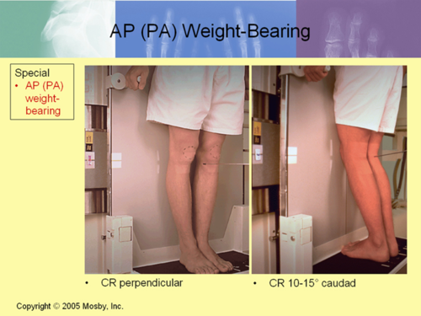
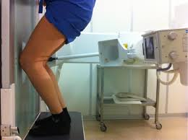
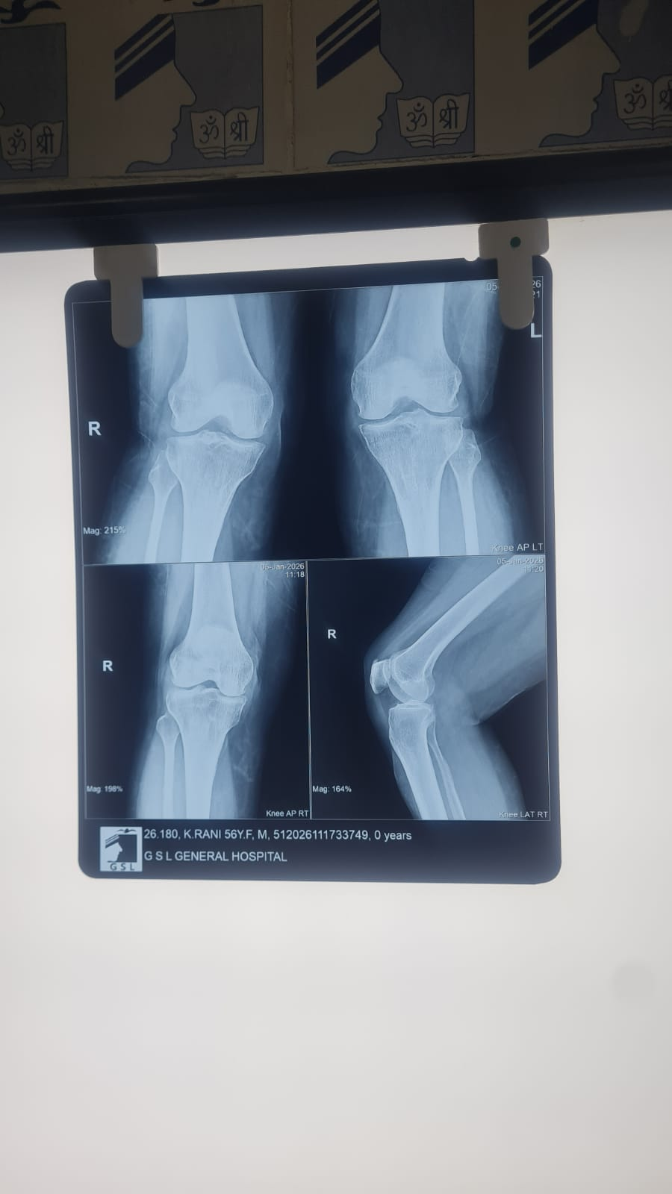
Rosenberg View vs Standing AP View in Early Detection of Knee Osteoarthritis-A comparative study
AUTHOR - Dr.Ramkoushik Parthasarathi-Postgraduate
CO AUTHOR- Dr.V.Nageswara Rao -PROF & HOD
GSL MEDICAL COLLEGE ,RAJAHMUNDRY
OSSAP ID - 393
INTRODUCTION
MATERIALS AND METHODS
RESULTS
CONCLUSION
Knee osteoarthritis is a leading cause of pain and disability in elderly ,making early detection essential for effective intervention and delaying progression
Standard standing AP radiographs are commonly used but may miss early degenrative changes ,especially in posterior weight bearing tibiofemoral component
Rosenberg view (PA,45* flexion) improves asssessment by plavcing knee in a functional, weight bearing position,enhancing posterior joint space
Our aim is to compare Rosenberg and AP views to determine whether incorporating view improves early radiographic detection of OA knee
50 patients with clinical suspicion of early knee OA underwent both standing AP and Rosenberg views.
Joint space narrowing, osteophytes, and subchondral sclerosis were graded using the Kellgren-Lawrence scale.
Detection rates for early osteoarthritic changes were compared between the two radiographic views.
RADIOGRAPHIC PROTOCOL-Standing AP view-patient standing with knee fully extended
standard expose paramteres
equal bilateral weight bearing during imaging.
Rosenberg view-Patient standing with knee flexed to 45* under equal weight bearing
X ray beam angled 10* caudally,identical expose parameters
Joint space narrowing -was identified in 80% cases using rosenberg view vompared to 50 % using standard AP view
Osteophytes were detected in 65% of rosenberg view versus 40% on Standard AP view,indicating improved visualization of marginal changes
Subchondral sclerosis was noted in 50% of Rosenberg view, nearly doublr 28% detected on AP view
Rosenberg view identified Kellgren Lawerence grade >1 changes in 60% of knees,whereas AP view detected changes in only in 35%
Overall ,Rosenberg view consistently revealed more subtle degenrative features than AP view
Rosenberg view is superior to standing AP radiographs for early detection of knee OA and should be included routinely in initial assessment to guide timely management.
subtle joint space narrowing,early osteophytes,subchondral changes are more consistently identified on rosenberg view
RECOMMENDATIONS
Incorporation of Rosenberg view in routine practice in clinical suspicion of OA knee
Standardized radiological parameters to be followed
Avoid Rosenberg view in recent trauma,knee instability patients
Standard AP view
Rosenberg
ACKNOWLEDGEMENT
I sincerely thank
Dr. V. Nageswara Rao-HOD along with the faculty of Orthopaedics and the Department of Radiology, GSL Medical College & General Hospital, for their guidance and support
AP view
rosenberg

