Slide 1
“A COMPARATIVE STUDY OF FUNCTIONAL RESULTS OF CEMENTED VERSUS UNCEMENTED HEMIARTHROPLASTY USING BIPOLAR
PROSTHESIS IN THE TREATMENT OF INTRA CAPSULAR FEMORAL NECK FRACTURES IN ELDERLY PEOPLE “
AUTHOR: DR.JEEVAN VALLURU-POSTGRADUATE
CO-AUTHOR: DR.NAESWARA RAO -HOD
GSL MEDICAL COLLEGE , RAJAHMUNDRY.

Slide 2
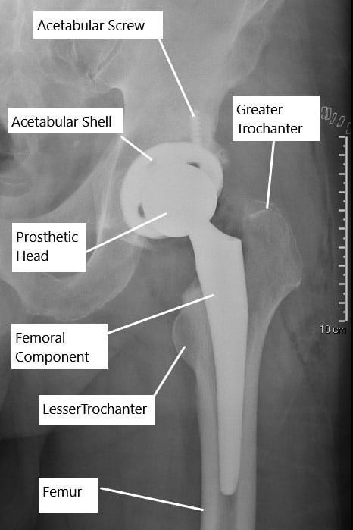
INTRODUCTION
Femoral neck fracture (FNF) is common injury that leads to increase in morbidity and mortality postoperatively in old age patients.
Two arthroplasty procedures are available for treatment of intracapsular fractures (displaced) of femur: HHA(hemi- arthroplasty) , and THA (total replacement of hip).
The present study was taken up to know functional outcome and clinical outcomes of intracapsular fracture of femoral neck with bipolar prosthesis with cemented and uncemented hemi arthroplasty.

Slide 3
AIM
The purpose of this two-centre randomized equivalence trial was to compare a hemiarthroplasty using cemented implant and HA-coated proximal press-fit uncemented implant with the following three research aims:
To check the differences in intraoperative events , be detectable?
Are there any differences in functional outcome and quality of life at 3 months and 1 year or are the results equivalent?
Are the rates of postoperative morbidity and mortality similar between the two groups?

Slide 4
OBJECTIVES
OBJECTIVES:
To evaluate intra-operative and post-operative events in cemented,
uncemented hemiarthroplasty using bipolar prosthesis with respect to surgery duration, blood loss.
To study the end results of bipolar prosthesis with respect to stability.
To elucidate whether hemiarthroplasty using either uncemented or
cemented implant for treatment of FNFs yields similar clinical outcome.

Slide 5
PATIENTS AND METHODS
PLACE OF STUDY :DEPT. OF ORTHOPAEDICS.
PLACE & YEAR OF STUDY: RAJAHMUNDRY . (DEC 2022 – JAN 2024 )
SAMPLE SIZE : 30 CASES.
STUDY TYPE: PROSPECTIVE RANDOMIZED COMPARATIVE STUDY.

Slide 6
METHODOLOGY
All patients are pre-operatively evaluated by detailed history, complete clinical examination is performed.
Medical conditions if present were treated.
Patients were operated based on the randomisation code they received.

Slide 7
INCLUSION CRITERIA:
Patients having Femur Neck Fracture .
Adult patients aged more than 60 years both male and female.
Patients medically fit for surgery.
Patients who were ambulatory before fracture.
Patients who were willing to give their informed consent.

Slide 8
EXCLUSION CRITERIA
1. Pathological fracture of femur neck.
2. Patients not willing for surgery .
3. Patients presented with polytrauma.
4. Patients with past history of symptomatic disease of hip such as osteoarthritis.
5. Patients who weren’t able to walk before the fracture.

Slide 9
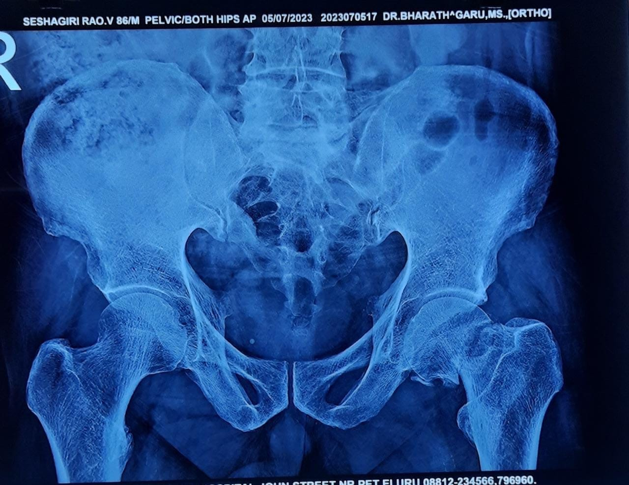
Case 1
Pt had history of fall @ home from stairs , complaints of pain and swelling in the left hip .
There’s presentation of shortening and external rotation of the limb.
All the nerve sensations are intact.

Slide 10
CEMENTED BIPOLAR HEMIARTHROPLASTY INDICATIONS :
Osteopenic / osteoporotic patients.
Bone irradiation / malignancy .
Abnormal wide femoral canal presentation

Slide 11
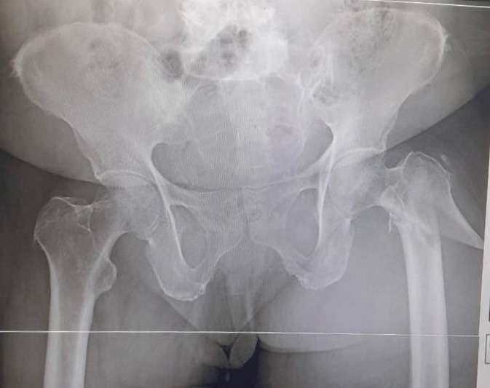
CASE-2
Pt had history of fall @ washroom and complaints of pain swelling around left limb .
There’s presentation of shortening and external rotation of the limb .
Nerve sensations are intact.

Slide 12
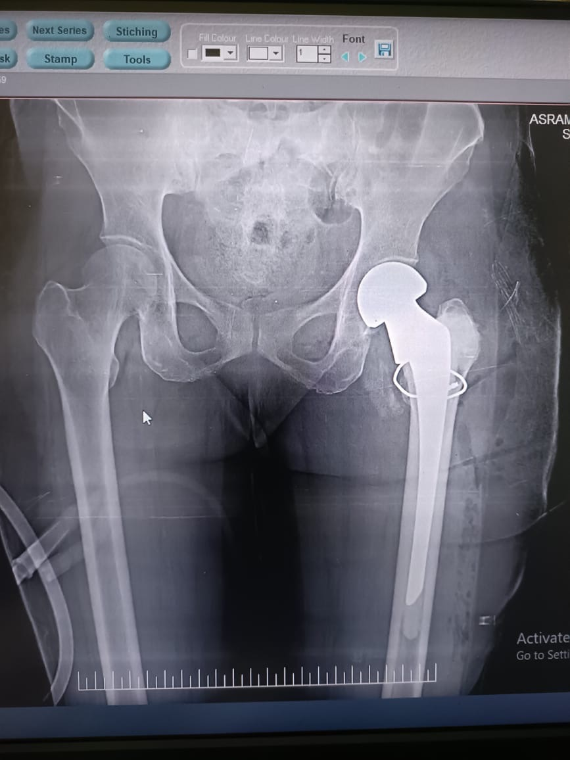

Slide 13
The modern technique of cementing involves:
Preparation of the femoral canal using serial broaching and using a pulsatile lavage to wash the canal and remove debris.
A cement restrictor is placed at an appropriate distance to prevent the cement from traveling down the canal.
The cement is filled in the canal using a cement gun that pressurizes the cement injection in the canal. The gun ensures the cement is not eviscerated by the bleeding in the canal .
The femoral stem is inserted to pressurize the cement and the tapered stem design ensures the cement pressure is maintained during the insertion. A proximal seal is made to ensure adequate pressure during the polymerization of the cement.

Slide 14
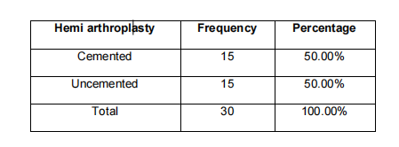
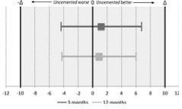
DISCUSSION
Complications were distributed equally between the groups three patients in the cemented group and one in the uncemented group needed one or more reoperations .
There were no intraoperative deaths, but there was one postop death within 72 hours; one patient in the cemented group experienced a severe decrease in blood pressure during the cementing procedure and died within 24 hours owing to an acute myocardial infarction.
This trial does not have the statistical power to address the potential adverse effects of cement as we did not find any indications of differences between the groups related to cementing, including mortality. The incidence of serious cement-related complications has been reported to be low .
The graph shows the mean difference in HHS between the two groups at 3 and 12 months.
Both CIs lie wholly inside the zone of equivalence and include zero, indicating the results in the uncemented group were near equivalent .

Slide 15
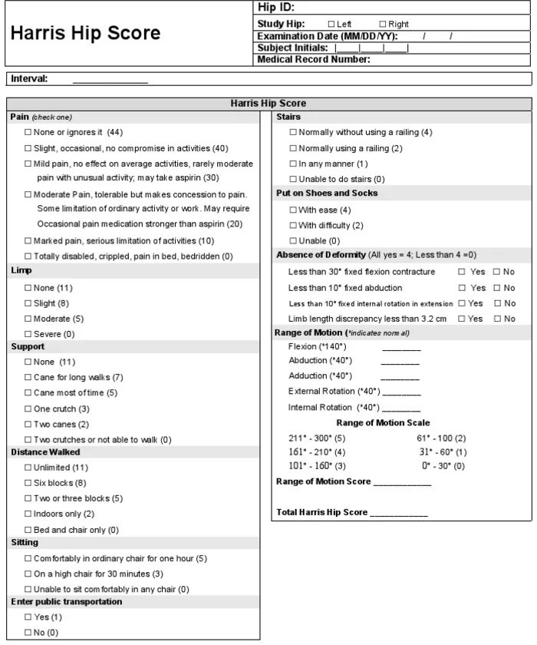

Slide 16
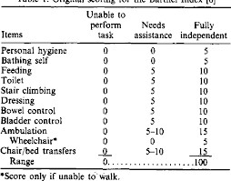
BARTHEL INDEX

Slide 17
CONCLUSION
Follow-up period postoperatively was followed over 3 , 6 and 12 months .
Femoral neck fractures are common in elderly. Incidence was found to be more in males in our study.
Hemi arthroplasty is the treatment of choice in displaced fracture neck of femur in elderly with normal acetabulum.
In our study statistical analysis of results uncemented hemi arthroplasty has shown better progress in terms of less intra operative blood loss.
This trial does not have the statistical power to address the potential adverse effects of cement, and we did not find any indications of differences between the groups related to cementing, including mortality. The incidence of serious cement-related complications has been reported to be low .
Hence, we conclude surgical treatment of fracture neck of femur in elderly with uncemented hemi- arthroplasty is preferable over cemented hemi-arthroplasty.

Slide 18
REFERENCES
Hopley C, Stengel D, Ekkernkamp A, Wich M. Primary total hip arthroplasty versus hemiarthroplasty for displaced intracapsular hip fractures in older patients: systematic review. BMJ. 2010;340:c2332. [PubMed] [Google Scholar]
Wang F, Zhang H, Zhang Z, Ma C, Feng X. Comparison of bipolar hemiarthroplasty and total hip arthroplasty for displaced femoral neck fractures in the healthy elderly: a meta-analysis. BMC Musculoskelet Disord. 2015;16:229. [PMC free article] [PubMed] [Google Scholar]
Protzman RR, Burkhalter WE. Femoral-neck fractures in young adults. Bone Joint Surg Am. 1976 Jul;58(5):689-95. [PubMed]

Slide 19
REFERENCES
Carroll C, Stevenson M, Scope A, Evans P, Buckley S. Hemiarthroplasty and total hip arthroplasty for treating primary intracapsular fracture of the hip: a systematic review and cost-effectiveness analysis. Health Technol Assess. 2011;15:1–74. [PMC free article] [PubMed] [Google Scholar].
National Institute for Health and Care Excellence. Hip fracture:
management 2011. London: National Institute for Health and Care Excellence; 2011.
Tuteja SV, Manusukhani SA, Mukhi SR. Functional outcome with Bipolar Hemiarthroplasty as against total hip replacement in intracapsular fracture neck femur. Int J Med Res Health Sci. 2014; 3:945 -953.

Slide 20
THANK YOU .

