Slide 1




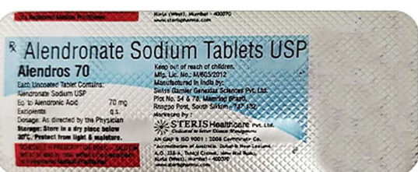
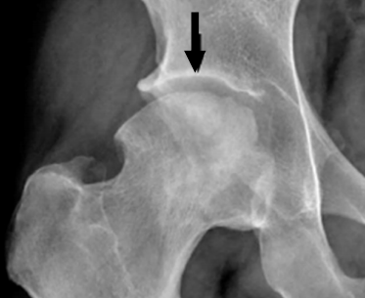
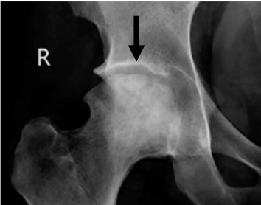
EFFECTIVENESS OF BISPHOSPHONATE IN FUNCTIONAL OUTCOME OF AVASCULAR NECROSIS OF HEAD OF FEMUR
AUTHOR : Dr. JEEVAN VALLURU -POSTGRDUATE
CO-AUTHORS: Dr. V NAGESWARA RAO-PROF AND HOD
OSSAP ID 394
ABSTRACT
MATERIALS AND METHODS
RESULTS
Avascular necrosis (AVN) of the femoral head is a severe illness marked by the gradual death of bone tissue resulting from impaired blood flow.our aim in this study is to determine the improvement in hip joint pain, function before and after
bisphosphonate therapy in AVN
The comparison of outcome is done before and after treatment with TAB. ALENDRONATE70mg weekly once for 1 year .outcome measured in term of clinically-Harris hip score(HHS),visual analogue score(VAS) and radiologically-FICAT stage,location of lesion.58 patients who was diagnosed with AVN of head of femur -FICAT ARLET stage 1,2A,2B-early stages were taken into study for period of 12 months
Statistically significant improvements were observed across FICAT stages and area of involvement, affirming the effectiveness of bisphosphonates, particularly Alendronate
(10mg daily) in early-stage AVN (FICAT I and II).
DISCUSSION
Progressive improvement in HHS,VAS suggests that the therapeutic intervention employed was effective in halting disease progression and promoting joint preservation. The most notable gains were observed within the first six months, indicating a critical period for early functional
recovery. However, longer-term follow-up would be necessary to assess the durability of these
outcomes and the risk of late deterioration.
 | before alendronate | after alendronate
HHS | 68 | 93.8
VAS | 5.81 | 1.72
INTRODUCTION
Avascular necrosis (AVN) frequently results in femoral head collapse and eventual osteoarthritis, significantly impairing patients' mobility and quality of life...Bisphosphonates, primarily used in osteoporosis and other bone metabolic disorders, function by inhibiting osteoclast-mediated bone resorption. Their role in AVN is hypothesized to prevent femoral head collapse by reducing bone turnover, stabilizing the necrotic bone, and potentially promoting repair mechanisms
CONCLUSION
The study confirms findings showing bisphosphonates delay disease progression, reduce early needs for surgery, and improve clinical outcomes.The most favourable responses were observed in younger patients, those with central lesions, and individuals with less than 30% femoral head involvement. patients with risk factors such as alcohol use, smoking, or advanced-stage disease showed limited improvement.
BEFORE ALENDRONATE
AFTER ALENDRONATE
ACKNOWLEDGEMENT
I sincerely thank Dr. V. Nageswara Rao-HOD along with the faculty of Orthopaedics and the Department of Radiology, GSL Medical College & General Hospital, for their guidance and support.

