Slide 1
FUNCTIONAL OUTCOME OF TALUS FRACTURES MANAGED BY OPEN REDUCTION AND INTERNAL FIXATION WITH CANNULATED CANCELLOUS SCREW
AUTHOR: DR SHAIK SHAFI ILIYAS
POST GRADUATE ,GSLMC
RAJAMAHENDRAVARAM
CO AUTHORS: DR V.NAGESWARA RAO
HOD

Slide 2
INTRODUCTION
Fractures of the talus are known to be relatively uncommon. Between 0.1and 0.85 percent of all fractures are talus fractures. The majority are brought on by high-energy trauma, including motor vehicle accident.
Consequently, further injuries such as adjacent joint dislocation and adjoining bone fracture frequently accompany talus fractures.

Slide 3
Aim & Objectives :
To assess the functional and radiological outcome of closed talus neck fractures managed by open reduction and internal fixation
Material and methods:
Retrospective evaluation of 20 patients in the age group of 15 years to 75 years with good general condition underwent open reduction and internal fixation with cannulated cancellous screw fixation for displaced talus fracture during November 2023 to November 2021.

Slide 4
Inclusion criteria
- Closed fracture of the talus with or without dislocation
- Road traffic accidents and fall injury
- Age -15- 75 years
Exclusion criteria
- Compound fractures with Talus bone exposed
- Neglected fractures with > 3 months duration

Slide 5
Technique of open reduction and fixation Surgical approaches
Combined approach:
1. Anteromedial approach : Incision, 10 cm long, beginning at the lower third of the leg 1 cm lateral to the anterior crest of the tibia, running parallel to it and then curved medially to midway between the tip of the medial malleolus and the navicular tubercle.
The long saphenous vein was ligated and divided and the saphenous nerve was identified and preserved.The fracture and the anteromedial aspect of the neck and body of the talus were exposed.

Slide 6
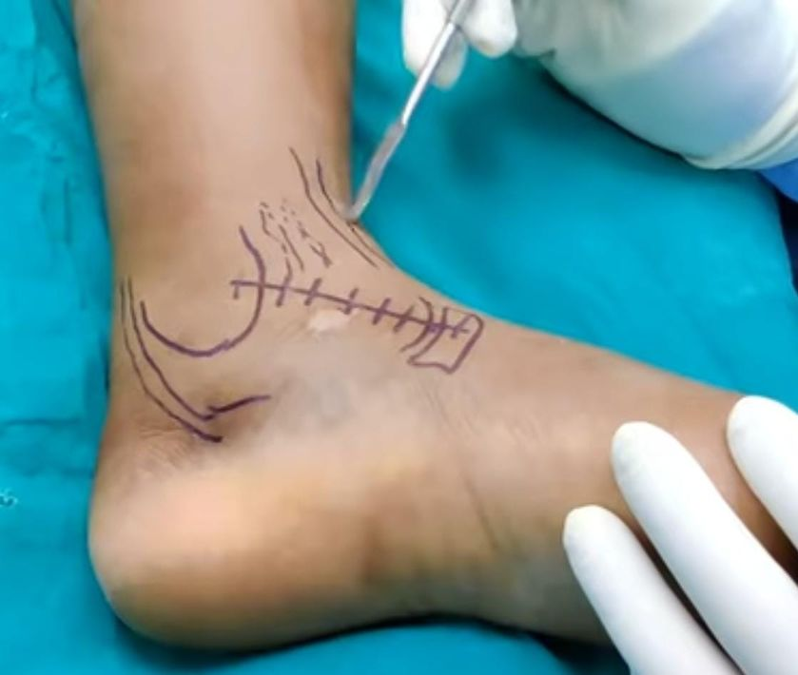
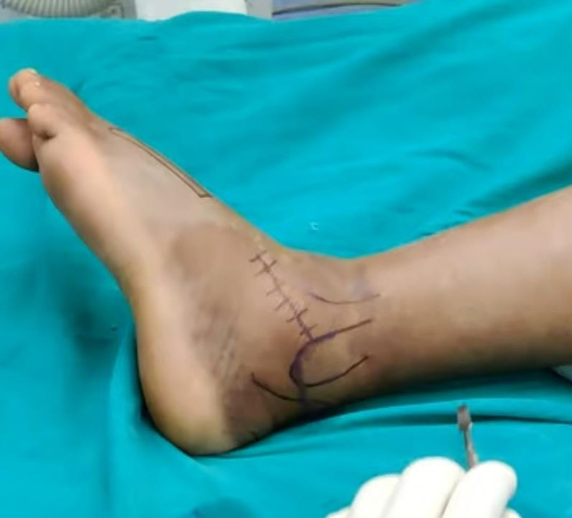
2. Anterolateral approach This approach uses a curvilinear skin incision that begins 2cm anterior to tip of fibula and extends to base of 4th metatarsal. Deep dissection is carried out through extensor retinaculum and lateral to extensor tendons. This allows access to the sinus tarsi, lateral talar body and neck
Anteromedial approach
Anterolateral approach

Slide 7
Post operative evaluation
Below knee slab with elevation advised for 4-6 weeks.
Early range of motion encouraged once the slab was removed.
After 3 month repeat x-ray was done in all patients then they were advised to start partial to full weight-bearing combined with physiotherapy.
At final follow-up after 1 year, range of motion (ROM) was assessed with the American orthopaedic foot and ankle society (AOFAS) ankle–hindfoot score.

Slide 8
In this scale, 50 points were assigned to function, 40 points to pain, and 10 points to alignment. Usually, the scoring system is divided as following. Excellent: 90 and 100;
Good: 75–89;
Fair: 50–74;
Poor: <50
Follow up
Follow up Patients were followed up at first month (4weeks), third month (12 weeks), and 6 months. During follow-up, X ray radiograph of the ankle joint was taken in both anteroposterior view and lateral view and mortise view to assess the reduction as well as to analyze and check for any signs of avascular necrosis and also to see joint congruity.

Slide 9
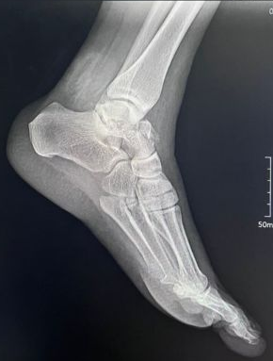
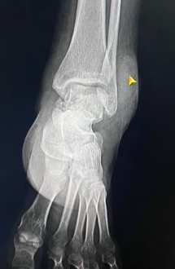
Case
pre operative x rays

Slide 10
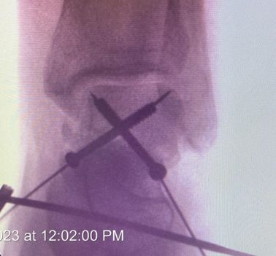
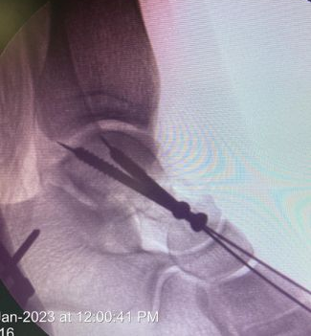
Intra operative pics

Slide 11
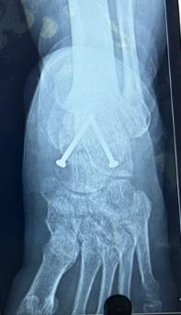
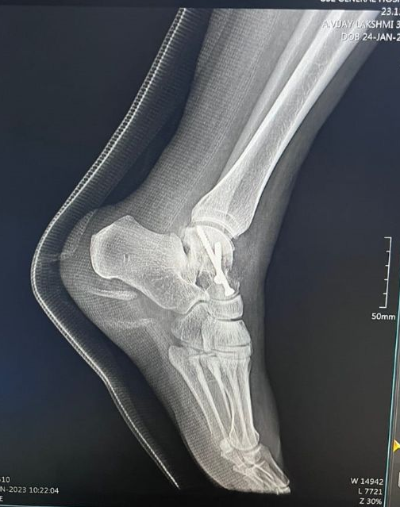
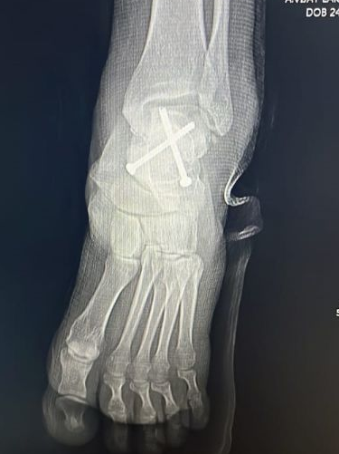
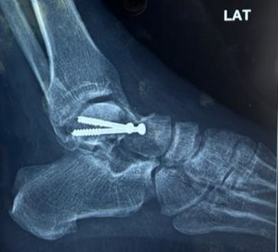
Post operative x rays
3 month follow up x ray

Slide 12
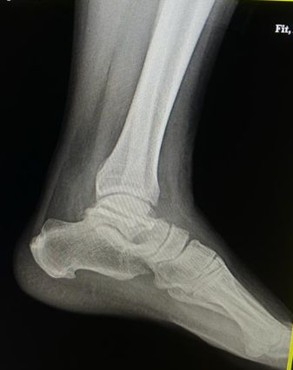
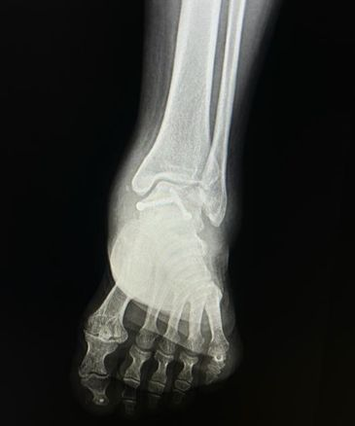
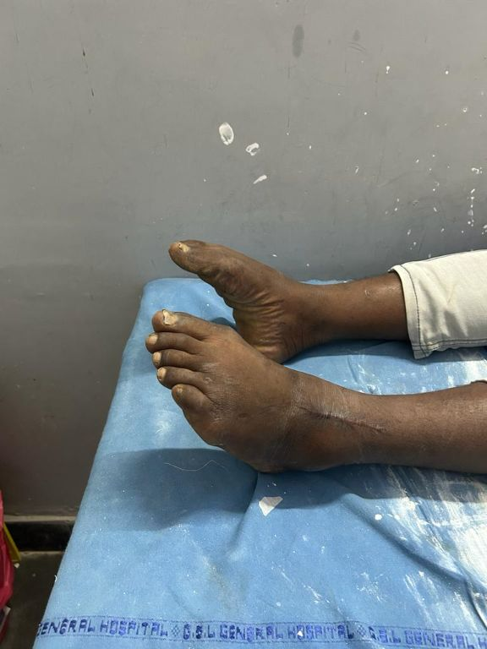
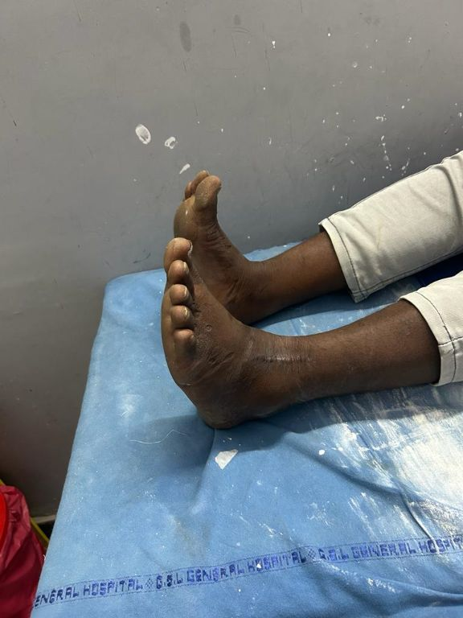
plantarflexion
dorsiflexion
6 month follow up x ray

Slide 13
RESULT:
A total of 20 patients are included in the study. The follow-up period for 6 months. Results are analyzed both clinically and radiologically.
Among these, 8 are Hawkins type II, 12 are Hawkins type III .
All talus fractures are managed using combined approach(anterolateral and anteromedial approach).

Slide 14

Age | Number of patients
15-30 | 5
31-45 | 9
46-75 | 6
Sex | NUMBER OF PATIENTS
Male | 12
Female | 6
Functional outcome is assessed using AOFAS mean score of 64.75 ± 10.77, with the majority having good outcome i.e 7 patients, fair in 6 patients, and excellent in 7 patients.

Slide 15
DISCUSSION
Now a days accidents in motor vehicle and fall from height results serious talar fractures. Low energy injuries can also result in talus fractures.
Computed tomography (CT) is useful to assess displacement, articular extension and fracture patterns.

Slide 16
Fournier et al 4 reported dual approach exposed medial and lateral faces of talar neck and facilitate better reduction also minimal interferences in blood supply to talar fragments.
For a better initial reduction, some authors recommend a dual anteromedial and anterolateral approach. This technique permits good visualization of the talus but increases the risk of skin necrosis or infection and increases the duration of surgery.

Slide 17
In this study of displaced talar fractures, we preferred a fast and slightly aggressive operative treatment to avoid wound complications and avascular necrosis.
Avascular necrosis is a common complication after talar fractures, the initial degree of fracture displacement is an important risk factor for osteonecrosis. The surgical delay also seems important and most authors recommend urgent reduction and stabilization of displaced talar fractures.
The majority of the talar surface is articular cartilage. This explains the high risk of osteoarthritis after a talar fracture. The risk factor associated with the dual approach is a skin infection and necrosis, however, in young active patients occurrence of infection carries a lesser probability

Slide 18
CONCLUSION
In this study treatment of fracture talus with open reduction and screw fixation facilitated early mobilisation of the patients and helped achieving stable, pain free subtalar and ankle joints and preventing avascular necrosis of talus, subtalar and ankle joint arthritis. AOFAS score has significant improvement during follow up.
The screw can be fixed either anterior to posterior direction or from posterior to anterior direction. But posterior to anterior directed screws are biomechanically stronger.Though age and sex of the patient, type of fracture, time of presentation, amount of blood loss, time of union influences the functional outcome, these parameters shows no gross variations in all patients regarding outcome and showed good results.

Slide 19
REFERENCE
1.Sarrafian SK. Anatomy of the foot and ankle: descriptive, topographic, and functional. Philadelphia: Lippincott, 1983, 400-407.
2.Blood supply of the talus comes from three arteries. These form extra osseous circulation as described by Wildenaur around the talar neck and sinus tarsi1. Elgafy H, Ebraheim NA, Tile M, Stephen D, Kase J. Fractures of the talus: experience of two level 1 trauma centers. Foot Ankle Int 2000;21:1023-1029
3.Inokuchi S, Ogawa K, Usami N. Classification of ~ 577 ~ International Journal of Orthopaedics Sciences www.orthopaper.com fractures of the talus: clear differentiation between neck and body fractures. Foot Ankle Int 1996;17(12):748-750
4.Abrahams TG, Gallup L, Avery FL. Nondisplaced shearing-type talar body fractures. Ann Emerg Med 1994;23(4):891-893. doi: 10.1016/S0196-0644(94)70331-0.

Slide 20
5.Peterson and Goldie (Acta Orthop Scand 1974;45:260- 270,)] The cause of injury was most frequently motor vehicle accidents (26) and falls from heights (11)
6.Lindvall E, Haidukewych G, DiPasquale T, Herscovici D, Jr, Sanders R. Open reduction and stable fixation of isolated, displaced talar neck and body fractures.
7.Hawkins LG. Fractures of the neck of the talus. J Bone Joint Surg (Am) 1970;52:991–1002.
8.Grob D, Simpson LA, Weber BG, Bray T. Operative treatment of displaced talus fractures. ClinOrthop. 1985;199:88-96.

