Slide 1
CLOSED INTRAMEDULLARY NAILING VS. PLATING IN THE TREATMENT OF EXTRA ARTICULAR DISTAL TIBIA FRACTURE
Moderator:
Dr. S. Appala Raju
Professor
Dept of orthopedics
NRI medical college, vizag
Presenting-Author:
Dr Yogitha Lakshmi Saladi
PG cum JR
Dept of orthopedics
NRI medical college, Vizag

Slide 2
INTRODUCTION
The best method of fixation for displaced, extra-articular fractures of the distal tibia remains debatable.
Operative fixation with intramedullary nail and plate osteosynthesis are mainstay of treatment.
The purpose of the study is to assess the treatment outcome of distal tibia fracture treated by intramedullary nail and plate osteosynthesis.

Slide 3
MATERIALS AND METHODS
Prospective observational study
  I) Inclusion criteria
    a) Age: Above 18 years upto 60 years of either gender
    b) Distal Tibial extra articular fractures
    c) Open fractures (Gustilo type-I, type-II)
  II) Exclusion criteria
    a) Pathological fractures
    b) Old neglected fractures
    c) Old fractures with implant failure

Slide 4
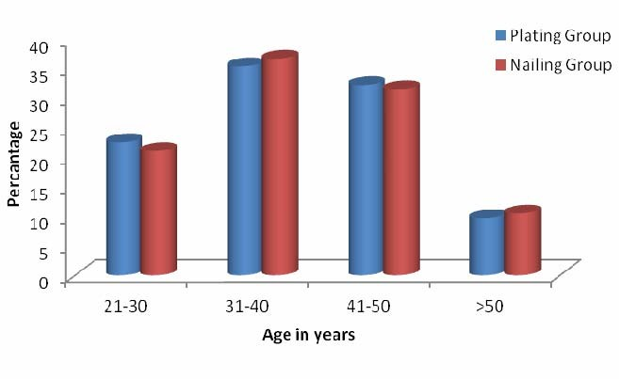
REsULTS
Total of 50 patients included in study
  Plating Group A : 31 patients
  Nailing Group B : 19 patients
Age in years | Plating group | Nailing group | Total
21-30 | 7(22.6%) | 4(21.1%) | 11(22%)
31-40 | 11(35.5%) | 7(36.8%) | 18(36%)
41-50 | 10(32.3%) | 6(31.6%) | 16(32%)
>50 | 3(9.7%) | 2(10.5%) | 5(10%)
Total | 31(100%) | 19(100%) | 50(100%)
Mean ± SD | 39.87±9.89 | 40.00±9.36 | 39.92±9.59

Slide 5
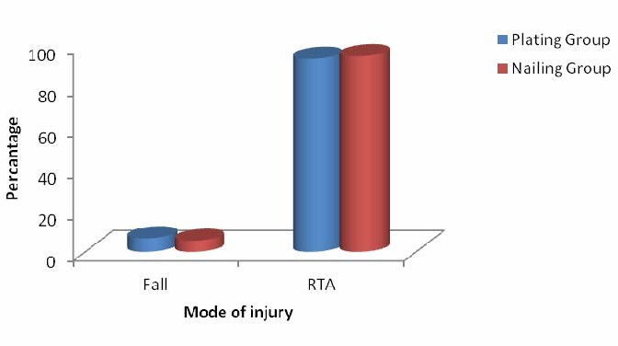
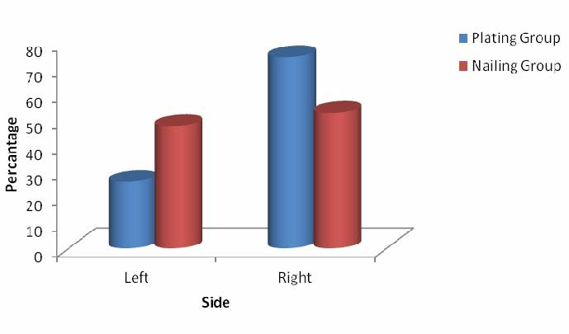
DEMOGRAPHICS
Mode of injury | Plating Group | Nailing Group | Total
Fall | 2(6.5%) | 1(5.3%) | 3(6%)
RTA | 29(93.5%) | 18(94.7%) | 47(94%)
Total | 31(100%) | 19(100%) | 50(100%)
Side | Plating Group | Nailing Group | Total
Left | 8(25.8%) | 9(47.4%) | 17(34%)
Right | 23(74.2%) | 10(52.6%) | 33(66%)
Total | 31(100%) | 19(100%) | 50(100%)
P=1.000, Not Significant, Chi-Square test

Slide 6
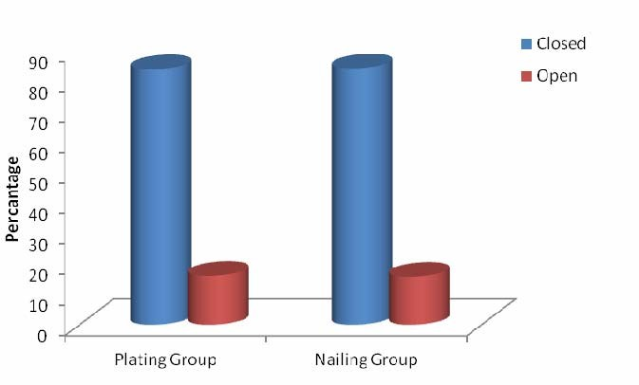
DEMOGRAPHICS
Open /Closed | Plating Group | Nailing Group | Total
Closed | 26(83.9%) | 16(84.2%) | 42(84%)
Open | 5(16.1%) Type I - 1 Type II -4 | 3(15.8%) Type I - 2 Type II -1 | 8(16%)
Total | 31(100%) | 19(100%) | 50(100%)
Type of surgery | Plating Group | Nailing Group | Total
CRIF | 19(61.3%) | 14(73.7%) | 33(66%)
ORIF | 12(38.7%) | 5(26.3%) | 17(34%)
Total | 31(100%) | 19(100%) | 50(100%)

Slide 7
COMPLICATIONS
Complications | Plating Group (n=31) | Nailing Group (n=19) | Total (n=50)
Nil | 26(83.9%) | 12(63.2%) | 38(76%)
Yes | 5(16.1%) | 7(36.8%) | 12(24%)
Infection | 2(6.5%) | 1(5.3%) | 3(6%)
Malunion | 2(6.5%) | 4(21.1%) | 6(12%)
Non-union | 1(3.2%) | 2(10.5%) | 3(6%)
All 3 Cases had superficial infection (1 nail & 2 plate) resolved by regular dressings & antibiotics
Non union – bone grafting

Slide 8
Union
Union of weeks | Plating Group | Nailing Group | Total
12-14 | 23(74.2%) | 14(73.7%) | 37(74%)
15-16 | 6(19.4%) | 5(26.3%) | 11(22%)
17-20 | 2(6.5%) | 0(0%) | 2(4%)
Total | 31(100%) | 19(100%) | 50(100%)
Mean ± SD | 14.19±2.09 | 13.11±1.73 | 13.78±2.01
The average time for fracture union in Our study is 13.8 weeks
Patients who underwent nailing for distal tibia fractures had earlier union

Slide 9
OUT COMES
Results | Plating Group | Nailing Group | Total
Poor | 2(6.5%) | 3(15.8%) | 5(10%)
Fair | 3(9.7%) | 3(15.8%) | 6(12%)
Good | 21(67.7%) | 10(52.6%) | 31(62%)
Excellent | 5(16.1%) | 3(15.8%) | 8(16%)
Total | 31(100%) | 19(100%) | 50(100%)
P=0.380, Not significant, student t test
In our study we found there is no significant difference in plating and nailing for distal tibia fractures with respect to functional and radiological out come when evaluated with Ankle evaluation scoring system (Merchant & Dietz) and criteria for evaluation of final results (Johner & Wruhs)

Slide 10
DISCUSSION
The present study was undertaken to compare the functional and radiological outcome of plate osteosynthesis versus intramedullary nailing for distal tibia fractures.
We evaluated our results and compared them to those obtained by various other studies utilizing various modalities of treatment.

Slide 11
Patients who underwent nailing for distal tibia fractures had faster union
In our study we found there is no significant difference in plating and nailing for distal tibia fractures with respect to range of motion.
In a study conducted by J. J. Guo wound complications were more common in the LCP Group, 14.6% compared with 6.8% in the IMN group. All were delayed wound healing
Guo JJ, Tang N, Yang HL, Tang TS. A prospective, randomized trial comparing closed intramedullary nailing with percutaneous plating in the treatment of distal metaphyseal fractures of the tibia. J Bone Joint Surg [Br]. 2010; 92-B:984-988

Slide 12
In a study conducted by C.Mauffrey et al a randomized pilot trial of “locking plate” fixation versus intramedullary nailing for extra-articular fractures of the distal tibia, three patients (6.8%) in the IM nail group and six (14.6%) in the locking-plate group had wound problems.
Compartment syndrome was noted in one patient in each group
Guo JJ, Tang N, Yang HL, Tang TS. A prospective, randomized trial comparing closed intramedullary nailing with percutaneous plating in the treatment of distal metaphyseal fractures of the tibia. J Bone Joint Surg [Br]. 2010; 92-B:984-988.

Slide 13
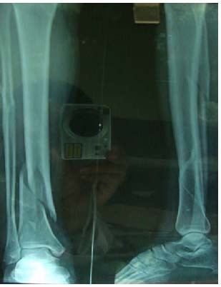
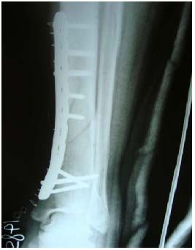
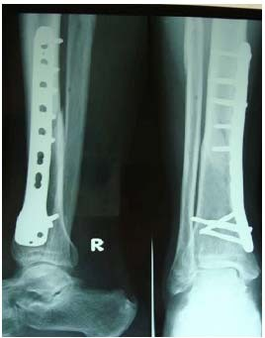
Pre-Op X-Ray
Immediate Post-Op X-ray
8 months Post-Op X-ray

Slide 14
Conclusion
According to this study, 50 patients with fracture distal tibia have
undergone plate osteosynthesis and IMIL nailing
There was no statistical significance between the two groups with respect to range of motion
Our results have shown that Union in nailing is earlier compared to plating

Slide 15
REFERENCES
Ajay Krishnan, Chetan Peshin, Dara Singh. Intramedullary nailing and plate osteosynthesis for fractures of the distal metaphyseal tibia and fibula Journal of Orthopaedic Surgery. 2009; 17(3):317-20
Guo JJ, Tang N, Yang HL, Tang TS. A prospective, randomized trial comparing closed intramedullary nailing with percutaneous plating in the treatment of distal metaphyseal fractures of the tibia. J Bone Joint Surg [Br]. 2010; 92-B:984-988
Lau TW, Leung F, Chan CF, Chow SP. Wound complication of minimally invasiveplate osteosynthesis in distal tibia fractures. Int Orthop. 2008; 32:697-703
Kasper W. Janssen & Jan Biert& Albert van Kampen Revised: 5 July 2006 Accepted: 7 July 2006 / Published online: 12 December 2006# Springer-Verlag 2006

