Slide 1




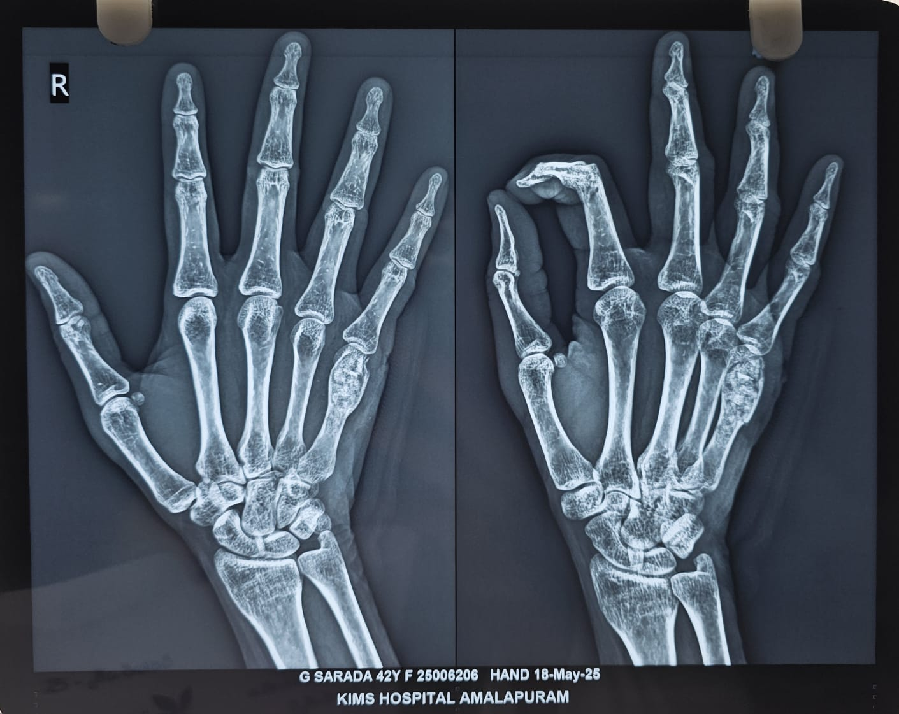
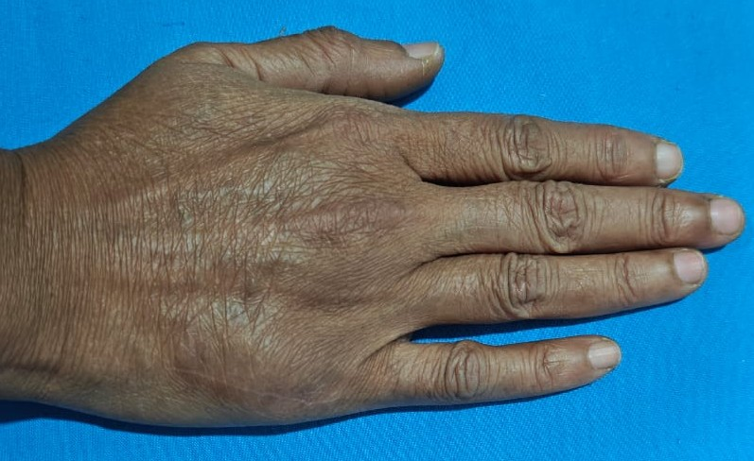
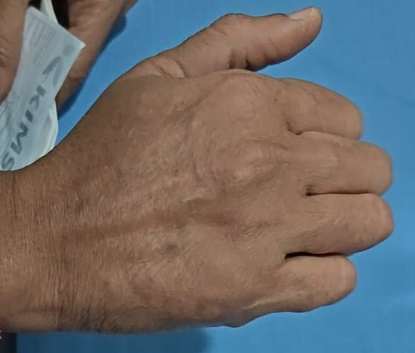
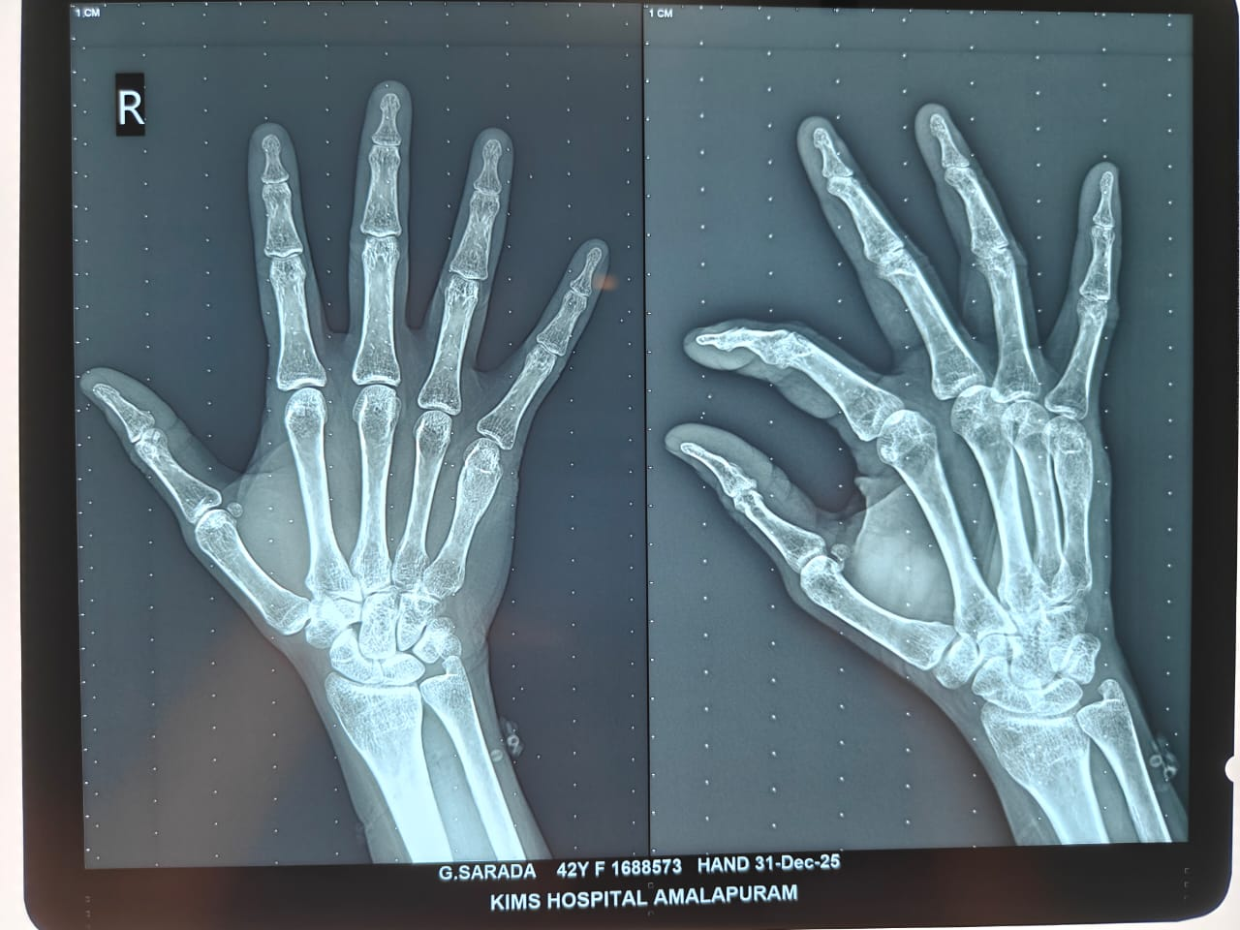
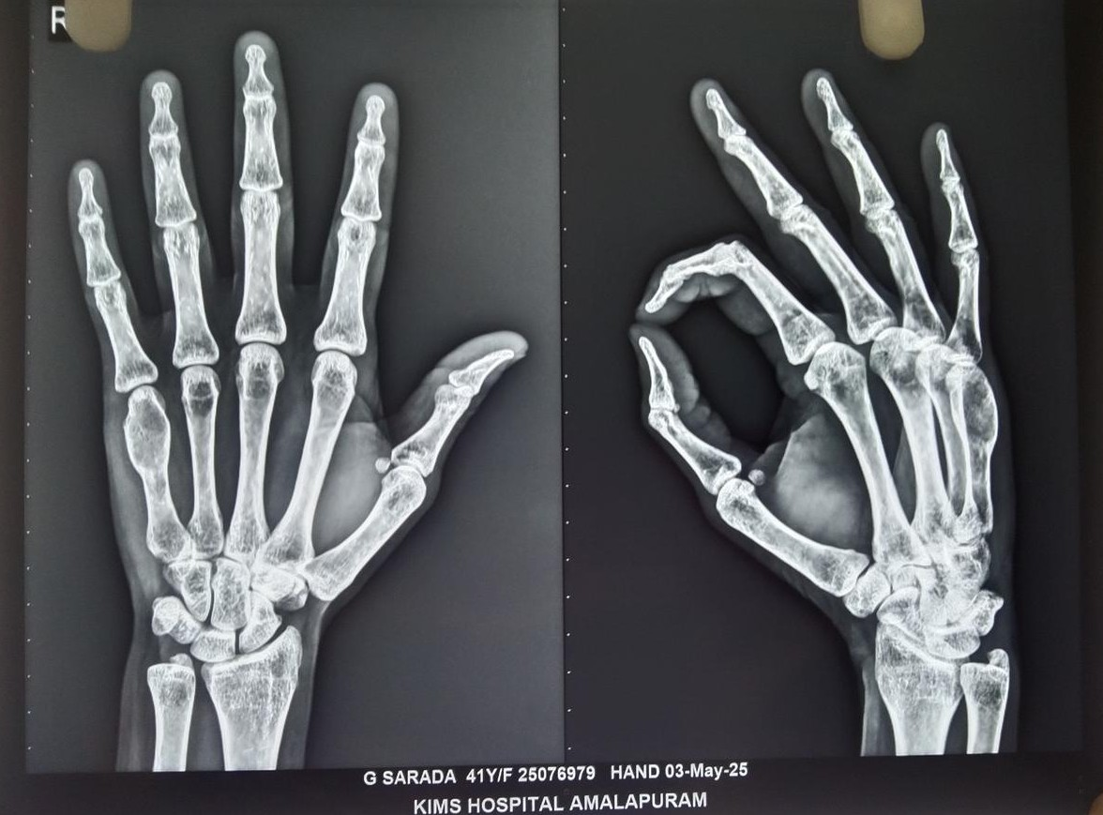
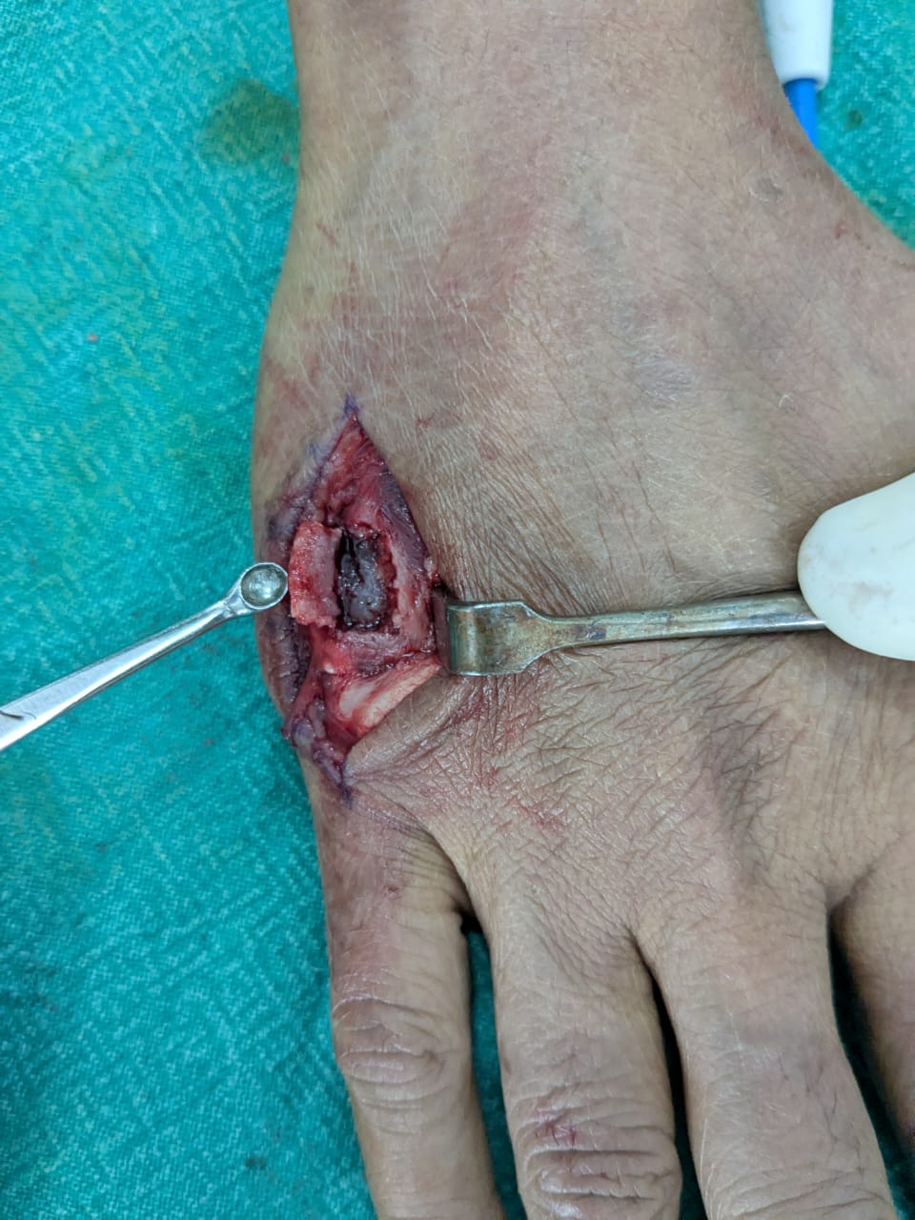
A CASE REPORT OF ENCHONDROMA OF RIGHT HAND MANAGED SURGICALLY
Dr SHAIK KHASIR WARISH, 2nd YEAR PG (MS ORTHOPAEDICS)
KIMS MEDICAL COLLEGE,AMALAPURAM, Dr. B.R. AMBEDKAR KONASEEMA DISTRICT.
55th Annual Conference of Orthopedic Surgeon Society of Andhra Pradesh
Date 6 – 8 February,2026, Venue : Kurnool Medical College
INTRODUCTION
OPERATIVE FINDINGS
DISCUSSION
Enchondroma is the most common benign cartilagenous tumour of the hand, frequently involving the metacarpals.
It arises within the medullary cavity and is often asymptomatic but may present with pain, swelling, or pathological fracture.
Radiological evaluation is essential for diagnosis and surgical management is inicated in symptomatic lesions.
This case hilights a metacarpal enchondroma and its management.
Intraoperatively, the affected metacarpal was noted to be expanded with thinning of the cortex.
On creating a cortical window, the medullary cavity was filled with grey-white, lobulated cartilaginous tissue of firm to friable consistency.
The lesion was well circumscribed confined within the medullary canal, with no cortical breach or soft tissue extension.
Thorough intralesional curettage was performed. The resulting cavity was filled with bone graft. No intraoperative complications were noted.
Enchondroma is the most common benign cartilaginous tumour of the hand, with frequent involvement of the metacarpals. Although many lesions are asymptomatic, pain may occur due to cortical expansion or micro-fractures.
Surgical curettage with bone grafting is the preferred treatment for symptomatic lesions and provides excellent functional outcomes with low recurrence rates.
Post operative recovery was uneventful. The patient showed progressive pain relief and improvement in hand function.
At final follow up, the patient was pain free with full range of motion and had resumed normal activities and the radiograph demonstrated satisfactory graft incorporation with no evidence of recurrence.
CASE REPORT
CONCLUSION
A 43-year-old female IT employee presented with insidious onset pain over 5th metacarpal region of hand, aggravated by activity. No history of trauma.
Examination revealed hard consistency of swelling with localised tenderness, skin over the swelling is free with preserved hand movements.
Enchondroma of the metacarpal bone may present with pain despite its benign nature.
Carefull clinico-radiological assessment is essential for diagnosis.
Surgical curettage with bone grafting offers excellent functional recovery with minimal risk of recurrence.
Biopsy shows lobulated lesion composed of mature hyaline cartilage and it helps to differntiate from low grade sarcoma.

