Slide 1




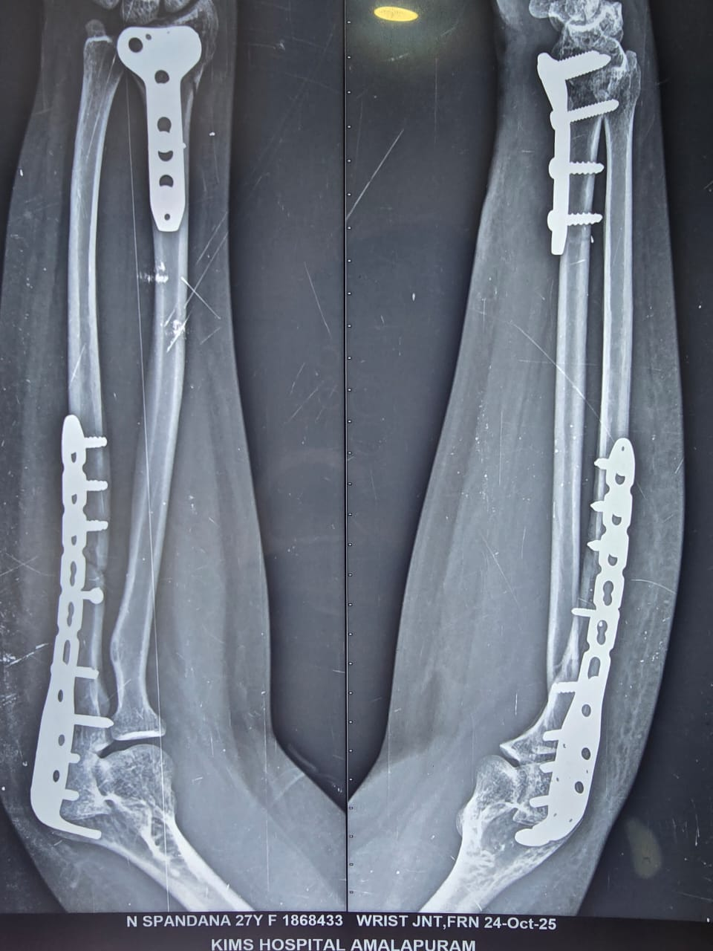
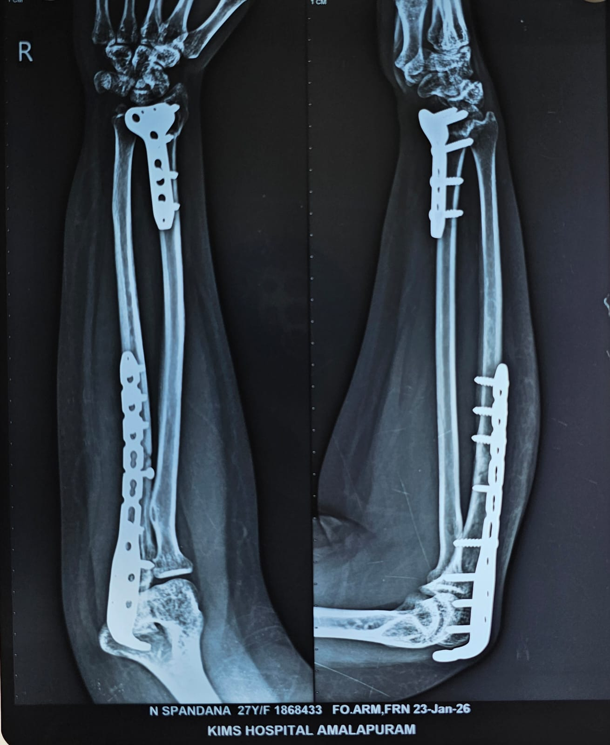
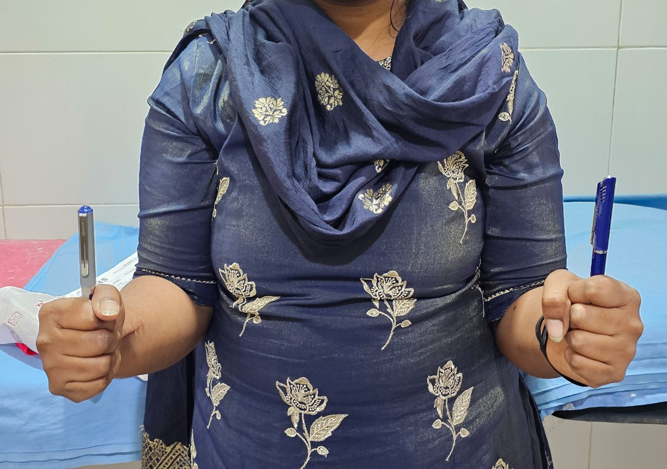
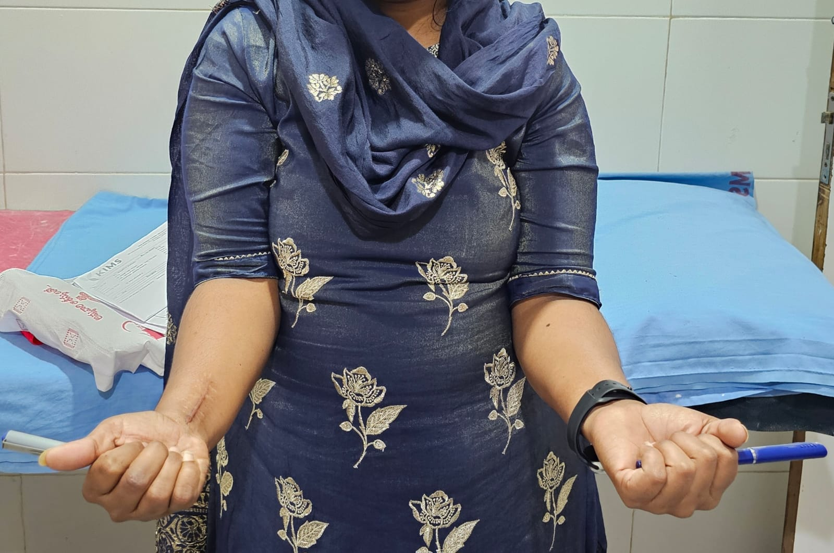
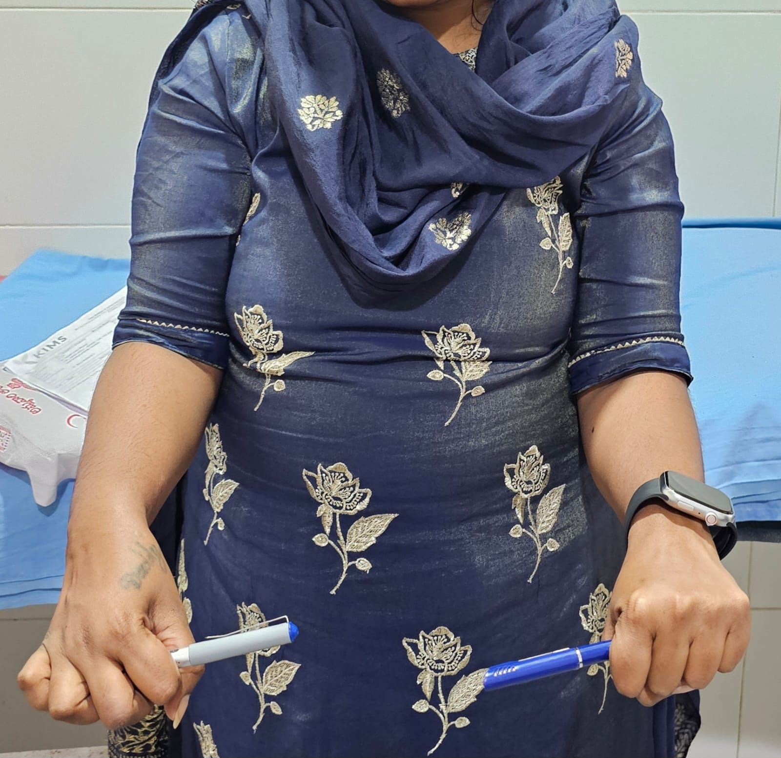
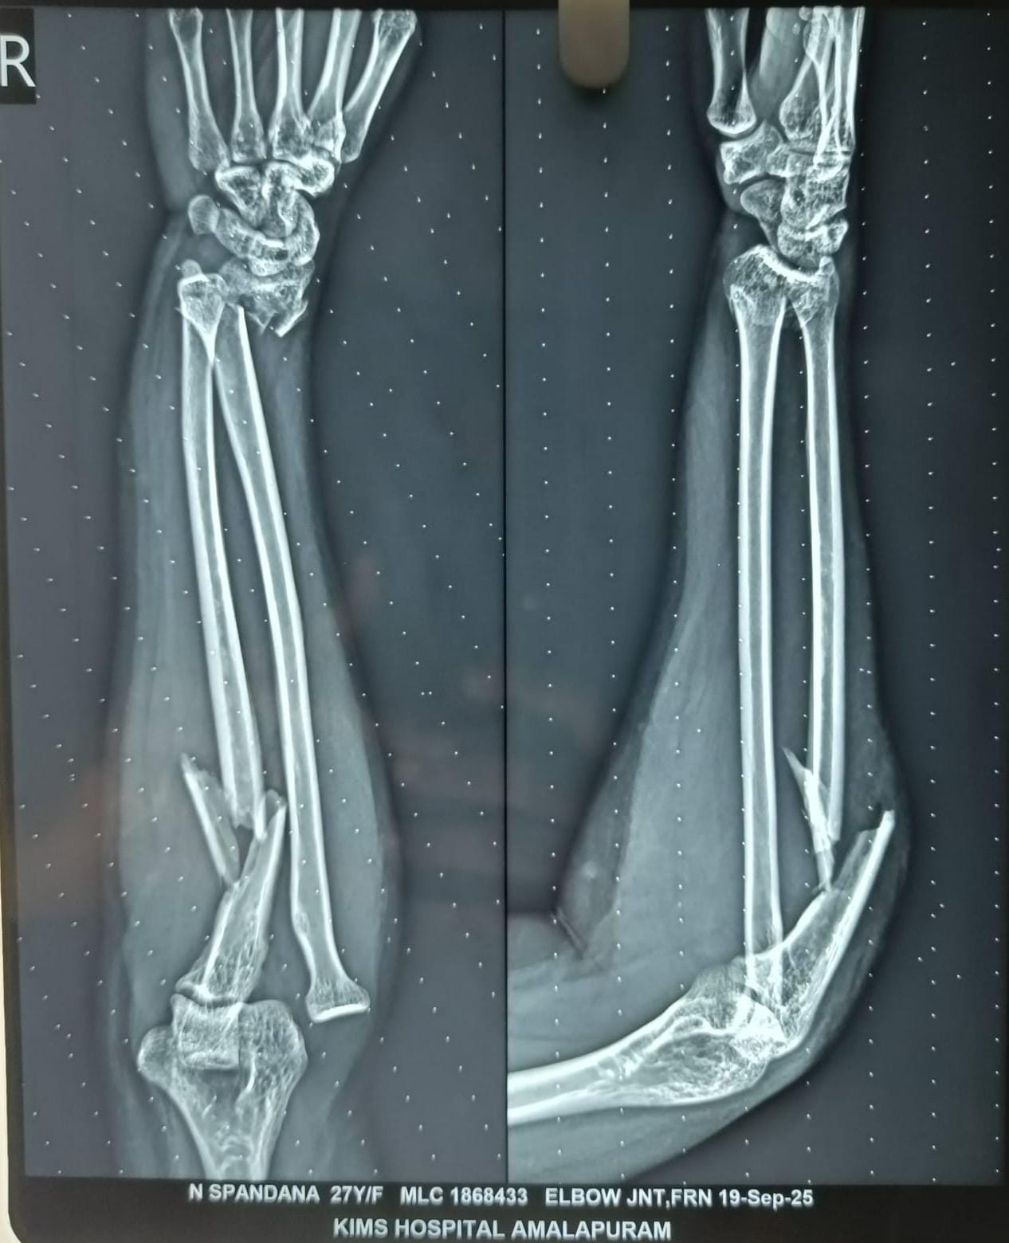
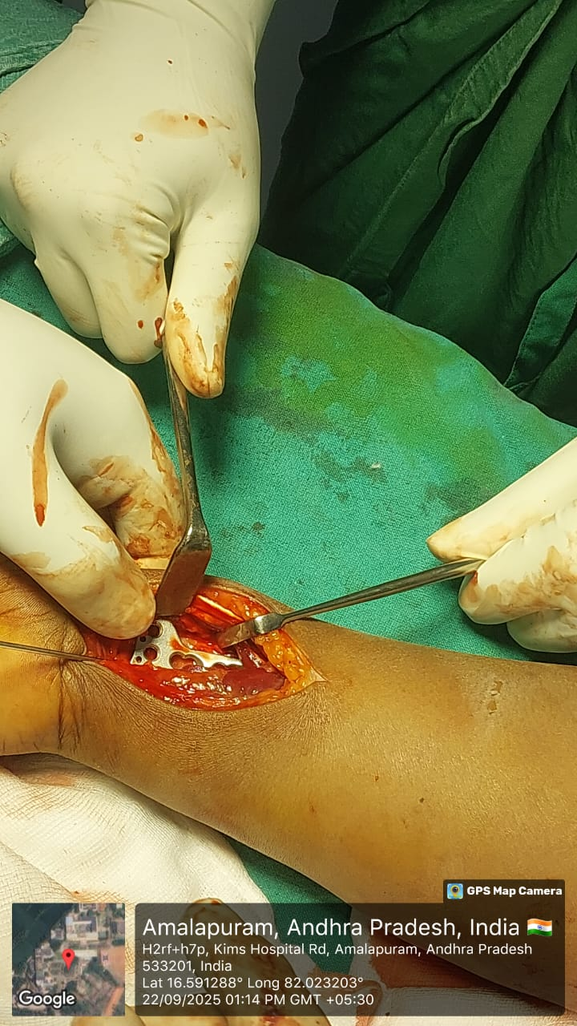
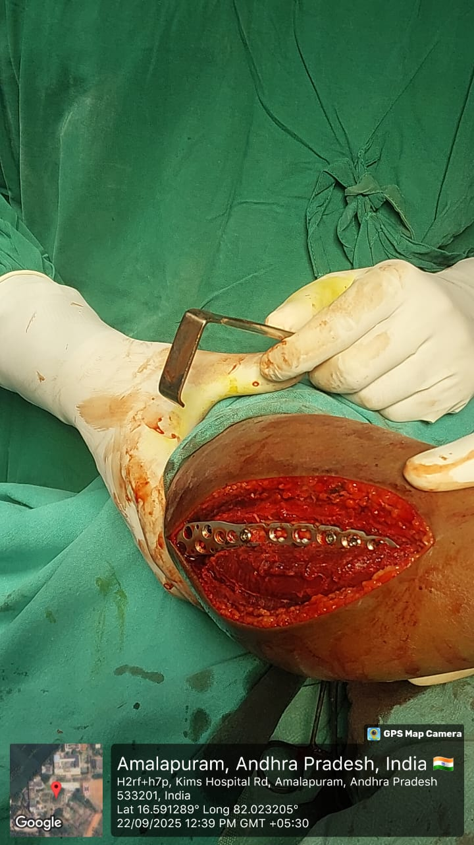
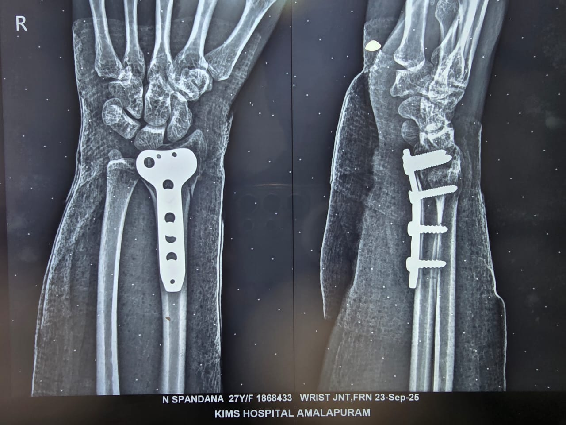
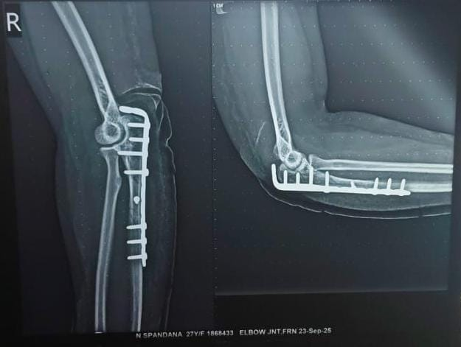
55th Annual Conference of Orthopaedics Surgeon Society of Andhra Pradesh
Date 6 – 8 February,2026, Venue : Kurnool Medical College
A CASE REPORT OF MONTEGGIA FRACTURE WITH AN IPSILATERAL DISTAL RADIUS FRACTURE
Dr.VELUGUBANTLA PHANI VENKATA SAHIT 2nd YEAR PG (MS ORTHOPAEDICS)
KIMS MEDICAL COLLEGE,AMALAPURAM,Dr.B.R. AMBEDKAR KONASEEMA DISTRICT.
INTRODUCTION
OPERATIVE FINDINGS
DISCUSSION
A Monteggia fracture with an ipsilateral distal radius fracture is a rare but complex injury pattern.
It involving simultaneous disruption of the forearm’s proximal and distal segments, often requiring careful diagnosis and rigid fixation for optimal outcomes.
This type of injury makes the management challenging.
The patient underwent surgical treatment with a 5 holed olecranon locking plate for ulna and a 3 holed T-type buttress locking plate for distal radius.
Intraoperative x-rays showed spontaneous reduction of ipsilateral dislocated radial head following osteosynthesis.
Monteggia fracture with ipsilateral distal radius fracture is an extremely rare injury pattern that poses significant diagnostic and therapeutic challenges.
Post operative recovery is uneventful.
At final follow-up,the patient showed full range of motion and had resumed normal activities.
Serial radiographs showed good signs of union.
CASE REPORT
CONCLUSION
A 27year-old woman fell from stairs,injuring her right forearm and wrist.On admission,x-rays of right upper extremity revealed a lateral Bado type-3 Monteggia
fracture-dislocation associated
with an ipsilateral distal radius.
In this rare case presentation,we emphasize the mechanism of the lesion and risk factors for poor functional outcomes when treating such injuries.
Early diagnosis is critical.
Rigid fixation of both fractures in such injuries is mandatory to achieve good functionality through early mobilization.

