Slide 1




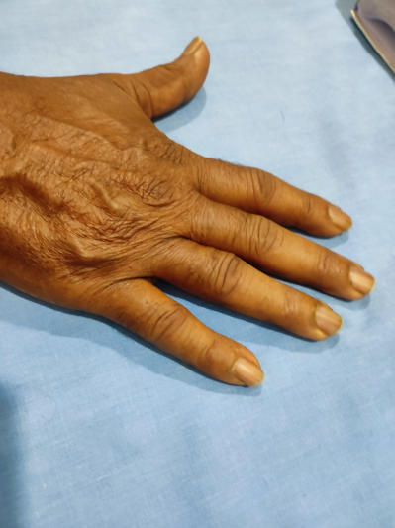
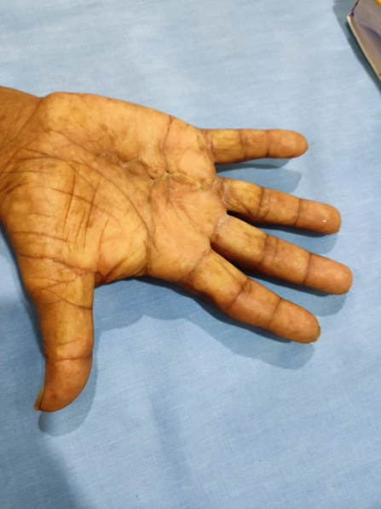
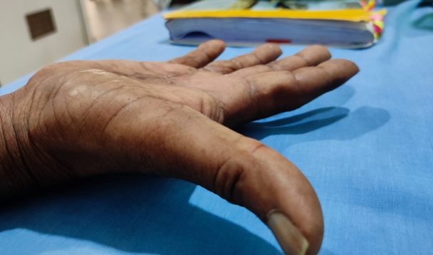
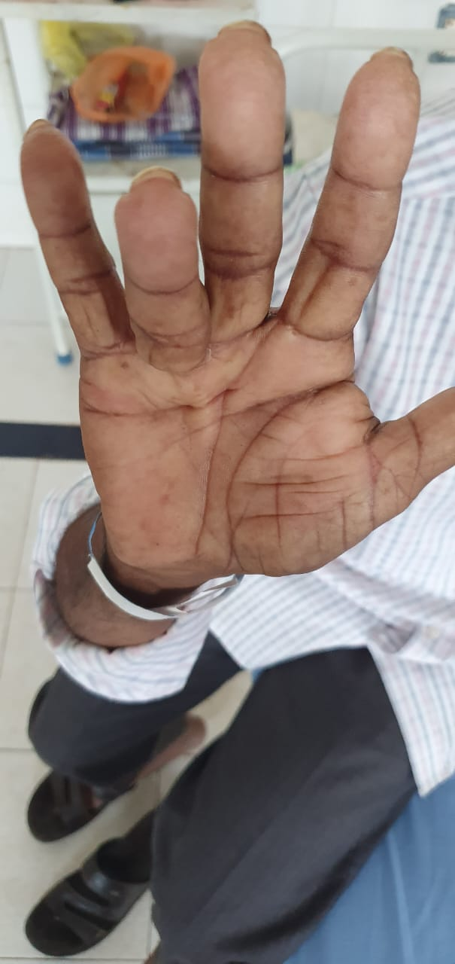
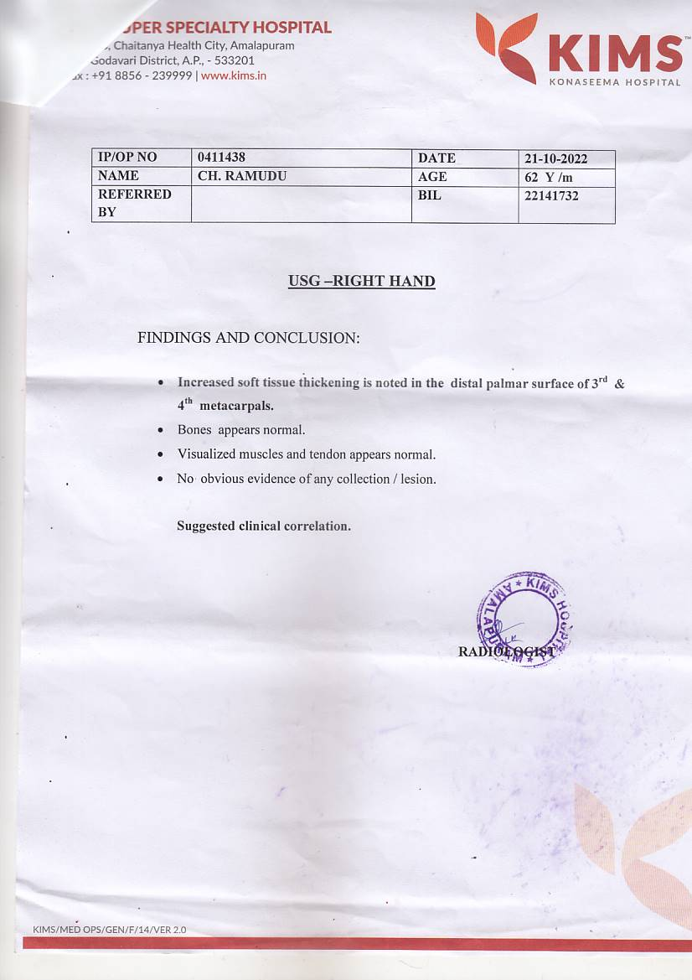
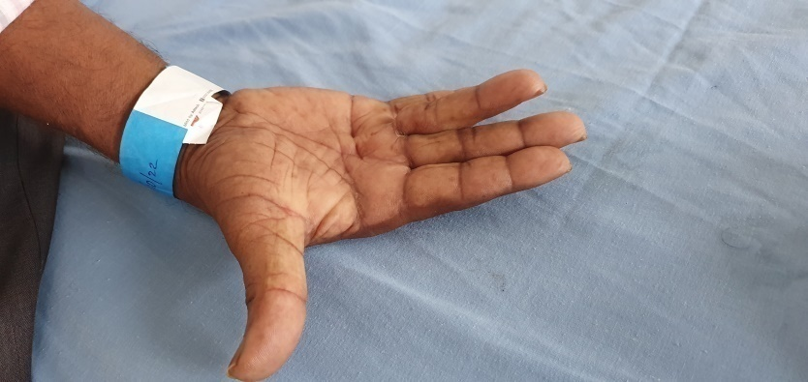
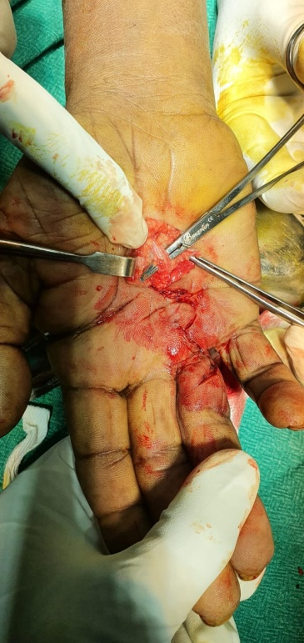
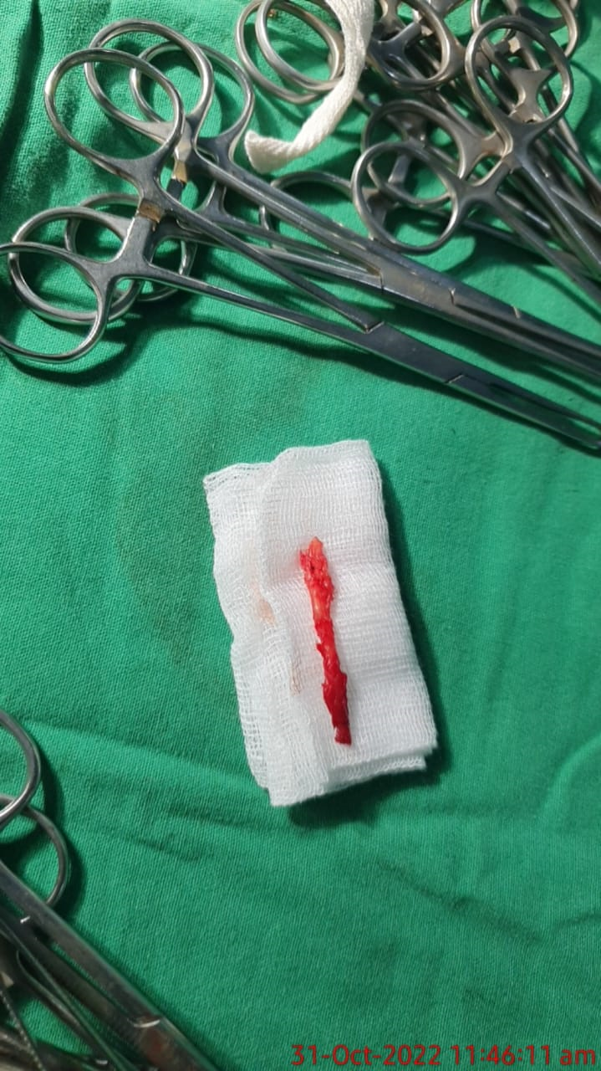
A CASE REPORT OF DUPUYTREN’S CONTRACTURE OF RIGHT HAND MANAGED SURGICALLY
Dr CHINTAPALLI SANDESH, 2nd YEAR PG (MS ORTHOPAEDICS)
KIMS MEDICAL COLLEGE, AMALAPURAM, Dr B.R. AMBEDKAR KONASEEMA DISTRICT.
55th Annual Conference of Orthopedic Surgeon Society of Andhra Pradesh
Date 6 – 8 February,2026, Venue : Kurnool Medical College
INTRODUCTION
OPERATIVE FINDINGS
DISCUSSION
Dupuytren’s contracture is a proliferative disease affecting the palmar aponeurosis of hand.
It commonly affects males between the ages of 40 and 80.
Risk factors are excess alcohol intake, smoking, epilepsy, diabetes, manual labour, and hand trauma.
Furthermore, there are number of genes associated with Dupuytren’s contracture.
He was clinically suspected as Dupuytren’s contracture and confirmed through ultrasound of right hand.
Patient taken up for surgery, through partial fasciectomy of fibrosed palmar fascia done and ring finger complete extension achieved and stabilized with volar slab in extension for 2 weeks.
After suture removal patient is advised regular stretching exercises.
Dupuytren’s contracture is a progressive fibrotic disorder of the palmar fascia causing flexion deformities of the fingers, commonly affecting the dominant hand.
Surgical intervention is indicated in advanced cases with functional impairment.
In this case, fasciectomy provided effective correction of deformity and functional improvement.
Early diagnosis and timely surgery are essential to prevent disability and recurrence.
CASE REPORT
CONCLUSION
A 67-year-old male, right hand dominant who is an agricultural labourer presented with progressive contracture of 1 year old duration involving right ring finger and unable to extend the ring finger.
Known case of diabetes since 5yrs, smoker and alcoholic since 30yrs.
Patient now able to completely extend and flex the ring finger and can do his daily activities.
Dupuytren’s contracture is a common disease that can have significant impact on function.
Treatment depends on the severity of contracture and limitations of daily activities.

