Slide 1




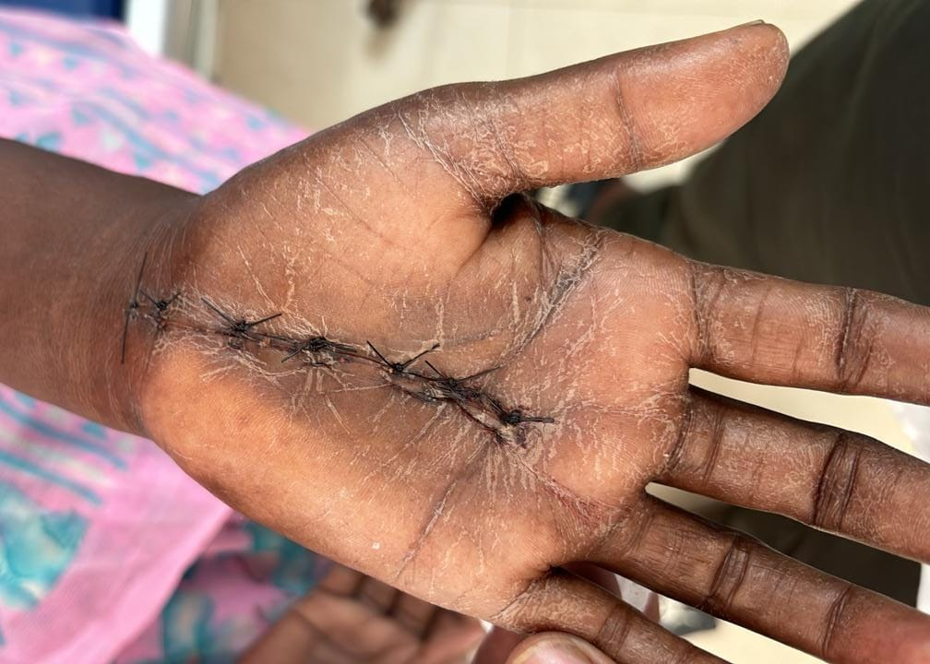
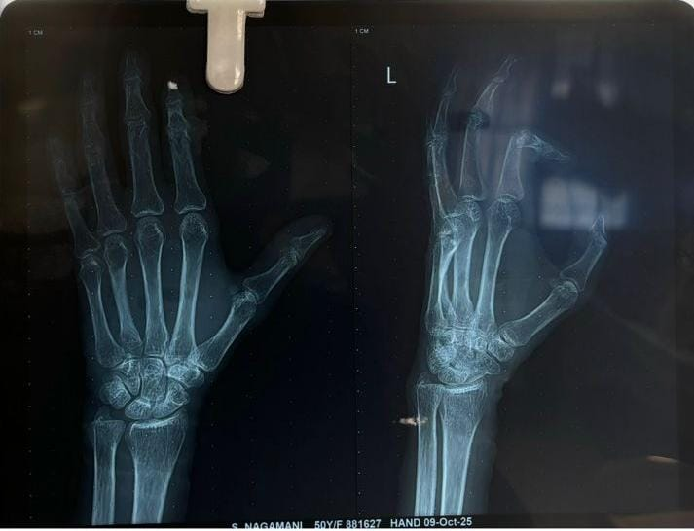
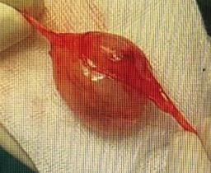
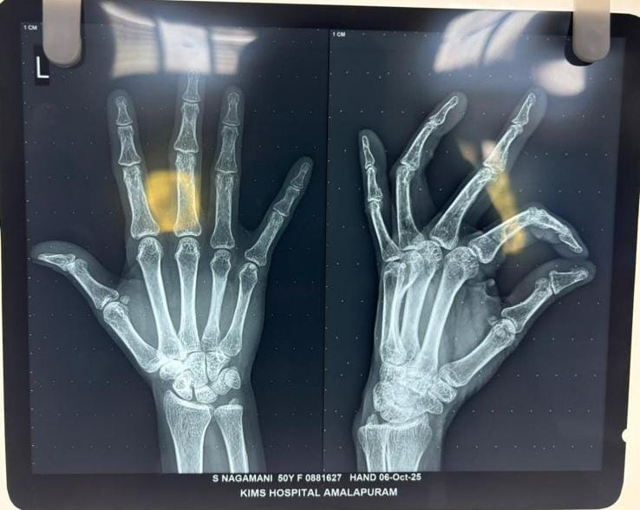
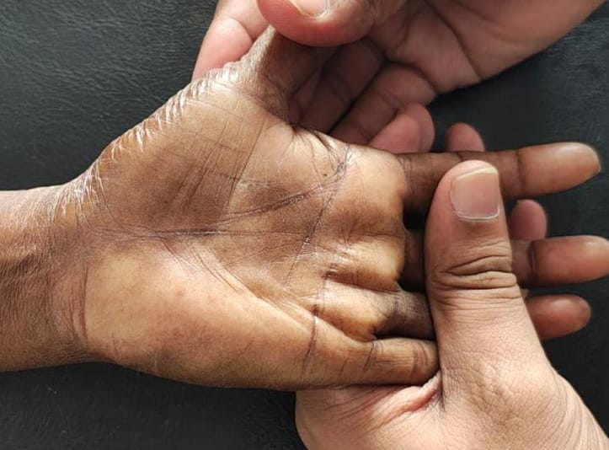
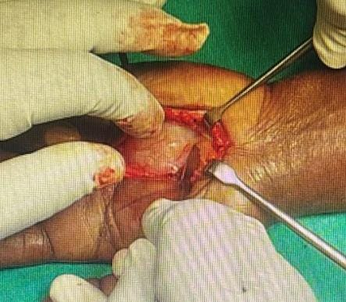
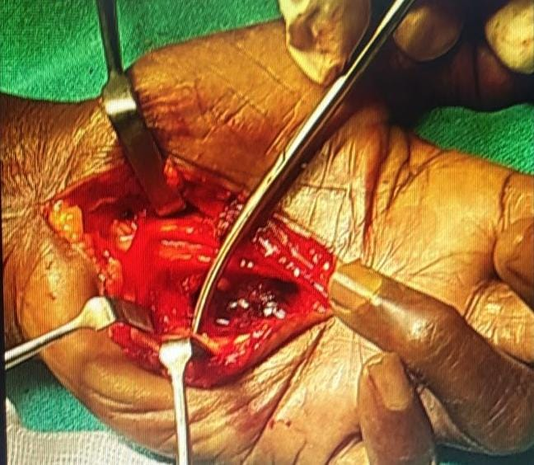
ISOLATED NEUROFIBROMA OF PALMAR HAND:A RARE CASE REPORT
Dr RACHAKONDU GURU KEERTHI PRIYA, 3rd YEAR PG (MS ORTHOPAEDICS)
KIMS MEDICAL COLLEGE,AMALAPURAM, Dr. B.R. AMBEDKAR KONASEEMA DISTRICT.
55th Annual Conference of Orthopedic Surgeon Society of Andhra Pradesh
Date 6 – 8 February,2026, Venue : Kurnool Medical College
INTRODUCTION
OPERATIVE FINDINGS
DISCUSSION
Neurofibroma is a benign peripheral nerve sheath tumor that commonly occurs in association with Neurofibromatosis type 1.
Solitary or isolated neurofibromas, however, are uncommon and are rarely encountered in the hand
Involvement of the palmar aspect of the hand is particularly rare due to the complex anatomy and dense neurovascular structures present in this region
We present a rare case of an isolated neurofibroma of the palmar hand, its clinical presentation, diagnostic approach and management.
Under Wrist block , a longitudinal palmar incision made over the swelling. Intraoperatively, a well-defined, encapsulated, firm nodular mass measuring approximately 4 × 4 cm is identified in the palmar soft tissue. The lesion was found to be arising from a digital ulnar nerve sheath and was closely adherent to the surrounding neurovascular structures. There was no invasion of adjacent tendons, muscles, or bone. Careful microsurgical dissection allowed complete excision of the tumor while preserving the continuity of the nerve. Hemostasis was achieved, and the wound was closed
Palmar involvement is rare, likely due to the dense fibrofatty tissue and compact neurovascular anatomy of the palm.
Clinically, these tumors present as slow-growing, painless nodules, although pain, paresthesia, or functional impairment may occur if adjacent nerve fibers are compressed.
Surgical excision with nerve preservation was undertaken, and the diagnosis was confirmed by histopathological examination.
Mri showed a well defined lobulated soft tissue intensity lesion with central cystic component involving volar aspect of hand at hypothenar eminence between flexor tendons anteriorly,3rd and 4th metacarpal bones posteriorly with minimal mass,biopsy confirmed as Neurofibroma
Postoperative follow-up assessed neurological status, recurrence, and functional recovery.
CASE REPORT
CONCLUSION
A 50-year-old female presented with a slow-growing, painless palmar hand swelling of two years duration, mild discomfort during gripping.
Clinical examination, radiographs, and MRI were performed.
Diagnosis was confirmed by histopathological examination.
Isolated neurofibroma of the palmar hand is a rare benign peripheral nerve sheath tumor.
Accurate diagnosis relies on histopathological evaluation, as clinical presentation often mimics other palmar soft tissue lesions.
Complete surgical excision with careful nerve preservation provides excellent functional outcome, with minimal risk of recurrence or malignant transformation in isolated cases.

