Slide 1
CLINICAL OUTCOME OF PLATELET RICH PLASMA (PRP) INJECTIONS IN SYMPTOMATIC EARLY OSTEOARTHRITIS OF KNEE JOINT
PRESENTED BY
DR.SOMNATH DAS, POST GRADUATE
SV MEDICAL COLLEGE, TIRUPATI

Slide 2
AIM OF THE STUDY …..
To establish the clinical efficacy of intra-articular platelet rich plasma (PRP) injections, in patients with symptomatic early osteoarthritis of knee joint.

Slide 3
INTRODUCTION…..
Osteoarthritis (OA) is a degenerative joint disease resulting from the degradation of articular cartilage, proliferative reformation of subchondral bone and a low degree of synovitis that leads to a reduced quality of life (QoL).
It is a major cause of pain and disability in the elderly population. OA alters the normal joint metabolism favouring increased catabolism and decreased anabolism.
Inflammation and vascular pathology in combination with cell death, meniscal changes, bone remodelling and subchondral sclerosis produces a vicious cycle of progressive joint degeneration. As the age advances, this can be exacerbated by excessive mechanical stress and oxidative damage.

Slide 4
Material & methods …..
Source of data :
This is a prospective study done in SV Medical college, Tirupati involving 40 patients with Kellgren Lawrence Grade 1 & 2 osteoarthritis of knee joint. The study group comprised of patients between 50 to 70 years. The duration of the study was for 6 months from January 2025 to July 2025
Inclusion criteria
- Patients between 50 - 70 years
- Kellgren Lawrence Grade 1 & 2 Osteoarthritis
- Informed consent taken from all patients.

Slide 5
Exclusion criteria
- History of diabetes mellitus
- Patients with infective focus in the periarticular area of the knee
- Patients on anticoagulant and antiplatelet medications
- Use of NSAIDS 2 days before injection
- History of intraarticular steroid injections within 2 preceding weeks

Slide 6
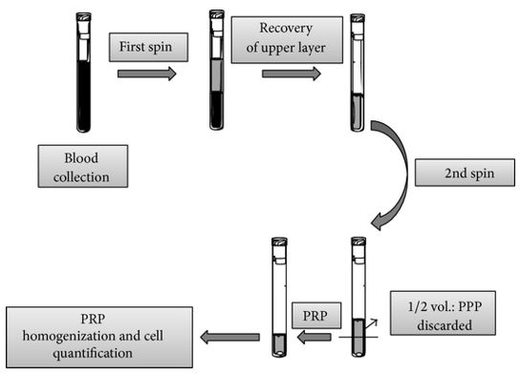
PREPARATION OF PRP …..
- Is by differential centrifugation
- 30 ml of venous blood harvested from the patient into acid citrate dextrose tubes. (Mixing rate 9:1).
- First soft spin at 1500 rpm for 3 minutes - supernatant is collected.
- Hard spin the supernatant at 2700 rpm for 15 minutes.
- Lower half is the platelet rich plasma.

Slide 7
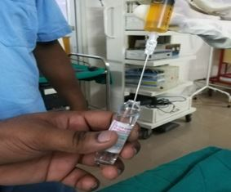
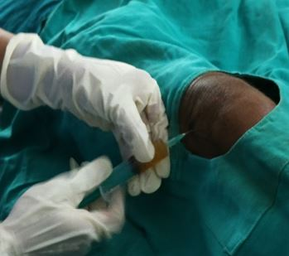
PROCEDURE …..
- Under strict aseptic precautions, patient thoroughly prepped & draped with the knee in extension.
- PRP is activated with calcium chloride and injected into the knee joint.
- Total three prp injections given at 3 weekly intervals with review at 3 weeks, 6 weeks and 6 months.
ACTIVATION OF PRP
PRP ADMINISTRATION

Slide 8
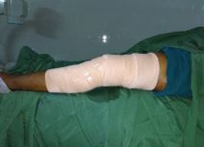
Post injection advice …..
- Compression crepe bandage applied.
- Advised rest for 24 hours with avoidance of vigorous activities.
- Ice compression and limb elevation to reduce pain and swelling.
- Three days of oral antibiotics.
- Patients are advised to quit taking NSAIDS

Slide 9
results …..
All the patients were followed up at regular intervals and there are no drop outs.
There was a statistically significant improvement in the pain intensity and activities of daily living at the end of 6 weeks.
Two patients had persistent swelling for 4 days which resolved with ice compressions.
Infection was not seen in any case.
Patients were evaluated for improvement by KOOS, WOMAC and VAS scores.

Slide 10
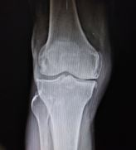
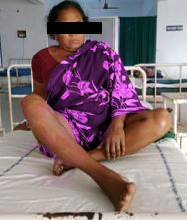
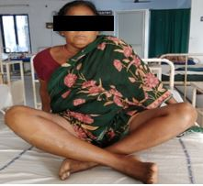
XRAY
BEFORE PRP INJECTION
AFTER PRP INJECTION

Slide 11
DISCUSSION …..
The International osteoarthritis research society (OARSI) states that there is little evidence that currently used drugs in osteoarthritis have action against progression of osteoarthritis.
A relatively new strategy is the use of cell elements and bio-mediators of tissue response in osteoarthritis. PRP stimulates the natural healing cascade of tissue regeneration by supra-physiologic release of platelet-derived factors directly at the site of treatment.

Slide 12
Patel et al Showed significant improvement in PRP treated osteoarthritis knee group compared to placebo. Negative clinical results are mostly associated with injection of poor quality PRP. The variability in platelet concentrating techniques may alter platelet degranulation characteristics that could affect clinical outcomes.

Slide 13
CONCLUSION …..
PRP is a novel therapy in the treatment of early osteoarthritic knee pain. It’s a simple and cost effective day care procedure which provides natural environment for regeneration of articular tissue.
Our study showed significant improvement in pain and activities of daily living with measurable increase in pain free range of motion. Hence, we conclude that PRP is a promising therapy for early osteoarthritic knee pain.

Slide 14
THANK YOU

