Slide 1




FUNCTIONAL OUTCOME OF CROSS PINNING VERSUS LATERAL PINNING IN SUPRACONDYLAR FRACTURES OF HUMERUS IN CHILDREN
Presenter : Dr. G Phanikumar
Guide : Dr. SCV Srikanth, MS Ortho, Professor
INTRODUCTION
The number of fractures peaked in children of ages between 5 to 11 years and then declined in teenagers.
The most frequent fractures [16.9%]were to the ulna and radius, with the humerus[12.0%] and distal radius [14.6%] following.
The next most common fracture was supracondylar humerus fracture affecting the elbow among children between the ages of 5 and 7 years of age with similar sex predisposition.
Supracondylar fractures of the humerus account for 55% to 80% of total elbow fractures in children.

Slide 2
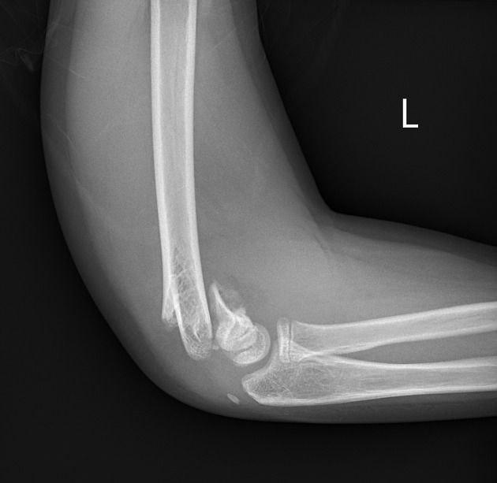
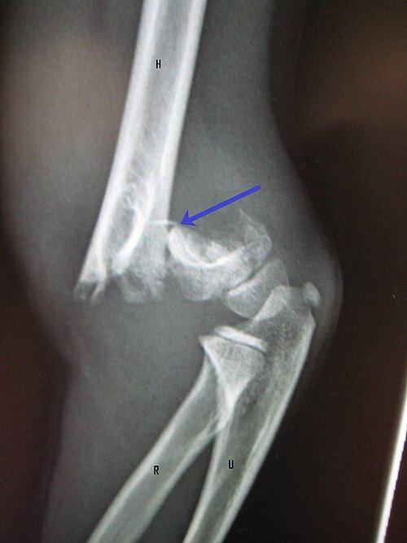
Mechanism of injury:
Extension type: fall on an outstretched hand with hyperextension of elbow, forearm position [pronation> supination] decides the rotational deformity
Flexion type: direct trauma or fall on a flexed elbow
Upto two- thirds of paediatric elbow injuries requires hospitalisation.
Displaced fractures need usually closed reduction and rarely open reduction and stabilisation with k wires by either cross or lateral technique.
Flexion type
Extension type

Slide 3
AIM
To assess functional outcome of cross pinning versus lateral pinning in supracondylar fractures of humerus in children
METHOD
The study was conducted with 24 patients of Gartland's type 2,3 supracondylar humerus fractures.
Radiographs including anterior posterior view, lateral view were performed.
Pre op, post op and intraop assessment were done with respect to incidence of Baumann's angle, Flynn criteria till 14 weeks post op period.
DATA COLLECTION:
Patients who got admitted with supracondylar humerus fractures in Dr. PSIMS & RF during our OPD and casualty

Slide 4
METHODS AND MATERIALS
INCLUSION CRITERIA:
1. Patients with displaced supracondylar fractures[ type 2 & 3 Gartland's fractures.
2. Duration of injury should be within 5 days.
3. Both males and females less than 15 years of age.
4. Fractures with no neurovascular deficit.
5. Isolated supracondylar fractures of humerus.
6. Only closed fractures.
EXCLUSION CRITERIA:
1. With neurovascular injury
2. Patients who are not willing for surgery.
3. Type 1 undisplayed Gartland's fracture
4. Previous history of elbow injury
5. Age group > 15 years in both sexes
6. Patients with inflammatory arthritis

Slide 5
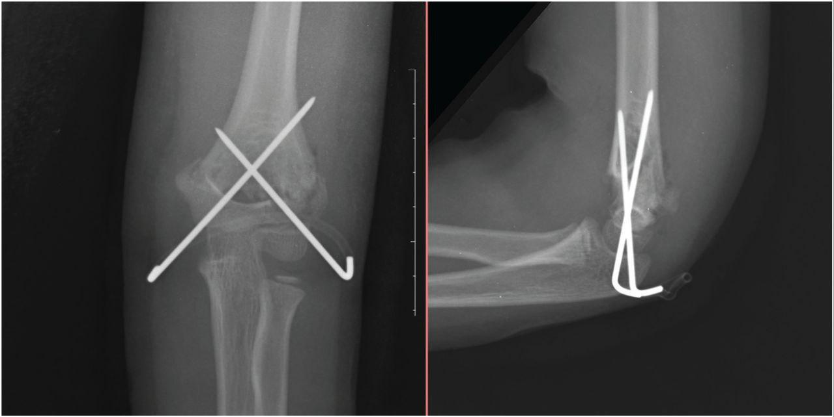
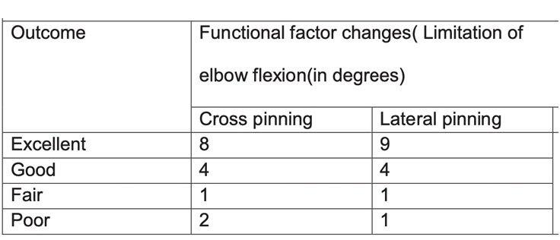
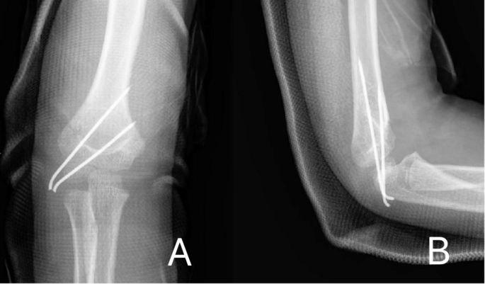
Results

Slide 6
CONCLUSION
In this study comprising of 24 cases, done with closed reduction and percutaneous pinning, the following were made:
Most commonly involved age group was 7 to 9 years, who complained the mode of injury was while playing.
Postero medial displacement was seen in majority of cases and left hand side of fall was seen
Good cosmetic factor results, functional factor were excellent, when observed with lateral pinning method compared to medial pinning method using Flynn's criteria.
Maximum number of cases showed around 5 to 7 degrees loss of angle except 2 cases with > 10 degrees loss of angle with medial pinning.

Slide 7
Although, minor complications were seen postoperatively, these complications were associated with medial pin fixation.
Hence, according to study lateral pin technique in fixing supracondylar fracture was superior to medial pin method in order to avoid ulnar nerve injuries.
While cross pinning provides definite stability to the fracture configuration and reduction.

Slide 8
References
1. Baig MN. A review of epidemiological distribution of different types of fractures in paediatric age. Cureus. 2017 Aug;9(8).
2. Kopjar B, Wickizer TM. Fractures among children: incidence and impact on daily activities. Injury Prevention. 1998 Sep 1:4(3):194-7.
3.Camp J, Ishizue K, Gomez M,Gelberman R, Akeson W. Alteration of Baumann's angle by humeral position: implications for treatment of supracondylar humerus fractures. Journal of Paediatric Orthopaedics. 1993 Jul 1;13(4):521-5.
4. van Bergen CJ. Pediatric Fractures Are Challenging from Head to Toe. Children. 2022 May 6;9(5):678.
5. Alton TB, Werner SE, Gee AO. Classifications in brief: the Gartland classification of supracondylar humerus fractures.

