Slide 1




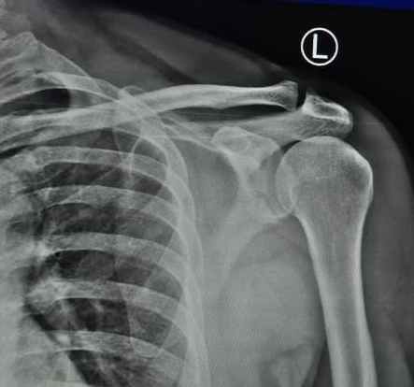
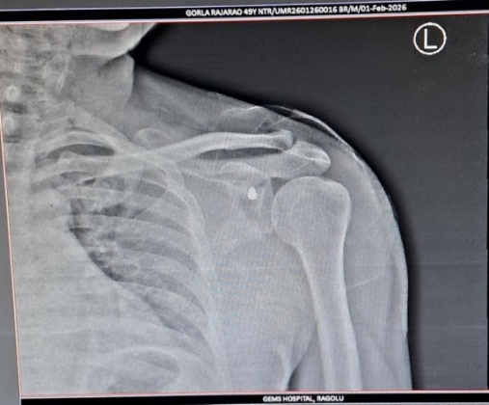
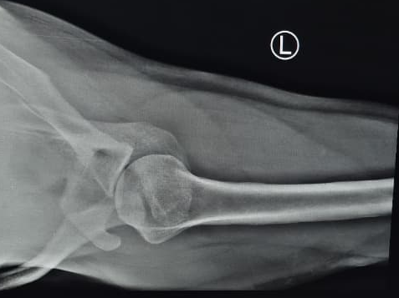
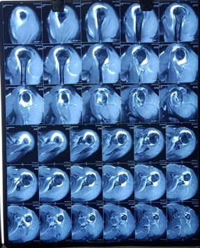
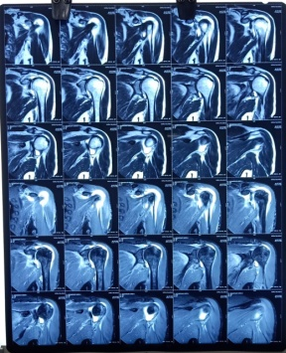
.
F
55th Annual Conference of
Orthopedic Surgeon Society of Andhra Pradesh
Date 6 – 8 February,2026, Venue : Kurnool Medical College
Organized by : Department of Orthopaedics, Kurnool Medical College Kurnool
FUNCTIONAL OUTCOME OF RECURRENT SHOULDER DISLOCATION
MANAGED WITH LATARJET PROCEDURE AND ITS COMPLICATIONS
PRESENTER – DR M SAI ROHIT
MODERATOR – DR B UDAYAKUMAR (PROF AND HOD )
OSSAP-484
INTRODUCTION
OPERATIVE FINDINGS
DISCUSSION
THE LATARJET PROCEDURE IS AN
ESTABLISHED SURGICAL APPROACH FOR MANAGING REURRENT
ANTERIORSHOULDER DISLOCATIONS , PARTICULARLY IN PATEINETS WITH SIGNIFICANT
GLENOID BONE LOSS OR FAILED .STABILIZATION SURGERIES . THE PROCEDURE INVOLVES
TRANSFERRING THE CORACOID PROCESS TO THE ANTERIOR GLENOID , THEREBY INCREASING
THE GLENOID SURFACE AREA AND CREATING A STABILIZING SLING TO PREVENT FURTHER DISLOCVATIONS . DESPITE ITS BENEFITS ,
THE PROCEDURE CARRIES RISK SUCH AS INFECTION , GRAFT NON UNION AND ARTHROSIS .
XRAY FINDINGS :-
1)LOSS OF NORMAL CONGRUITY OF GLENO HUMERAL JOINT
2)FLATTENING/ IRREGULARITY OF THE ANTERO-INFERO GLENOID RIM
3)COMPRESSION DEFECT ON THE POSTERO LATERAL ASPECT OF THE HUMERAL HEAD
4)WIDENED JOINT SPACE ON AXILLARY VIEW
THIS PROCEDURE PROVIDES STABILITY THROUGH THE TRIPLE EFFECT
BONE BLOCK EFFECT – RESTORES GLENOID CONCAVITY
SLING EFFECT – DYNAMIC RESTRAINT BY CONJOINT TENDON
CAPSULAR REPAIR EFFECT – ADDITIONAL STATIC STABILITY
.
MRI FINDINGS :-
1)HILLSACHS DEFORMITY AND BONY BANKARTS LESION
2)MODERATE GLENOHUMERAL JOINT EFFUSION
3)SUBACROMIAN AND SUBDELTOID BURSITIS
CONCLUSION
CASE REPORT
A 40 YEAR OLD MALE WITH CHIEF COMPLAINTS OF RECURRENT EPISODES OF RIGHT SHOULDER DISLOCATION
HISTORY OF 1ST DISOCATION FOLLOWING TRAUMA 4 YEARS AGO . MULTIPLE RECURRENT DISLOCATIONS
DESPITE CONSERVATIVE MANAGEMENT AND DIFFICULTY IN OVERHEADACTIVITIES
LATARJET PROCEDURE OFFERS PRODUCTABLE STABILITY AND GOOD FUNCTIONAL OUTCOME IN RECURRENT
ANTERIOR SHOULDER DISLOCATION, WITH GLENOID BONE LOSS , WITHACCEPTABLE AND MANAGEABLE COMPLICATIONS

