Slide 1




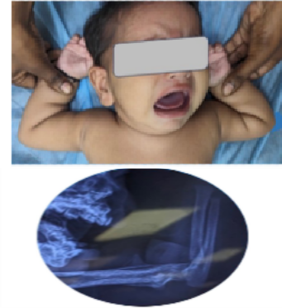
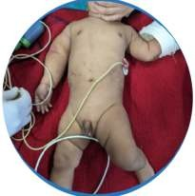
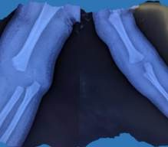
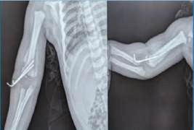
₅₅th
Annual Conference of
Distal humerus physeal separation - a case report
55th Annual Conference of
Orthopedic Surgeon Society of Andhra Pradesh
Date 6 – 8 February,2026, Venue : Kurnool Medical College
Organized by : Department of Orthopaedics, Kurnool Medical College Kurnool
Orthopedic Surgeon Society of Andhra Pradesh
Date 6 – 8 February,2026, Venue : Kurnool Medical College
Organized by : Department of Orthopaedics, Kurnool Medical College Kurnool
Dr G SethuRam PG3
GANDHI MEDICAL
INTRODUCTION
CASE REPORT
COLLEGE,
percutaneous K-wire fixation to maintain stable alignment. No intra-operative neurovascular compromise was noted.
Distal humeral physeal separation is a rare injury in infants, accounting for approximately 1.6% of distal humeral fractures. It occurs predominantly in children younger than 2 years and should raise a high index of suspicion for non-accidental trauma (NAT).
Rotational shear forces, either during birth or due to child abuse, are the usual mechanisms.
Owing to incomplete ossification, these injuries are frequently missed or misdiagnosed as elbow dislocations or infections.
A 6-month-old infant presented with right elbow swelling and deformity 6 days after an alleged fall from bed, with history of massage following trauma. Examination revealed painful restriction of movement with multiple healing abrasions, raising a high index of suspicion for non-accidental trauma.
FOLLOW UP
At 3 weeks, radiographs showed callus
formation with myositis ossificans, following which K-wires were removed and elbow mobilization was initiated.
At 3 months, the child was pain-free with elbow range of motion 0–140°, and radiographs showed mature myositis ossificans, warranting continued follow- up for deformity.
RADIOLOGICAL FINDINGS
Plain radiographs revealed postero-medial displacement of the forearm axis relative to the distal humerus, a pathognomonic sign of distal humeral physeal separation. Periosteal reaction was noted in the ipsilateral proximal humerus. The injury was classified as DeLee Group A transphyseal distal humeral separation.
DISCUSSION AND CONCLUSION
Distal humeral physeal separation in infants is rare and often missed due to incomplete ossification.
Posteromedial displacement of the forearm axis is a key diagnostic clue. Delayed presentation, inconsistent history, and associated injuries should raise suspicion for non-accidental trauma (NAT). Closed reduction and percutaneous pinning remain the treatment of choice in acute cases. Myositis ossificans should be managed conservatively, as early excision carries a high risk of recurrence. Long-term follow-up is essential to detect growth disturbances and cubitus varus deformity.
OPERATIVE FINDINGS
Due to suspected NAT, delayed presentation, and significant swelling, the patient underwent operative management. Under anesthesia, instability at the distal humeral physis was
confirmed.
Closed reduction was achieved, followed by

