Slide 1
FUNCTIONAL OUTCOME OF ENDOSCOPIC CALCANEOPLASTY WITH FLEXOR HALLUCIS LONGUS TENDON TRANSFER IN HAGLUND SYNDROME
PRESENTER: Dr. S SAI DHARMA TEJA
GANDHI MEDICAL COLLEGE
HYDERABAD

Slide 2
INTRODUCTION
Haglund syndrome consists of a triad of posterosuperior calcaneal exostosis (Haglund deformity), retrocalcaneal bursitis, and insertional Achilles tendinopathy.
Retrocalcaneal bursitis and insertional Achilles tendinopathy cause pain and discomfort in the posterior part of heel.
While conservative management like rest, ice, physiotherapy and NSAIDs are effective in many cases, some chronic cases may require surgical management

Slide 3
aim
To evaluate the clinical and functional outcomes of endoscopic calcaneoplasty combined with flexor hallucis longus (FHL) tendon transfer in patients with Haglund syndrome

Slide 4
methods
A prospective case series of 10 patients with MRI- confirmed Grade IB or Grade II insertional Achilles tendinopathy who failed conservative treatment was conducted between April 2023 and August 2024
All patients underwent endoscopic resection of the posterisuperior calcaneal prominence with FHL tendon transfer
Outcomes are measured using Visual Analogue Scale( VAS), AOFAS ankle-hindfoot score, time to weight bearing, return to activity and complications

Slide 5
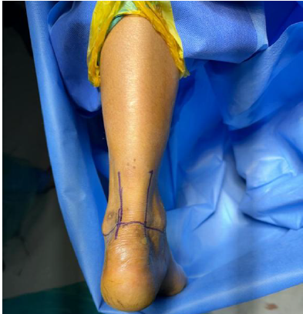
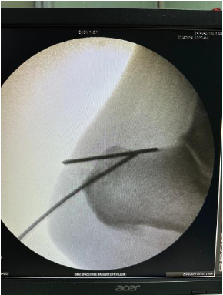
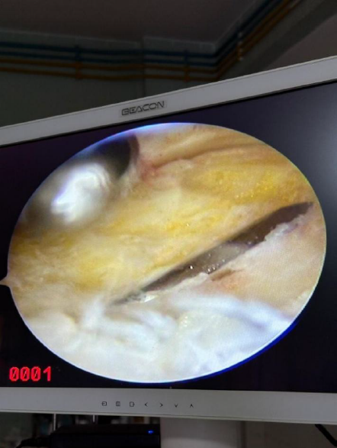
technique
Intraoperative delineation of haglund tubercle under fluoroscopy
Marking of anatomical landmarks and portals.
Excision of calcaneal prominence with burr.

Slide 6
Isolation of FHL tendon.
Fixation of FHL tendon to calcaneum with interference screw.
Intraoperative fluoroscopy image of interference screw.

Slide 7
results
Mean AOFAS improved from 71.2 to 97 at 6 months.
VAS reduced from 6 to 1.
Early return to activity with minimal complications.
Study | Complications
Open FHL transfers
Ahmed et al | 15.6% - wound related
Alhaug et al | 30% - wound related
Endoscopic FHL transfers
Basita et al | 10.7% - portal pain
Our study | 13% - portal pain
Study | Weight bearing | Return to normal activities
Mc Garvey et al | 12 weeks | 20 weeks
Batista et al | 3-4 weeks | 5 weeks
Our study | 3-4 weeks | 5 weeks

Slide 8
conclusion
Endoscopic calcaneoplasty with FHL transfer is a safe, minimally invasive technique providing excellent pain relief, rapid functional recovery, and low complication rates in Haglund syndrome

Slide 9
refernces
van Dijk CN, van Sterkenburg MN, Wiegerinck JI, Karlsson J, Maffulli N. Terminology for Achilles tendon related disorders. Knee Surg Sports Traumatol Arthrosc. 2011;19(5):835-41.
Batista JP, Abdelatif NMN, Del Vecchio JJ, Diniz P, Pereira H. Endoscopic Flexor Hallucis Longus Transfer for the Management of Acute Achilles Tendon Ruptures: A Prospective Case Series Report With a Minimum of 18 Months' Follow-Up. J Foot Ankle Surg. 2020;59(5):927-37.
McGarvey WC, Palumbo RC, Baxter DE, Leibman BD. Insertional Achilles tendinosis: surgical treatment through a central tendon splitting approach. Foot Ankle Int. 2002;23(1):19-25.
Alhaug OK, Berdal G, Husebye EE, Hvaal K. Flexor hallucis longus tendon transfer for chronic Achilles tendon rupture. A retrospective study. Foot Ankle Surg. 2019;25(5):630-5.

