Slide 1




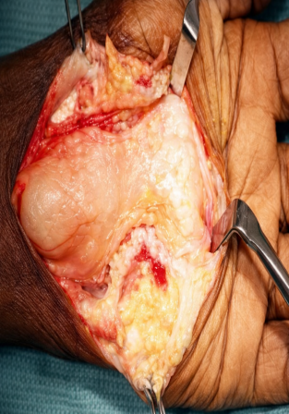
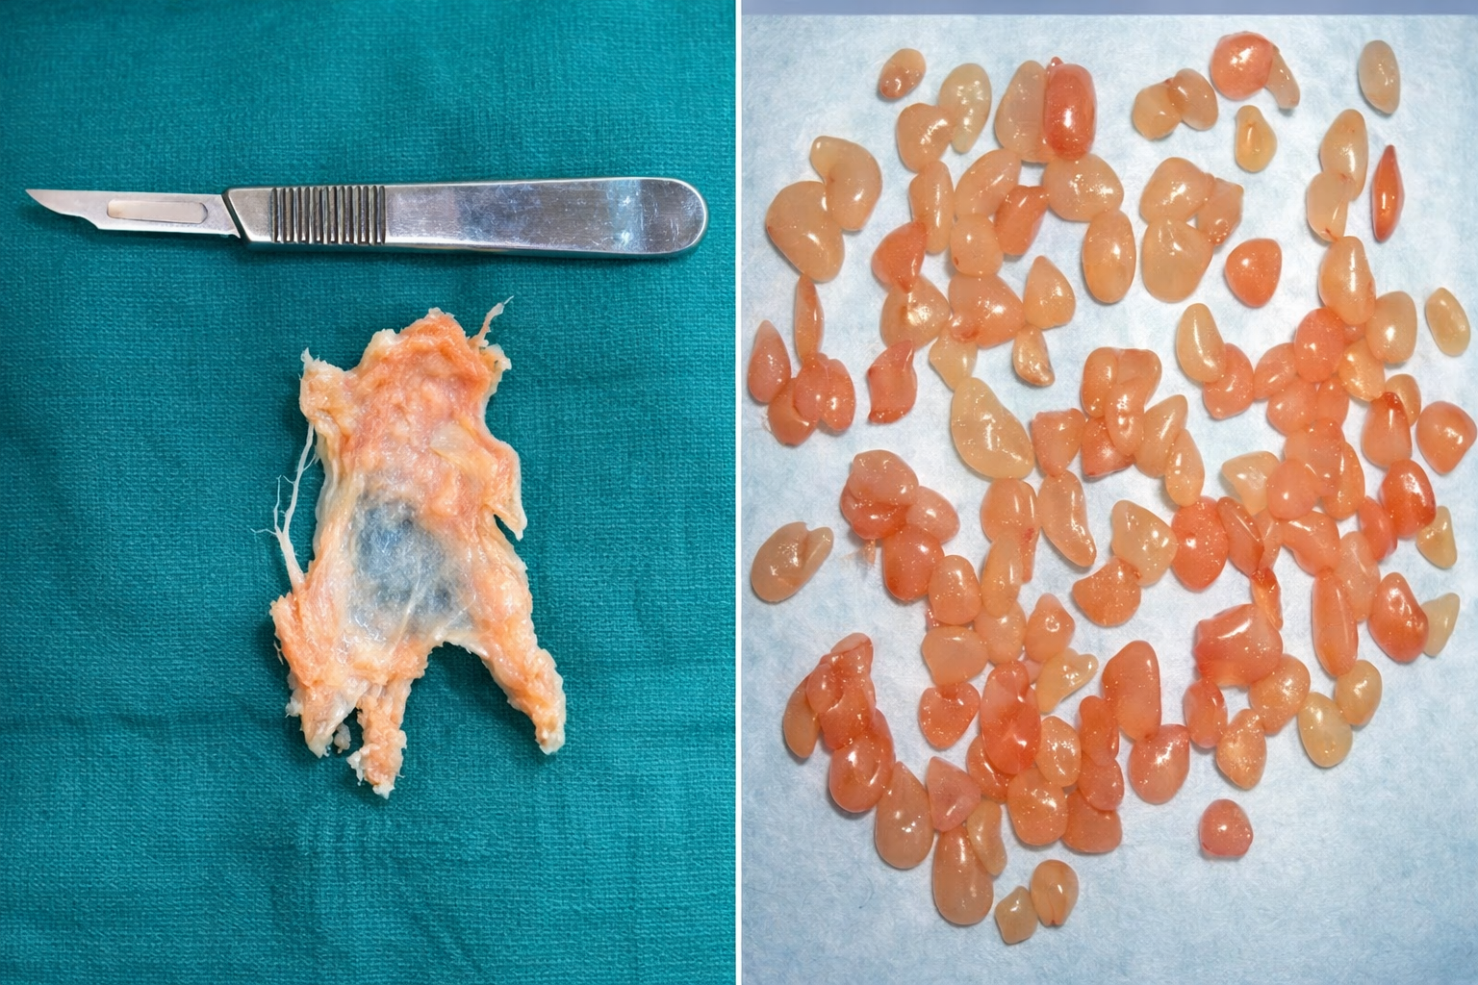
A RARE CASE OF TUBERCULOUS COMPOUND PALMAR GANGLION CAUSING COMPRESSIVE NEUROPATHY
Presenting Author: DR P SRINIVASURAO, Co Author: Dr G SUNIL (PROFESSOR)
Dept of Orthopaedics, Great Eastern Medical School and Hospital, Srikakulam
Medical college ID: OSSAP 502
INTRODUCTION
OPERATIVE FINDINGS
DISCUSSION
Isolated tuberculosis (TB) of the synovial sheath or bursa occurs rarely; the disease is thought to reach the synovial sheath by the hematogenous spread or directly from underlying bone or joint.
Palmar fascia when infected it causes inflammation of all tendon sheaths about the hand and wrist resulting in median nerve compression.
It can also lead to the destruction of underlying bone if left untreated.
We report this case for its rarity and successful early management.
Excision biopsy was planned and carried out through volar approach to wrist and hand.
Skin and fascia were incised and retracted, flexor retinaculum dissected and median nerve carefully retracted, there was a bilobed continuous fluctuant mass which was filled with fibrinous material and straw colored fluid.
The fluid and melon seed bodies evacuated, inflamed thick and woody tendon sheath excised. A through wound wash was given and closed in layers.
There was no other bony/soft tisssue involvement.
Tuberculous compound palmar ganglion is a rare form of extrapulmonary TB affecting the flexor tendon sheaths of the hand and wrist. Its slow progression and nonspecific features often delay diagnosis and lead to confusion with inflammatory or degenerative conditions.
Chronic synovial hypertrophy with rice body formation can cause compressive neuropathy, commonly involving the median or ulnar nerve. MRI helps assess tendon sheath involvement, but histopathology remains the gold standard for diagnosis.
Management includes surgical decompression with tenosynovectomy followed by antitubercular therapy. Early recognition is crucial to prevent permanent neurological deficits and achieve good functional recovery.
CONCLUSION
CASE REPORT
Tuberculosis can involve many organs, but synovial sheath involvement of the hand is rare, accounting for <1% of skeletal TB, often leading to delayed diagnosis.
Late detection may result in poor functional outcomes despite adequate ATT; MRI is the best diagnostic modality.
Early intervention before bony involvement is crucial.
With the resurgence of musculoskeletal TB, TB should always be considered in cases of tenosynovitis to ensure timely diagnosis and complete recovery.
A 60-year-old male farmer presented with an 18-month history of progressive swelling of the right wrist extending to the hand. Initially painless, it later became painful and was associated with persistent tingling and numbness over the thenar area.

